Slide 1
This week, we wrote what we knew about Poland…
A lot of us confessed that they didn’t know anything…
Others had little knowledge about your country
(or made huge mistakes! ) ;o)

Slide 2
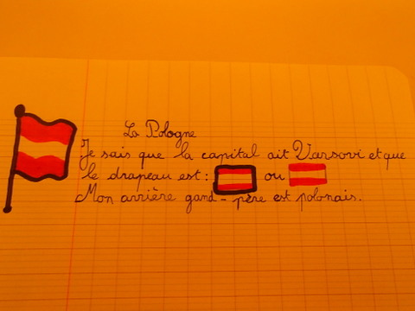
Julien knows : that the capital of Poland is Varsovie, and that Poland’s flag is likewise :
His grandfather is Polish.

Slide 3
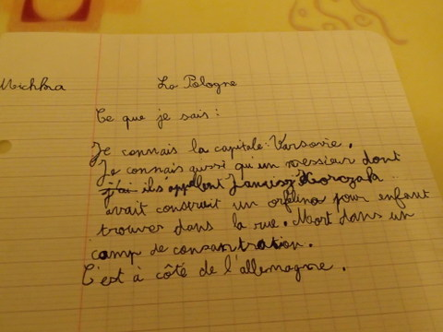
Michka wrote that the capital of Poland is Varsovie. He also knows a man, called Janusz Korczak, who built a home for orphans, and who died in a concentration camp.
He says that Poland is next to Germany.

Slide 4
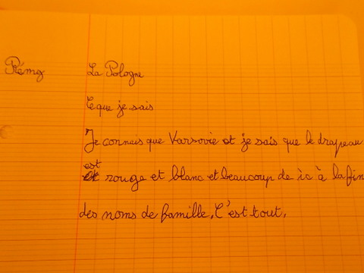
Rémy knows Varsovie and that the flag is red and white.
According to him, a lot of Polish family names end with « ic »

Slide 5
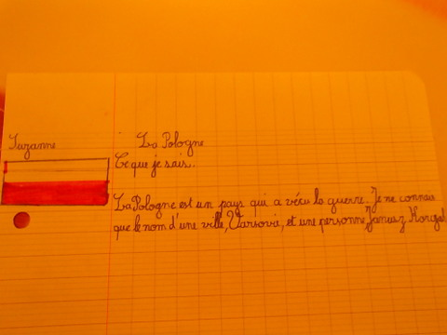
Suzanne wrote that Poland is a country that knew the war. She knows only one city : Varsovie, and only one man : Janusz Korczak.

Slide 6
One girl don’t know anything about Poland… except it’s somewhere in France !!

Slide 7
One boy wrote that the capital of the Poland is Varsovie.
Poland is next to Russia.
It’s cold place.
… and it’s located… in France !!

Slide 8
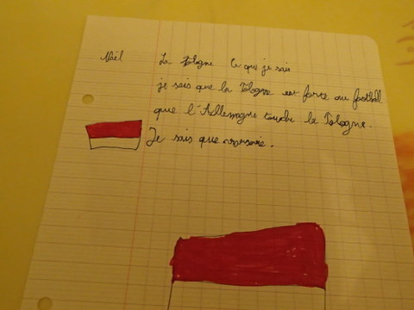
Naël wrote he knows that Polish are great soccer players, that Poland is next to the Germany, and he knows Varsovie.

Slide 9
Another girl knows that the sushis come from Poland and sumos as well !!

