Slide 1
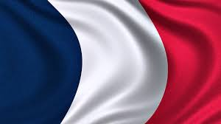
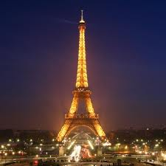
FRANCE
Paris
– capital of France

Slide 2
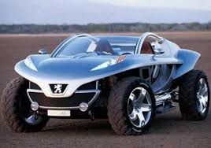
FRENCH CAR BRANDS
French car brands are:
Peugeot
Citroen
Reno

Slide 3
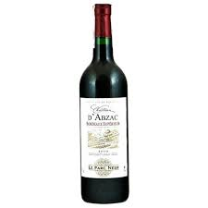
FRENCH DISHES:
-snails
-crossiants
-frogs
-wine

