Slide 1
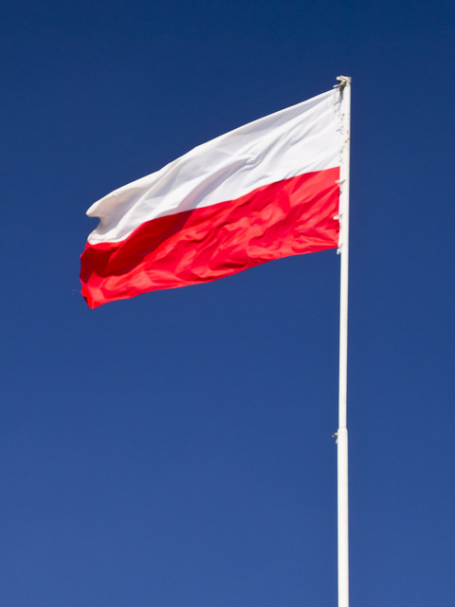
POLAND

Slide 2
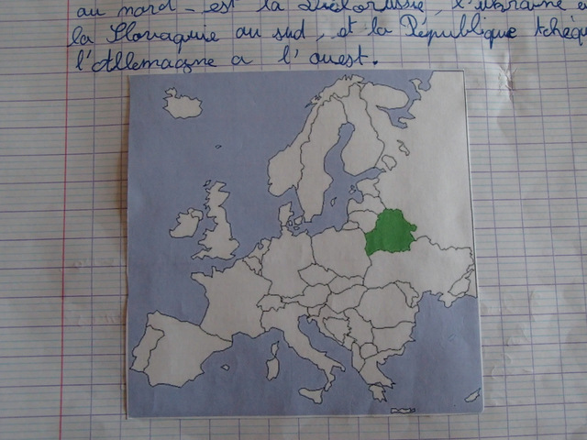
Where is Poland ?
Now, we know Poland is in the middle of Europe.
It’s bordered by Germany, the Czech Republic , Slovakia,Ukraine, Lithuania, Russia (Kaliningrad Oblast)and the Baltic Sea.

Slide 3
Which places or monuments are famous in Poland ?
The biggest castle
in the world :
Malbork Castle

Slide 4
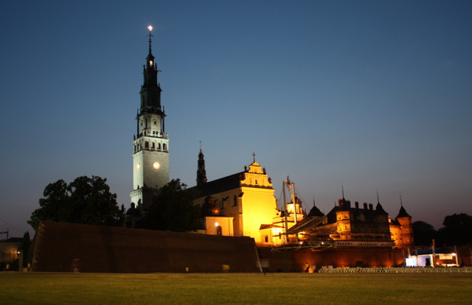
The Monastery of
Jasna Góra in
Częstochowa

Slide 5
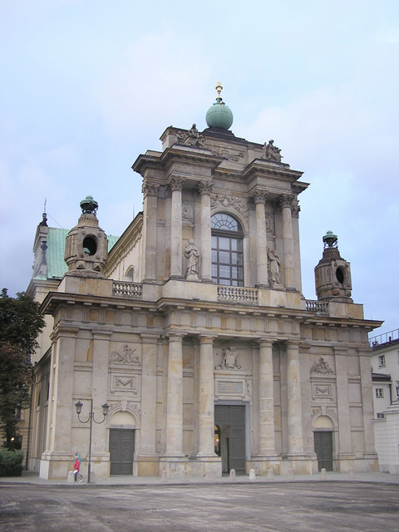
The capital of Poland
Warsaw

Slide 6
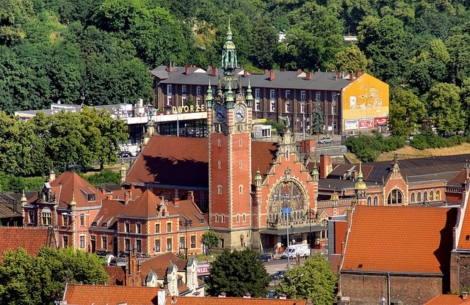
Gdańsk

Slide 7
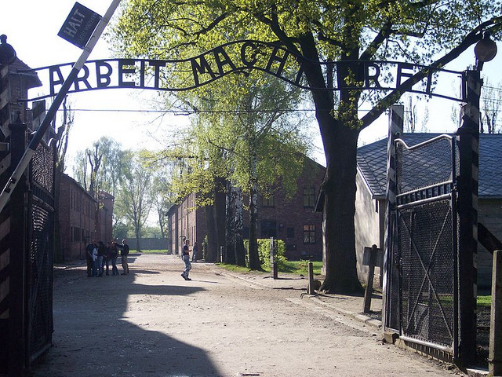
Auschwitz concentration camp

Slide 8
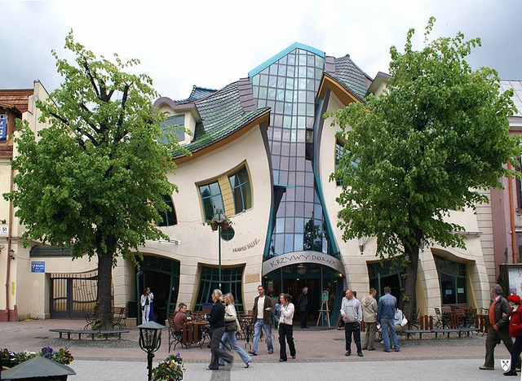
The “Crooked House”
in Sopot

