Slide 1
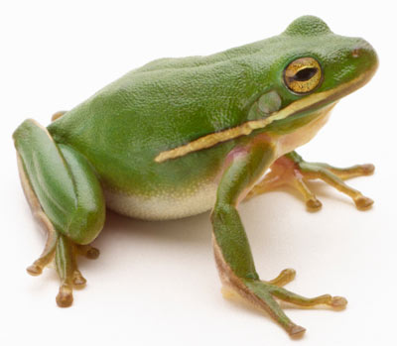
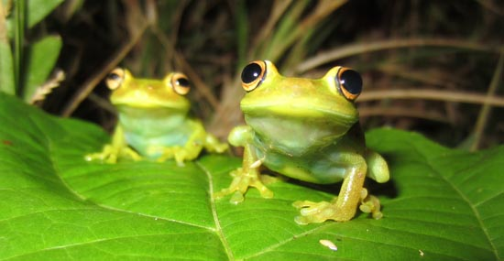
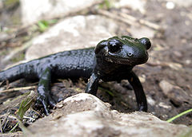
PROTECT THE AMPHIBIANS!

Slide 2
Amphibians in Croatia
Approximately 5020 species have been described
a total of 20 species of amphibians classified in 2 orders have been recorded: Anura (frogs and toads - 13 species) and Caudata (salamanders - 7 species)
the most numerous are the Ranidae (green and brown frogs) and Salamandridae (salamanders and newts)

Slide 3
Why are the amphibians importanat?
bioindicators
- indicators of environmental stress -> their permeable skin is subject to the influence of various environmental pollutants
role in drug production
- skin glands produce a large number of chemical compounds that are altered to give medicine for many human diseases

Slide 4
important members of the ecosystem and an important link in food chains
a significant role in some cultures in the world
- rain guards, fertility and happiness mediators, a source of food, characters in fairy tales ...

Slide 5
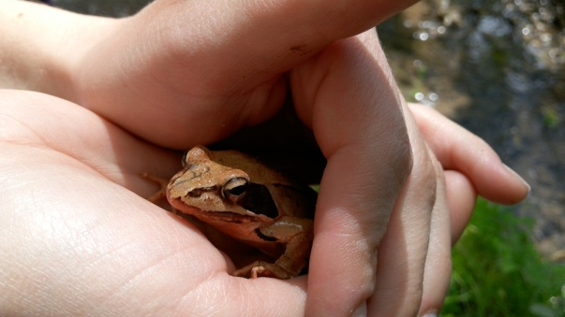
Why are the amphibians disappearing?
disappearance and fragmentation of wetland habitats
use of pesticides and artificial fertilizers
road construction
bringing foreign species into their habitats
road traffic during migration

Slide 6
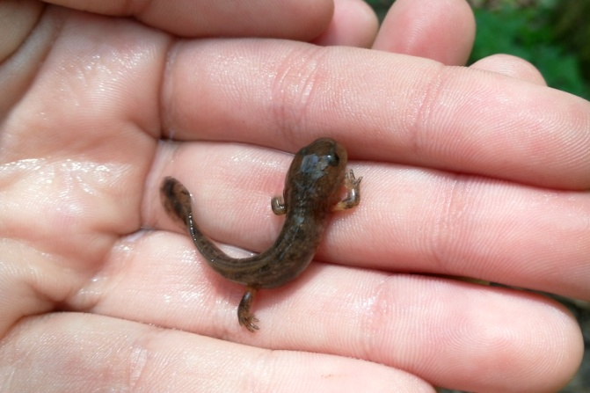
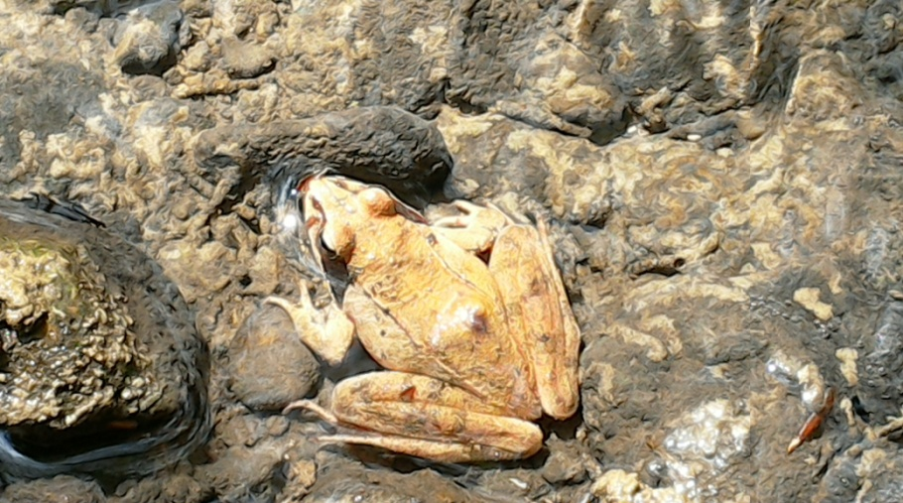
collecting the amphibians for commercial purposes
climate changes
contamination of water, soil and air
UV-B radiation (at higher latitudes)
diseases

Slide 7
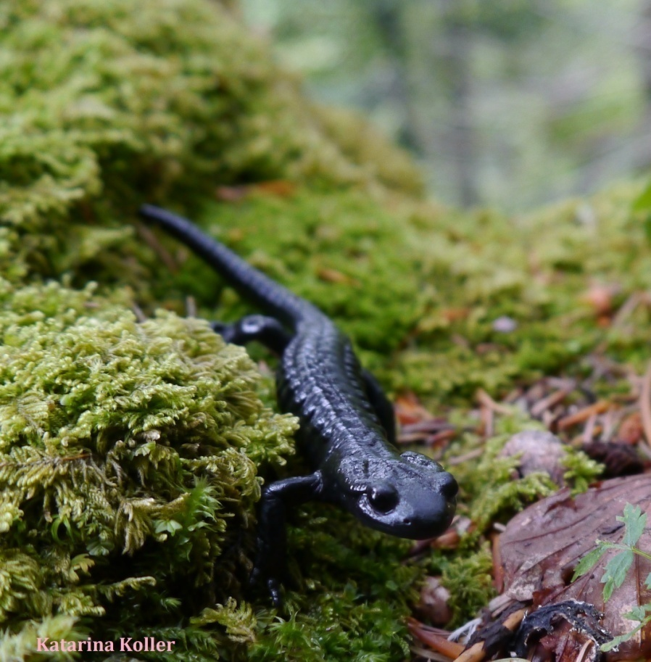
Protected amphibians in Croatia
CAUDATA
Alpine (black) salamander
a completely land animal,
mountain areas– Gorski kotar, Žumberak, Ćićarija, Učka

Slide 8
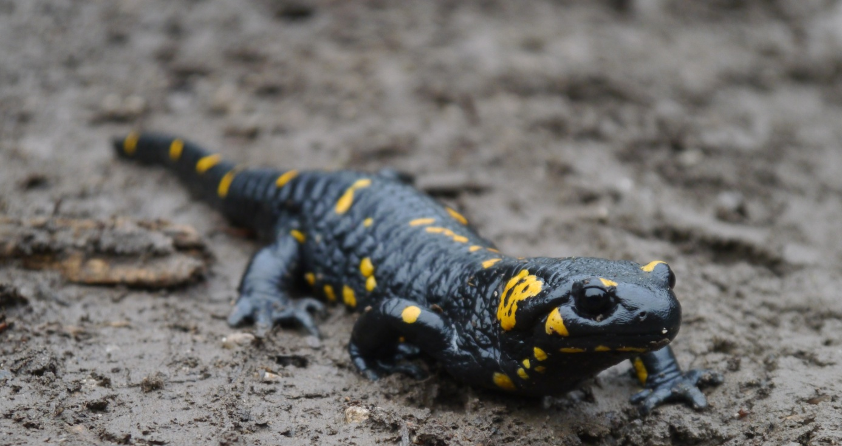
Fire salamander
Inhabits forest areas at lower altitudes near the standing and flowing waters

Slide 9
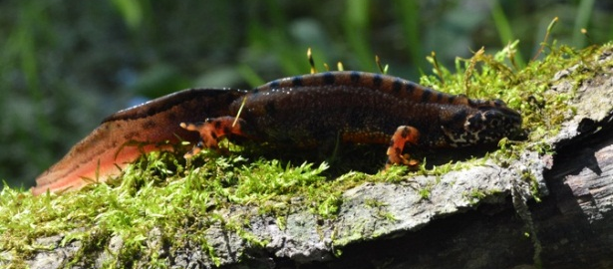
Danube crested newt
wetland areas of the river basins in lowlands, up to 300 m above sea level

Slide 10
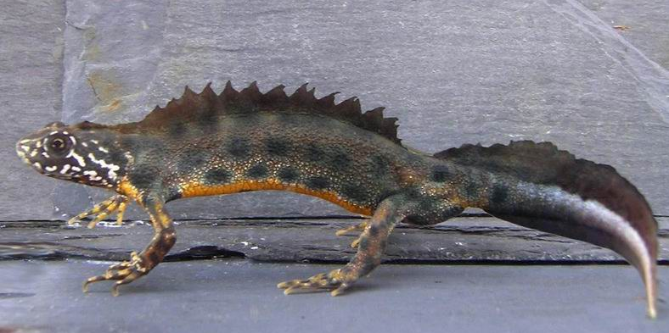
Italian crested newt
-permanent and temporary standing water, prefers mountain areas

Slide 11
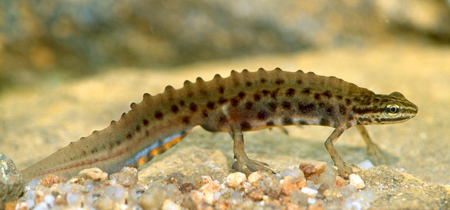
Smooth newt
- widespread, lowland areas

Slide 12
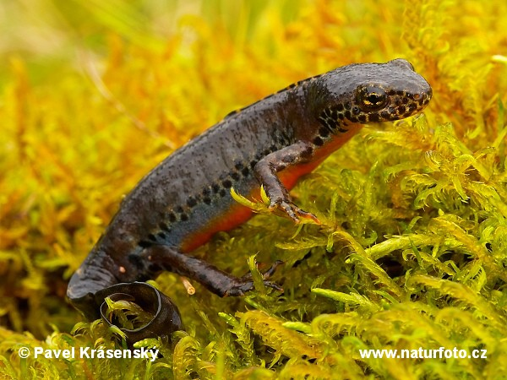
Alpine newt
- an aquatic species, sexual dimorphism

Slide 13
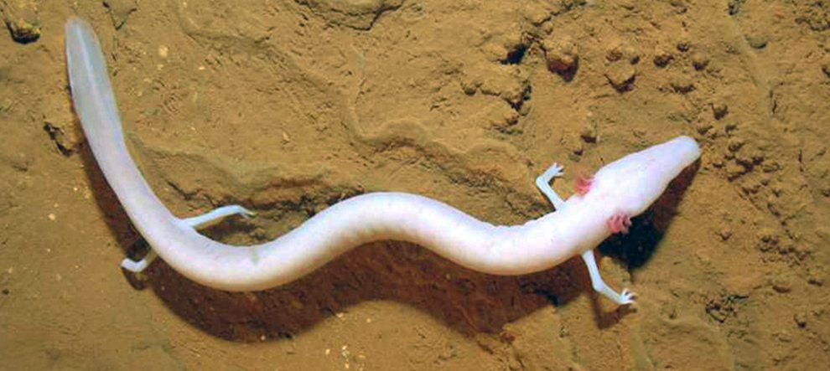
Olm
- Dinaric karst groundwater, an endemic species

Slide 14
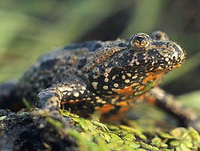
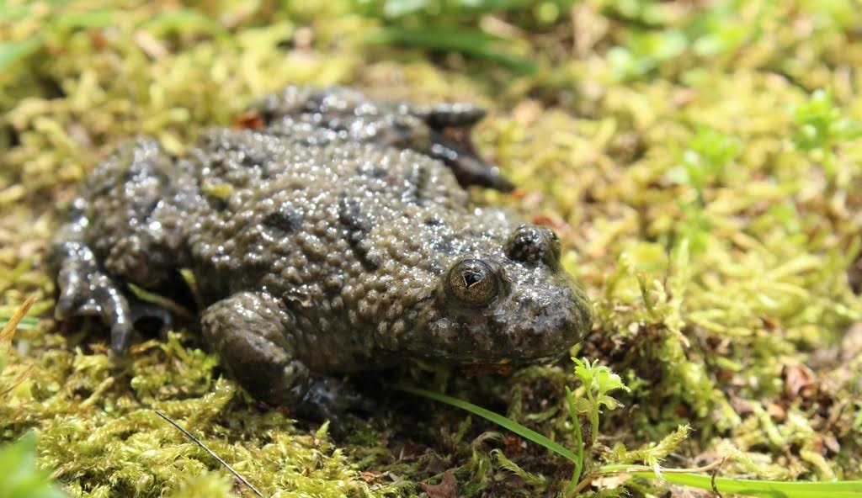
FROGS AND TOADS
European fire-bellied toad
- lowland areas with standing waters
Yellow-bellied toad
- the entire territory of Croatia except the north-east part of Podravina and Baranja

Slide 15
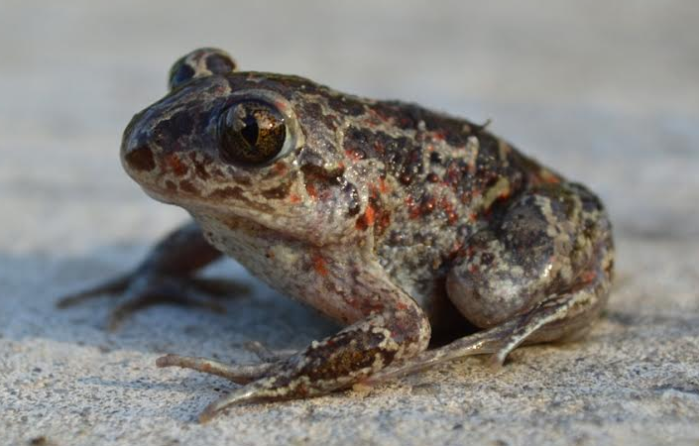
Pelobates fuscus (garlic toad)
- lowland areas, habitats with light and soft soilo

Slide 16
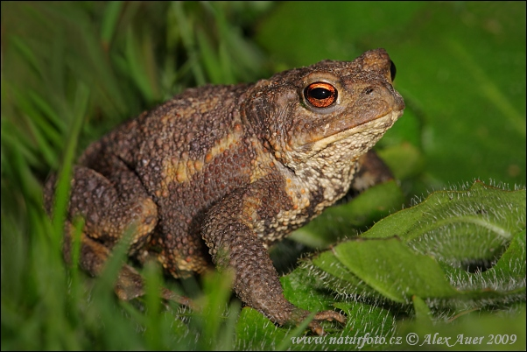
Brown toad
- different types of habitats -> forests, parks, gardens, human settlements

Slide 17
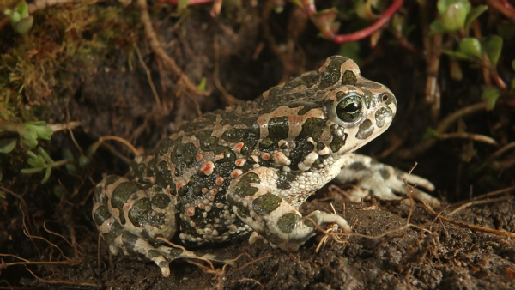
Green toad
- habitats with a lower amount of moisture -> deciduous forests, agrarian areas

Slide 18
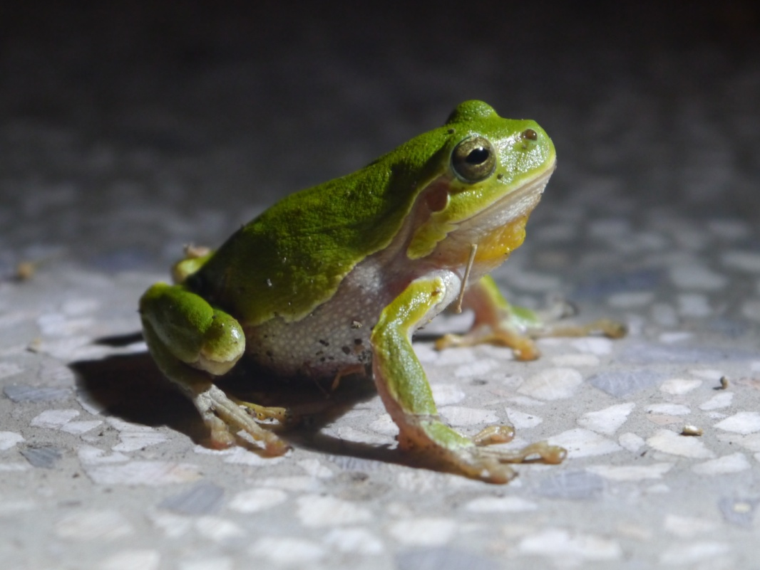
European tree frog
lives at lower altitudes
a pervasive species

Slide 19
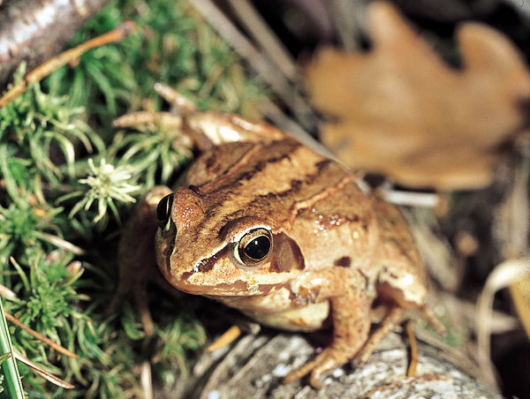
Moor frog
- lowland areas, deciduous and coniferous forests, agrarian areas

Slide 20
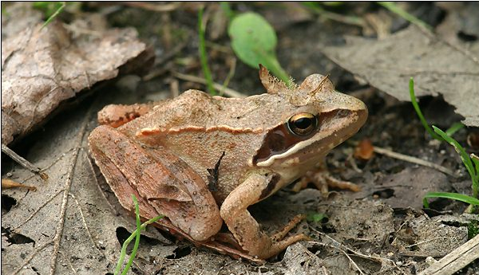
Agile frog
- inhabits deciduous forests, meadows, lays eggs in shallow standing water

Slide 21
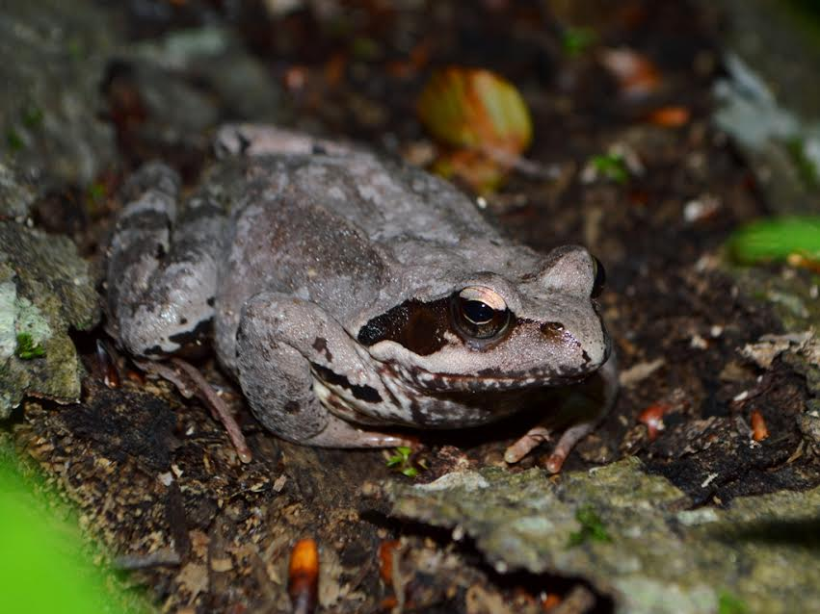
Common frog
- wet forests and meadows, the colour of its body is changeable

Slide 22
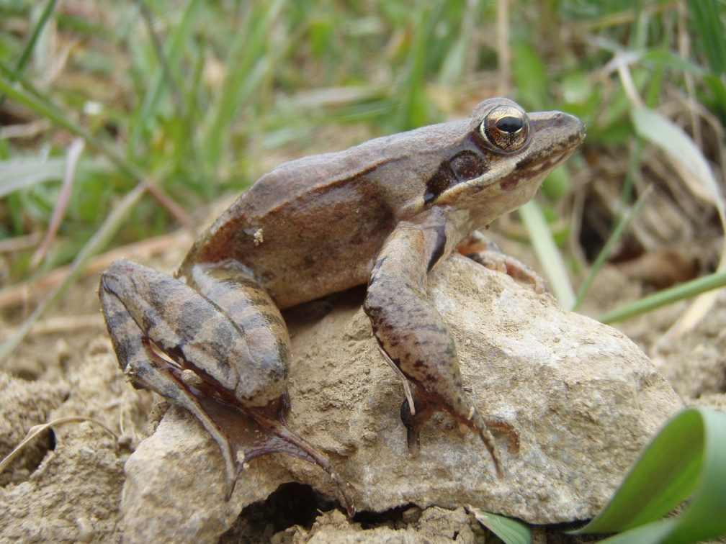
Italian agile frog
the area of Istra
endemic to Europe

Slide 23
Bibliography
Udruga Hyla. Vodozemci Hrvatske, <http://www.hhdhyla.hr/vrste/vodozemci>. On 21 September 2017
Photos downloaded from the websites:
http://www.hhdhyla.hr/vrste/vodozemci
http://www.naturephoto-cz.com

