Slide 1
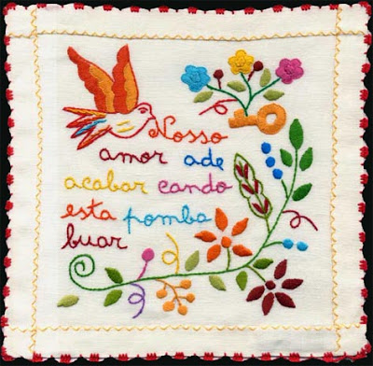
Valentine’s handkerchief

Slide 2
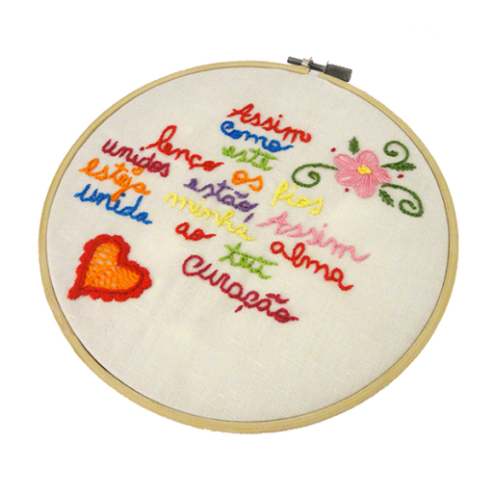
Valentine's handkerchief is a handkerchief made from a fine linen cloth or cotton scarf, embroidered with various motifs. It is a piece of handicraft and clothing typical of the Minho, being used by women of marriageable age.

Slide 3
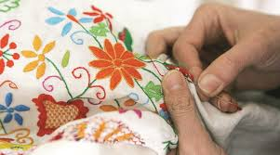
It was customary for the girl in love to embroider her handkerchief and hand it over to her lover when he went away. In the handkerchiefs could have embroidered verses, besides several drawings, some standardized, having own symbologies.

Slide 4
It was used as a ritual of conquest. Once made, the handkerchief would eventually come to the possession of the beloved man, who would use it in public as a way of showing that he had begun a relationship. If the boyfriend did not use the handkerchief publicly was signal that had decided not to initiate the amorous connection.

Slide 5
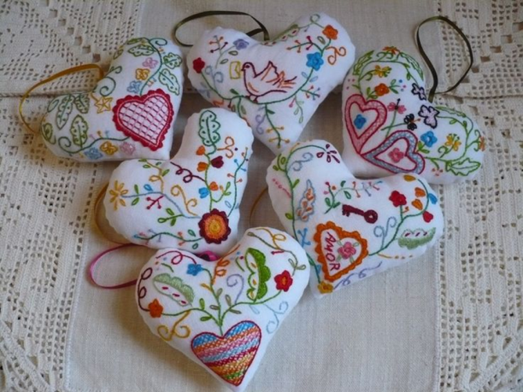
Like the main Portuguese embroideries, the Scarf of Valentine also has its registered patterns. Only artisans who meet the requirements can officially sell the products.

Slide 6
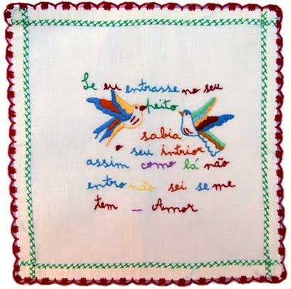
A legitimate handkerchief is between 40 and 60 cm. Among the official symbols are flowers, birds, hearts, keys, butterflies and letters. All colors can be used, but the predominance is of the primaries.

Slide 7
Spelling mistakes are part of their culture and poetics. Originally, they were made by embroiderers with scarce literacy. Therefore, his popular expressions became a rich document of the time. It is common to see the "vai" replaced by "bai" or "beijinho" for "veijinho", for example.

Slide 8
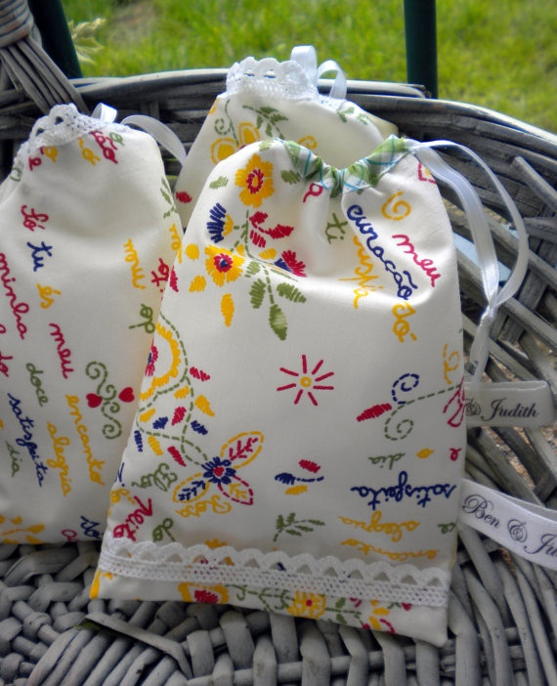
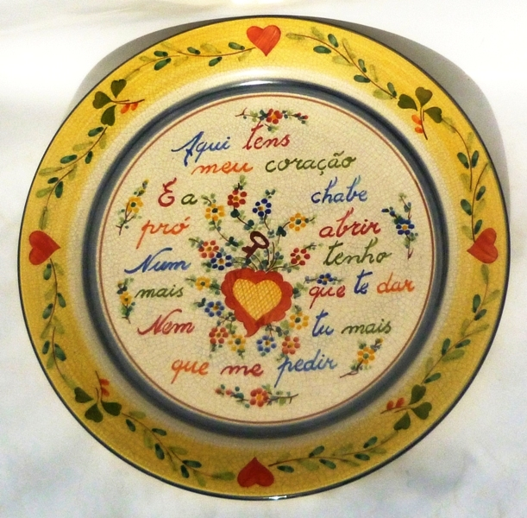
There is currently a technical committee that acts as an evaluation and certification body for this type of regional crafts.

