Slide 1
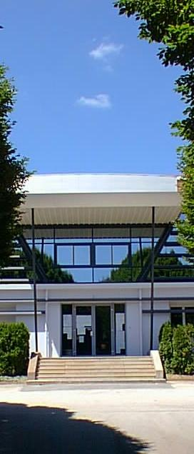
Erasmus + Lycée Louis Pergaud
A staff mobility project

Slide 2
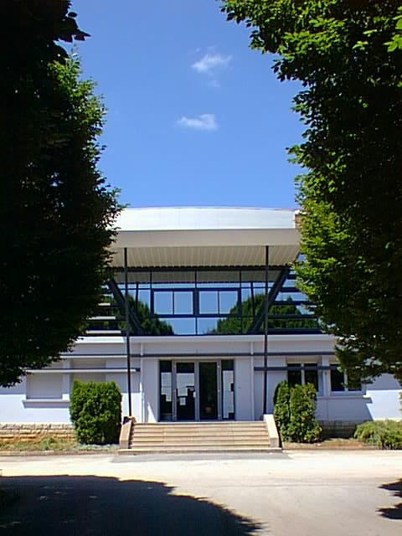
LYCEE LOUIS PERGAUD
A staff mobility project
For a better knowledge about European Education systems, and to find ways to limit the school drop out.

Slide 3
Thank you for welcoming us

Slide 4
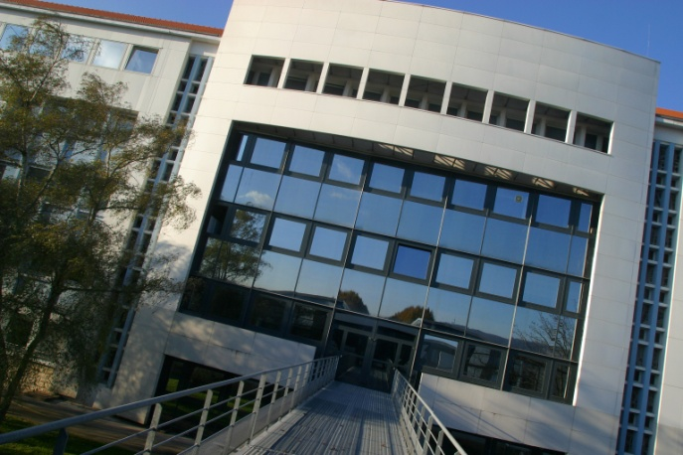
Lycée Pergaud Besançon
A French high school with a growing international scope

Slide 5
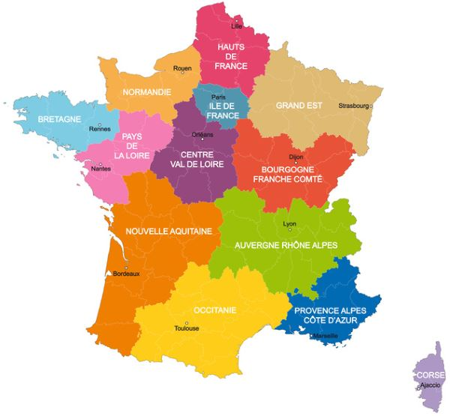
Geographical location
Besançon
120 000 residents

Slide 6
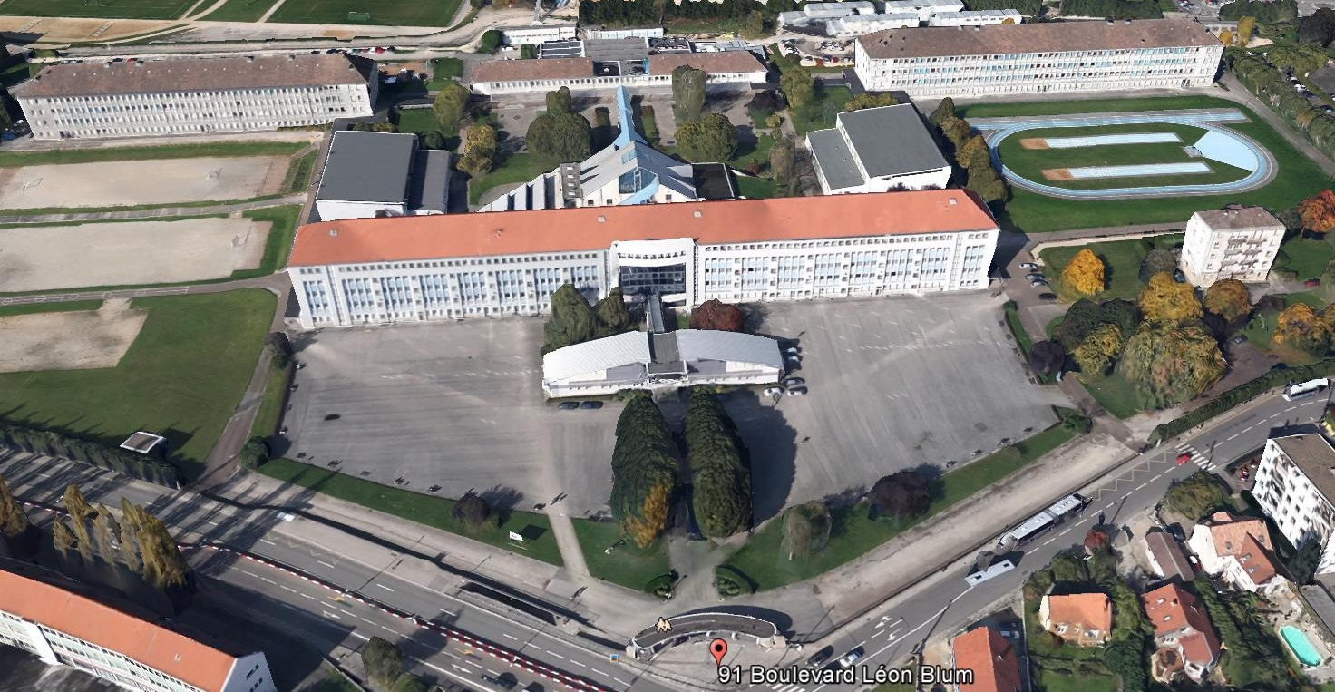
Lycée Pergaud - Besançon
Photo lycée ? Plan ?

Slide 7
Lycée Pergaud in Franche Comté
The first High school in Bourgogne Franche Comté by the number of students (about 2290)
An organisation depending on the Rectorat of Besançon (educational board) for teaching human resources and curriculum
An organisation depending on the County « Franche Comté » for material resources and technical human resources

Slide 8
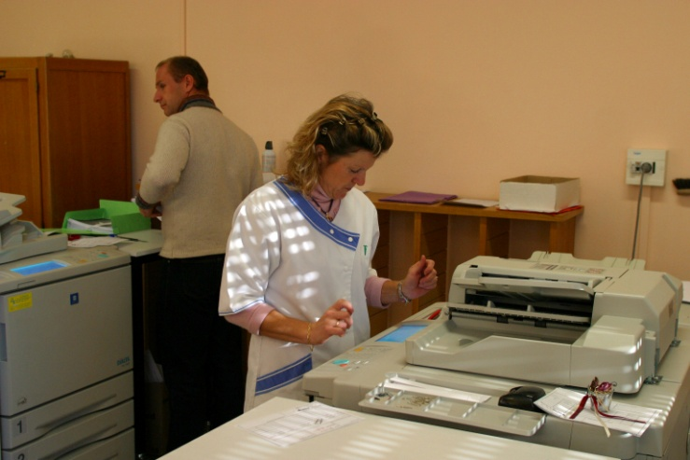
More than 350 employees…
Depending on | Employment
The French government | 1 Principal and 3 Deputy-Principals 230 Teachers 4 Educational advisers and 35 assistants 3 Nurses - 1 finance accountant and 16 secretaries
The County Franche Comté | - 68 Maintenance technicians

Slide 9
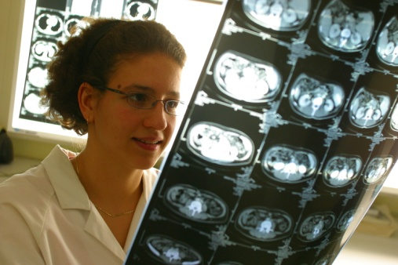
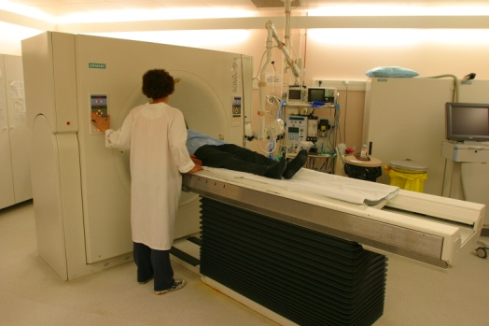
The lycée Pergaud organisation
About 3 millions euros for the annual operating budget (approximately 1,3 M for boarder students and cafeteria, and about 1 M euros for main services).
Two schools in one :
1690 students in high school
600 students at college level

Slide 10
Current international opening
Our high school European classes
About 100 students each year
One extra period of English per week
Learning a subject in English (history, geography biology, physics, management or economics)
Participating in an exchange with a foreign school or a cultural trip to an English-speaking country.
Taking an oral exam for a special reward written on the diploma

Slide 11
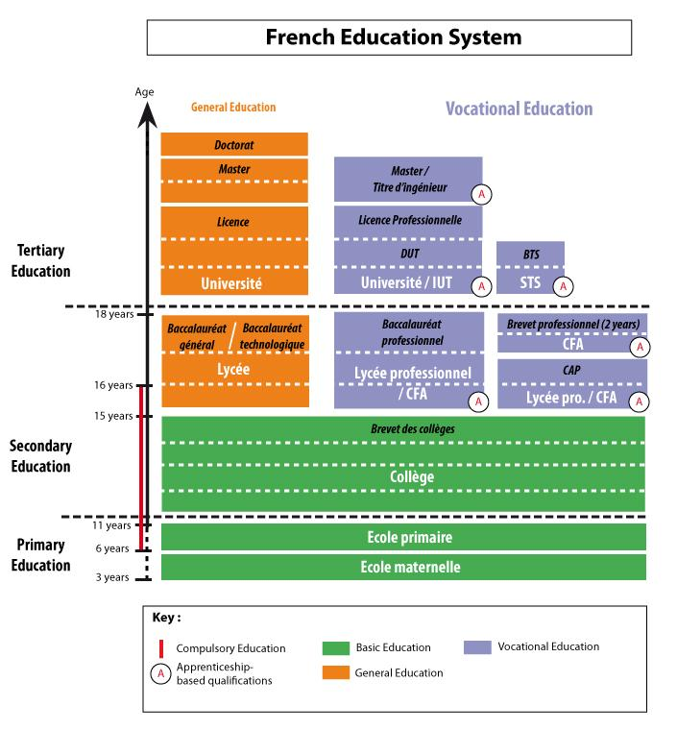
Lycée Louis Pergaud

Slide 12
The Lycée Pergaud activity
The tertiary level is composed of :
6 classes leading to professional certificates
4 preparatory classes for selective entry exams to national further educational schools
The secondary level lead up to :
General certificates of secondary education (majors : humanities, economics, sciences)
Technological certificates (biotechnology, management, social and health sciences)

Slide 13
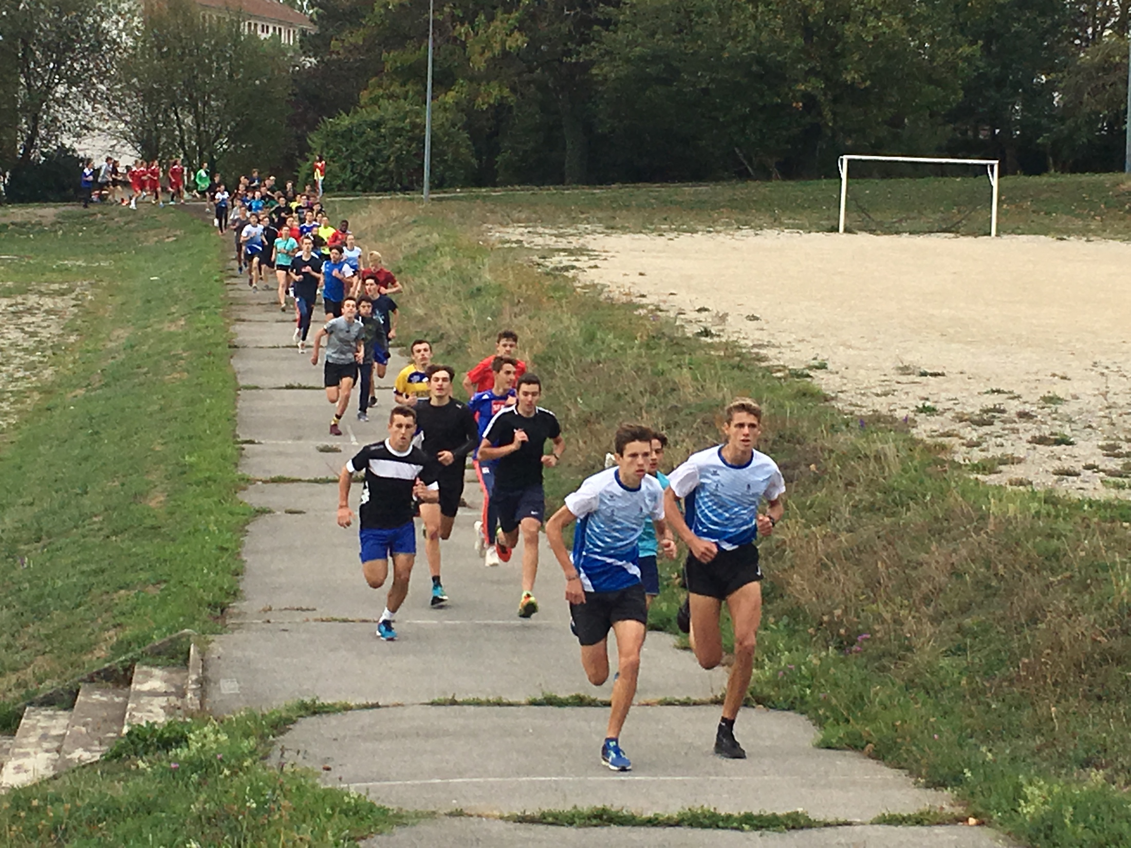
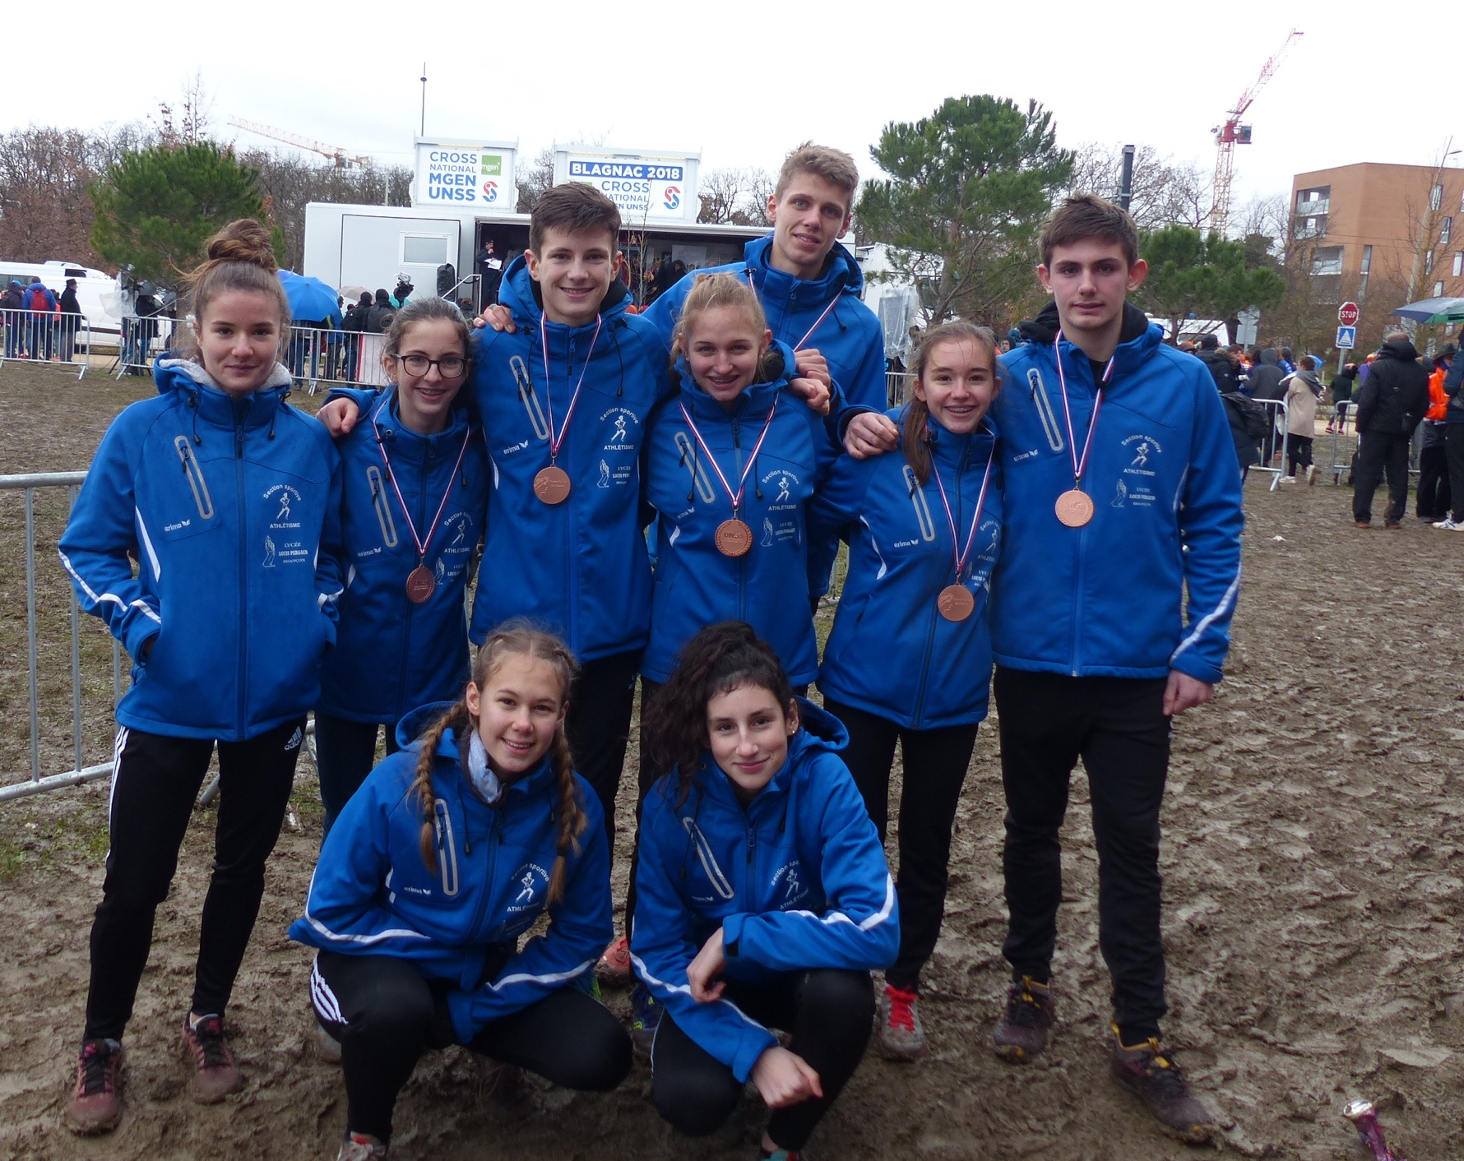
Sports sections : women’s soccer and athletic

Slide 14
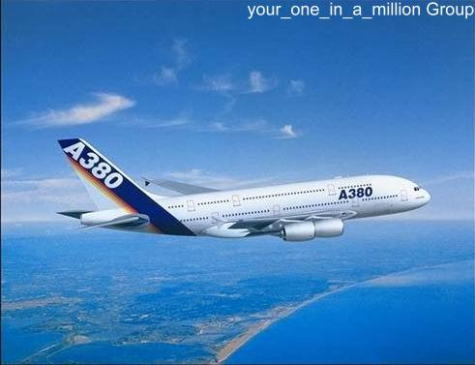
Current international opening
Exchanges with
A High school in Nimegen (Netherlands)
A High school in Olomouc (Czech Republic)
A high school in Harpenden and Milton Keynes (Great Britain)
Trips in foreign countries
Italy
Spain,
Ireland / Scotland
Germany…

Slide 15
Our Erasmus + project
An Erasmus + Key 1 project concerning Staff mobility
12 Teachers and 1 Headmaster
Discovering 7 countries :
Germany
Italy
Finland
Portugal
Bulgaria
The Nethertlands
Our main focus : « Decreasing School’s drop out »

Slide 16
Louis Pergaud High School’s ways to limit School drop out
4 Educational advisers follow the diligence of the students
One class of « Micro lycée » to prepare the diploma again
One class of « UPE2A » for foreign pupils
One work group called « GPDS » to follow the early school leaving students
A Student Tutoring to accompany and support them

Slide 17
Thank you for your attention

