Slide 1
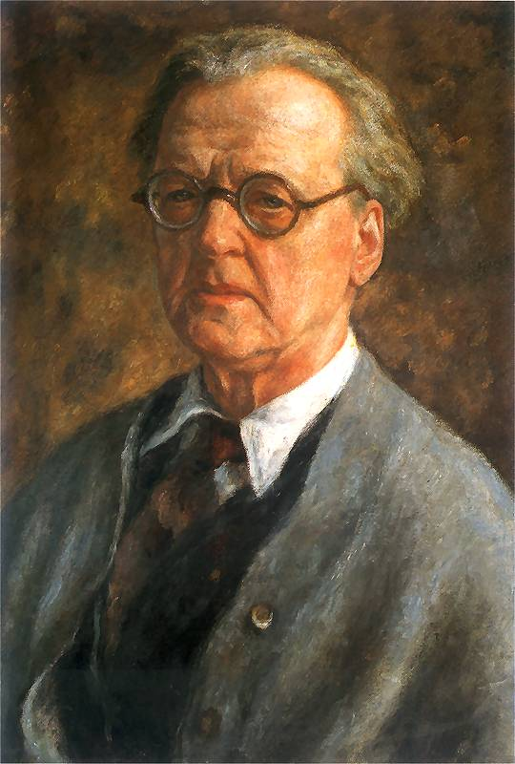
Józef Pankiewicz
By zuzanna Wójcik & joanna patryn

Slide 2
Life
Józef Pankiewicz was born on the 29 November 1866 in Polish city, Lublin and died on the 4 July 1940 in La Ciotat, France.
He was a Polish painter, graphic designer and pedagogue.
In 1889 he travelled to Paris where his painting „Targ na jarzyny na placu za żelazną bramą” was rewarded with silver medal on Exposition universelle.

Slide 3
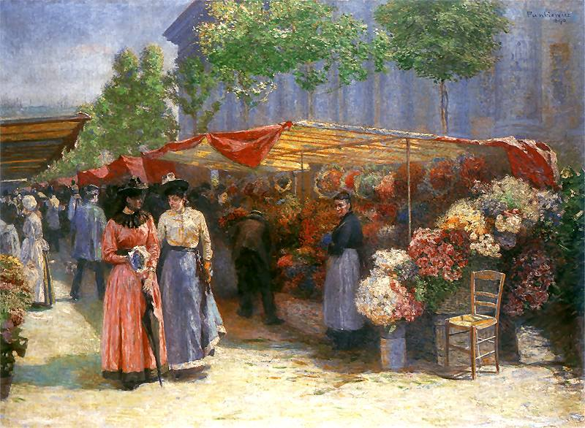
When he returned to Poland in 1890 he tried to convey French impressionism into Polish art but his new painting „Targ na kwiaty po kościołem Św. Magdaleny” gained disapproval among many critics.

Slide 4
In 1897 he joined Polish Artists' Association “Art”.
In 1897-1906 he travelled across the world and visited many countries e.g. Belgium, Italy, England, Germany, France and Netherlands. Thanks to those journeys he developed intellectually and his paintings became more appealing to people all around the world.
In 1906 he became a professor in Academy of Fine Arts in Cracow.

Slide 5
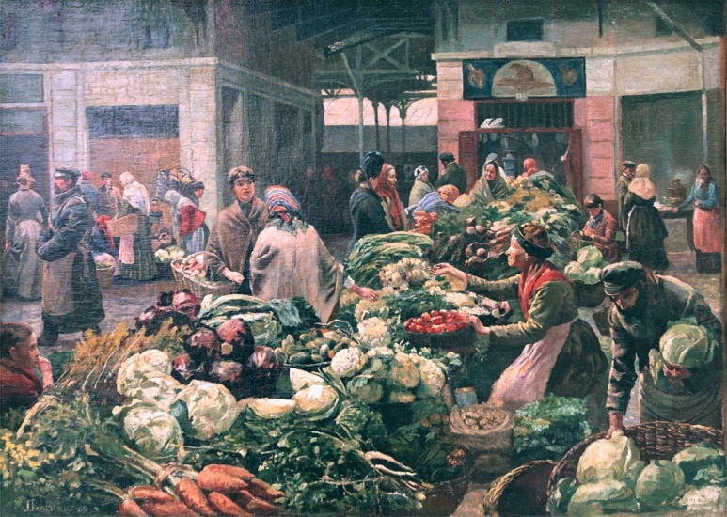
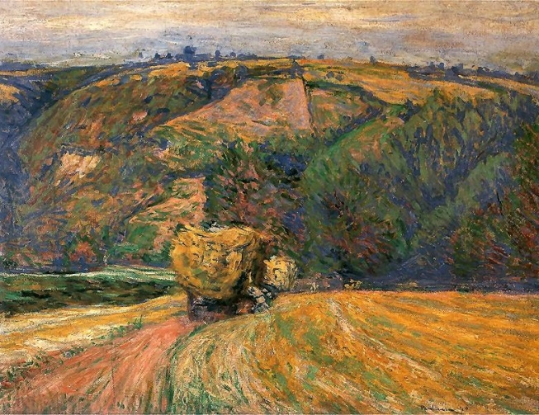
Some of his paintings
,,Martwa natura z nożem”
„Targ na jarzyny na placu za żelazną bramą”
,,Wóz z sianem”

Slide 6
We are going to recreate this painting
,,Maria i Krystyna Mańkowskie”

