Slide 1
TASK 1
Greece. Sophia Aggoura, Eleni Mandana and Konstantina Baltzi. Upper High School Of Pentapolis.

Slide 2
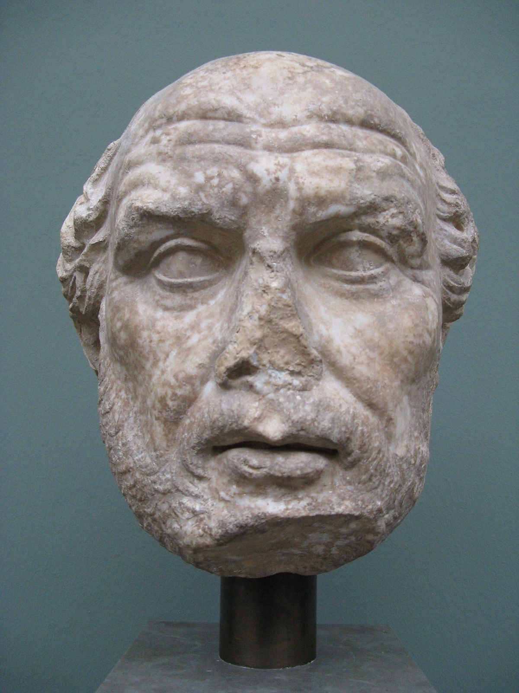
Phidias
or Pheidias a Greek sculptor, painter, and architect.

Slide 3
SOME OF HIS WORKS

Slide 4
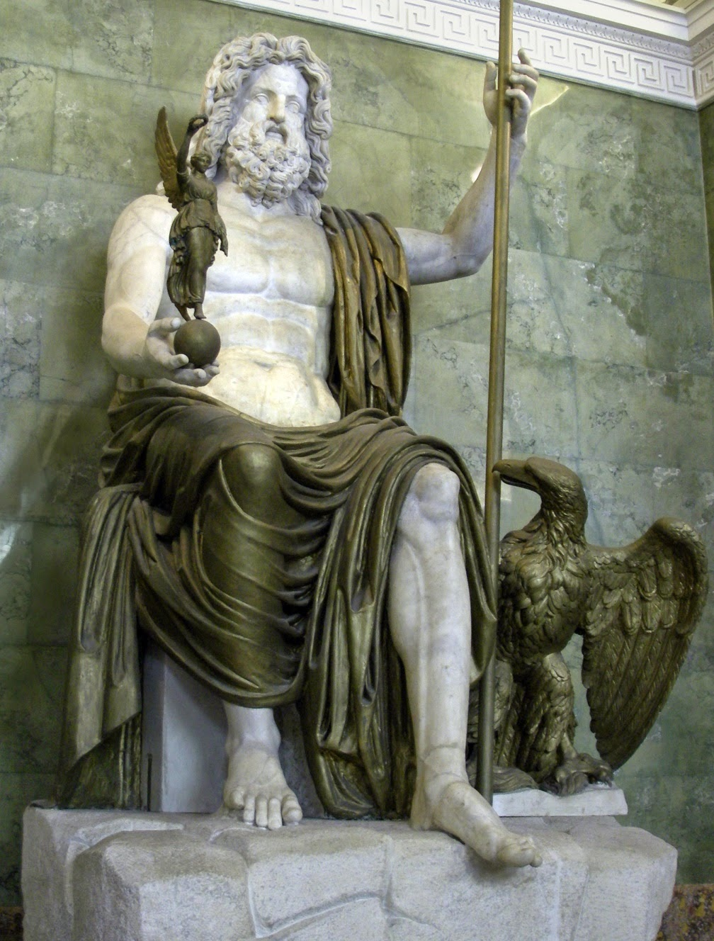
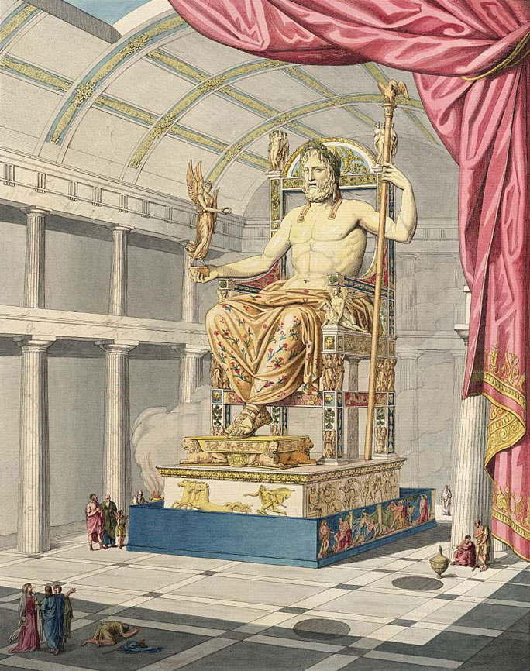
His statue of Zeus at Olympia was one of the Seven Wonders of the Ancient World

Slide 5
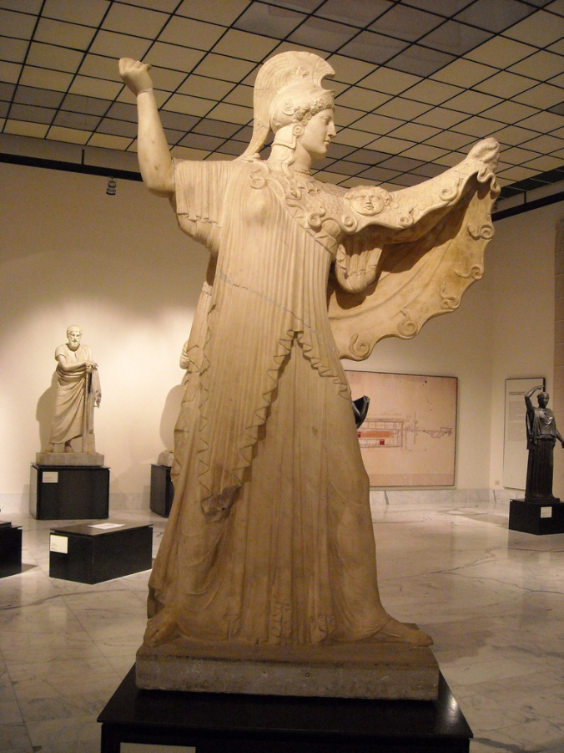
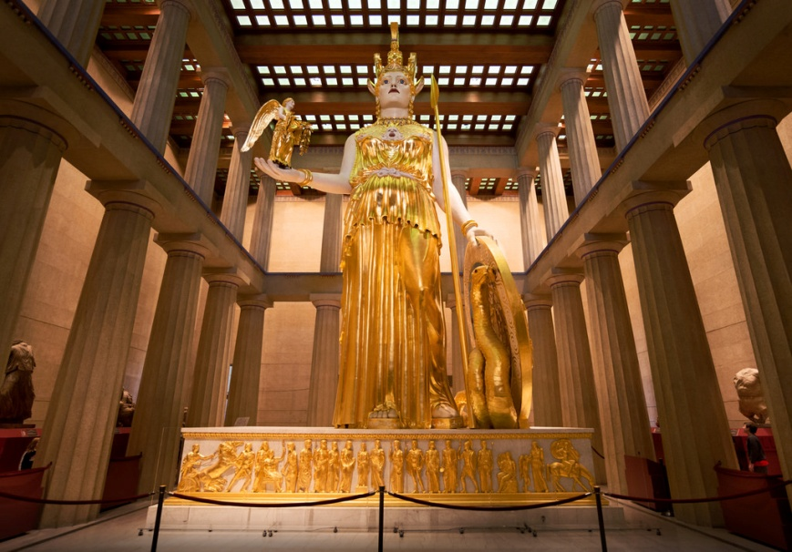
The statues of the goddess Athena
The Athena Parthenos inside the Parthenon, and the Athena Promachos, a colossal bronze which stood between it and the Propylaea, a monumental gateway that served as the entrance to the Acropolis in Athens.

Slide 6
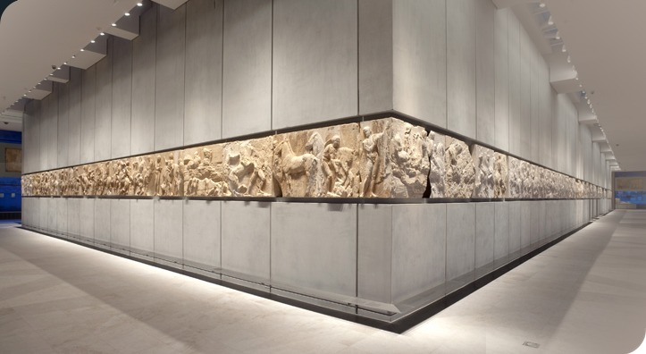
The Parthenon frieze Phidias
The frieze consisted of 115 blocks. It had a total length of 160 meters and was 1.02 meters high. Some 378 human figures and deities and more than 200 animals, mainly horses, are presented in the process. The sacrificial procession follows next, with animals and groups of men and women carrying ceremonial vessels and offerings. The procession concludes with the giving of the peplos, the gift of the Athenian people to the cult statue of the Goddess, a xoanon. Left and right of the peplos scene sit the twelve gods of Mount Olympos.

Slide 7
FACTS ABOUT HIS LIFE
Phidias was the son of Charmides of Athens
Plutarch discusses Phidias' friendship with the Greek statesman Pericles, recording that enemies of Pericles tried to attack him through Phidias - who was accused of stealing gold intended for the Parthenon's statue of Athena, and of impiously portraying himself and Pericles on the shield of the statue

Slide 8
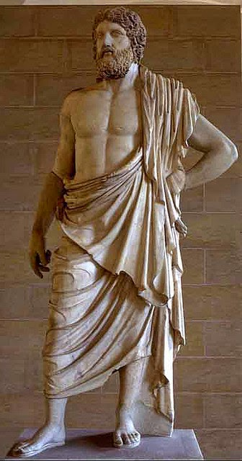
THE END

