Slide 1
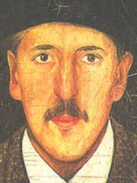
Tadeusz Makowski
Polish painter, illustrator,
and graphic artist

Slide 2
Life
Tadeusz Makowski was one of the most famous Polish painters.
He was born in 1882 in Oświęcim
and died in 1932 in Paris.

Slide 3
School
Tadeusz Makowski studied philology
at the Jagiellonian University
and painting at the Academy of Fine Arts
in Cracow.

Slide 4
His works
Tadeusz Makowski painted :
∙landscapes
∙still lifes
∙and children

Slide 5
His interests
Makowski was interested in theatre.
He created the puppets for "Green Balloon" Cabaret.
He was an illustrator of books and a cover designer
Makowski also wrote poetry, short stories, and essays in art.

Slide 6
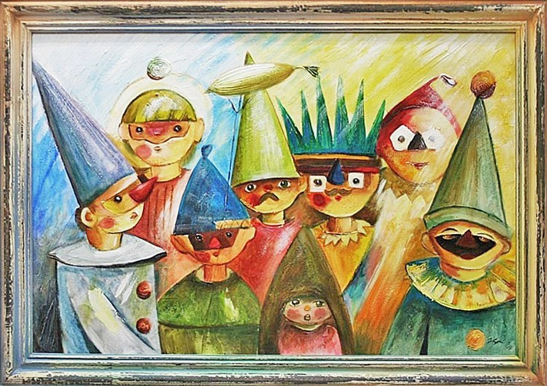
Masquerade- our painting ☺

