Slide 1
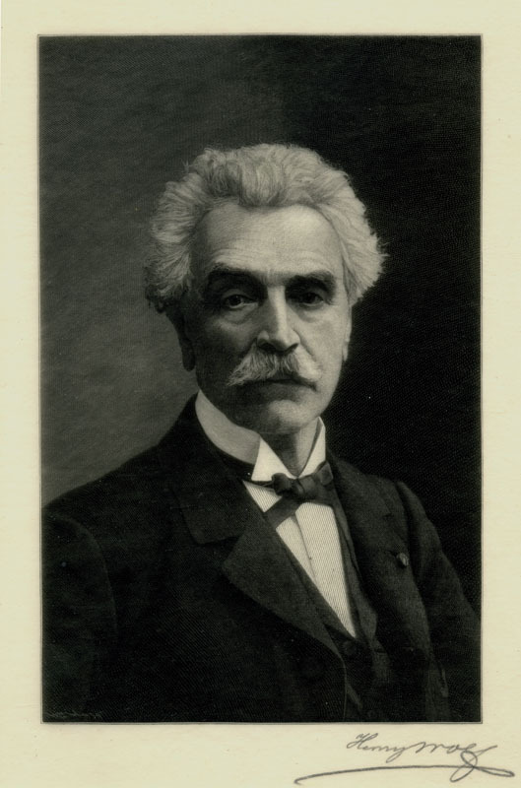
JEAN-LEON GEROME

Slide 2
Biography
Jean-Léon Gérôme (11 May 1824 – 10 January 1904) was a French painter and sculptor in the style now known as academicism. The range of his oeuvre included historical painting, Greek mythology, Orientalism, portraits, and other subjects, bringing the academic painting tradition to an artistic climax. He is considered one of the most important painters from this academic period. He was also a teacher with a long list of students.

Slide 3
Early Life
Jean-Léon Gérôme was born at Vesoul, Haute-Saône. He went to Paris in 1840 where he studied under Paul Delaroche, whom he accompanied to Italy (1843–44). He visited Florence, Rome, the Vatican and Pompeii, but he was more attracted to the world of nature. Taken by a fever, he was forced to return to Paris in 1844. On his return, he followed, like many other students of Delaroche, into the atelier of Charles Gleyre and studied there for a brief time. He then attended the École des Beaux-Arts. In 1846 he tried to enter the prestigious Prix de Rome, but failed in the final stage because his figure drawing was inadequate.

Slide 4
Death
Jean-Léon Gérôme died in his atelier on 10th January 1904. He was found in front of a portrait of Rembrandt and close to his own painting Truth Coming Out of Her Well. At his own request, he was given a simple burial service without flowers. But the Requiem Mass given in his memory was attended by a former president of the Republic, most prominent politicians, and many painters and writers. He was buried in the Montmartre Cemetery in front of the statue Sorrow that he had cast for his son Jean who had died in 1891.
He was the father-in-law of the painter Aimé Morot.

Slide 5
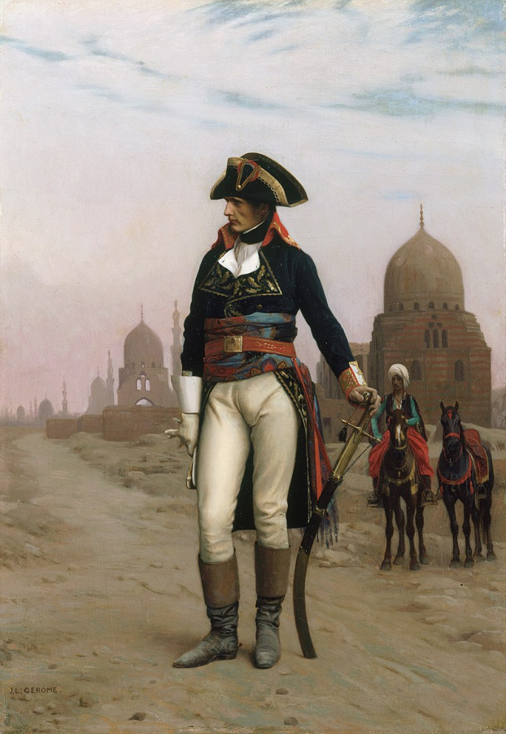
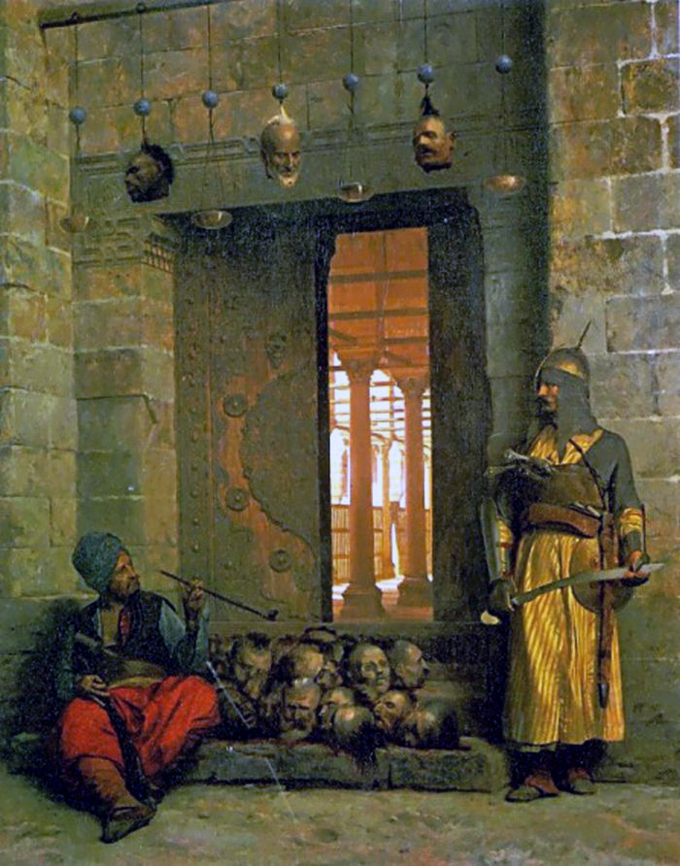
Paintings
Heads of the Rebel Beys at the Mosque of El Hasanein, Cairo
Undated photo of Gérôme by Nadar
Napoleon in Egypt

Slide 6
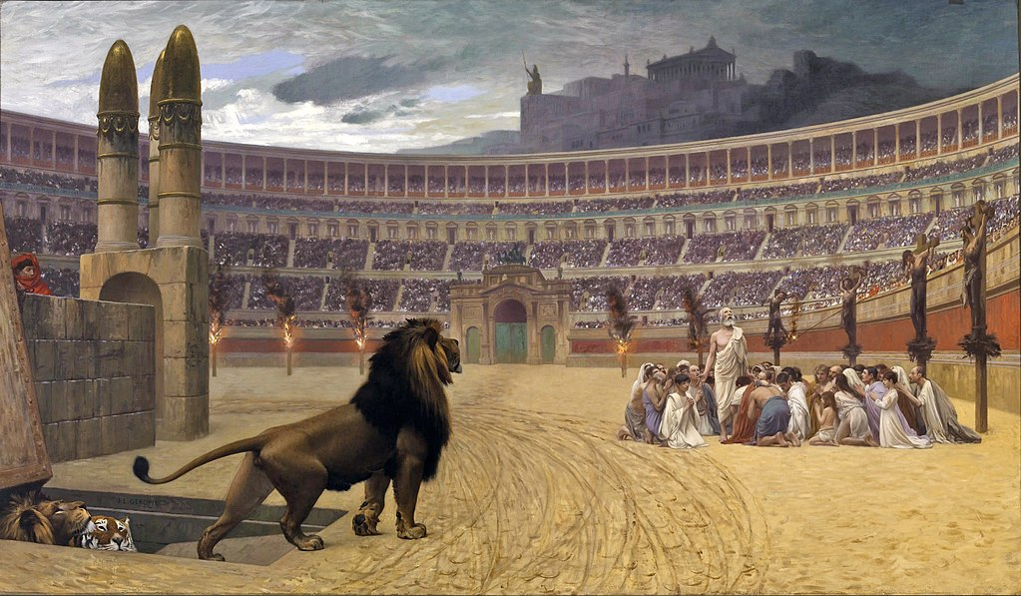
The Christian Martyrs' Last Prayer

Slide 7
Description
Rome's amphitheater, in which gladiatorial combats and other spectacles were held. Similarly, the hill in the background surmounted by a colossal statue and a temple is nearer in appearance to the Athenian Acropolis than it is to Rome's Palatine Hill. The artist also commented on the religious fortitude of the victims who were about to suffer martyrdom either by being devoured by the wild beasts or by being smeared with pitch and set ablaze, which also never took place in the Circus Maximus.

