Slide 1
TASK 1.
ETWINNING.
GREEK TEAM.
GENIKO LYKEIO PENTAPOLIS.

Slide 2
GENIKO LYKEIO PENTAPOLIS.
Powered by Aggelos Domouktsis , Stelios Papaoikonomoy , Andreas Hotzas and George Antoniadis.
Etwinning

Slide 3
Famous Artist .
GENIKO LYKEIO PENTAPOLIS .
Asprogeraka Erato
Date of birth: 01-01-1880 Date of death: 01-01-1965 Art Works 1
BIOGRAPHY
She graduated from the School of Arts in 1908. She painted mostly landscapes. After 1920 she also got involved in ethnography and with compositions of religious content. She took part in group exhibitions: • Artistic Company 1909 • Mela Hotel 1916 • SEK 1917, 1921, 1939 • Greeks Painters Lyceum Greek 1922, 1924 • Studio 1933 • Pan-Hellenic 1938, 1939, 1948, 1952 At the same time, she organized also solo exhibitions many of which along with N. Asprogeraka (1916, 1929, 1931, 1935 and 1939). She was member of the Pictorial Arts Chamber of Greece.

Slide 4
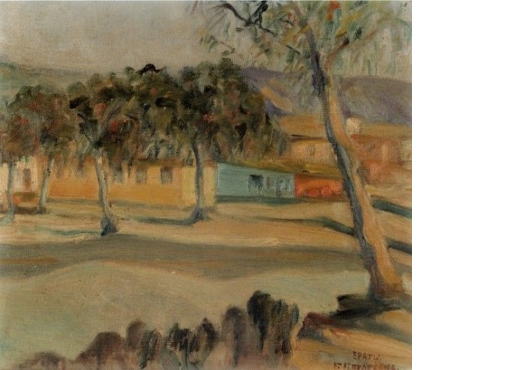
Title: view with houses

