Slide 1
WE READ, WE LEARN, WE KNOW
BULGARIA, PORTUGAL, UKRAINE, GREECE
https://twinspace.etwinning.net/108903/pages/page/879484

Slide 2
MAIN PROJECT AIMS
to promote and consolidate the pleasure of reading
to improve the reading skills through an articulated and collaborative
to raise the students’ awareness and commitment regarding themselves, their community and the planet.

Slide 3
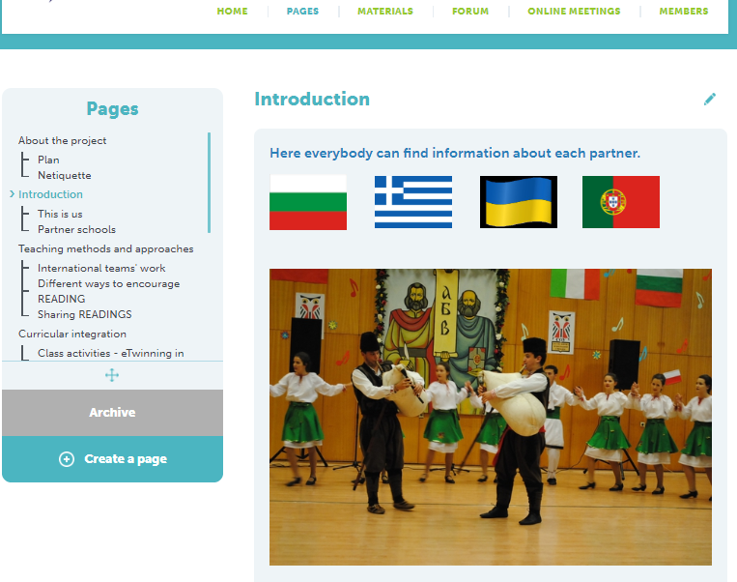
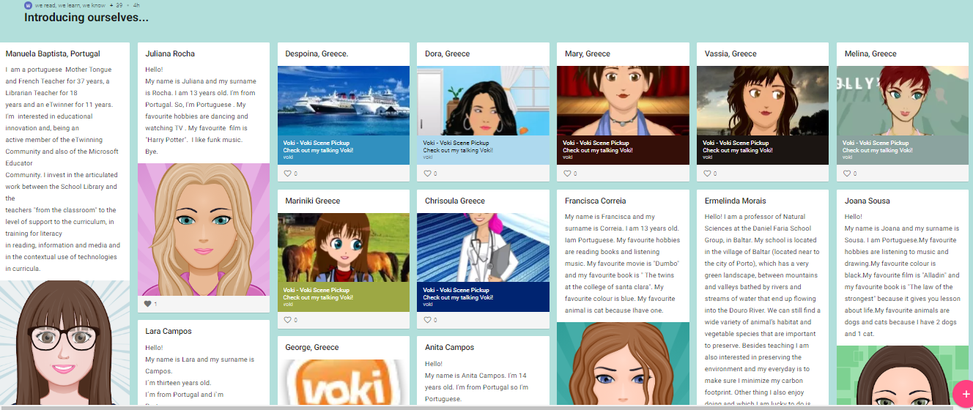
PROJECT ACTIVITIES
INTRODUCTION

Slide 4
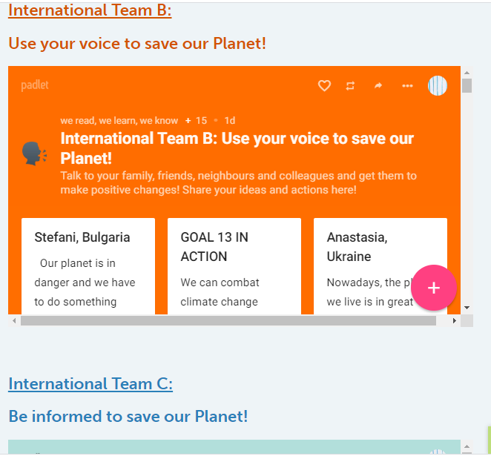
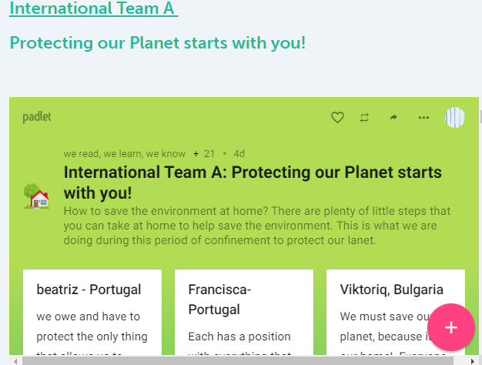
INTERNATIONAL TEAM’S WORK

Slide 5
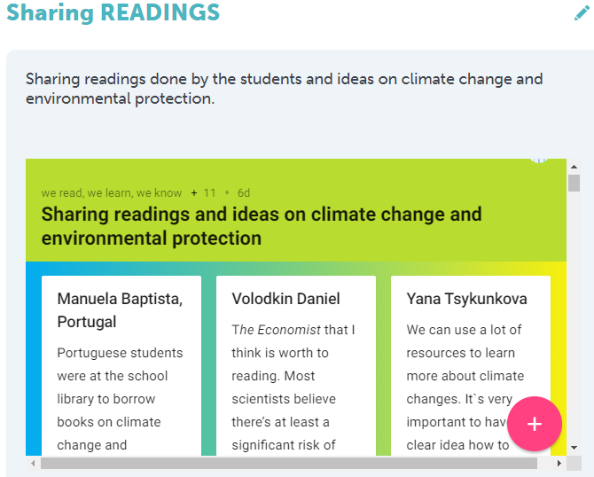
SHARING READINGS

Slide 6
WAYS OF ENCOURAGE READING
MY FAVOURITE BOOK
WORLD BOOK DAY
EARTH DAY
HAPPY EASTER
STRATEGY FOR IMPROVING READING
READING TIPS

Slide 7
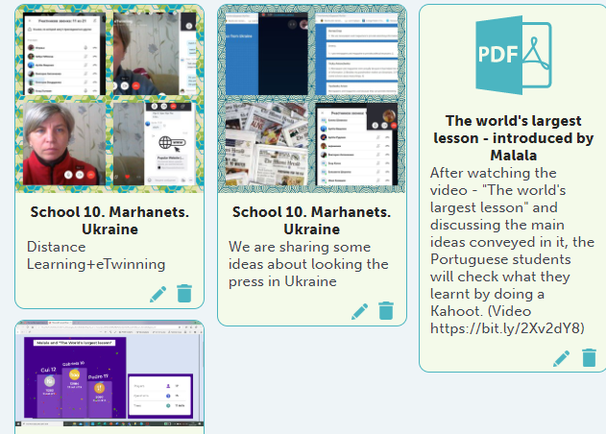
CLASS ACTIVITIES
DISCUSSION
QUIZZES
READING COMPREHENSION
TEAM WORKING
WRITING
CREATING

Slide 8
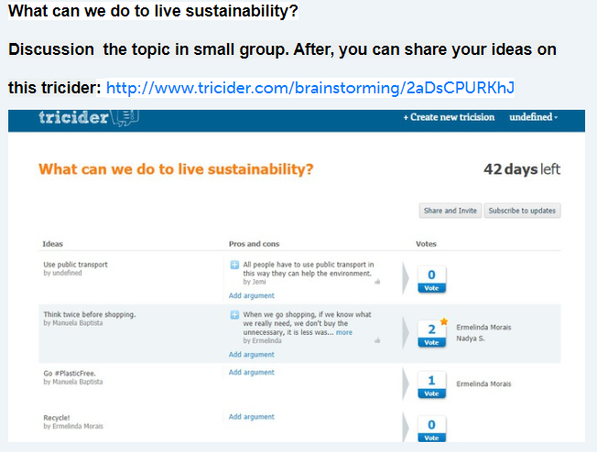
ENVIRONMENTAL IDEAS

Slide 9
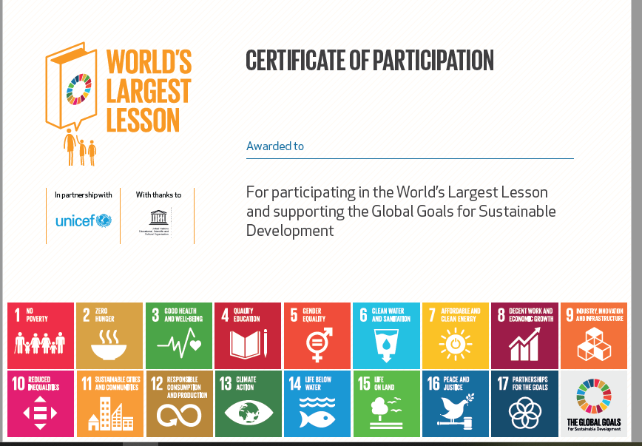
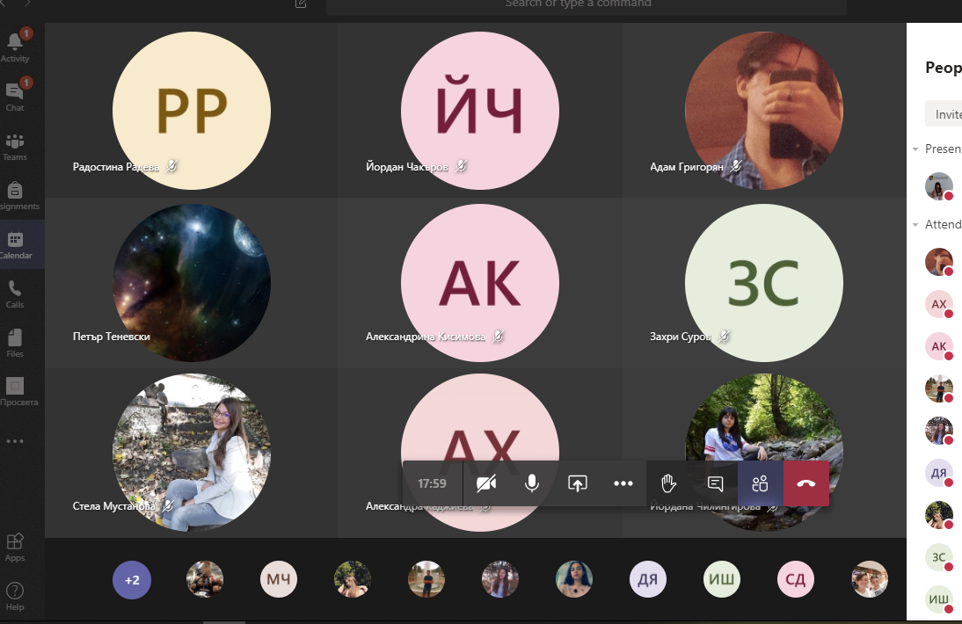
WORLD’S LARGEST LESSON

Slide 10
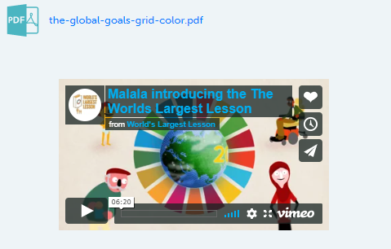
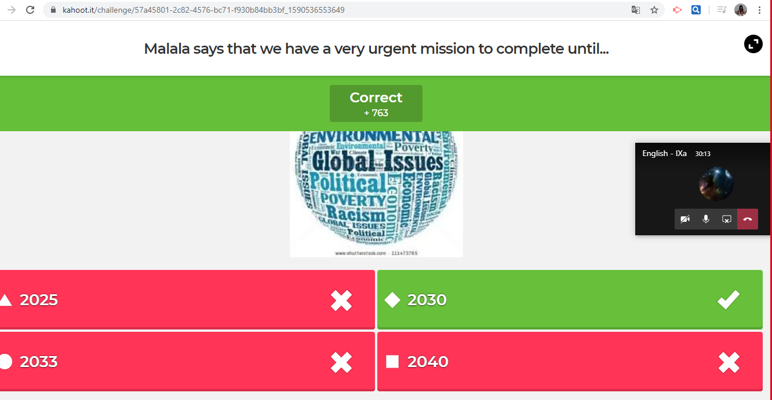
WORLD’S LARGEST LESSON

Slide 11
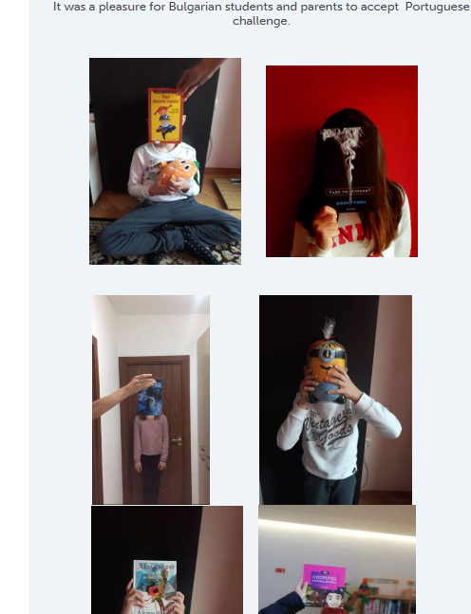
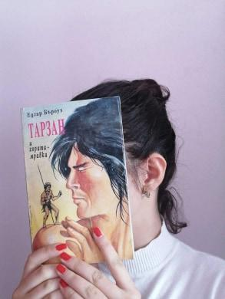
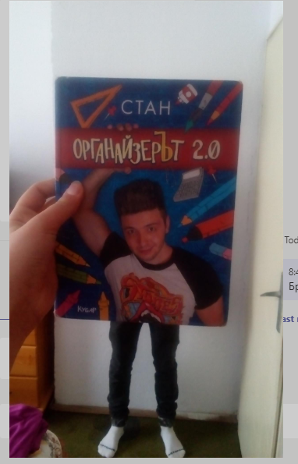
CREATING BOOKFACE

Slide 12
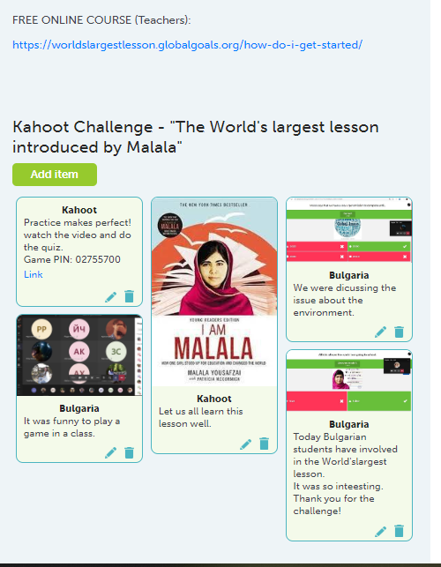
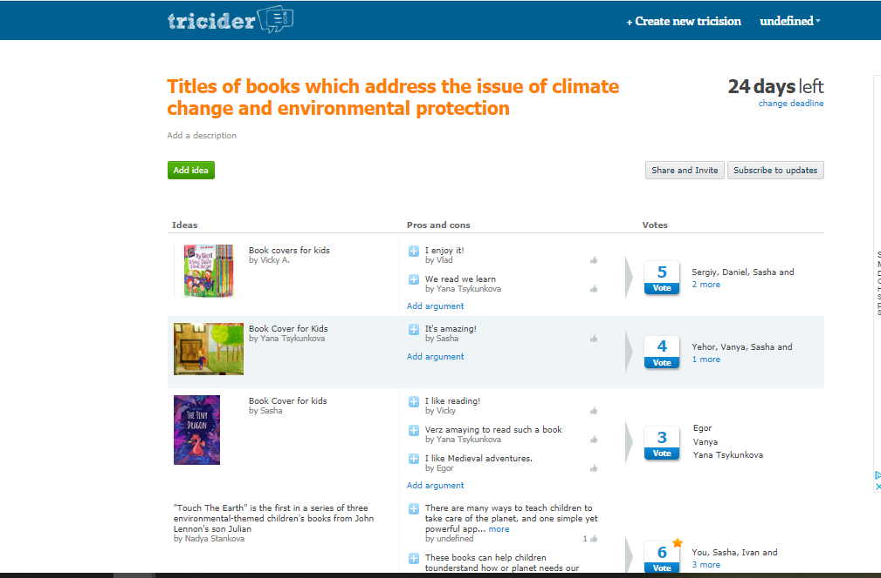
DIGITAL TOOLS
PADLET
MENTIMETER
TRICIDER
KAHOOT
ANIMOTO
CALAMEO
GOOGLE DRIVE
FORUM

Slide 13
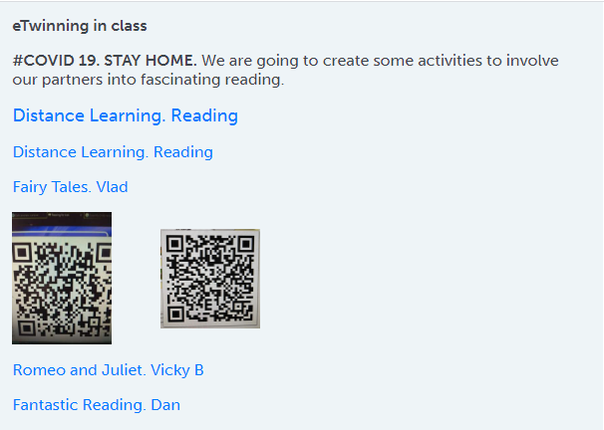
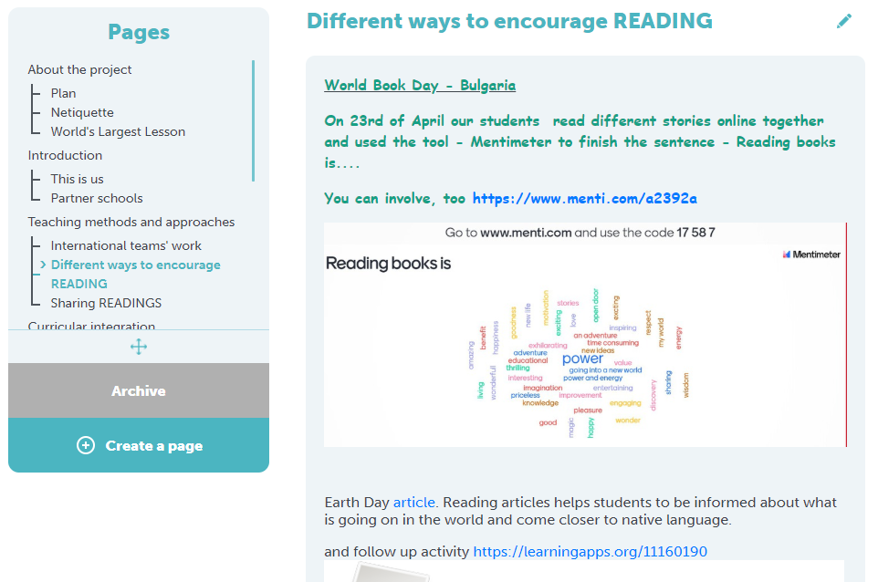
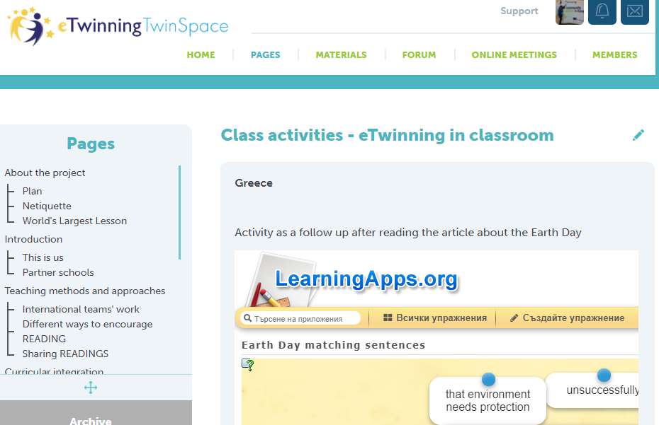
DIGITAL TOOLS

Slide 14
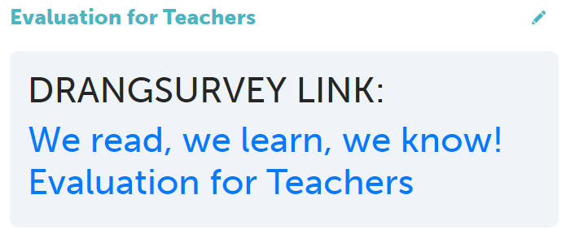
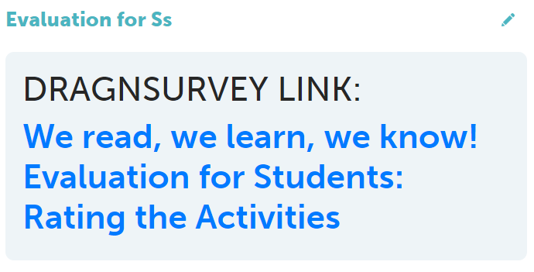
EVALUATION

Slide 15
“We read, We learn, We know”
- this is a project which has got together partners from Portugal, Bulgaria, Greece and Ukraine.
We created really a good team!

