Slide 1
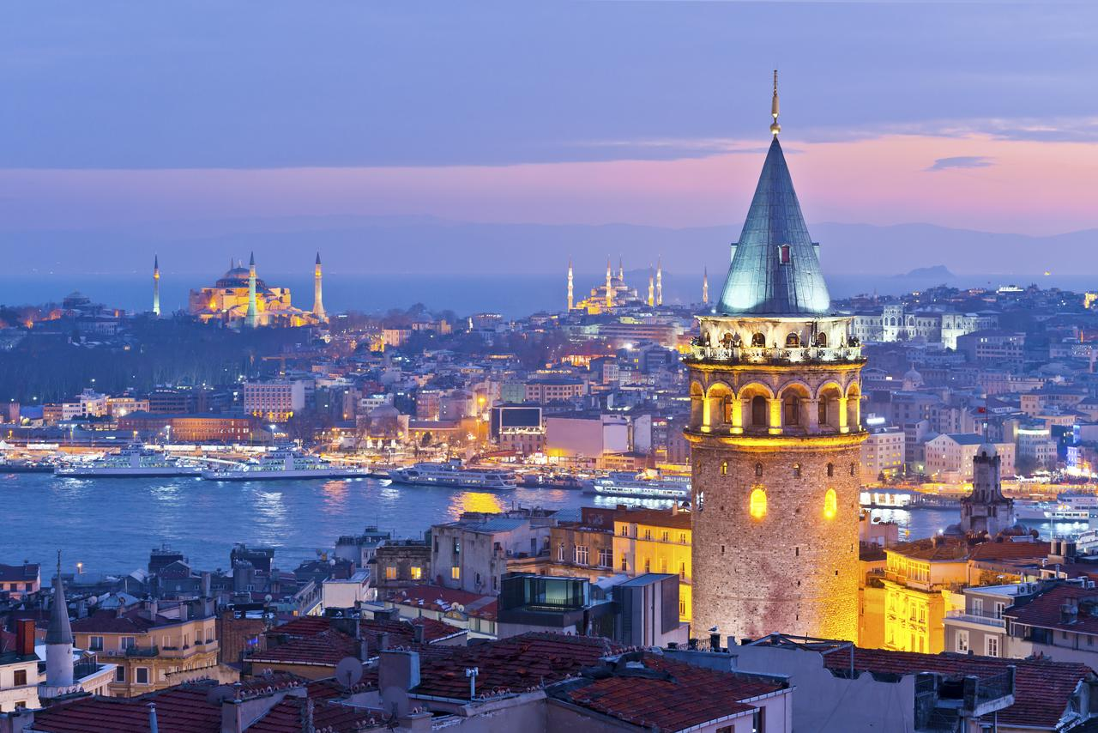
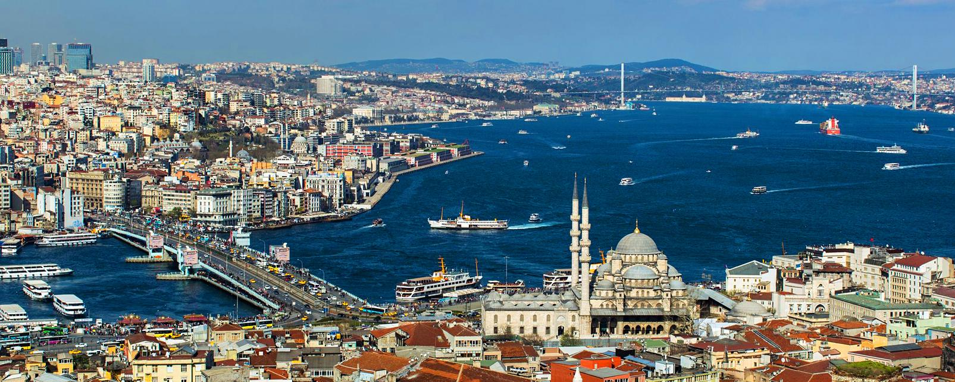
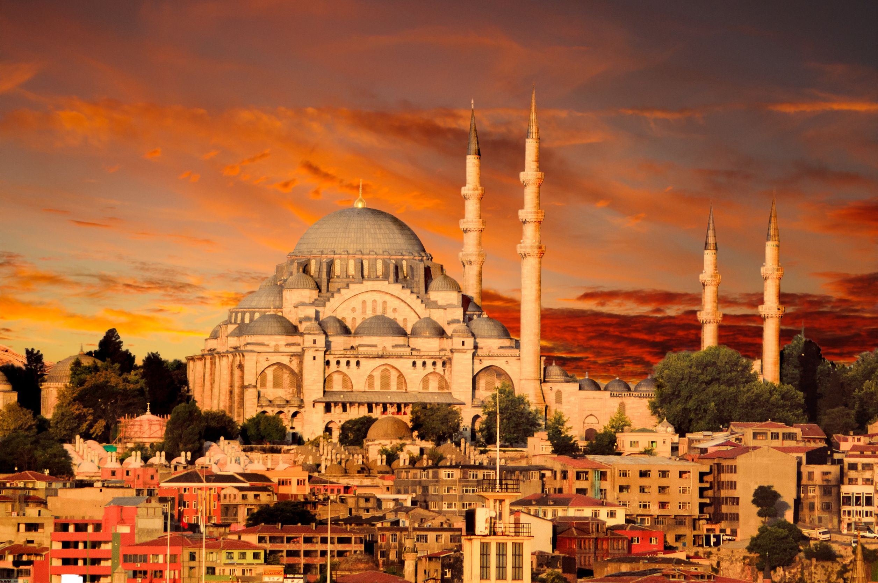
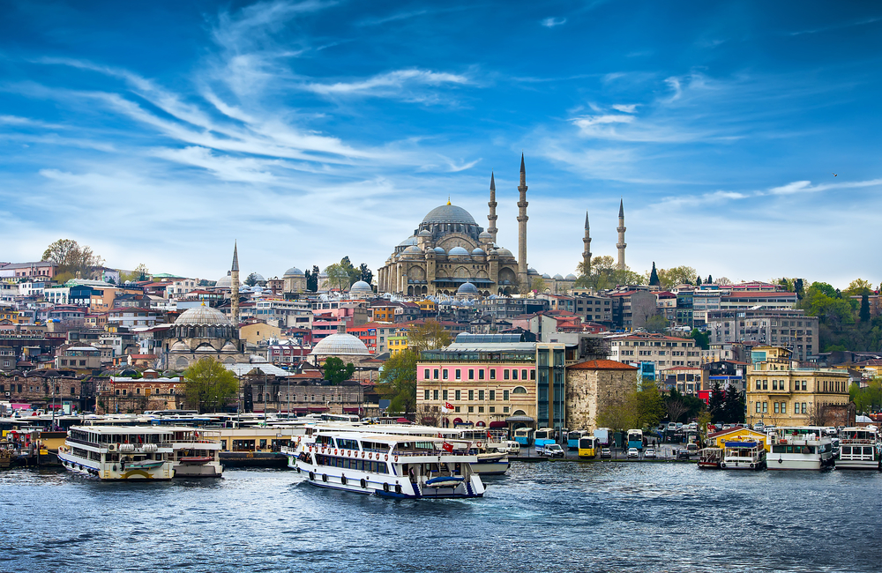
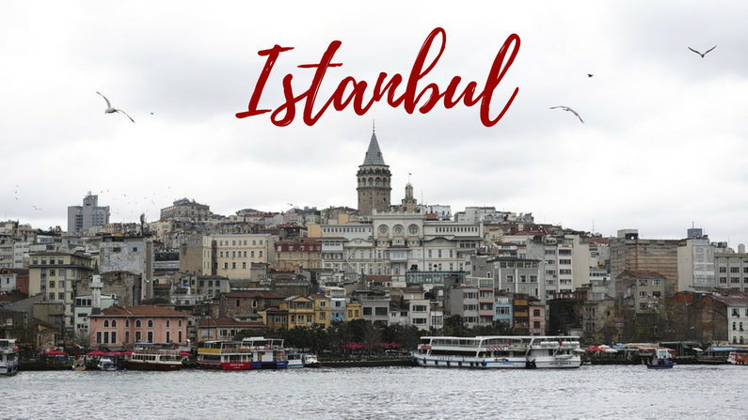
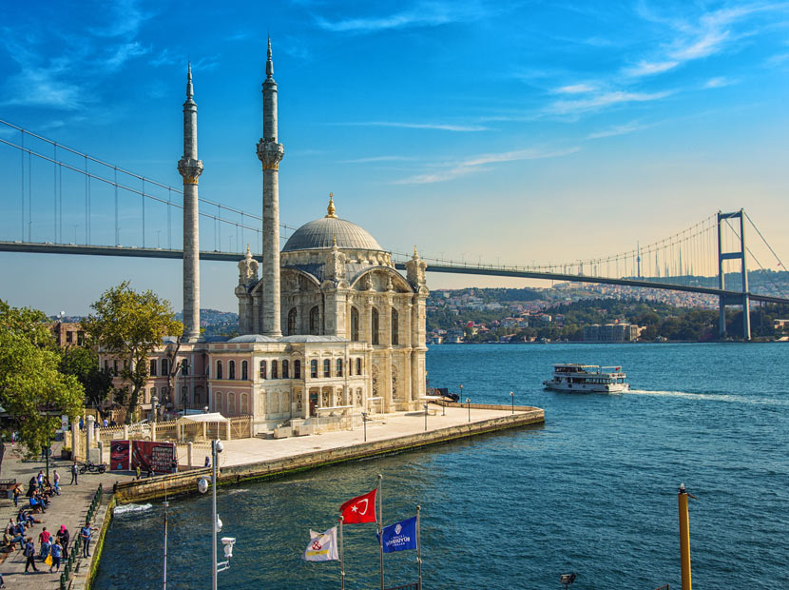
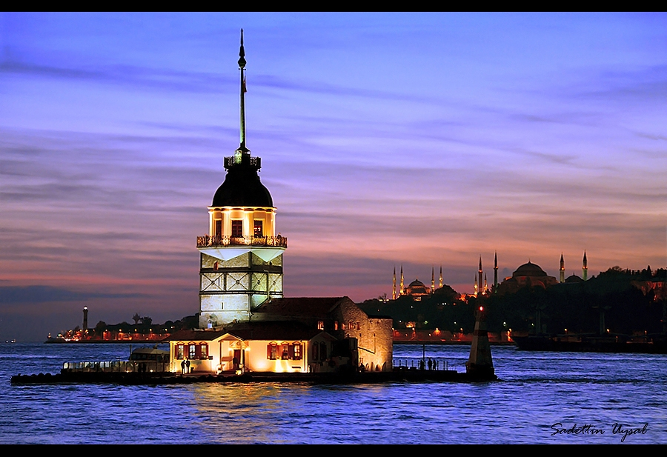
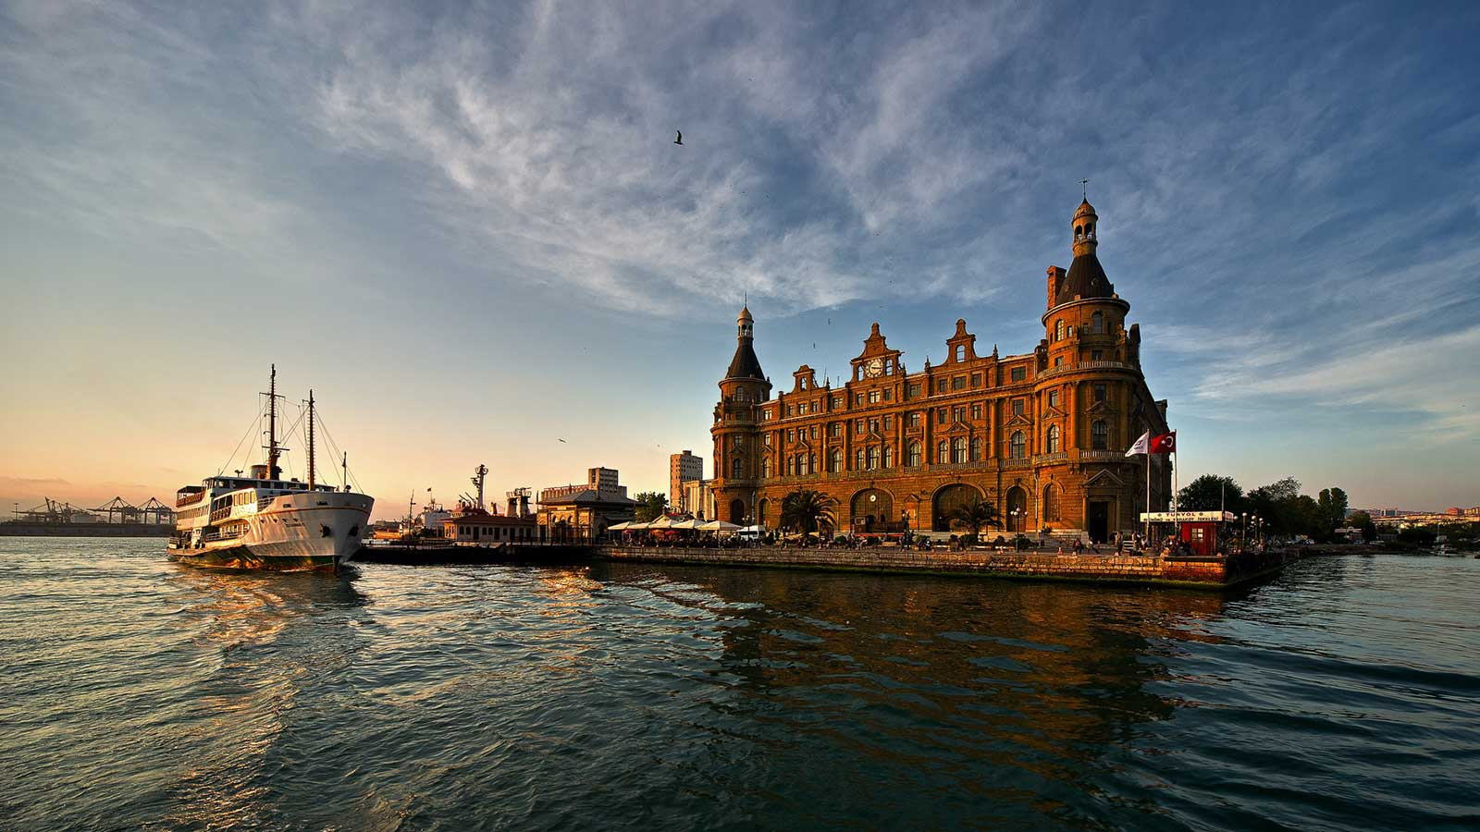
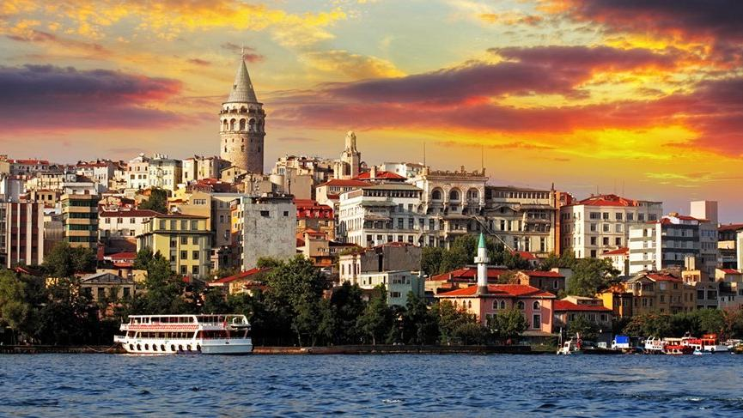
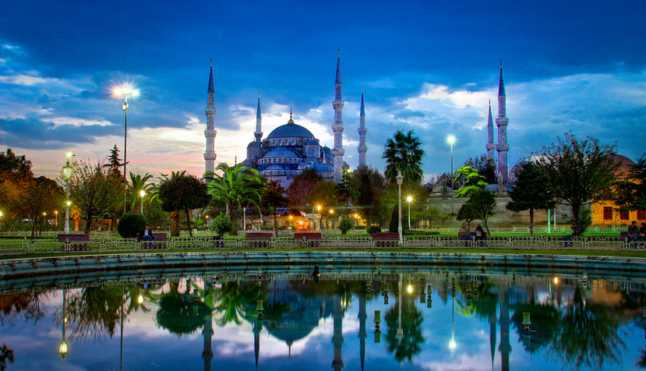

Slide 2
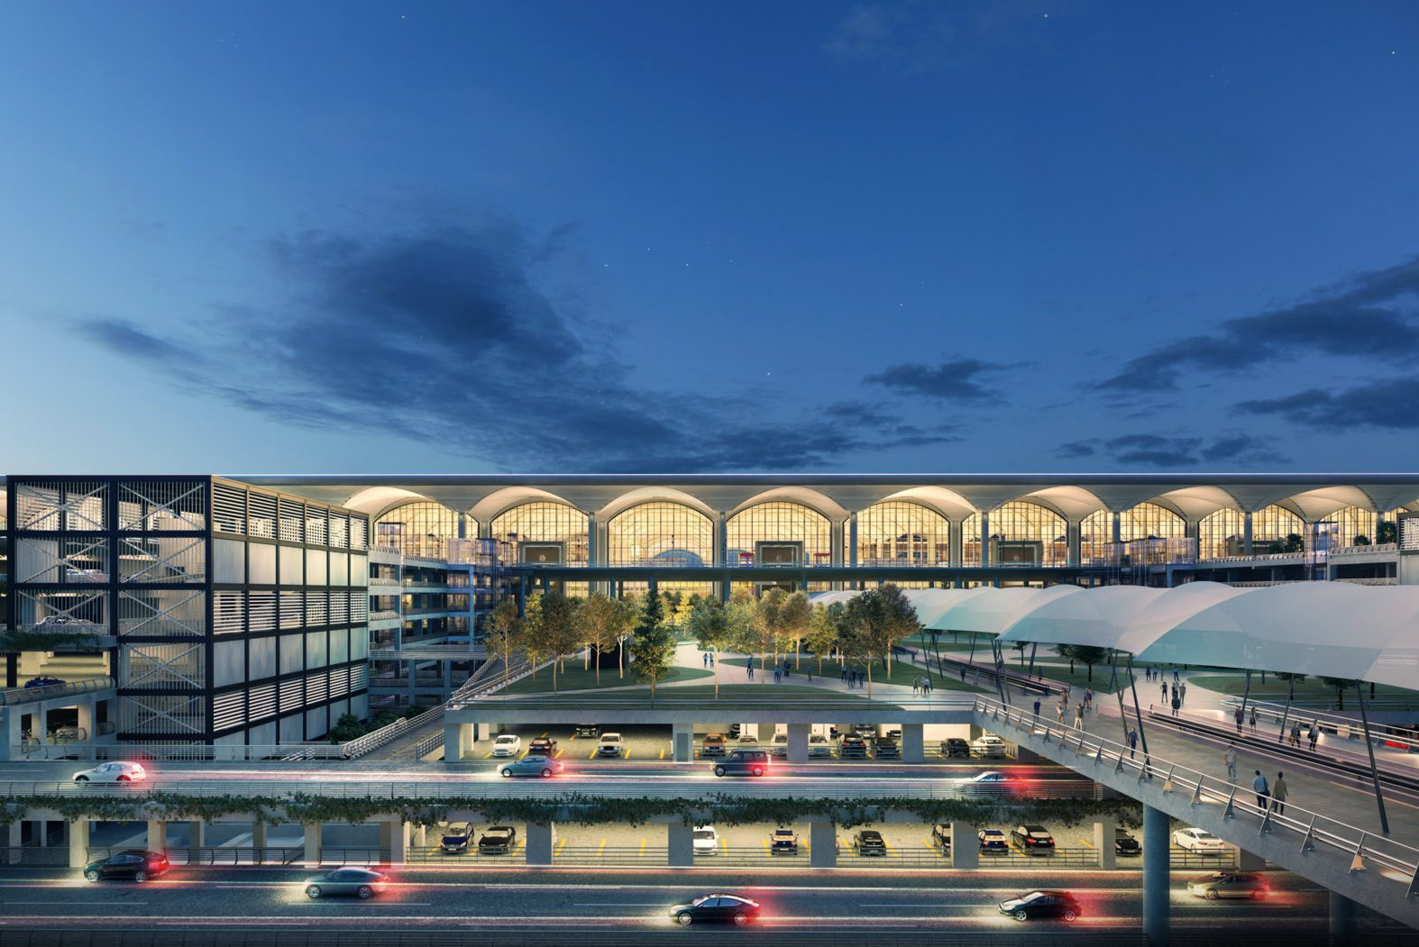
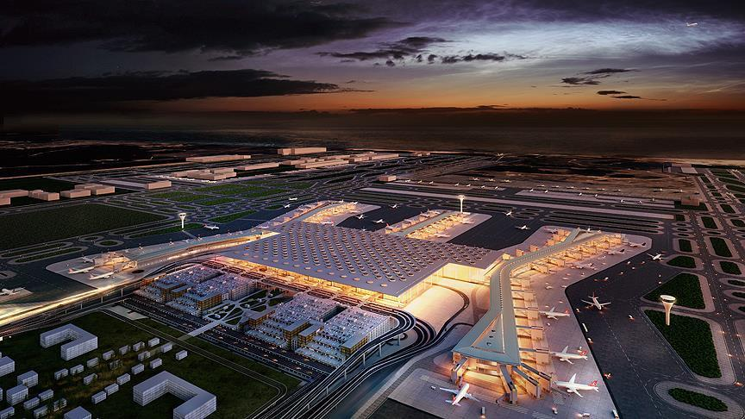
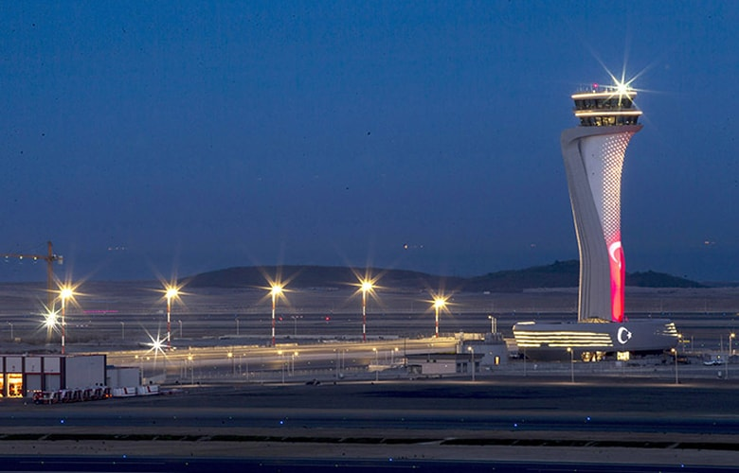
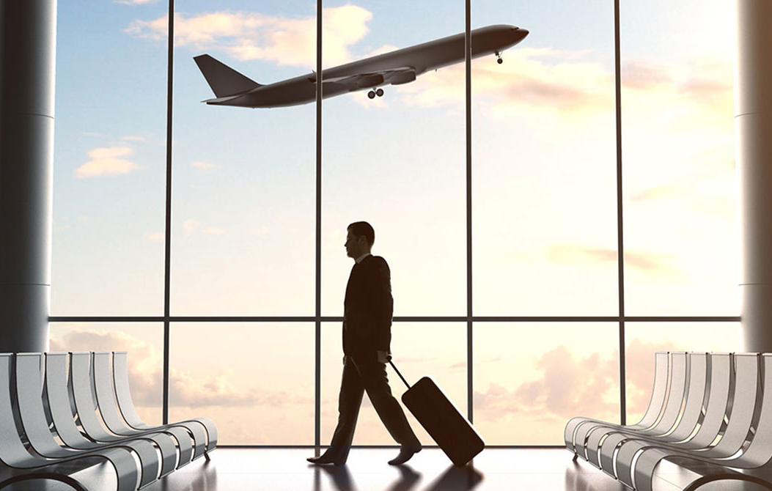
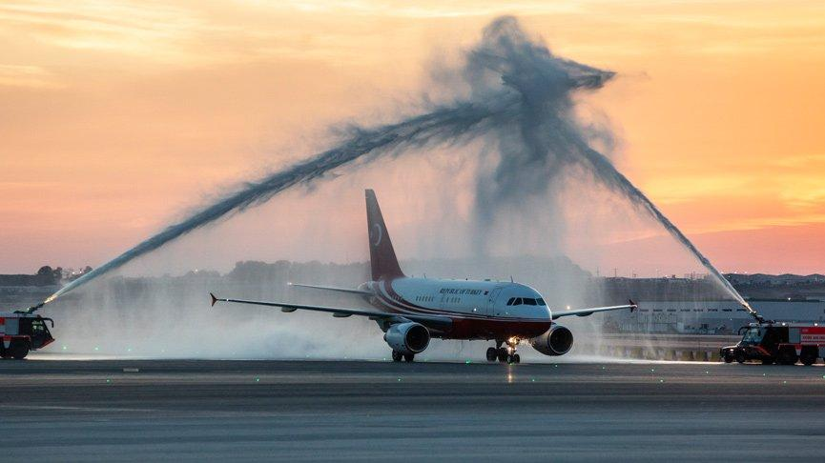
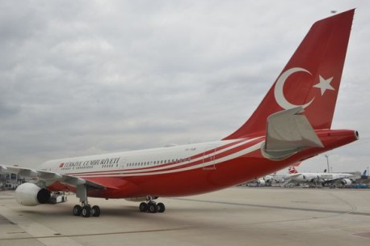
AIRPORTS OF ISTANBUL

Slide 3
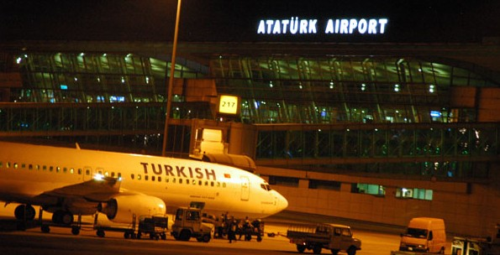
ATATURK AIRPORT
It's in Yesilkoy, on European side of Istanbul.
It's the first airport of Turkey.
It took its name from Mustafa Kemal Ataturk(founder of Turkey).
ATATURK AIRPORT

Slide 4
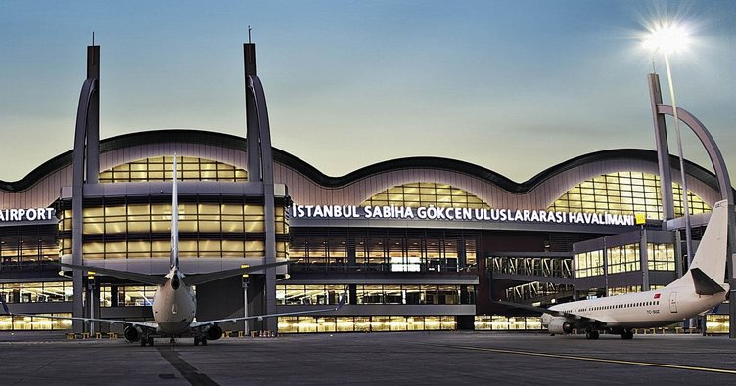
SABIHA GOKCEN AIRPORT
It's located in the southeast of the city center, it's in the Asian part of the bi-continental Istanbul.
It took its name from Sabiha Gokcen.
She is Ataturk's adopted daughter.
She is first female pilot and first female war pilot of Turkey.
SABIHA GOKCEN AIRPORT

Slide 5
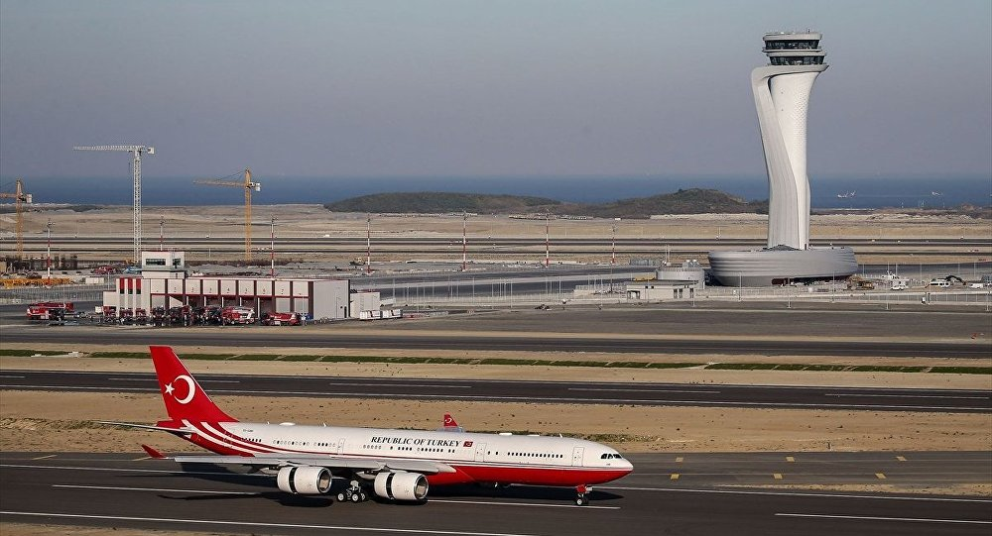
ISTANBUL AIRPORT
It's in the Arnavutkoy district on the European side of Istanbul, Turkey.
It was opened on 29th October 2018.
It's the biggest airport in the world.
It took Awards Of Tower Design (with tulip design).
ISTANBUL AIRPORT

Slide 6
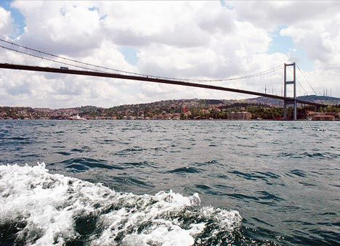
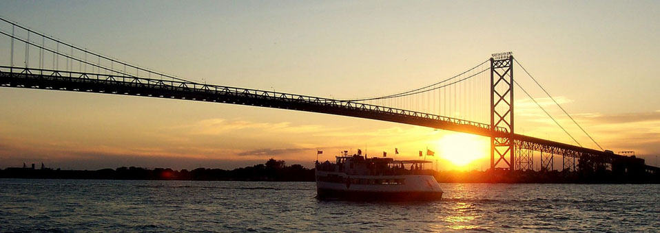
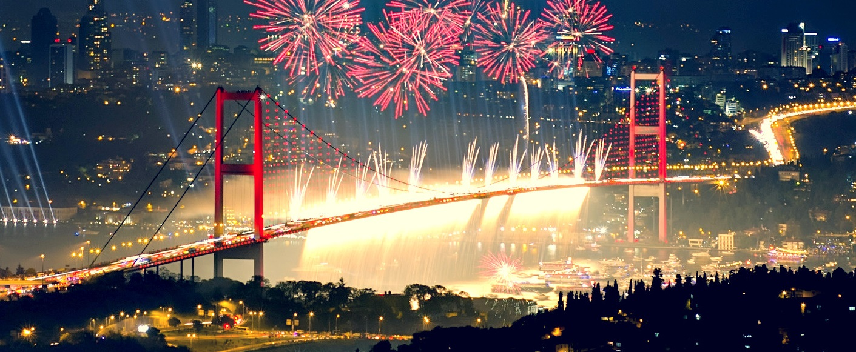
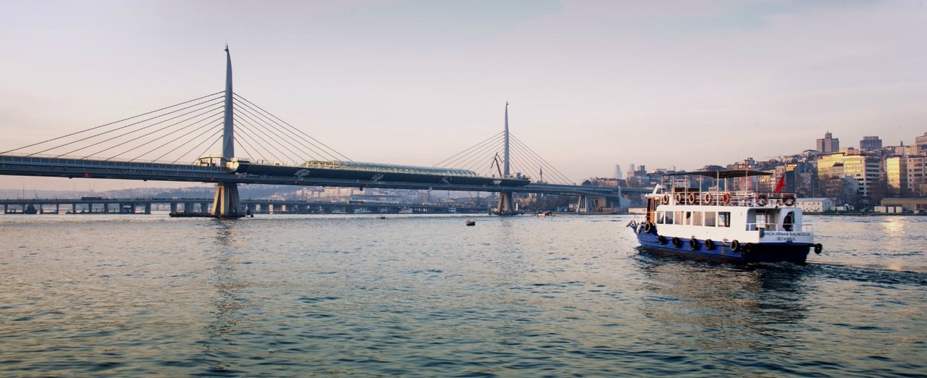
BRIDGES OF ISTANBUL

Slide 7
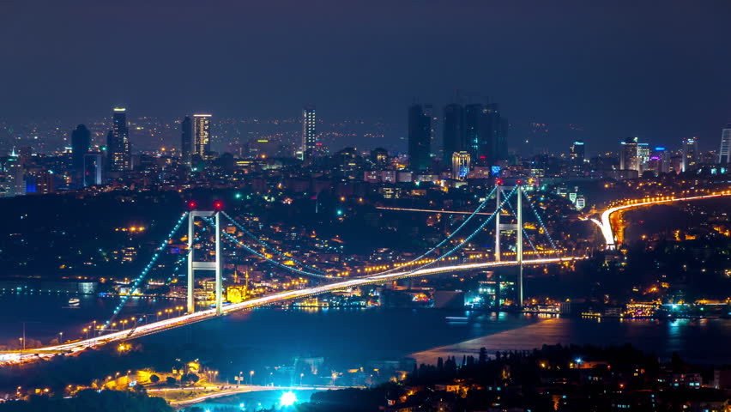
15 JULY MARTYRS BRIDGE
It's the first bridge of Istanbul.
It's the 4th longest bridge in the world when building was finished.
However, it's the 21st longest bridge in the world now.
Its first name is "Bosphorus Bridge."
15 JULY MARTYRS BRIDGE

Slide 8
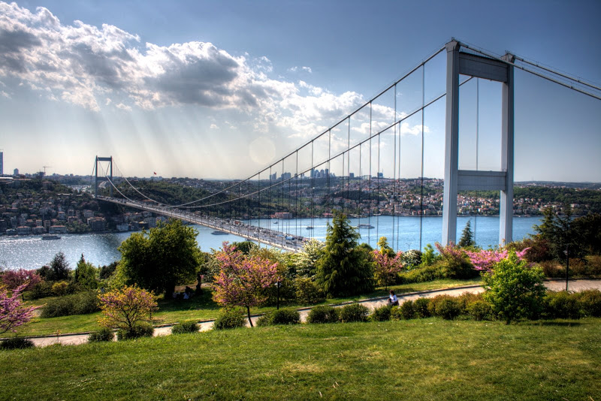
FATIH SULTAN MEHMET BRIDGE (Sultan Mehmed the Conqueror Bridge)
It's the 14th biggest steel suspension bridge in the world.
It took its name from Ottoman sovereign.
FATIH SULTAN MEHMET BRIDGE (Sultan Mehmed the Conqueror Bridge)

Slide 9
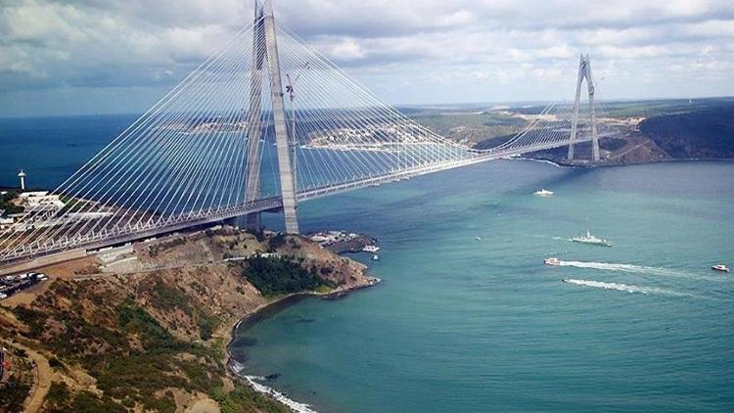
YAVUZ SULTAN SELIM BRIDGE
It's the largest and highest bridge in the world.
It took its name from Ottoman sovereign.
YAVUZ SULTAN SELIM BRIDGE

Slide 10
PREPARED BY
ASLI CENGIZ
11th CLASS

