Slide 1
Poland
Jakub Półgrabia

Slide 2
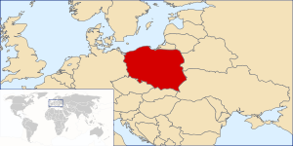
Description of Poland
Poland is a country situated in Central Europe. It covers more that 320 thousands square kilometers and has population of over 38 million people.

Slide 3
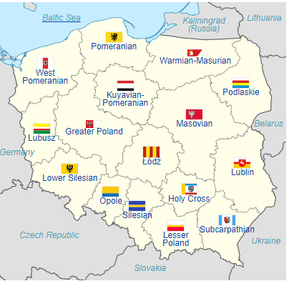
Administrative divisions
Poland's current voivodeships (provinces) are largely based on the country's historic regions, whereas those of the past two decades (to 1998) had been centred on and named for individual cities. The new units range in area from less than 10,000 square kilometres (3,900 sq mi) for Opole Voivodeship to more than 35,000 square kilometres (14,000 sq mi) for Masovian Voivodeship. Administrative authority at voivodeship level is shared between a government-appointed voivode (governor), an elected regional assembly (sejmik) and a voivodeship marshal, an executive elected by that assembly.The voivodeships are subdivided into powiats (often referred to in English as counties), and these are further divided into gminas (also known as communes or municipalities). Major cities normally have the status of both gmina and powiat. Poland has 16 voivodeships, 380 powiats (including 66 cities with powiat status), and 2,478 gminas.

Slide 4
Languages
Polish is a Slavic language spoken primarily in Poland and the native language of Poles. It belongs to the Lechitic subgroup of West Slavic languages. Polish is the official language of Poland, but it is also used throughout the world by Polish minorities in other countries. It is one of the official languages of the European Union. Its written standard is the Polish alphabet, which has 9 additions to the letters of the basic Latin script(ą, ć, ę, ł, ń, ó, ś, ź, ż), with the notable exclusion of q,v, and x, which are used mainly for foreign words. The deaf communities use Polish Sign Language belonging to the German family of Sign Languages.

Slide 5
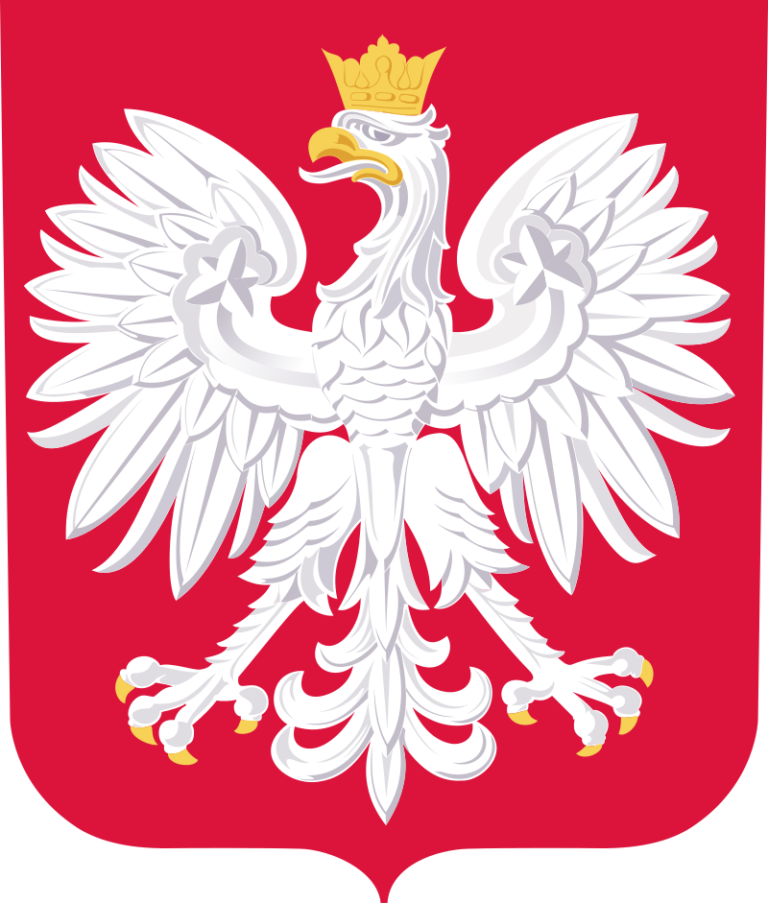
Flag and Coat of arms
The flag of Poland consists of two horizontal stripes of equal width, the upper one white and the lower one red. The two colors are defined in the Polish constitution as the national colors.
The White Eagle is the national coat of arms of Poland. It is a stylized white eagle with a golden beak and talons, and wearing a golden crown, in a red shield.

Slide 6
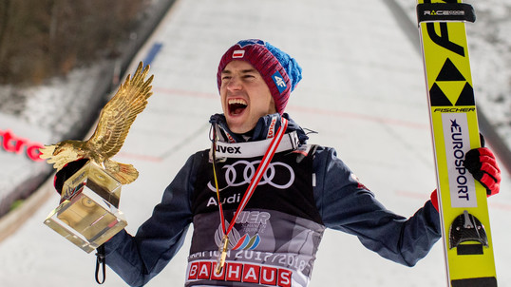
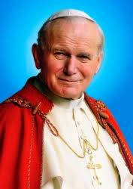
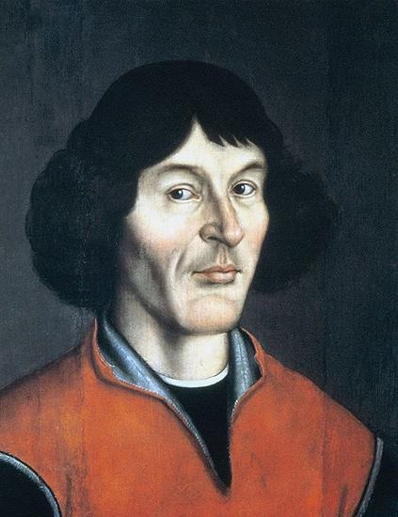
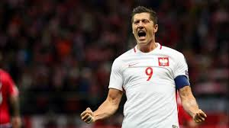
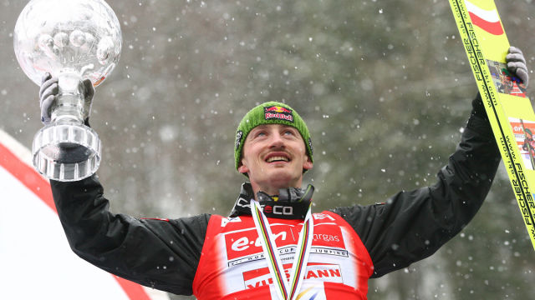
Famous people
The most popular sport in Poland is football. Poland is also the birthplace of many prominent people such as: Mikołaj Kopernik, Fryderyk Chopin, Maria Skłodowska-Curie, Karol Wojtyła, Adam Małysz, Kamil Stoch, Robert Lewandowski

Slide 7
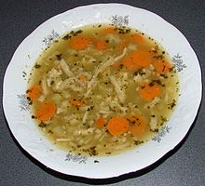
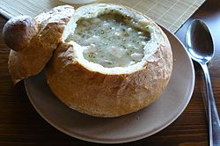
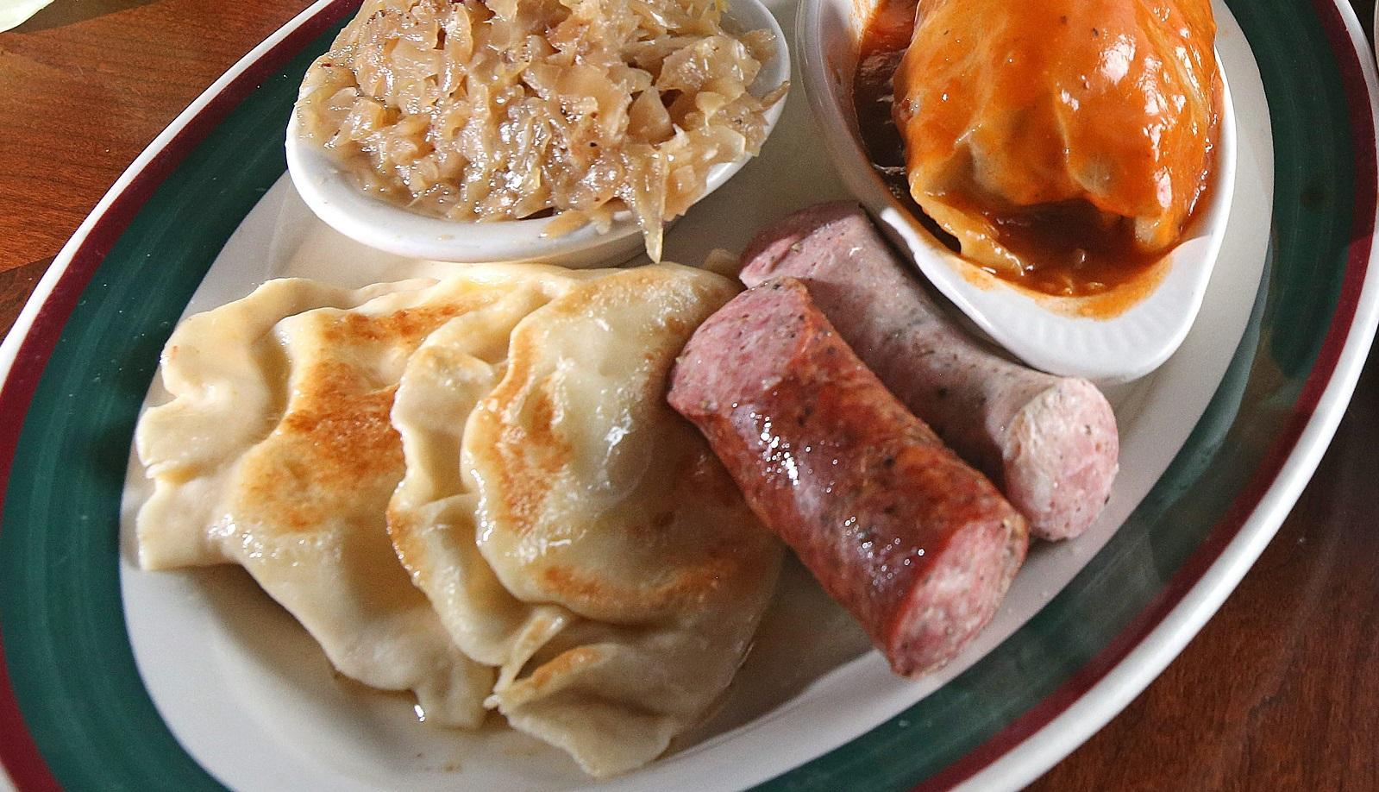
Polish food
Pierogi (Polish dumplings)
Gołąbki (cabbage roll)
Bigos (Hunter’s stew)
Kotlet schabowy (breaded pork cutlet)
Kielbasa (sausage)
Żur (sour rye soup)
Flaki (meat stew)

Slide 8
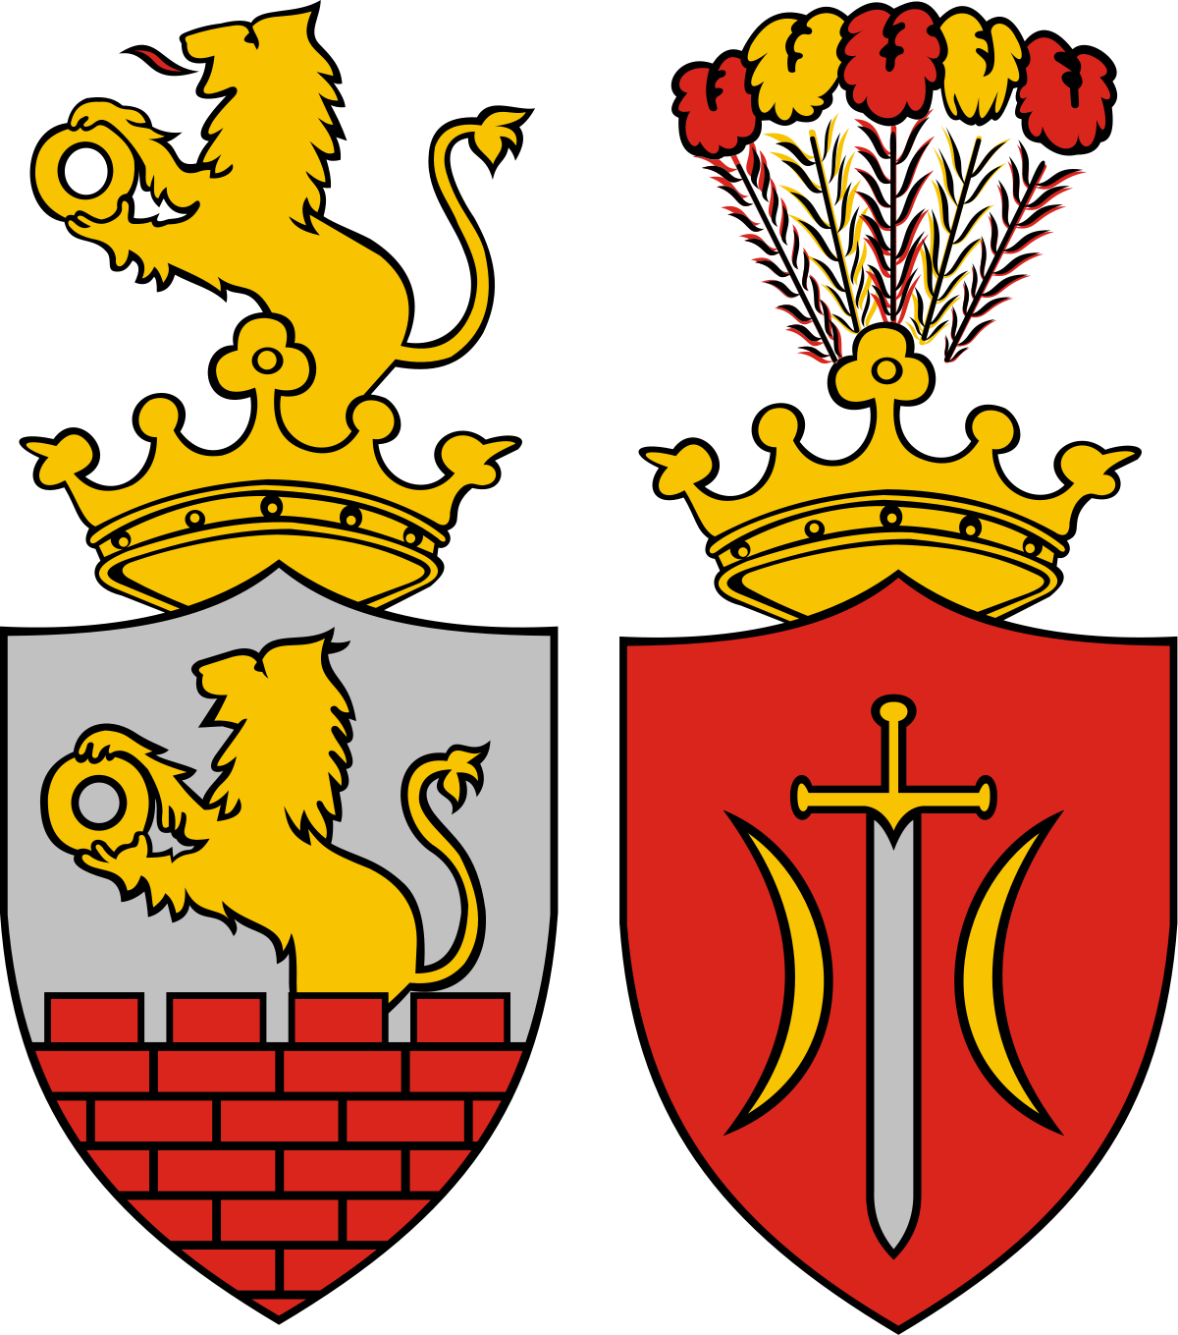
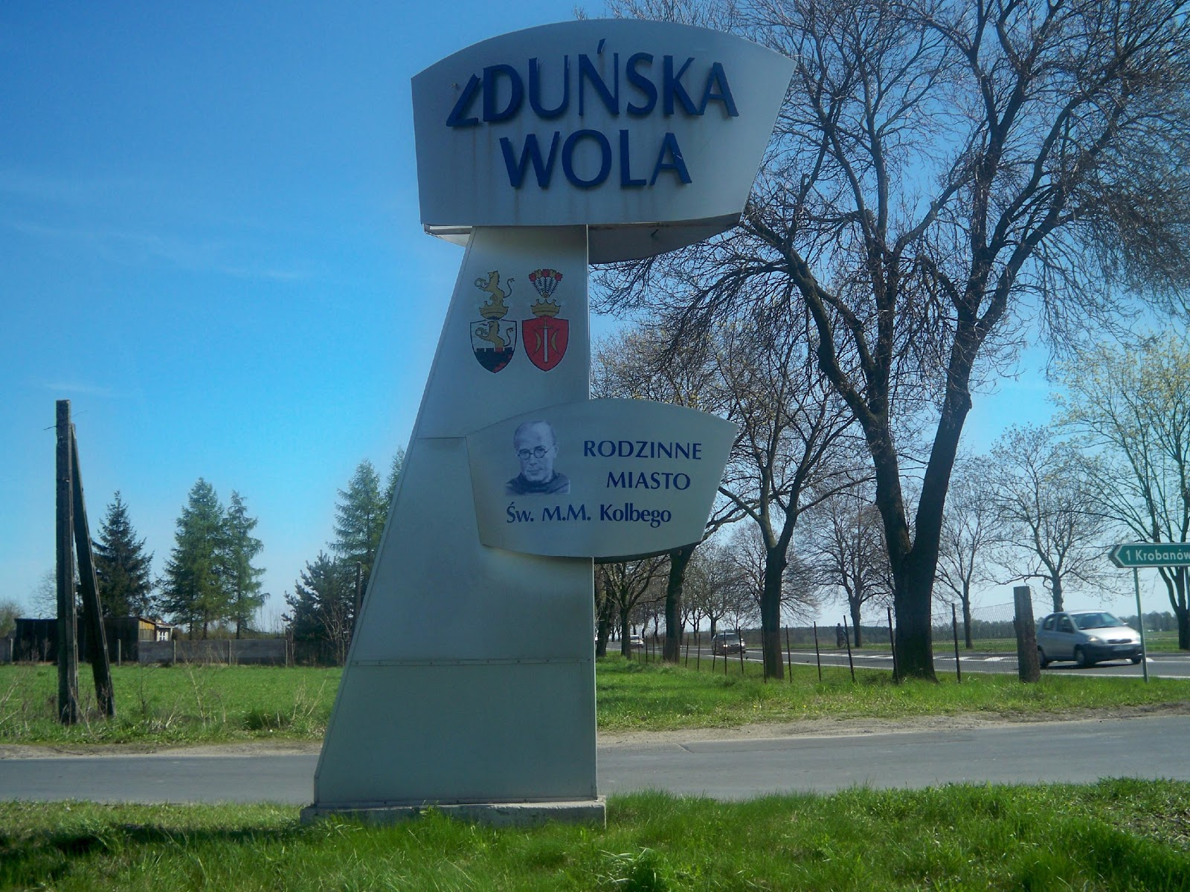
Zduńska Wola
Zduńska Wola is a town in central Poland with 42,698 inhabitants. Situated in the Łódź. It is the seat of Zduńska Wola County. The town was once one of the largest cloth, linen and cotton weaving centres in Poland and is the birthplace of Saint Maximilian Kolbe and Maksymilian Faktorowicz, the founder of Max Factor cosmetics company.

Slide 9
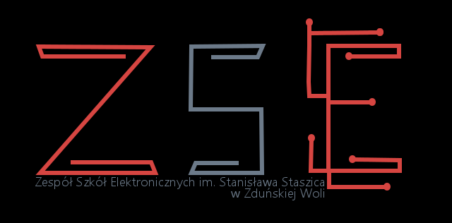
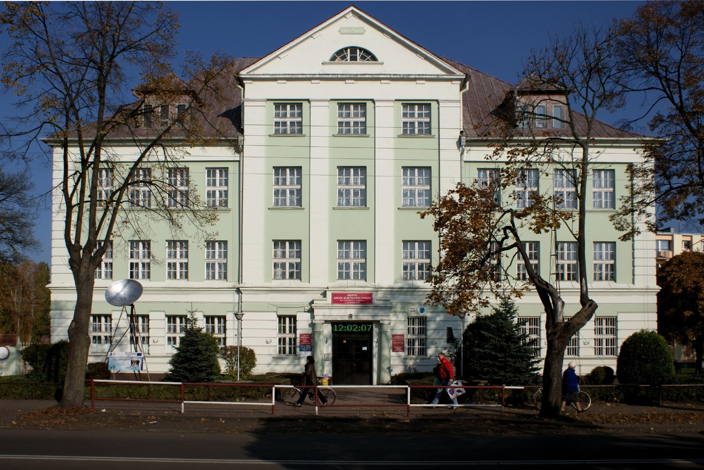
My school - Zespół Szkół Elektronicznych im. Stanisława Staszica
This is a secondary school(vocational school). Student spend there about 8-10 hours a day and we lern IT subjects. This is the one of the best vocational schools in Poland.

Slide 10
The End
Done: Jakub Półrabia 2cTI

