Slide 1
POLAND
Krzysztof Trzcianowski

Slide 2
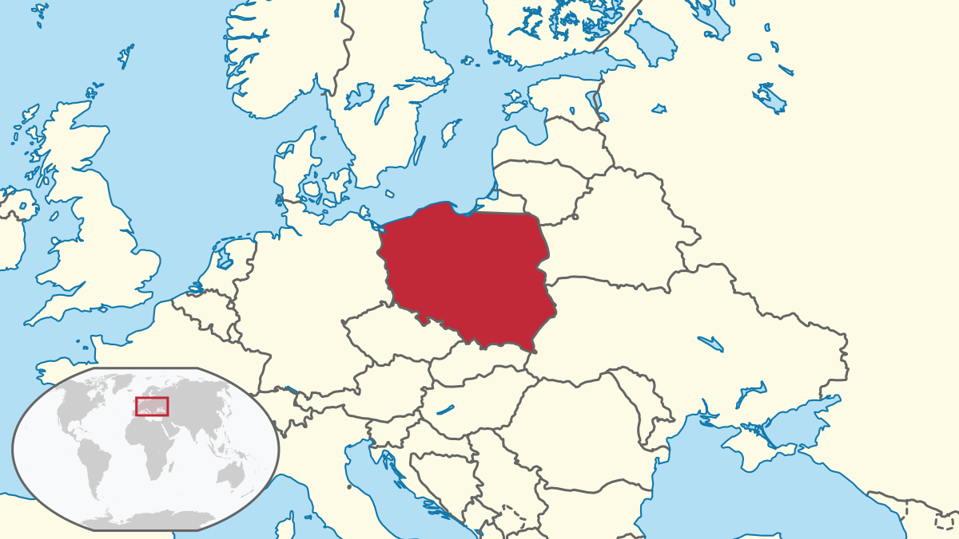
Description of Poland
Poland is a country situated in Central Europe. It covers more that 320 thousands square kilometers and has population of over 38 million people. Poland's official language is Polish. The climate is moderate there, which means that summers are usually hot and sunny, winters cold and springs and autumns quite mild. The longest river in Poland is the Vistula River.

Slide 3
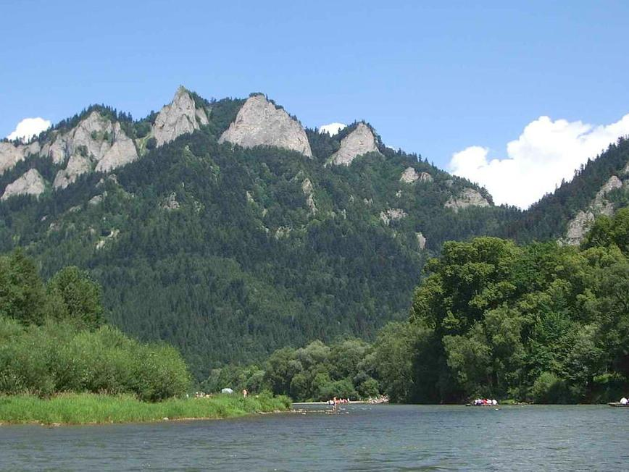
Sea and Moutains
While the north of Poland has an access to the sea, the south of Poland is dominated by the mountains. The Tatra Mountains are perfect for winter sports and hiking, so they attract a lot of tourists and climbers from all over the Europe. The Baltic Sea, on the other hand, is known for its healthy climate, sandy beaches and popular holiday resorts.

Slide 4
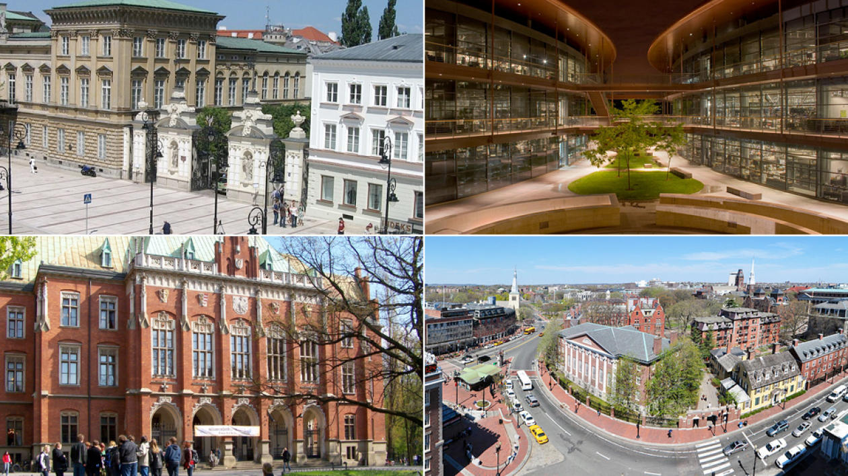
Facts about Poland
Poland belongs to the European Union and has a great economic potential. There are many universities and academies which offer the highest level of education. Polish culture and art have a long history and are distinguishable abroad. Although Poland is highly developed and influenced by contemporary trends, it also retains its own unique tradition.

Slide 5
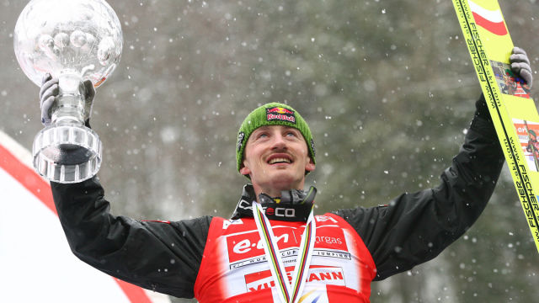
Prominent people
The most popular sport in Poland is football. The country has a rich history in this field as the national football team has achieved a lot throughout the years. Poland is also the birthplace of many prominent people. Mikołaj Kopernik, Fryderyk Chopin, Adam Mickiewicz, Kazimierz Pułaski, Maria Skłodowska-Curie, Karol Wojtyła, Ryszard Kapuściński, Andrzej Wajda and Adam Małysz are among them.

Slide 6
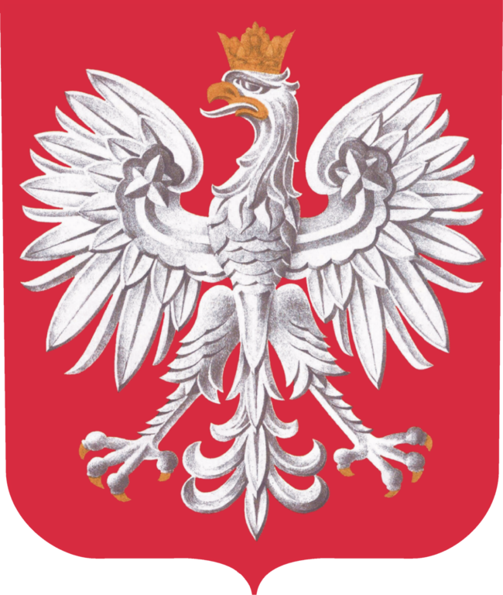
Flag and Emblem
The flag of Poland consists of two horizontal stripes of equal width, the upper one white and the lower one red. The two colors are defined in the Polish constitution as the national colors.
The White Eagle is the national coat of arms of Poland. It is a stylized white eagle with a golden beak and talons, and wearing a golden crown, in a red shield. The White Eagle emblem originated when Poland's legendary founder Lech saw a white eagle's nest. When he looked at the bird, a ray of sunshine from the red setting sun fell on its wings, so they appeared tipped with gold, the rest of the eagle was pure white. He was delighted and decided to settle there and placed the eagle on his emblem.

Slide 7
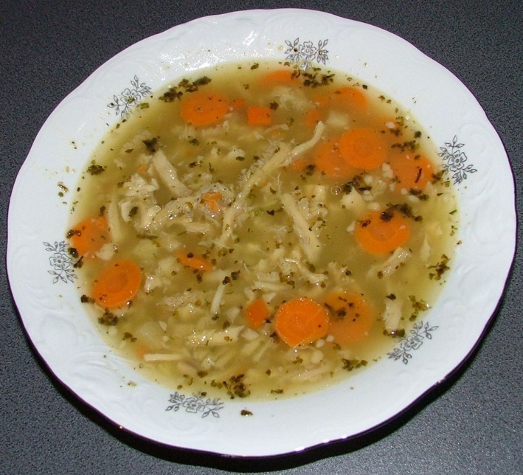
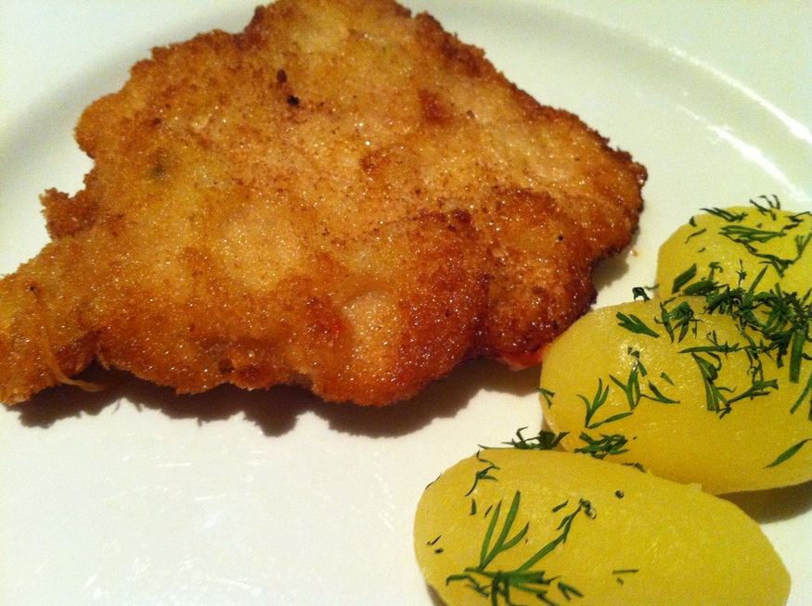
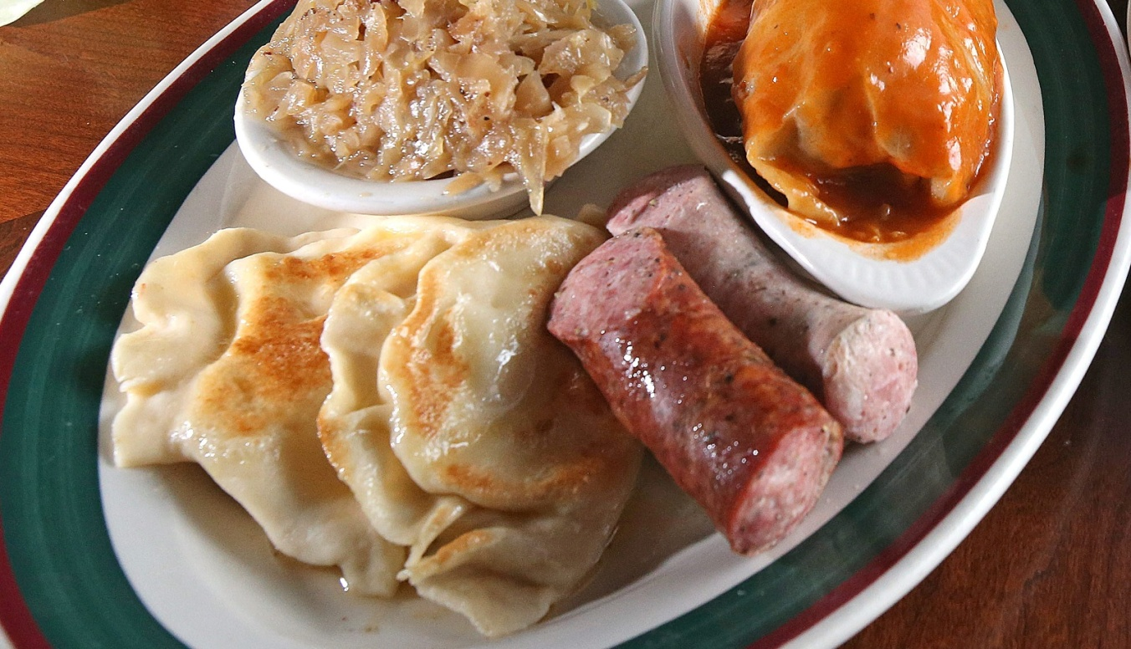
Polish food
Pierogi (Polish dumplings)
Rosół (broth/ chicken soup)
Gołąbki (cabbage roll)
Bigos (Hunter’s stew)
Śledź w oleju z cebulą (herring in oil with onion)
Kotlet schabowy (breaded pork cutlet)

Slide 8
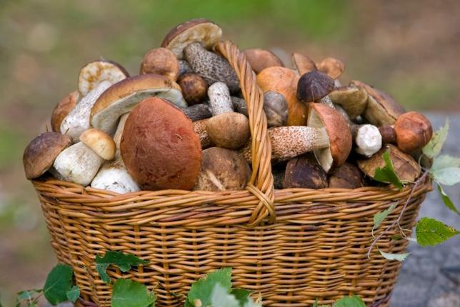
Mushrooming Is a Popular Family Activity
Going to the forest to pick wild mushrooms at the end of the summer is a popular activity for many people in Poland. Kids are taught how to distinguish an edible mushroom from a poisonous one early on.

Slide 9
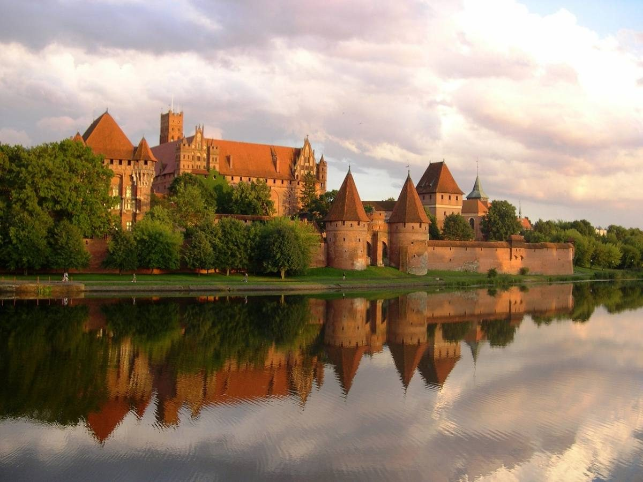
World’s Biggest Castle
Poland has an impressive 16 World Heritage Sites and among them the biggest castle in the world – Malbork. Measured by the area. Prague Castle often claims to be world’s largest, but it’s not since it’s not a single area.

Slide 10
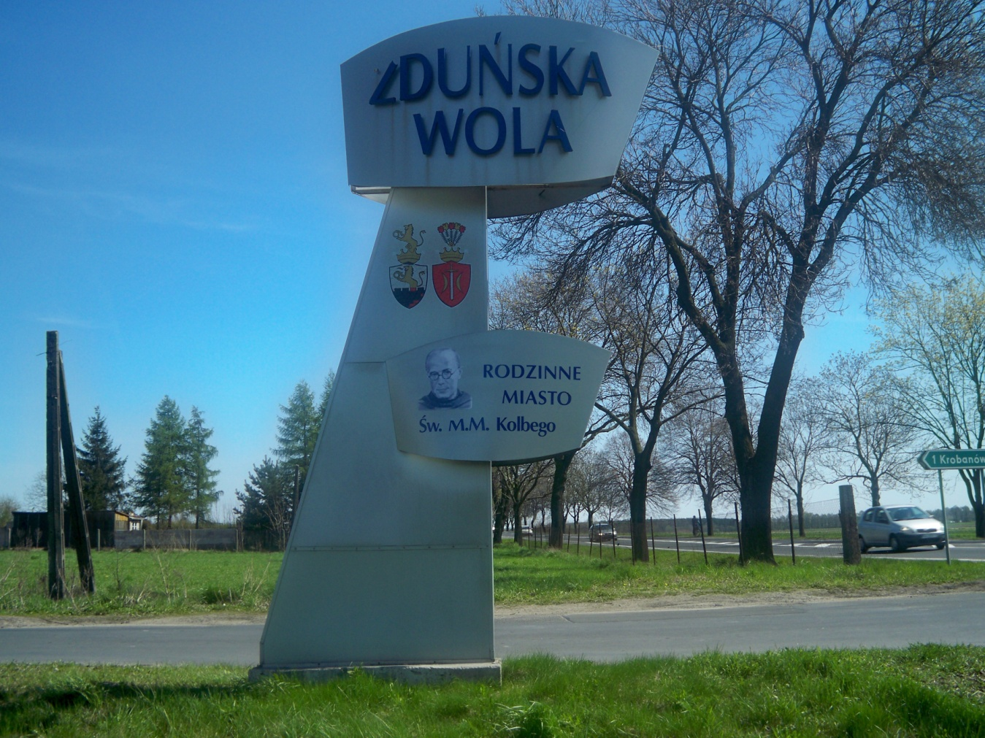
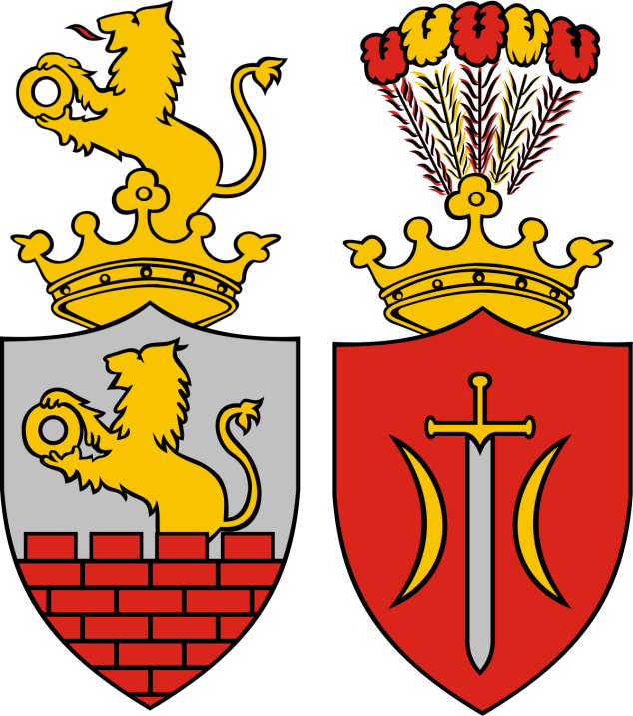
Zduńska Wola
Zduńska Wola is a town in central Poland with 42,698 inhabitants (2016). Situated in the Łódź Province (since 1999), previously in Sieradz Province (1975–1998). It is the seat of Zduńska Wola County. The town was once one of the largest cloth, linen and cotton weaving centres in Poland and is the birthplace of Saint Maximilian Kolbe and Maksymilian Faktorowicz, the founder of Max Factor cosmetics company.

Slide 11
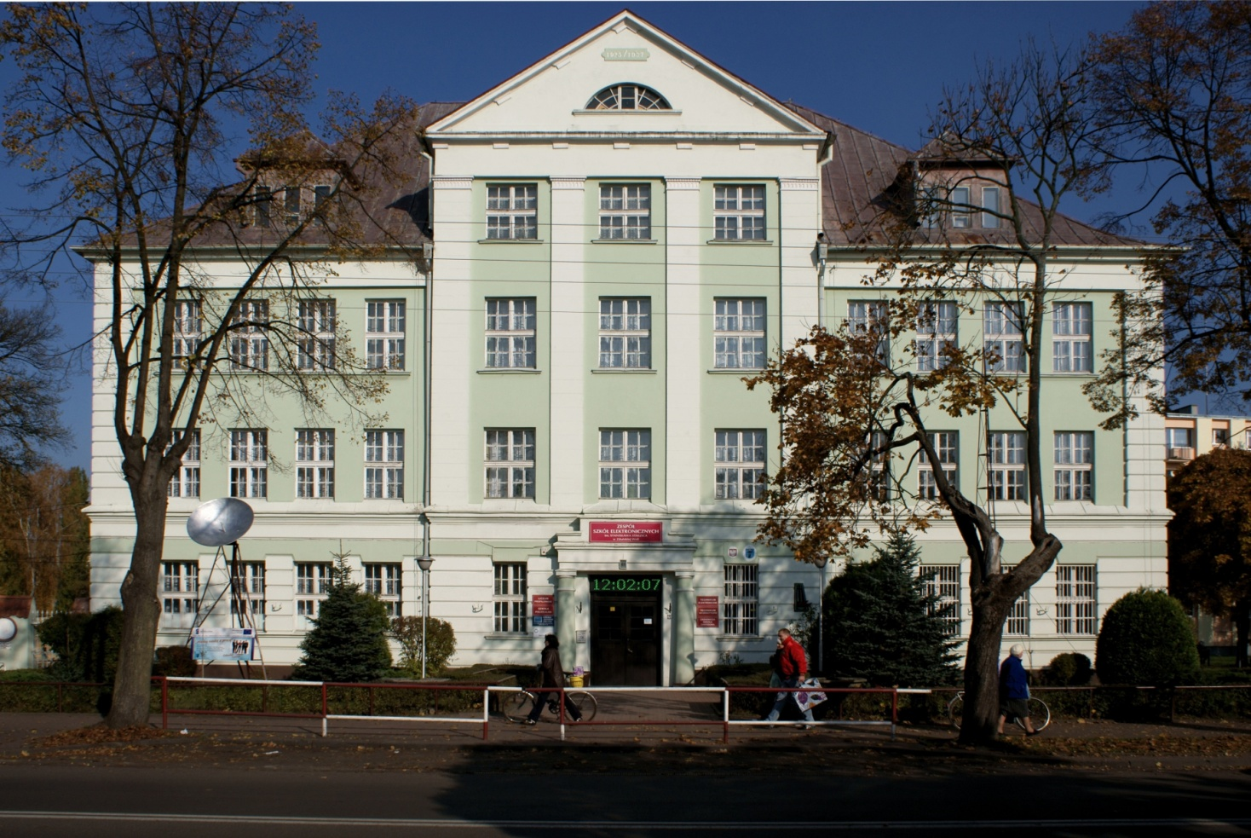
Our School - Zespół Szkół Elektronicznych im. Stanisława Staszica
As a secondary school student I spend about 8 hours a day at school. In comparison with other activities - it is quite a lot. I learn there, broaden my horizons, meet new people, make friends and have fun. This place forms my personality and influences my outlook on life.

Slide 12
THE END
Krzysztof Trzcianowski

