Slide 1
HEALTHY LIFE
TURKEY - KONYA YONTEM COLLEGE
PREPARED BY: IŞILAY KURT

Slide 2
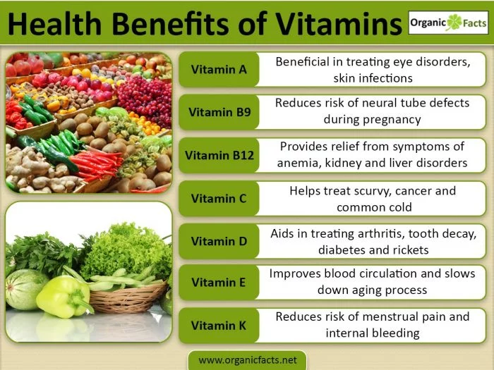
VITAMINS
Vitamins be in foods and drinks. These are their job, carry on our l lives and to be protected from diseases.
They have got assortment.
They heve got a lot of benefits.

Slide 3
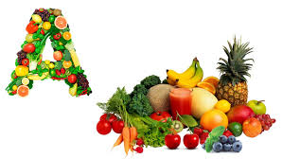
VITAMIN A
Vitamin A protects our eyes. Also it affects our tooth and gum health positively, it strengthens our immune system.
If we don`t take vitamin A, that reasons to night blindness.
Vitamin A becomes in carrot, milk, patato…

Slide 4
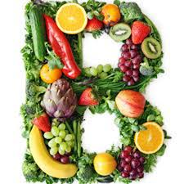
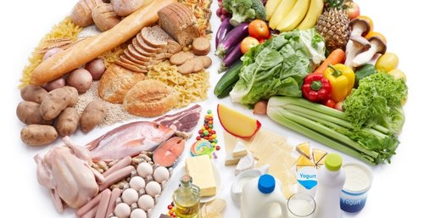
VITAMIN B
Vitamin B keeps healthy skin tissue. Also it strengthens the memory and it provides recovery of learning disorders.
In default of vitamin B, we slog on walking, leads to depression.
Vitamin B becomes in fish, meat, milk, egg…

Slide 5
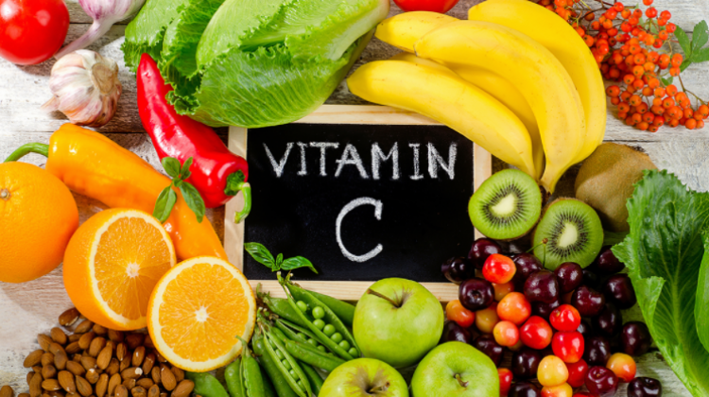
VITAMIN C
Vitamin C protects us from hardening of the arteries, cataract formation.
In default of vitamin C, we can be caught imperial disease.
Vitamin C is in tangerine, lemon, orange, broccoli…

Slide 6
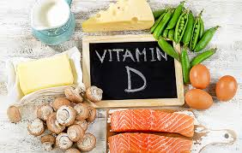
VITAMIN D
Vitamin D, improves our muscles and bones, protects us from diabetes.
In default of vitamin D, the bones be weak.
Vitamin D is in milk, yoghurt, cheese, fish, mushroom…

Slide 7
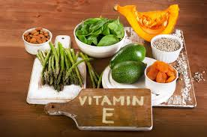
VITAMIN E
Vitamin E; grows hair, makes soft the dry skin, heals the skin inflammation.
In default of vitamin E, show ups nervous system, liver and kidney problems.
Vitamin E is in sunflower, almonds, hazelnuts…

Slide 8
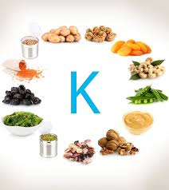
VITAMIN K
Vitamin K, ensures that the blood clotting and strengthens bones.
In default of vitamin K, leads to osteoporosis, cancer, excessive bleeding, heart diseases
Vitamin K is in oregano, basil, sage, lettuce…

Slide 9
BE CAREFUL TO
REGULAR DIET
DRINK A LOT WATER
EAT MEAT AND VEGETABLES
DO EXERCISE
SLEEP ENOUGH
USE HYGIENIC THINGS

Slide 10
THANKS FOR WATCHING IŞILAY KURT

