Slide 1
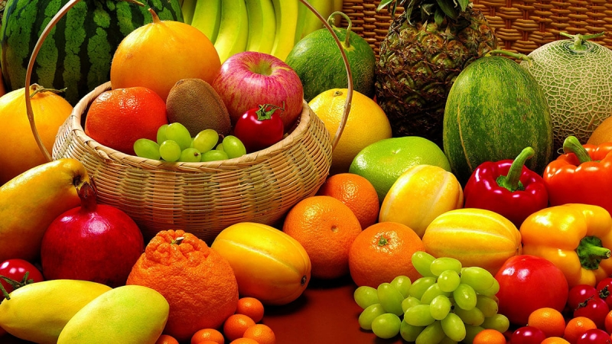
HEALTHY EATING

Slide 2
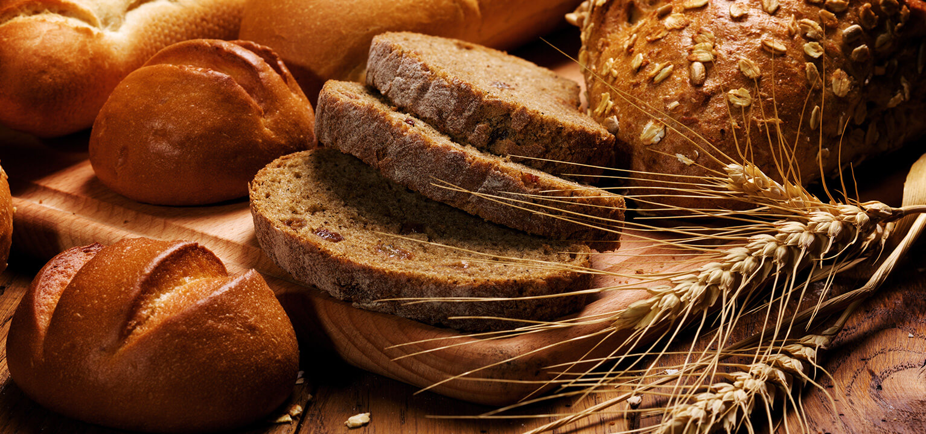
Adequate and Balanced (Healthy Nutrition) What is Nutrition?
The growth of the body is the adequate intake of the nutrients required for tissue renewal and operation, and the proper use of it in the body.

Slide 3
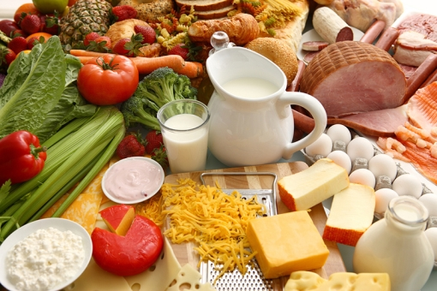
HOW CAN WE BE HEALTHY
Eat fresh vegetables and fruits for our reasons.
Eat full grain cereal products.
Prefer fibrous foods.
Choose healthy oils.
Consume less sugar.
Use less salt
Choose safe foods

Slide 4
LETS REFERENCE TO WHAT WE SHOULD EAT AND THEY BENEFIT FOR OUR HEALTHY

Slide 5
ORANGE : Strengthens the immune system.

Slide 6
POMEGRANATE: It contains more vitamin C and potassium than all fruits.

Slide 7
GRAPEFRUIT: Cleans the skin and balances digestion

Slide 8
AVOCADO: Reduce heart disease risk

Slide 9
SALMON FISCH: Reduce skin cancer risk

Slide 10
CİNNAMON: Brain and intestinal health is beneficial.

Slide 11
WALNUT: It is beneficial to heart health.

Slide 12
HONEYCOMB: Develop your cells and protect your eyes.

Slide 13
BLACK CABBAGE: useful for skin, eyes and teeth.

Slide 14
BY NEHİR KILIÇ

