Slide 1
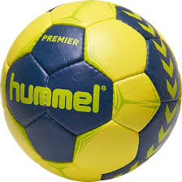
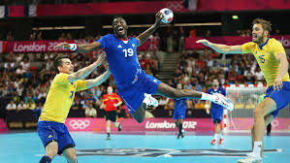
Handball

Slide 2
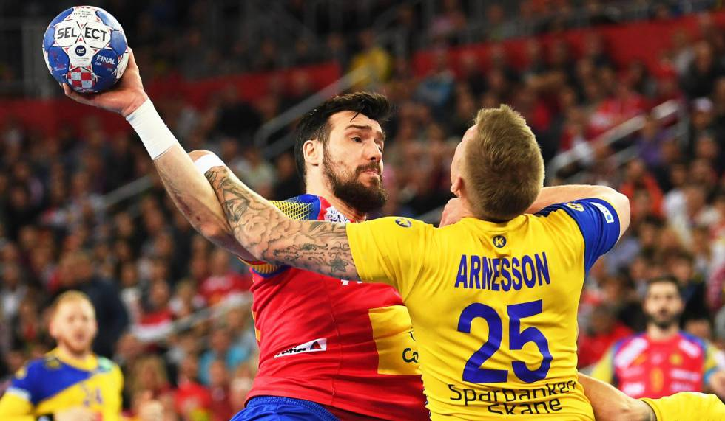
What’s that?
Handball is a team sport in which two teams of seven players each (six outfield players and a goalkeeper) pass a ball using their hands with the aim of throwing it into the goal of the other team. A standard match consists of two periods of 30 minutes, and the team that scores more goals wins.

Slide 3
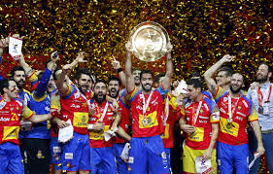
Handball in spain
The Spain national handball team is governed by the Royal Spanish Handball Federation. Spain is one of the most successful handball teams in the world, having won two World Championships and being the reigning European Champions.

Slide 4
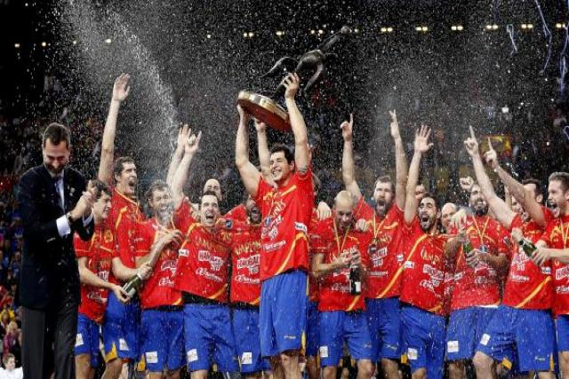
HANDBALL CURIOSITIES
Spain has been the only team capable of scoring 40 goals in a final. They were made to Croatia (which scored 34) in Tunis 2005
Only three times in history has the World Cup been held outside of Europe:Japan 1997 Egypt 1999 and Tunis 2005(the one won by Spain)

Slide 5
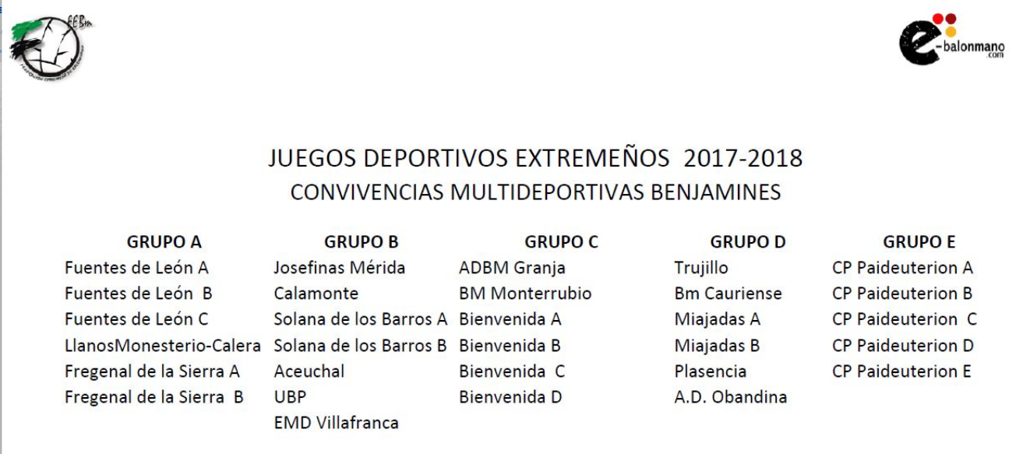
HANDBALL IN EXTREMADURA
In Extremadura we have a federation.
It has at least 13 villages for example Villafranca, Bienvenida, Fuente de Cantos, Plasencia…

