Slide 1
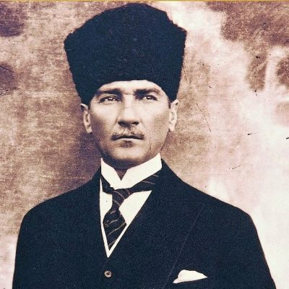
ATATURK MUSEUM
İZMİR

Slide 2
ATATURK MUSEUM
The building is in Izmir, I. Kordon (Atatürk Boulevard) built in between 1875-1880 by a carpet merchant, Takfor, as a resident. It was nationalized after being abandoned by its owner on 9 September 1922. After entering Izmir, the Turkish Army used the building as its headquarters. During Izmir Economy Congress Meeting, which started on 17 February 1923, Atatürk carried out his private studies in this building. After the Congress, headquarters were moved from this building and the Treasury leased it to Naim Bey to be used as a hotel. During their visit to Izmir on 16 June 1926, Atatürk and Ismet Pasha stayed in this hotel named as Naim Palas.

Slide 3
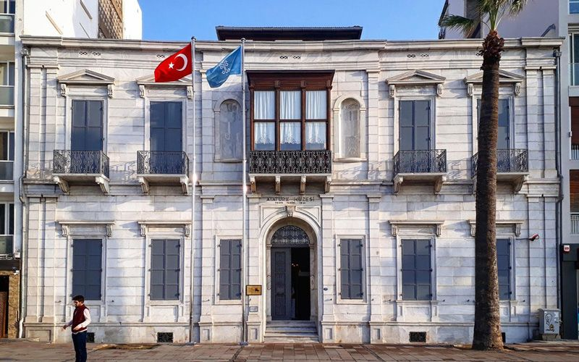

Slide 4
On 13 October 1926 Izmir Municipality purchased the building and after refurbishing it presented to Atatürk as a gift. During his visits to Izmir between 1930 and 1934, Atatürk always stayed in this residence. After Atatürk’s death on 10 November 1938, the building was inherited by his sister Makbule Baysan. On 25 September 1940 Izmir Municipality expropriated the building in order to convert it to a museum. On 11 September 1941, on the 19th Anniversary of Atatürk’s arrival in Izmir, the museum was opened to public with an official ceremony. After 5 October 1962, the museum has been named “Atatürk Provincial Public Library and City of Izmir Atatürk Museum”.

Slide 5
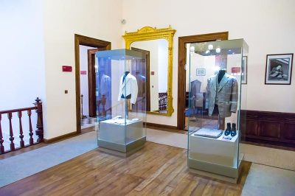

Slide 6
The proprietorship of the building transferred to Izmir Archeological Museum. After restorations and refurbishment, it was reopened on 29 October 1978 as “Atatürk and Ethnographical Museum”. On 13 May 1988, the ethnographical items that were in display in the building were moved to the new Ethnographical Museum. After that it was renamed as “Atatürk Museum”.

Slide 7
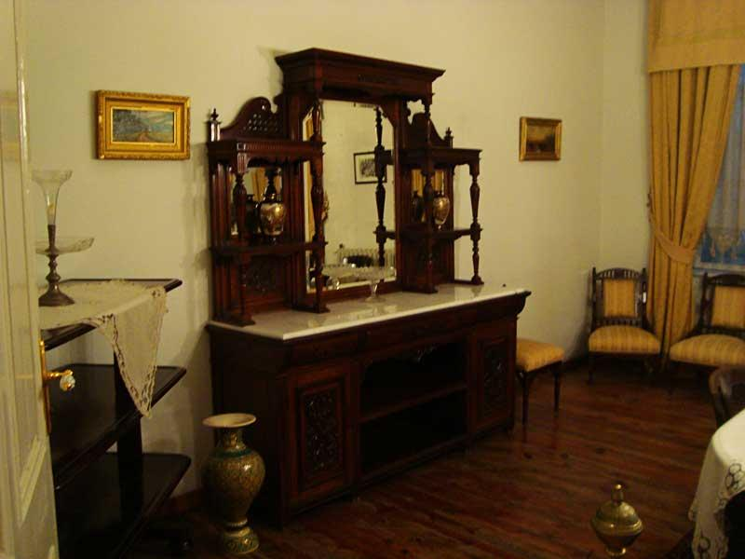

Slide 8
The building is a neoclassic style, a mixture of Ottoman and Levantine architectures. A four-storey masonry building, including the basement floor and the attic, has a rectangular plan and covers 852 square metres. It has a courtyard and a porch at the rear, and bay windows on the first floor at the front. The ground floor is paved by large marble tiles and the hall is covered by a 34.5 square metres carpet from Usak. In the left and right niches there are marble statues, a large crystal mirror and, an Atatürk bust. In the rooms at both sides and in the small living room beautiful XIX. Century style fireplaces are quite eye-catching. Two bronze knight figurine appliques are on the wall at the head of the staircase leading to the upper floor. A big size Atatürk portrait is hanged in the stair hall.

Slide 9
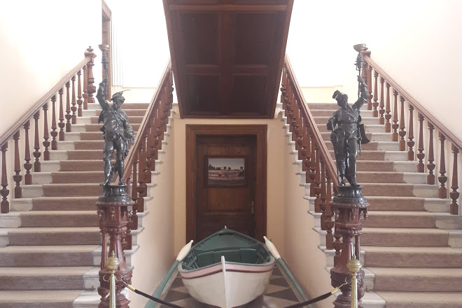

Slide 10
The first floor was for Atatürk’s private use; meeting room, study room, bedroom, guest room, barber's room, guard's room, waiting and reception room, library, dining room and the bathroom. In the meeting room, a roulette table with green broadcloth and 12 Cosmos brand chairs around it, are placed in the middle. Ten small mahogany chairs all along the walls have china plates at their backs with scenes from Shakespear’s works depicted on them. A mahogany bedstead, two commodes, two velvet armchairs, one couch, one chaise longue, one marquisette and three wardrobes are in the bedroom. The bedroom is furnished with the fashion of its time. There is a French encyclopaedia in the library. An oak veneered study table, with Atatürk’s writing set on it, is in the study room. All the rooms are decorated with twisted bronze statues, vases and oil paintings. The floors are covered with precious carpets from Isparta and Usak provinces.

Slide 11
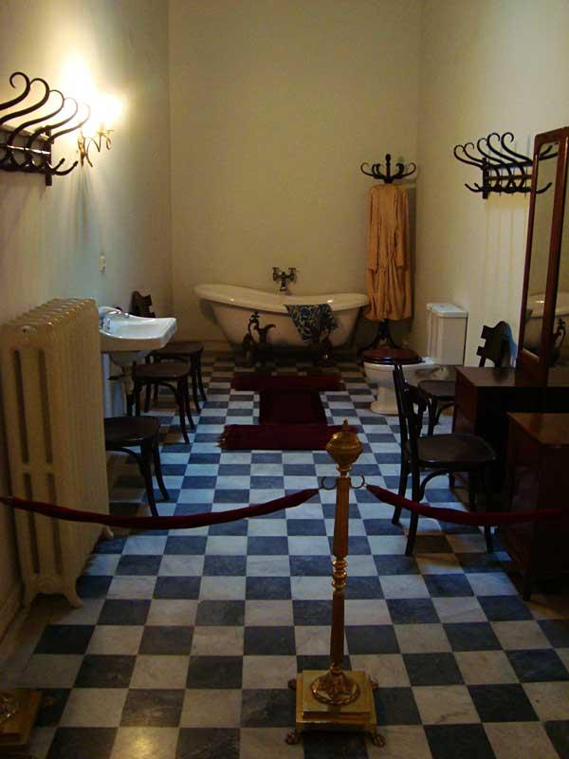

Slide 12
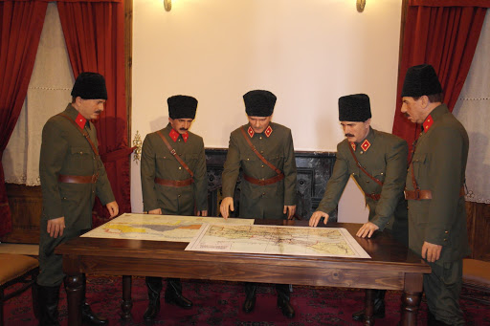

Slide 13
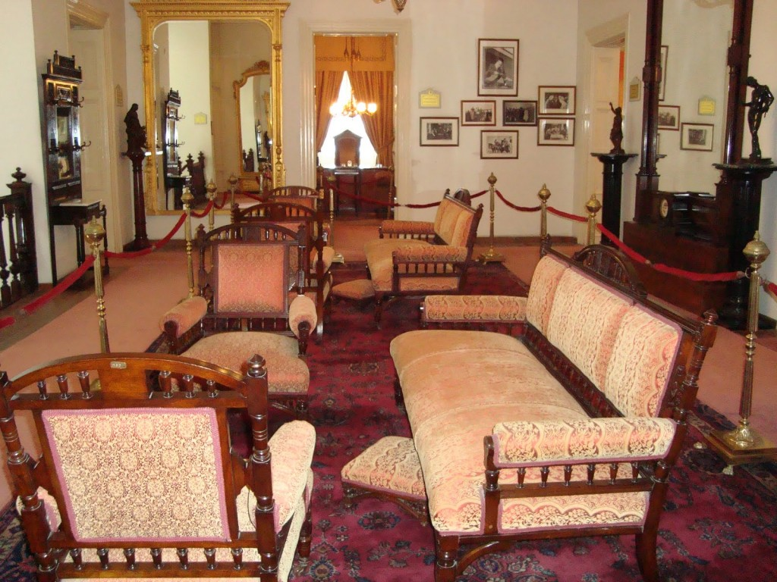

Slide 14
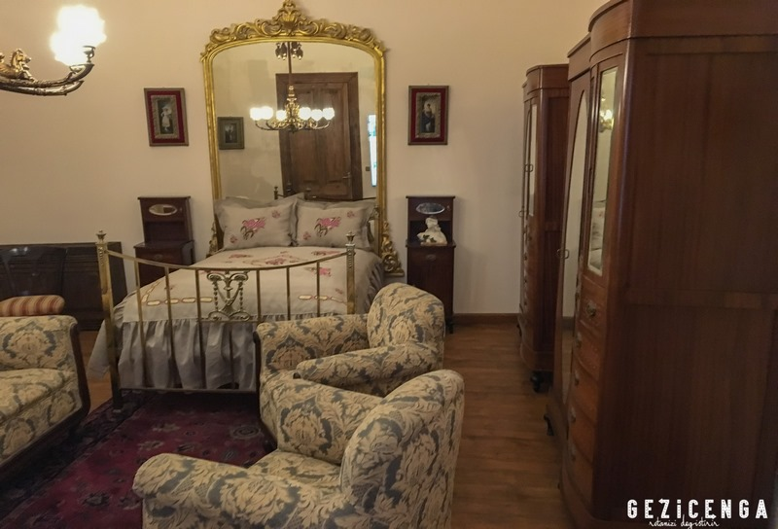

Slide 15
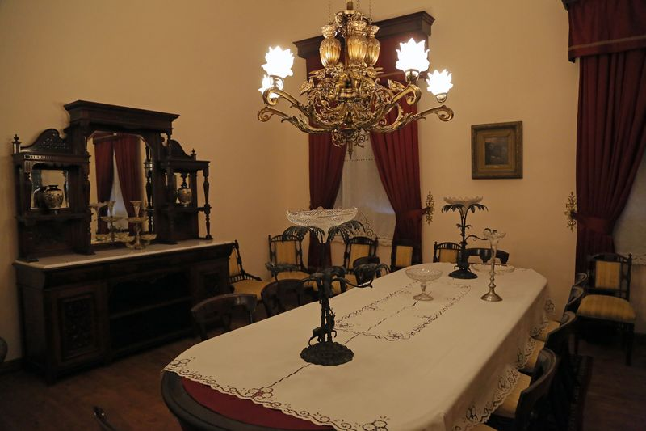

Slide 16
