Slide 1
Archaeology Museum
BURSA

Slide 2
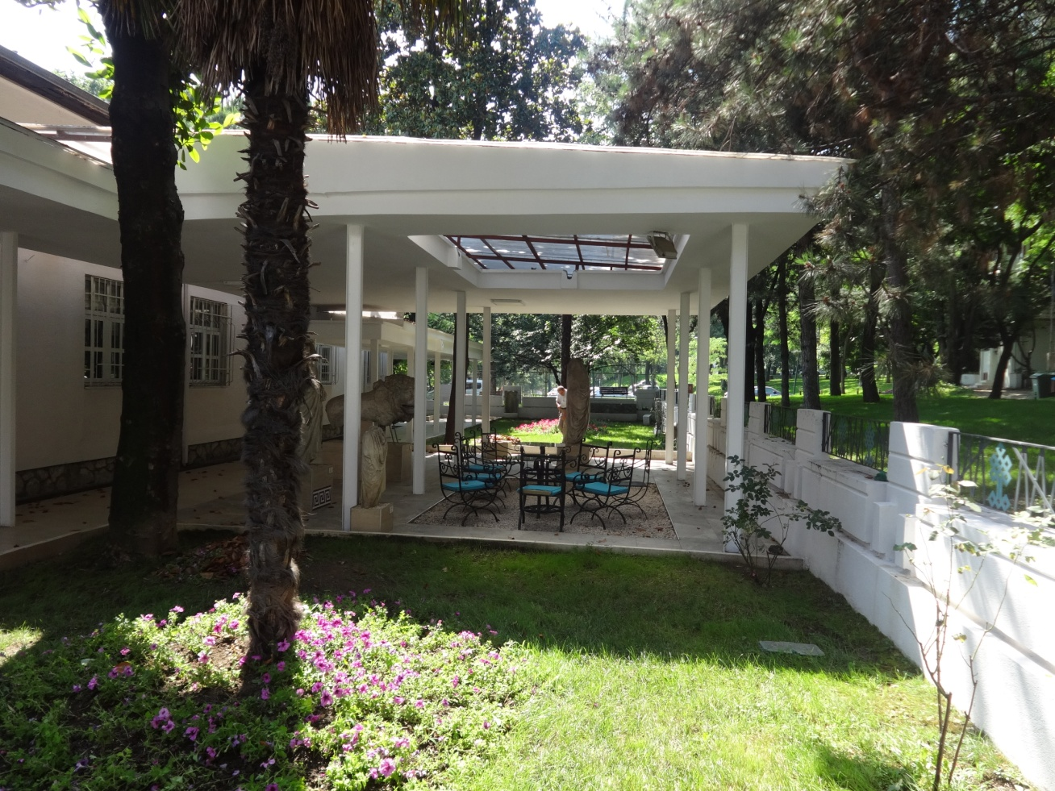
Located on the south side of Kültür Park.

Slide 5
This museum focuses on preserving local artifacts from 3000 BC to the end of the Byzantine era.

Slide 9
Museum houses art, coins, ceramics, metals, coins, and stone works

Slide 15
This museum's small collection ranges from beautiful Roman pottery and figurines to stone tools and artefacts dating back to the Paleolithic era.

