Slide 1
THE KIEVAN RUS PARK

Slide 2
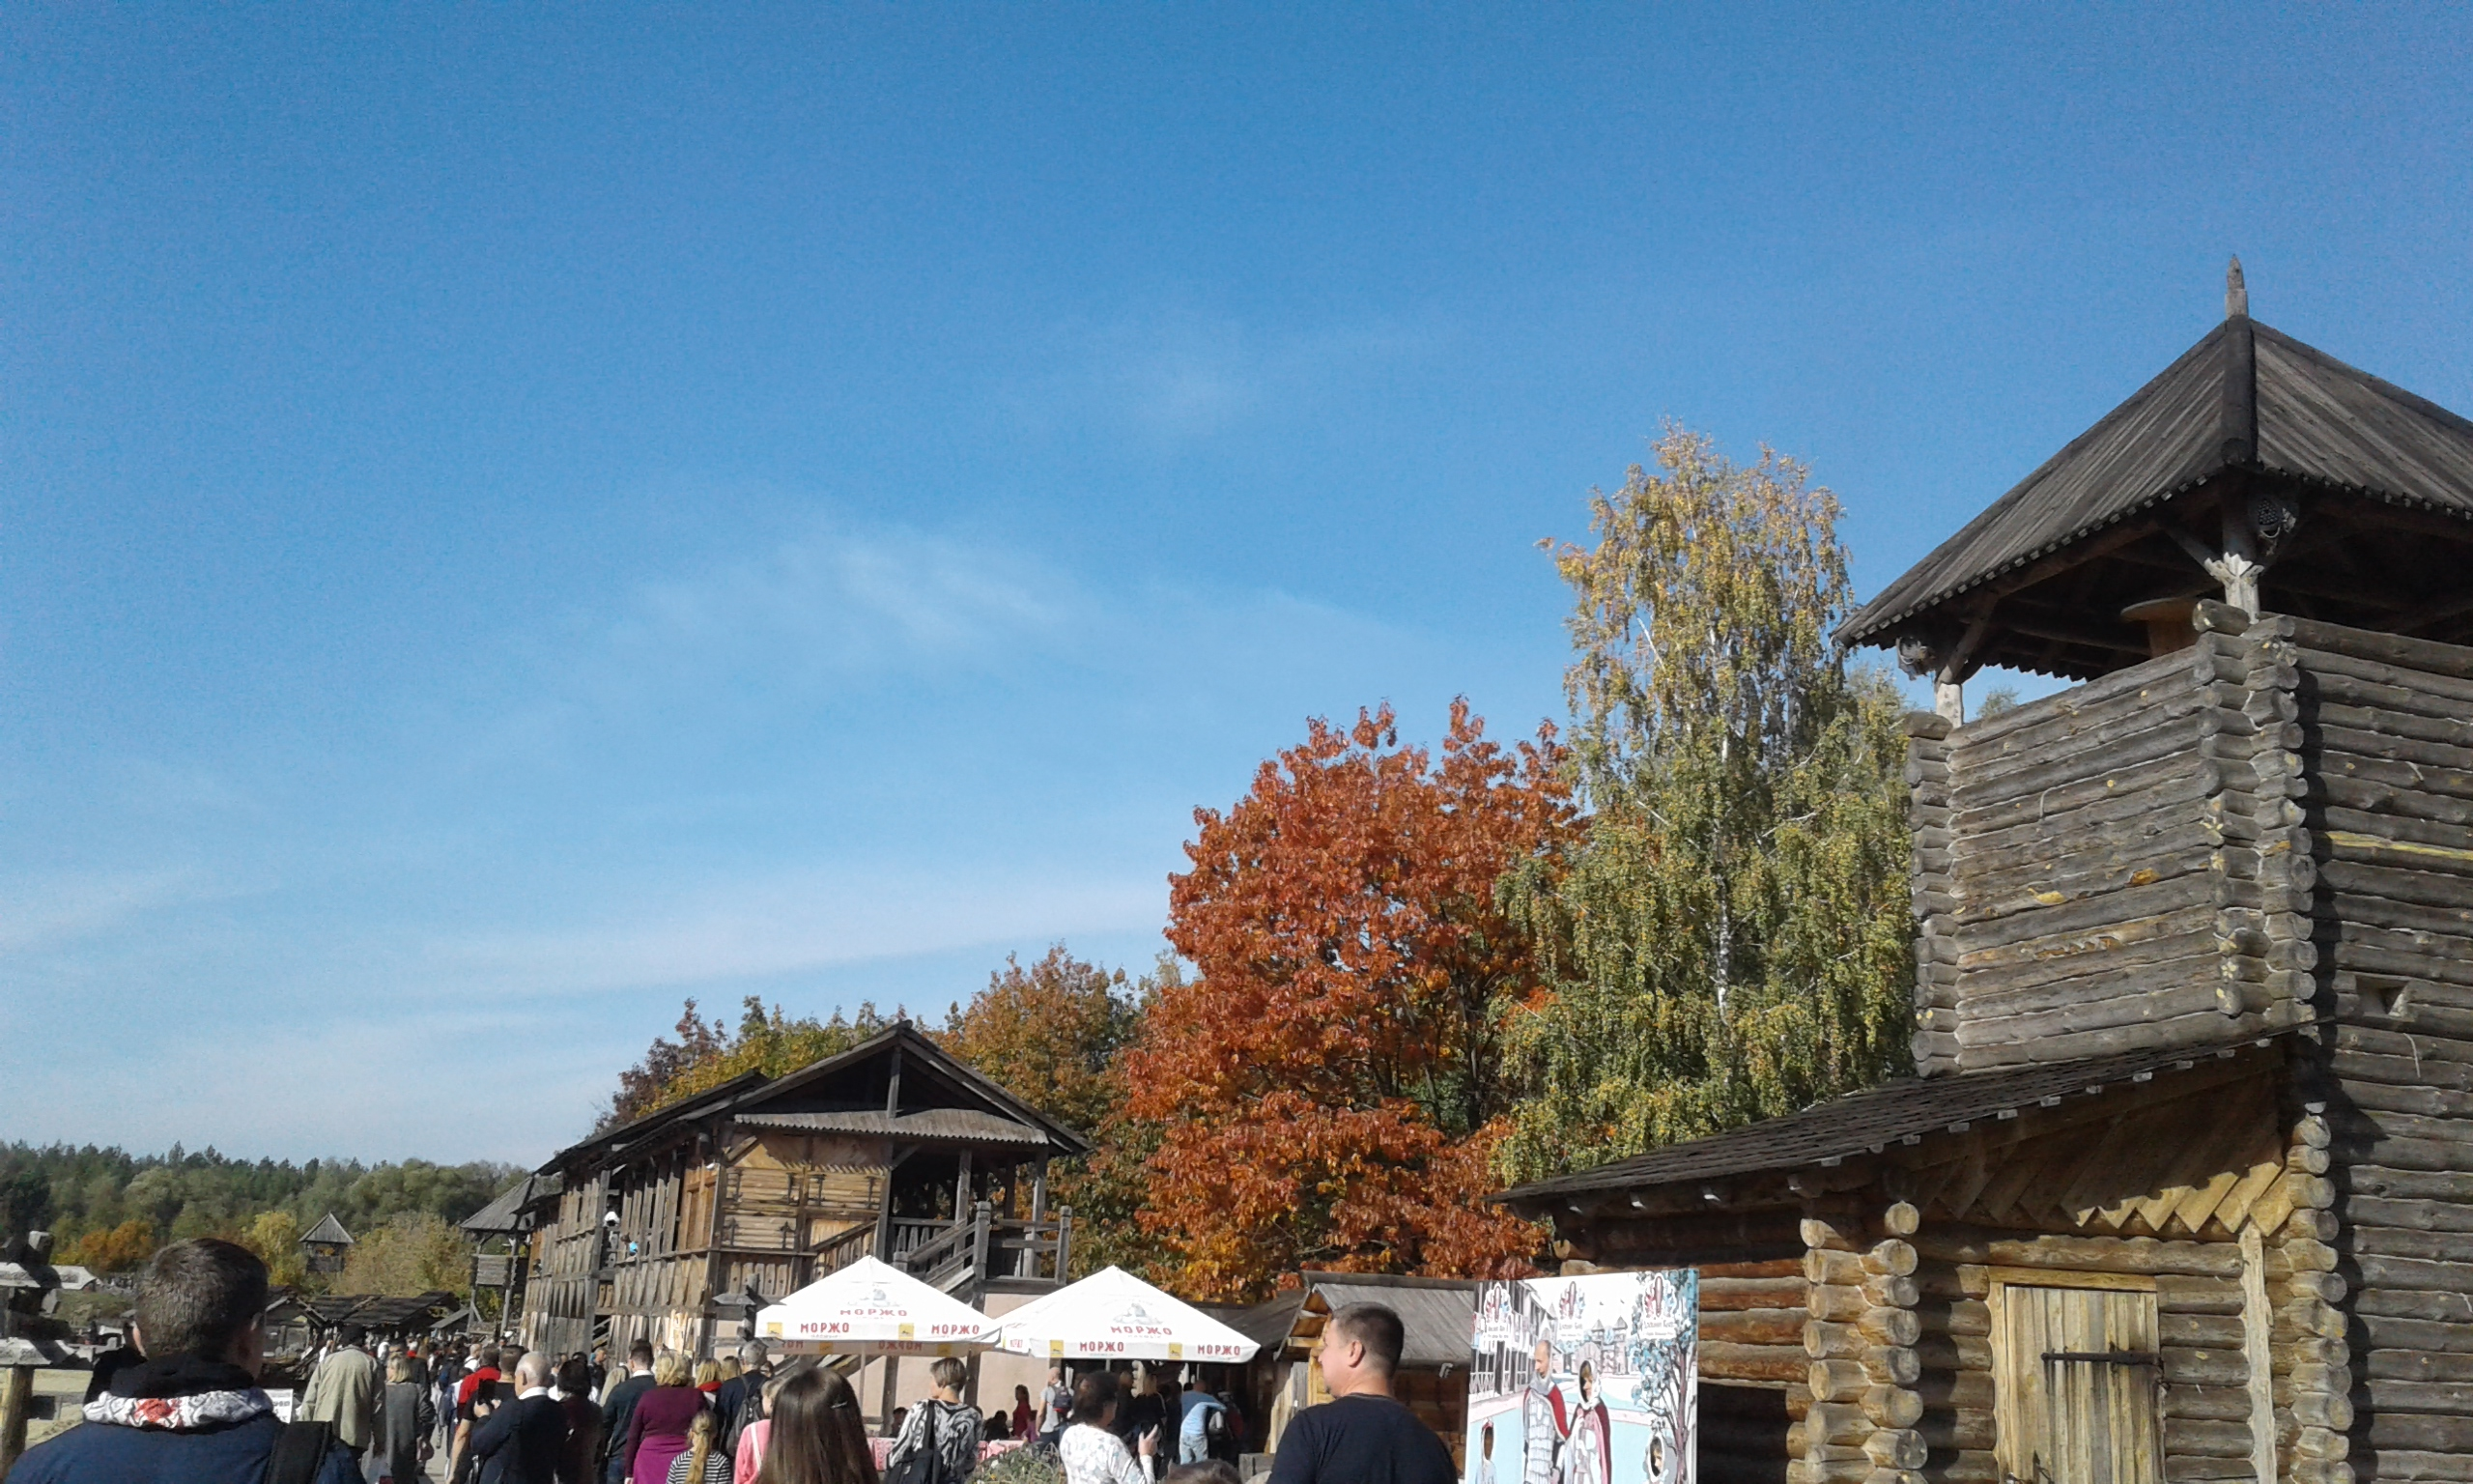
"The Kievan Rus Park" is a unique reconstruction of one of the most famous and at the same time the most mysterious medieval city of the Eastern Europe – Ancient Kiev of the V-XIII centuries, the capital of the greatest country - Kievan Rus. It is being reconstructed in the size of its historical center known as Detinets of Kiev or the city of Vladimir in its real scale 1:1, taking into consideration the modern scientific knowledge.
"The Kievan Rus Park" is a unique reconstruction of one of the most famous and at the same time the most mysterious medieval city of the Eastern Europe – Ancient Kiev of the V-XIII centuries, the capital of the greatest country - Kievan Rus. It is being reconstructed in the size of its historical center known as Detinets of Kiev or the city of Vladimir in its real scale 1:1, taking into consideration the modern scientific knowledge.

Slide 3
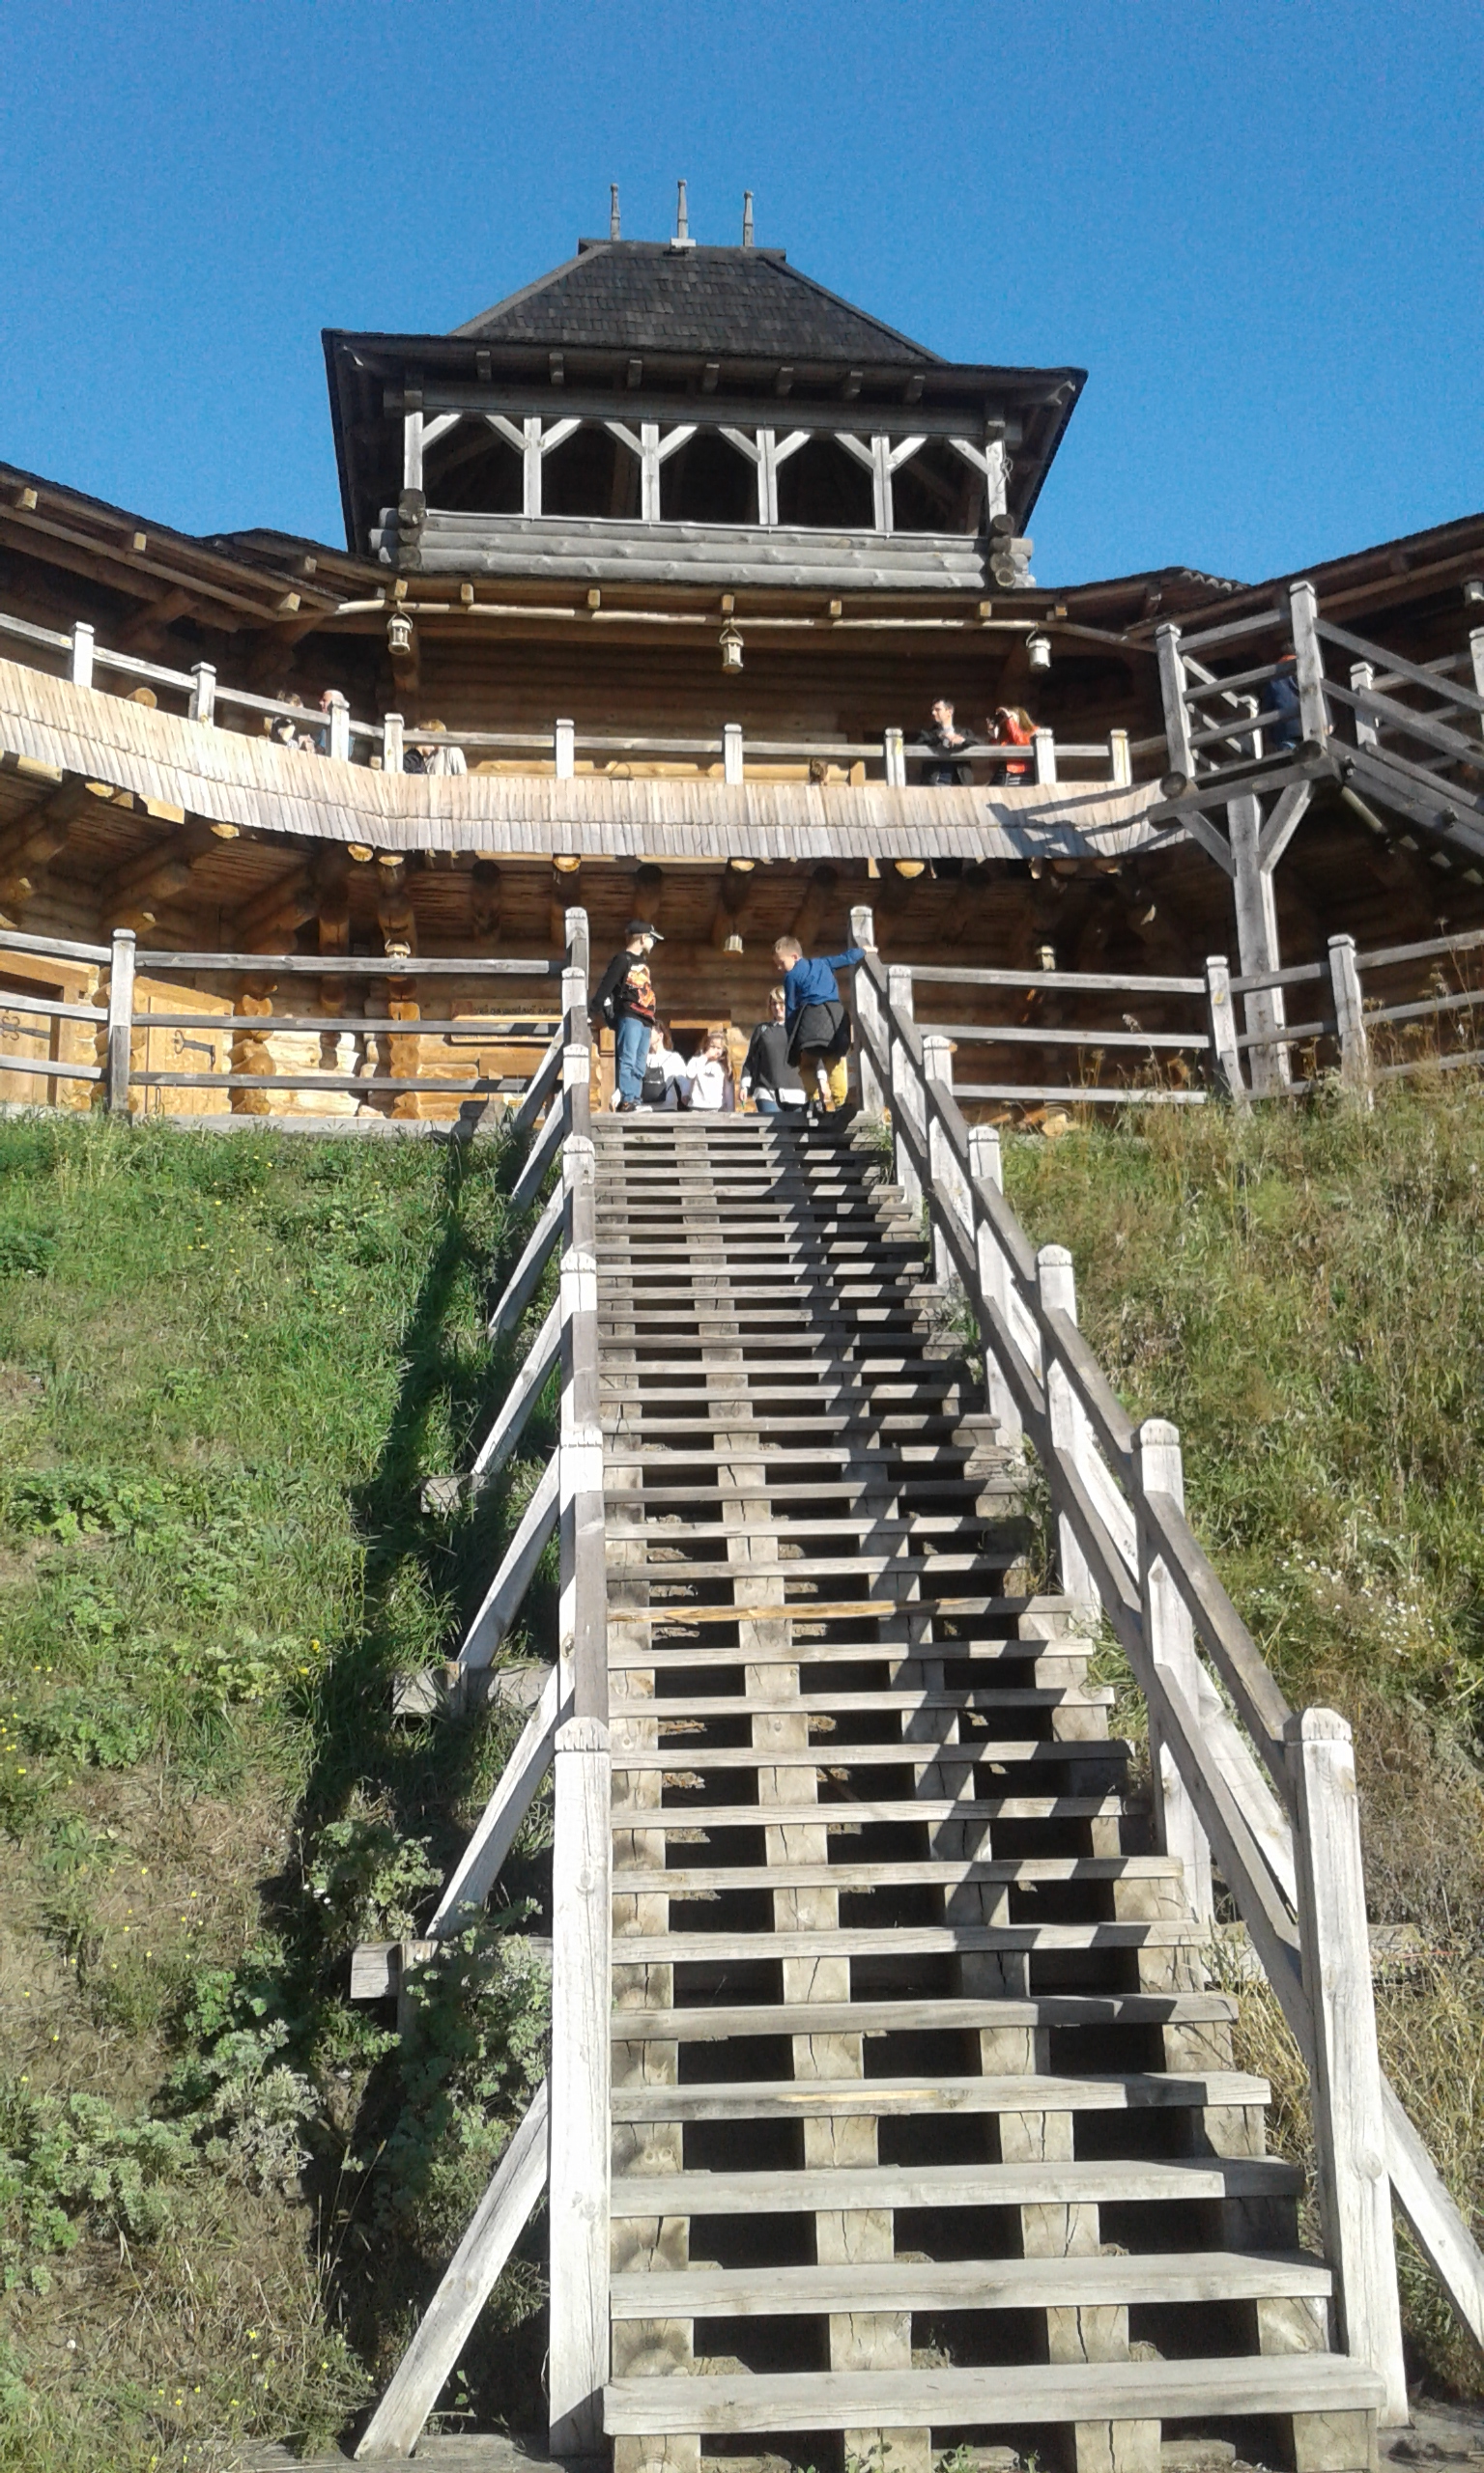
"The Kievan Rus Park" team together with the leading experts in the field of history, architecture, ethnography and culture of various countries created the Master Plan of Detinets of Kiev of the V-XIII centuries on the basis of the scientific data approved by the National Academy of Science of Ukraine.

Slide 4
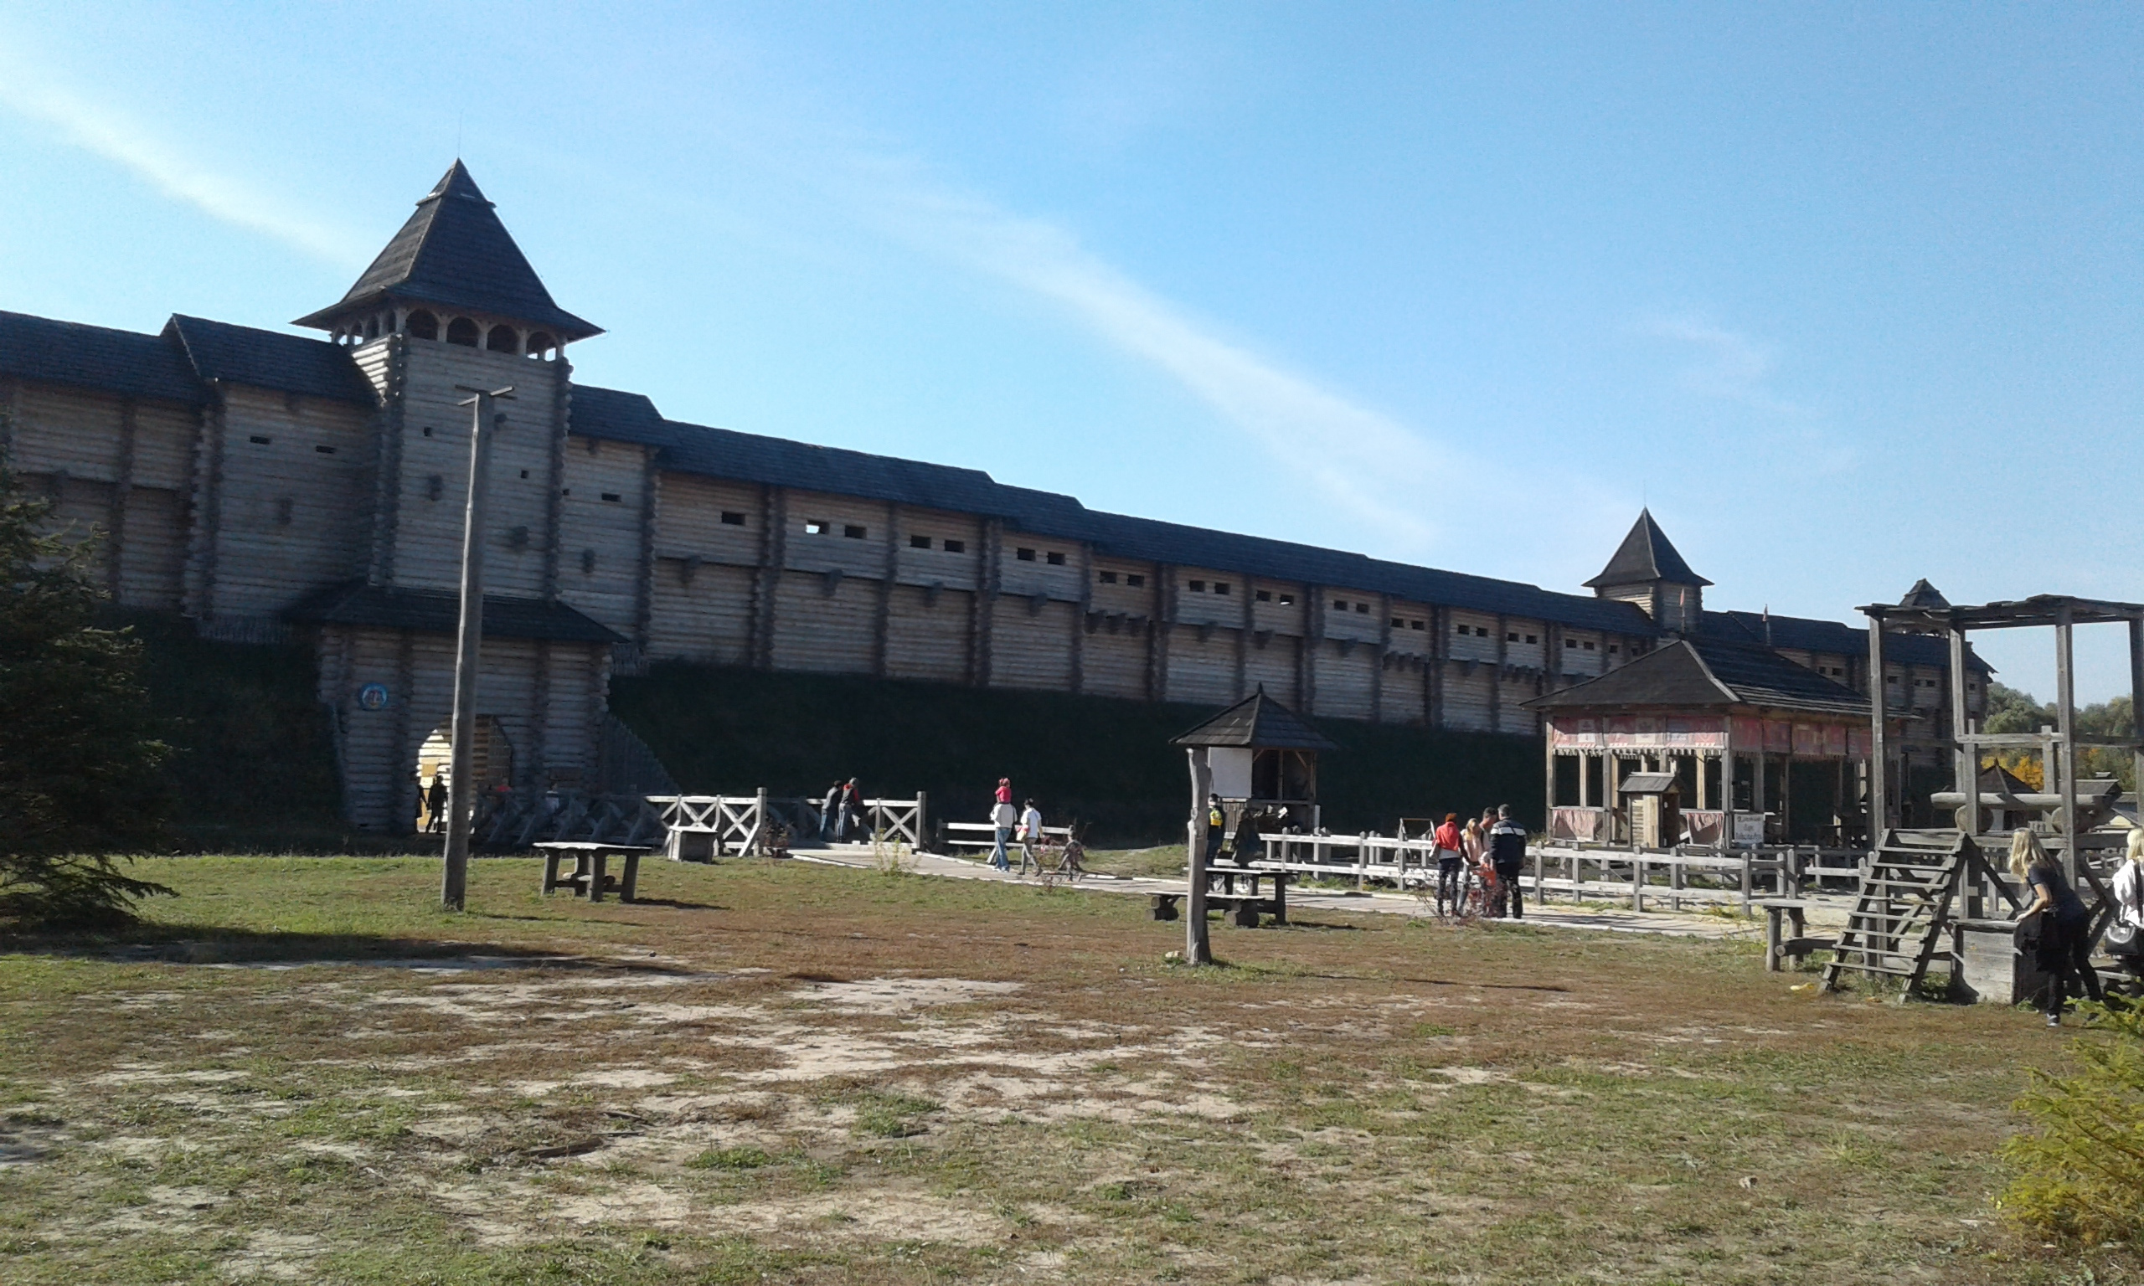
The project is being realized in the historically significant place, mentioned in the chronicles, and it most closely matches the landscape and flora of Ancient Kiev in the village Kopachiv (Obukhiv district, Kiev region).

Slide 5
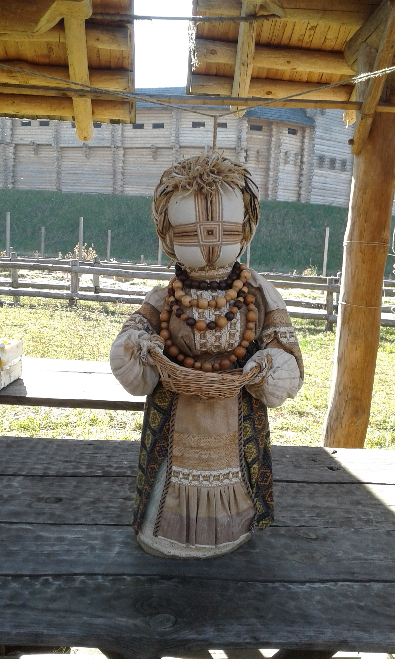
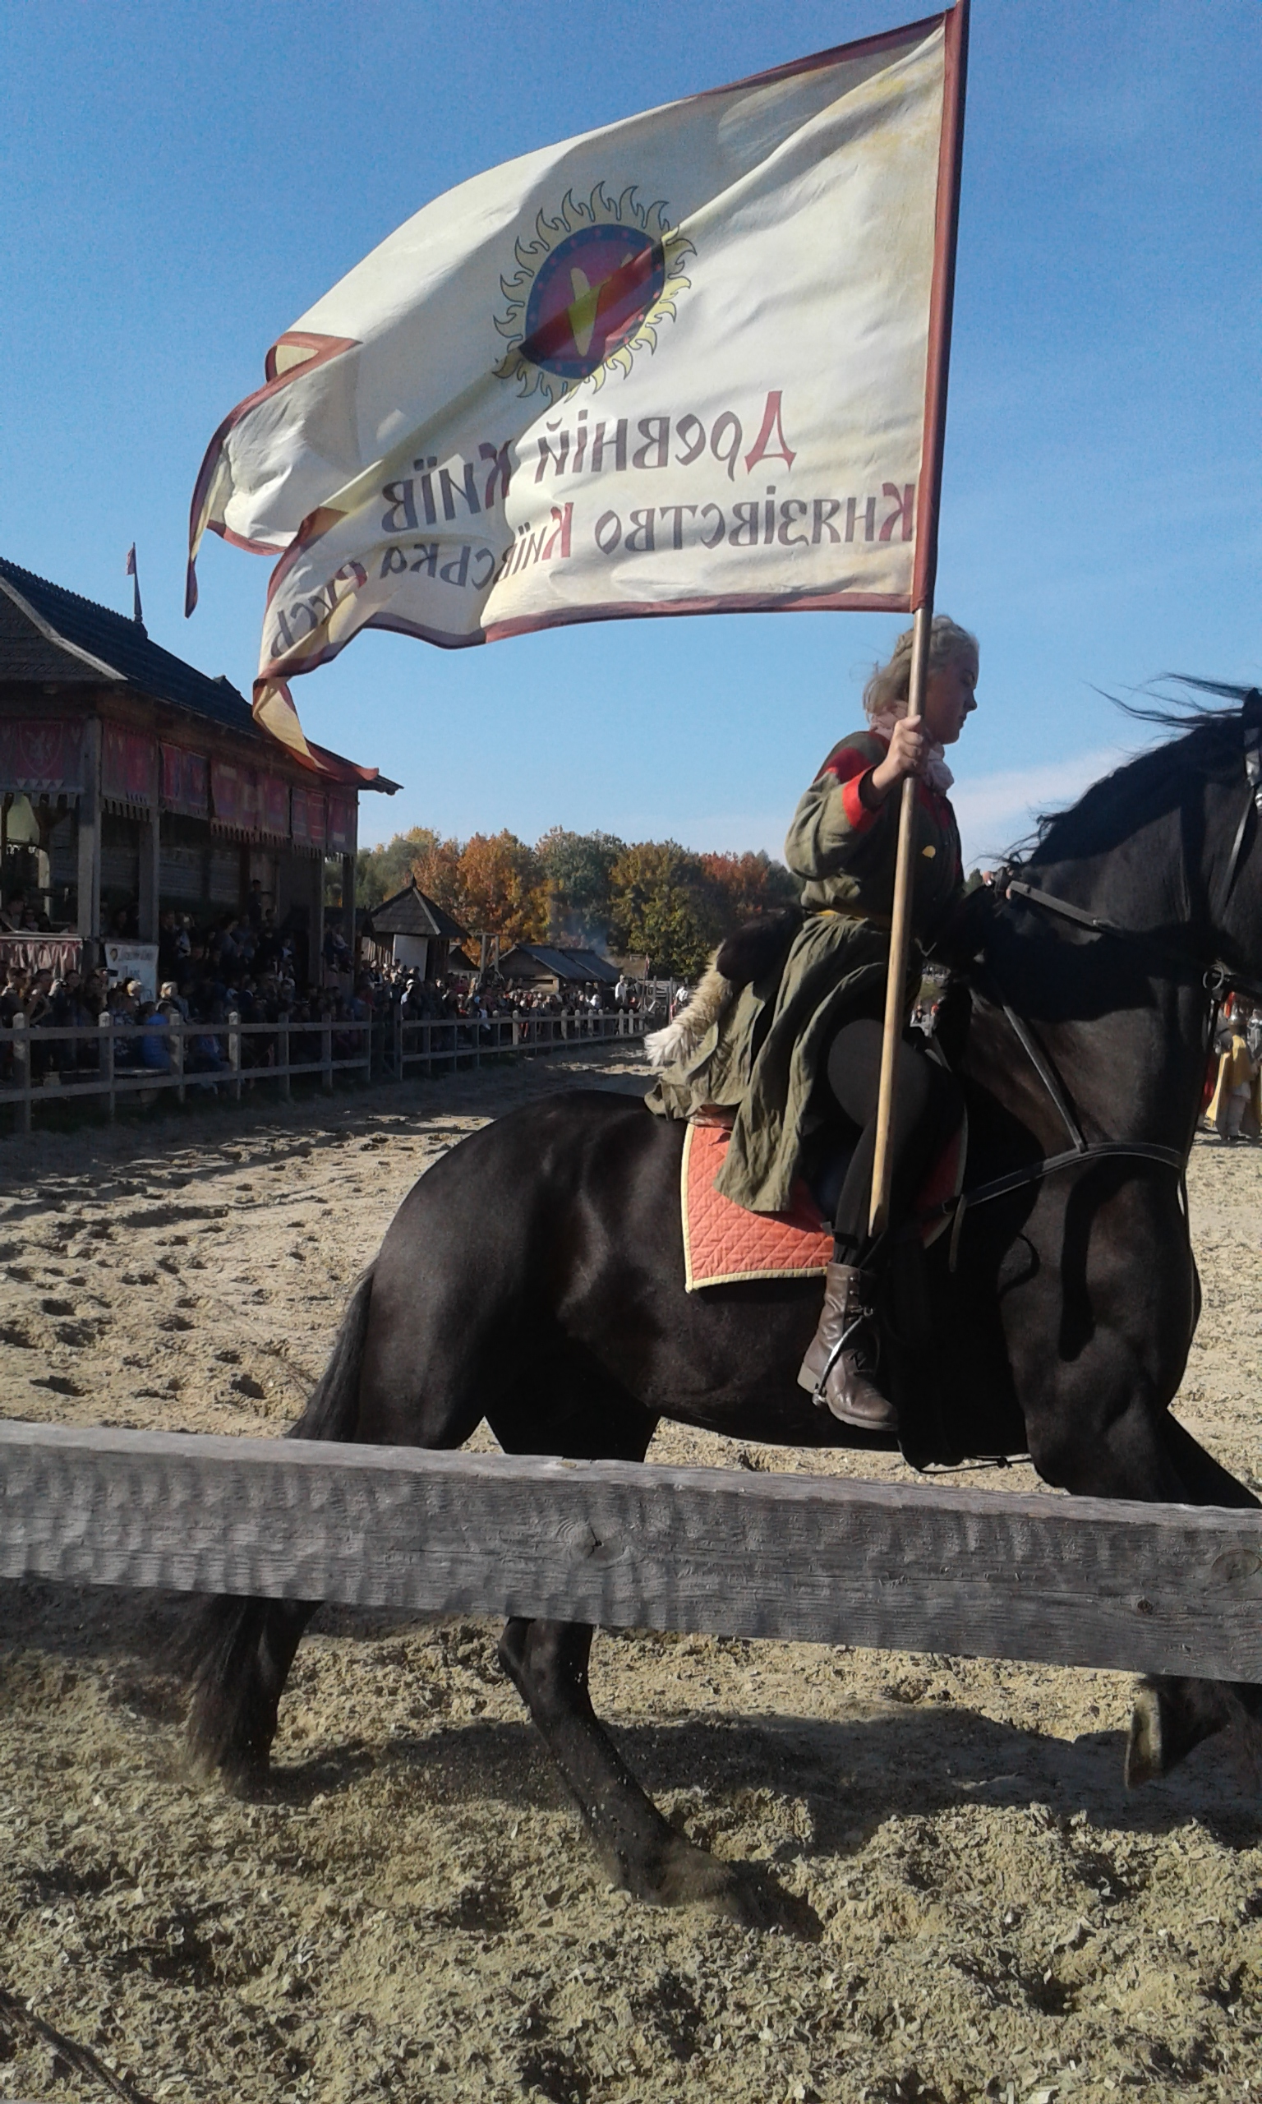
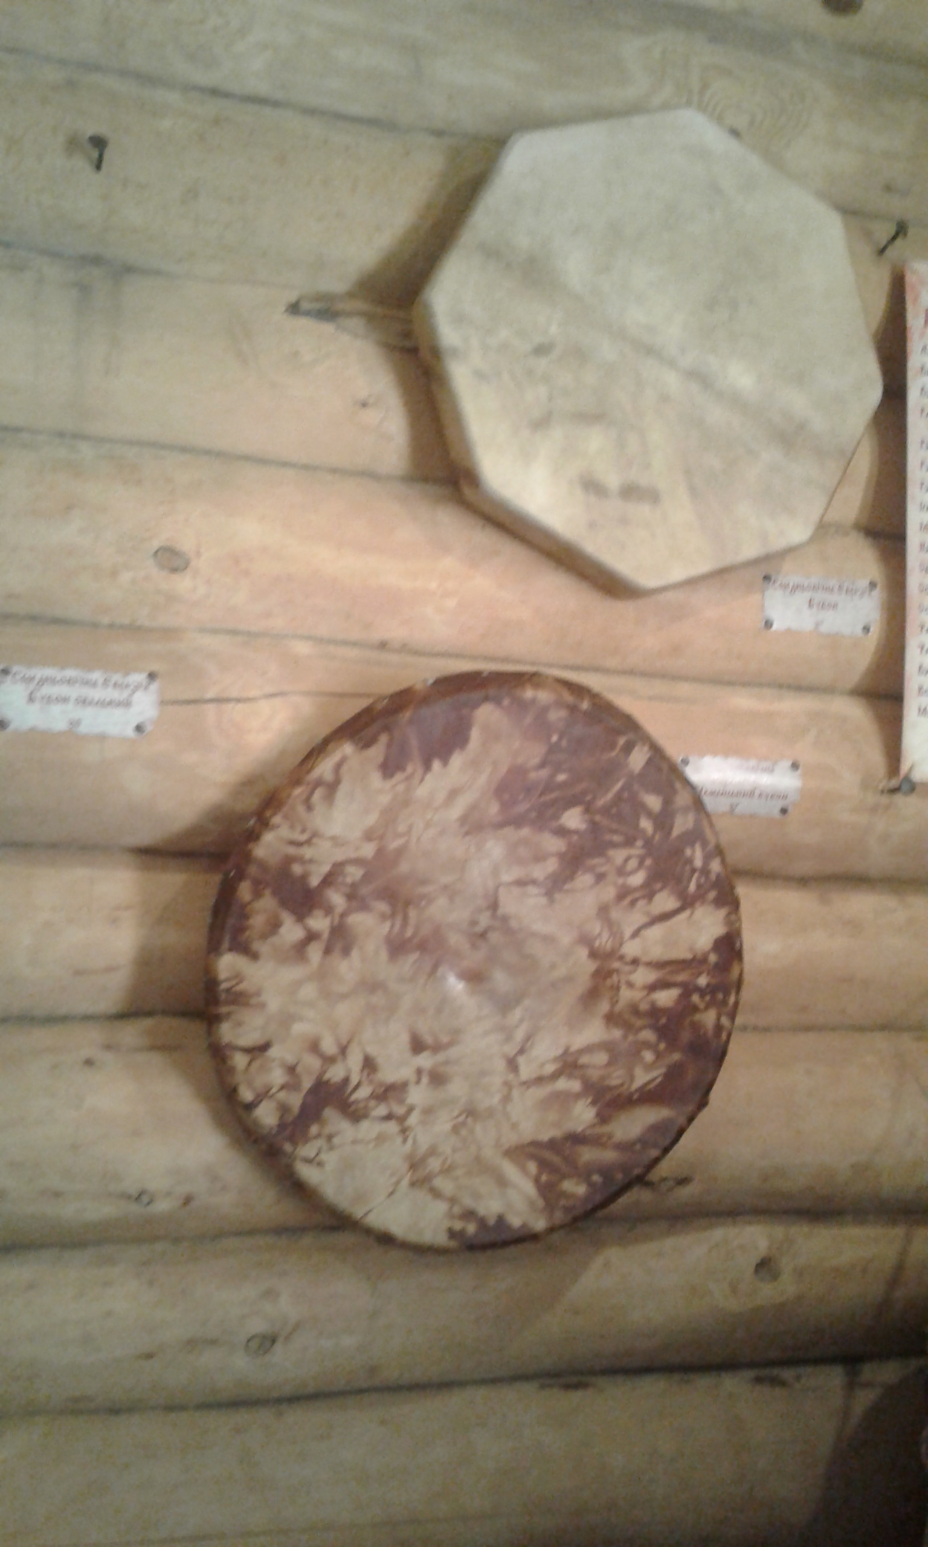
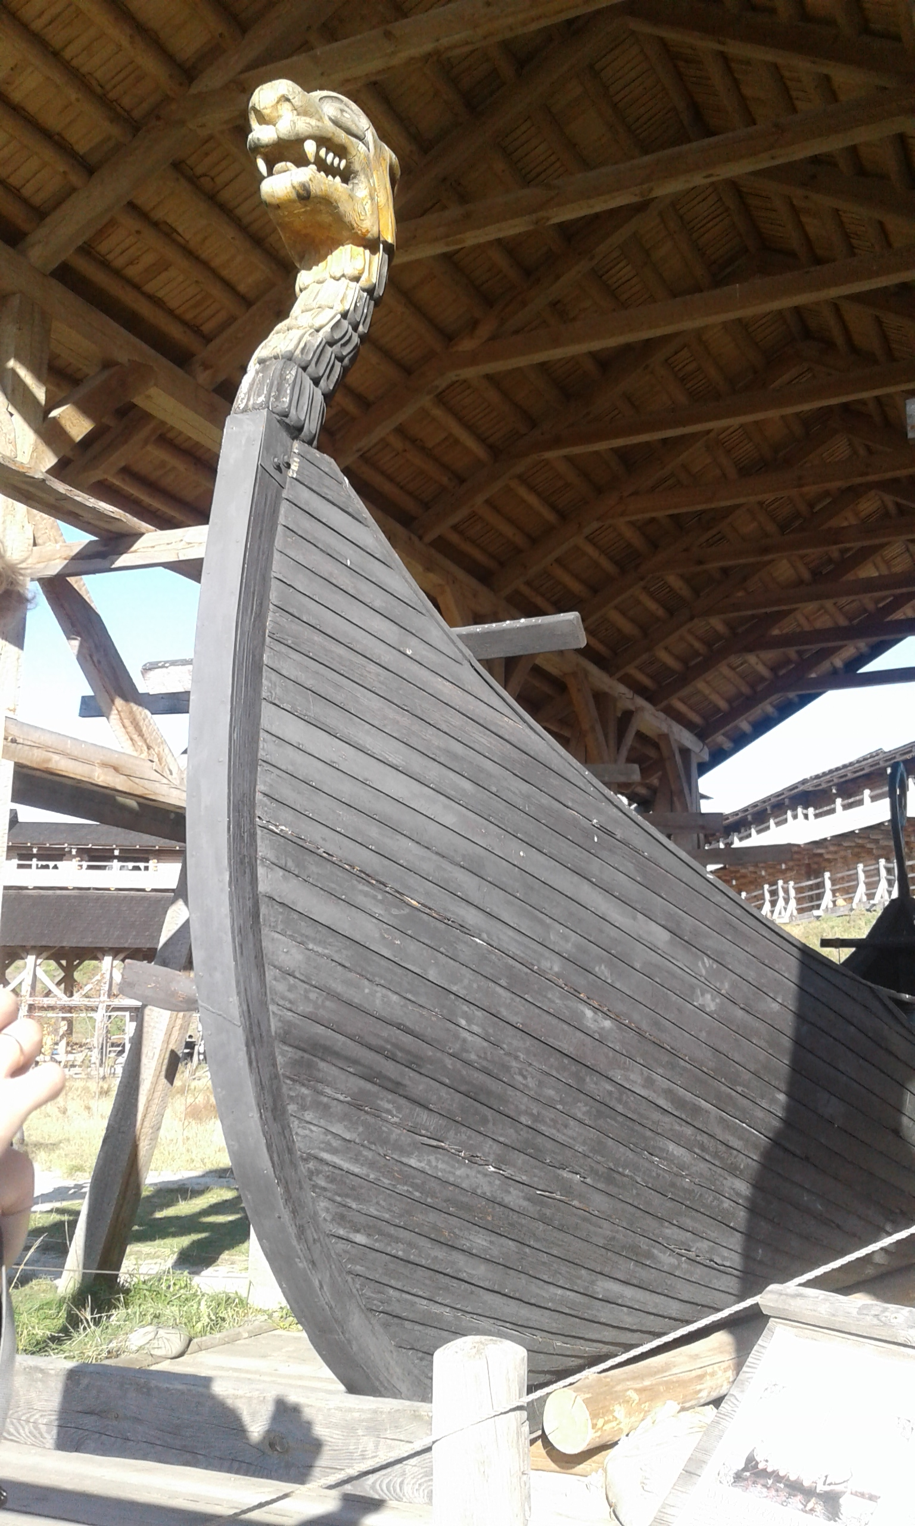

Slide 6
