Slide 1



St.St.cyril and methodius – primary school
The village of Voivodinovo, Bulgaria
Notes:
1

Slide 2

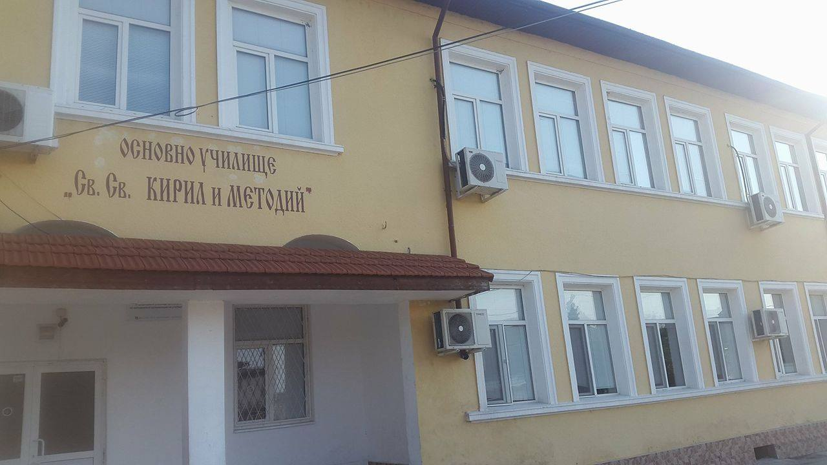
A small school near the second biggest town in Bulgaria - Plovdiv
Notes:
About 130 students, 20 staff, 13 classrooms

Slide 3
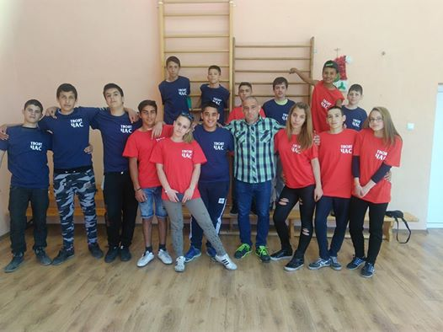
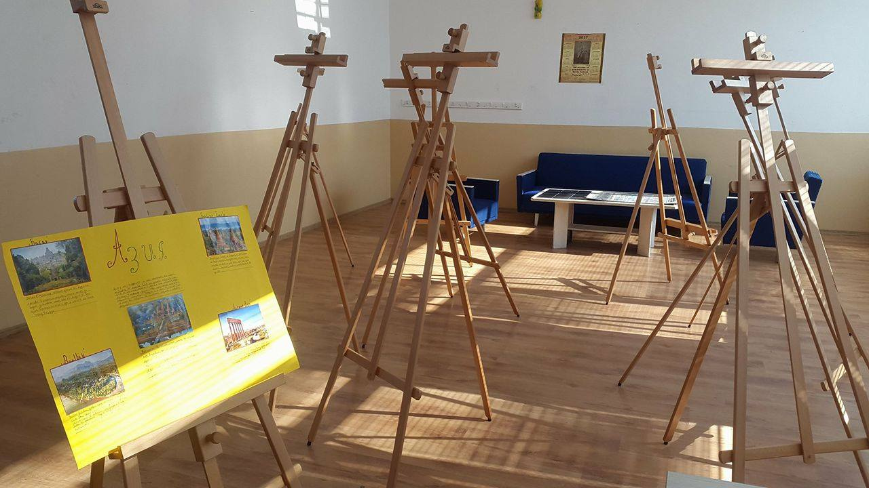
School Facilities and Interior
Notes:
A gym, an art room, science room

Slide 4
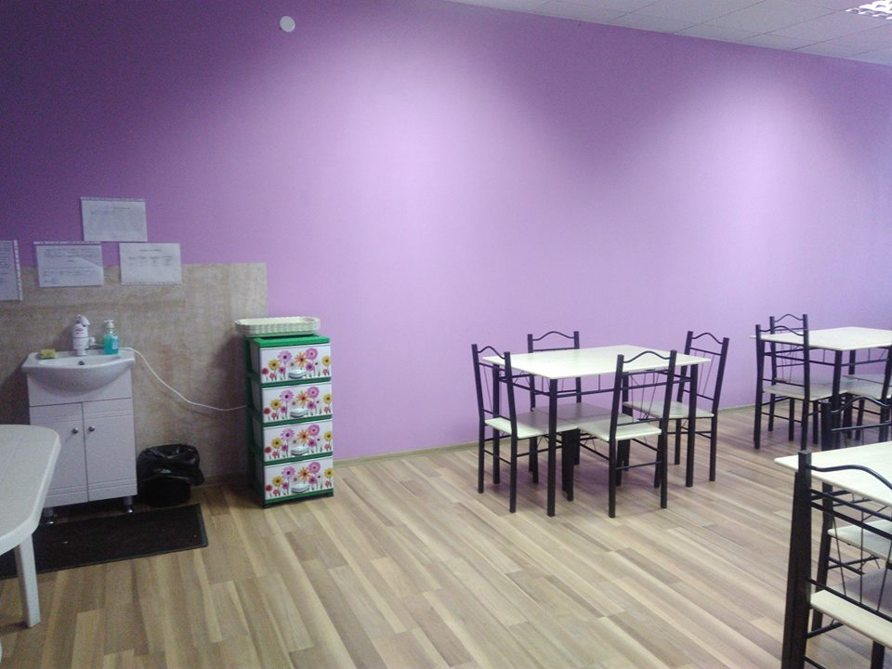
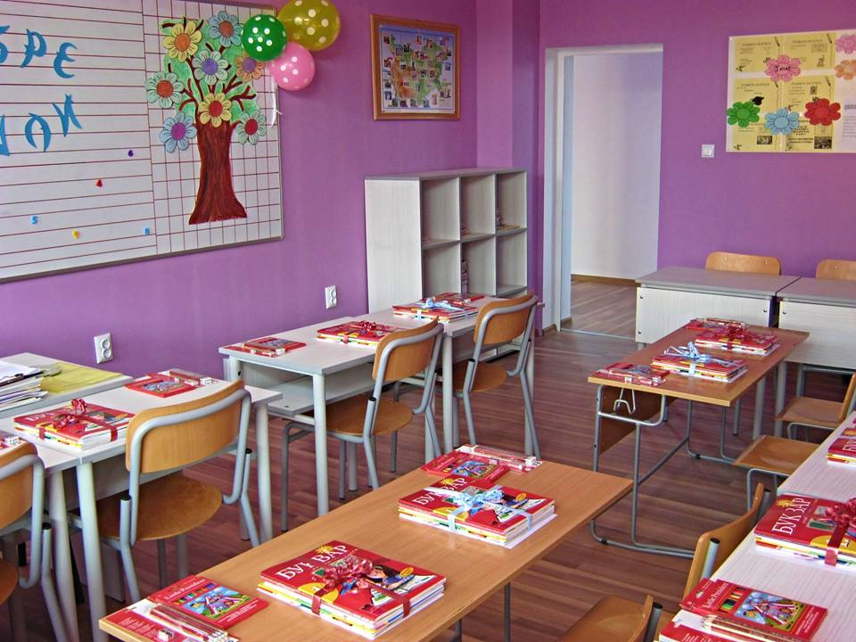

School Facilities and interior
Notes:
A canteen, a classroom

Slide 5

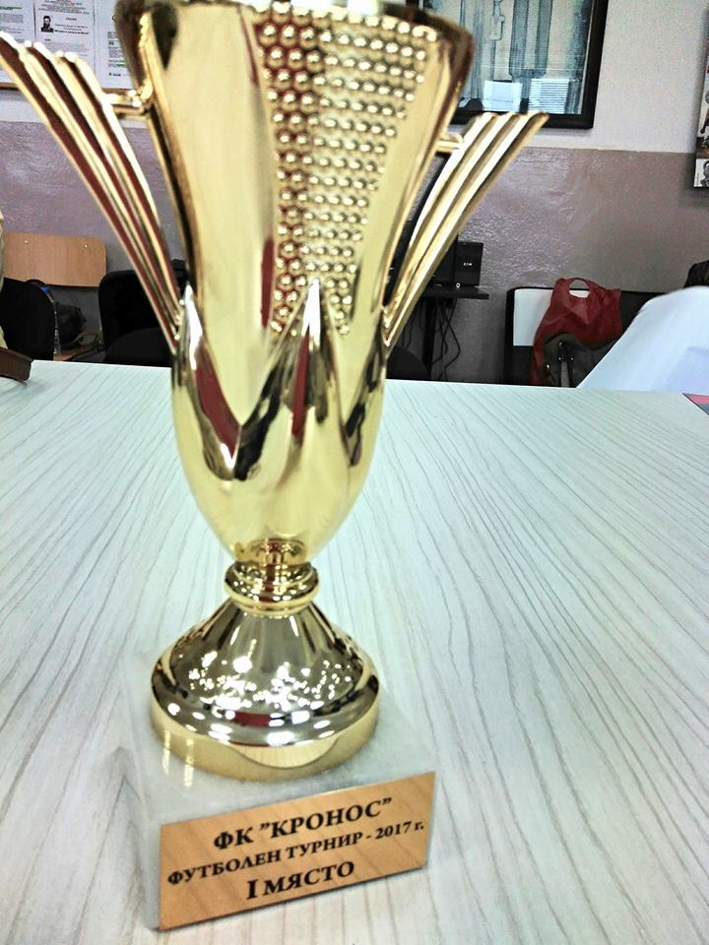
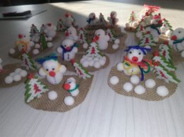
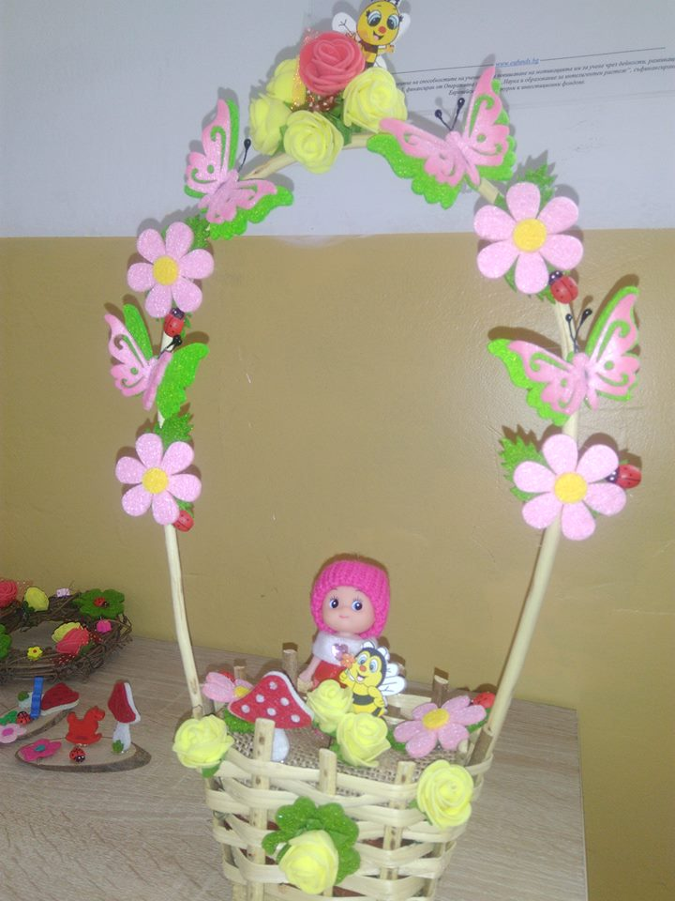
sportS achievements and crafts
Notes:
Football tournaments, different crafts

Slide 6
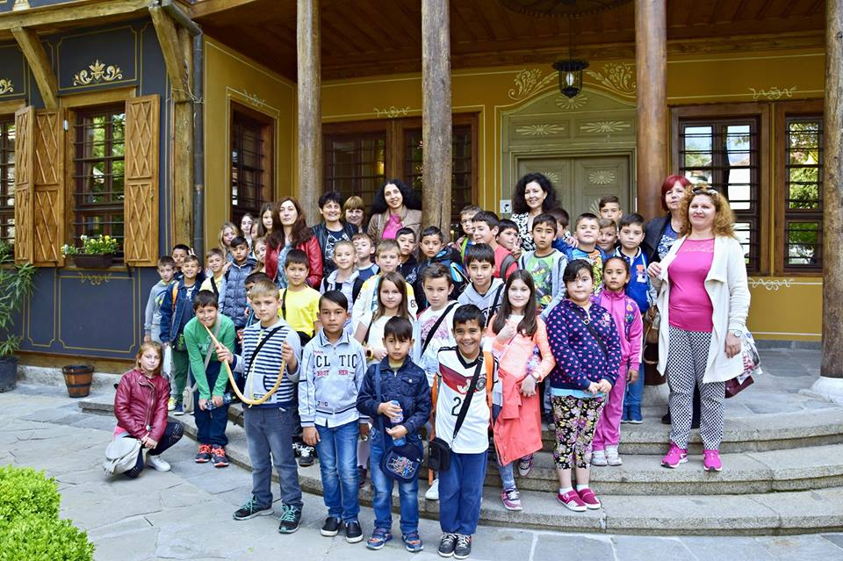
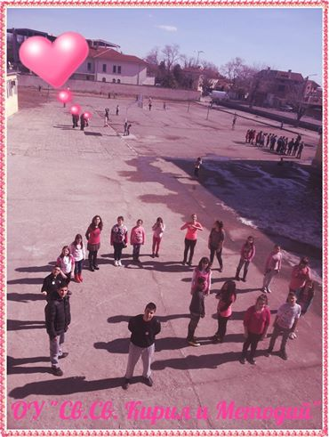
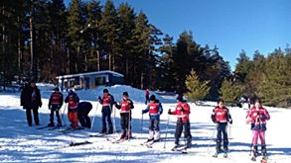
Outdoor activities and trips
Notes:
Trips, ski school and a day against aggression at school

Slide 7
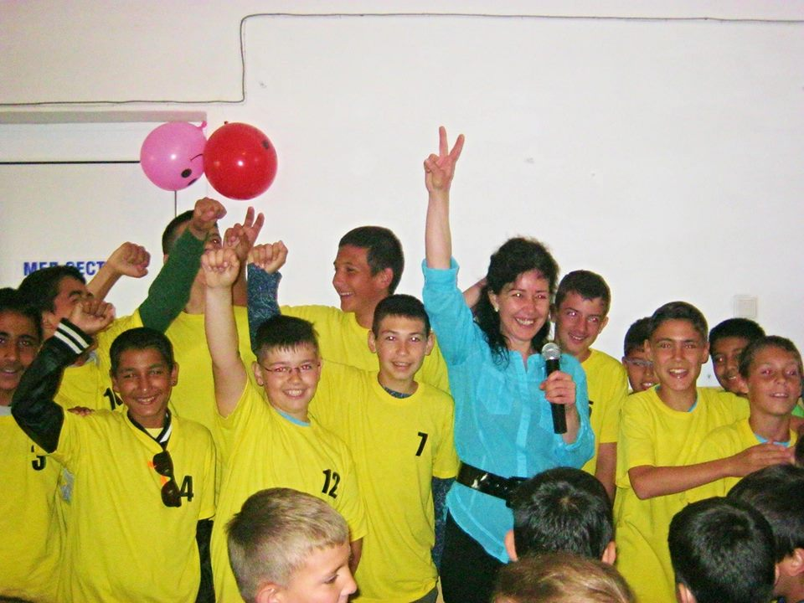
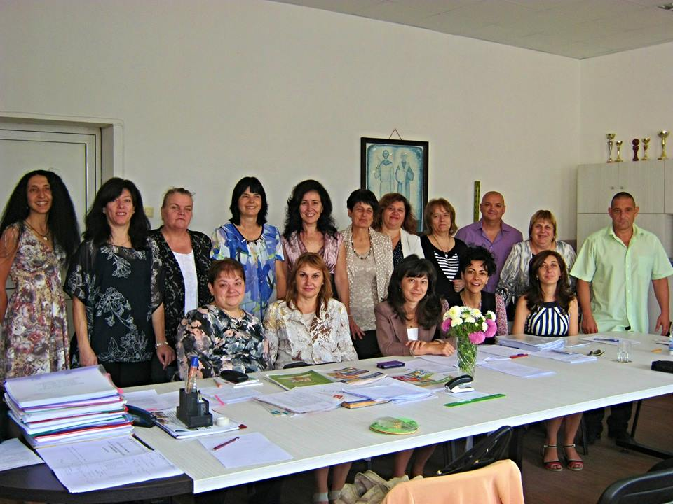
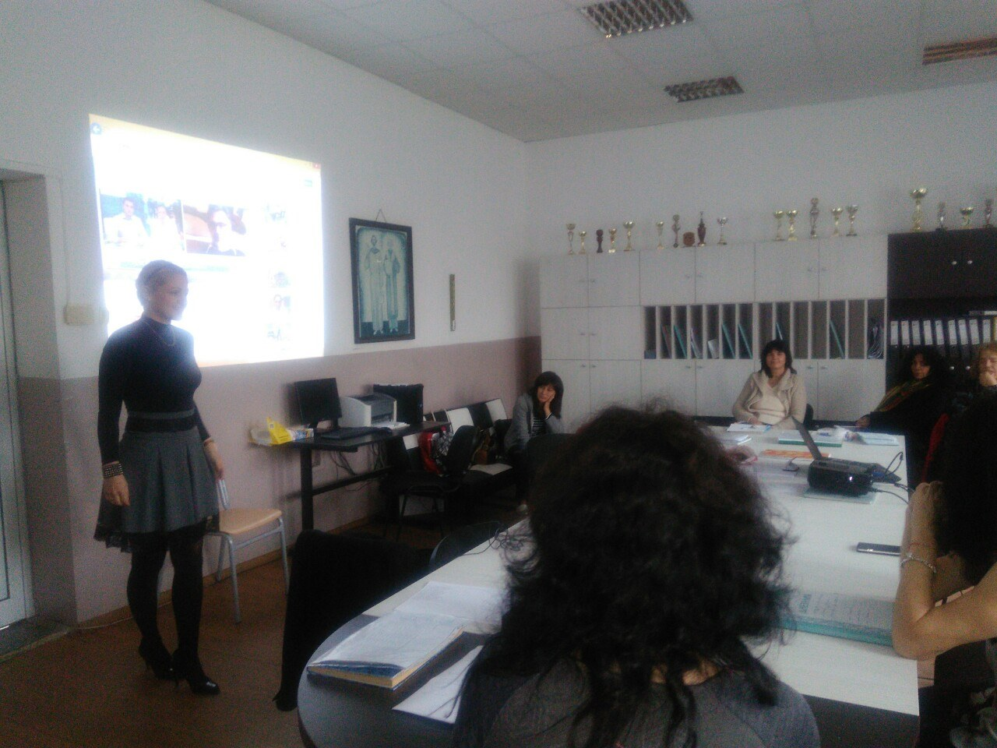
OUR colleagues and qualifications
Notes:
Our Principal with the football team, our colleagues and a qualification day

Slide 8

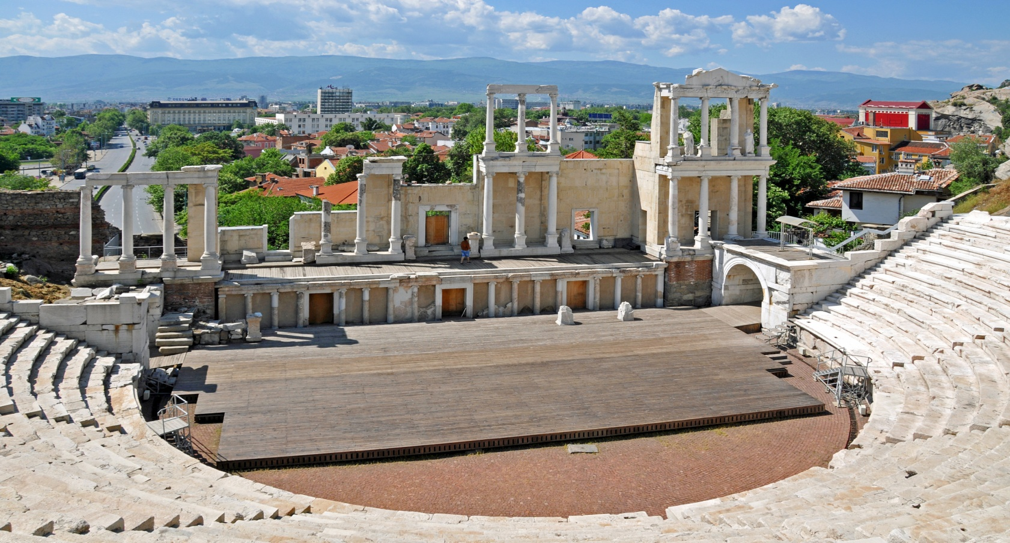
Plovdiv – European capital of culture
https://www.youtube.com/watch?v=pR-2fa1ACsw -

Slide 9

Traditional Bulgarian SOng
Notes:
A schoolgirl from the village of Voivodinovo singing a traditional Bulgaria song on the day of agriculture…

Slide 10

THANK YOU FOR YOUR ATTENTION!
REGARDS,
Maria Nedelcheva
Ruska Tsonevska-Stoycheva
St.St.Cyril and Methodius staff and students
“Looking forward to welcoming you at our school”

