Slide 1
Transfiguration Class
by Mrs. Barlas

Slide 2
I’m Fatma Barlas. I’m the teacher of Transfiguration Class in SMILE. In this class we focus on transformations in life and nature by creating and using our own SMILE alphabet. Collaborative interaction tasks are in the heart of this class. In addition some tasks are correlated with Dada Class activities. Now let’s have a quick review what tasks we’ve achieved in this class.

Slide 3
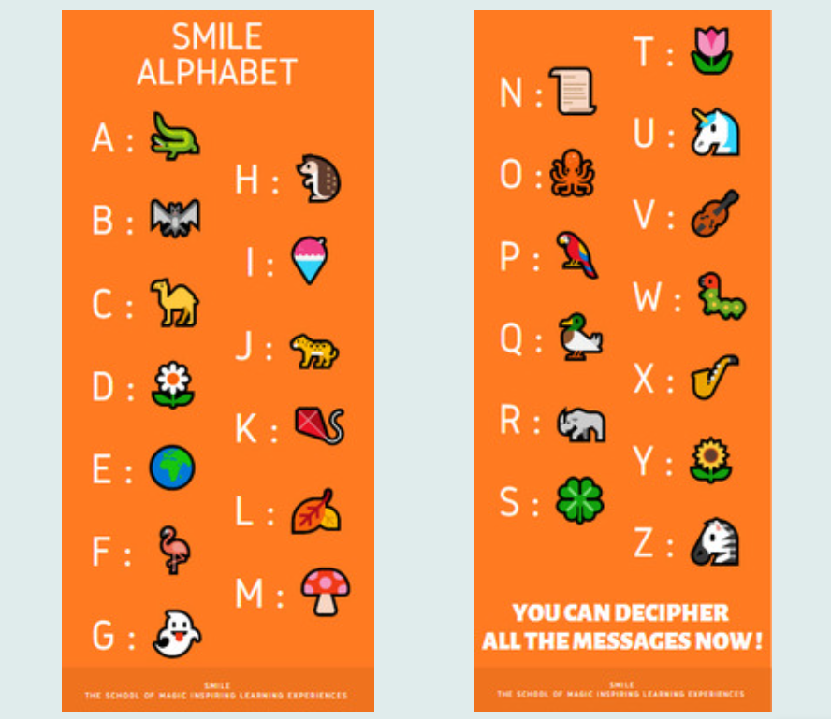
Task 1:
Heraclitus, an ancient philosopher, says:
Decode Heraklitus' message and go to discussion part at the end of the page and share it by replying the other questions.
"What is Heraklitus' message? Please decode it. What do you think about this message?
Can you share your ideas about transformation / change in our lives and in nature?"

Slide 4
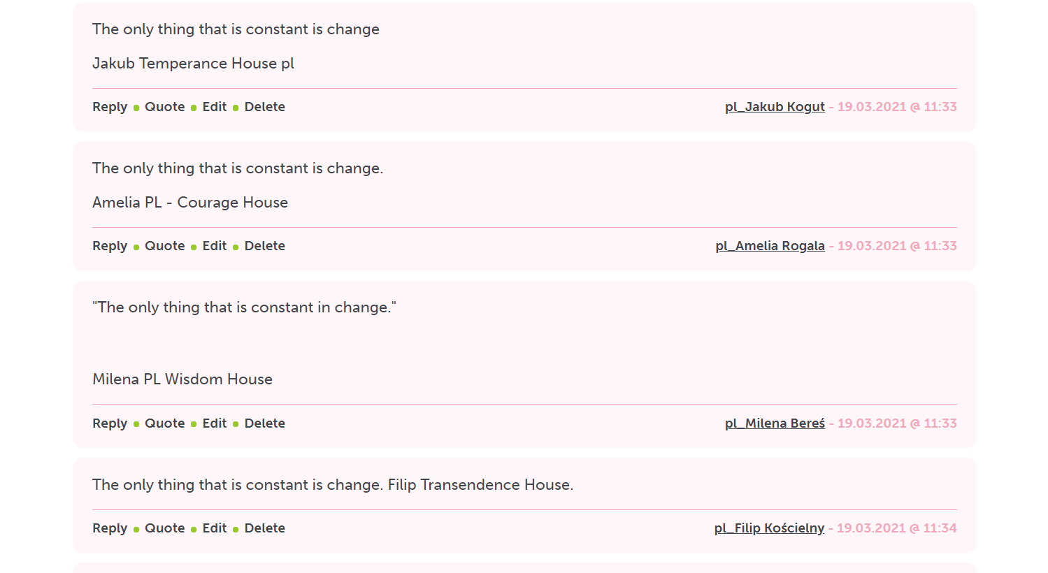
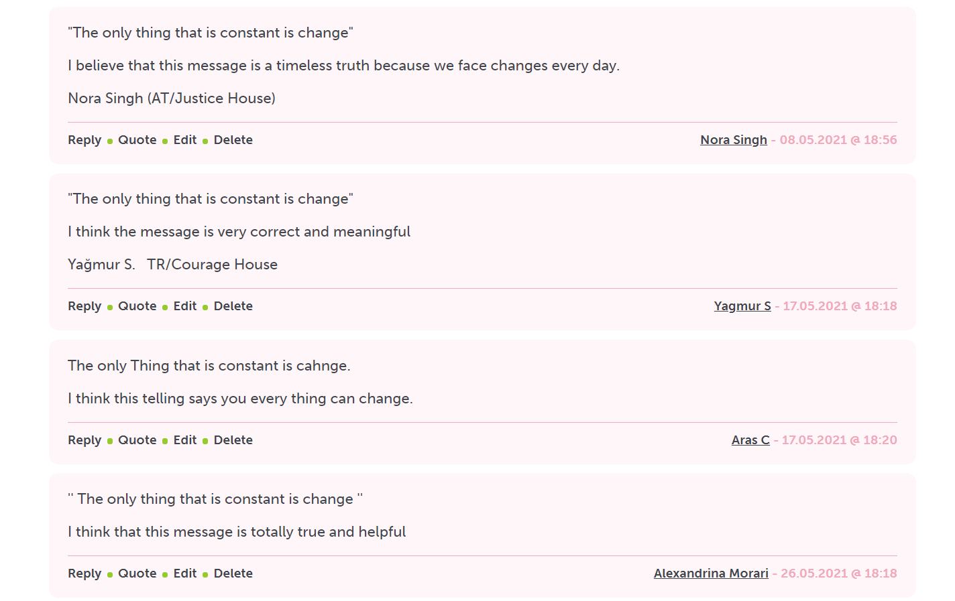
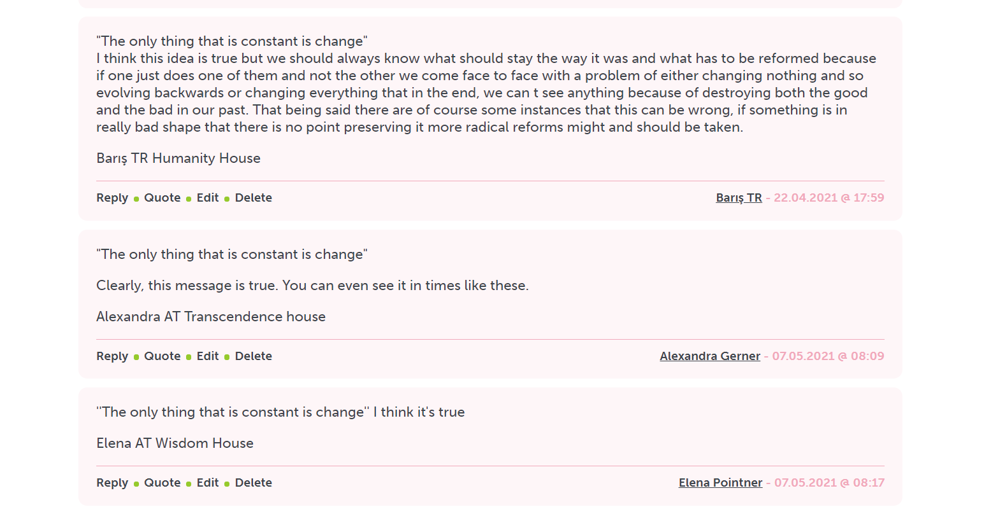
Some samples from the pages

Slide 5
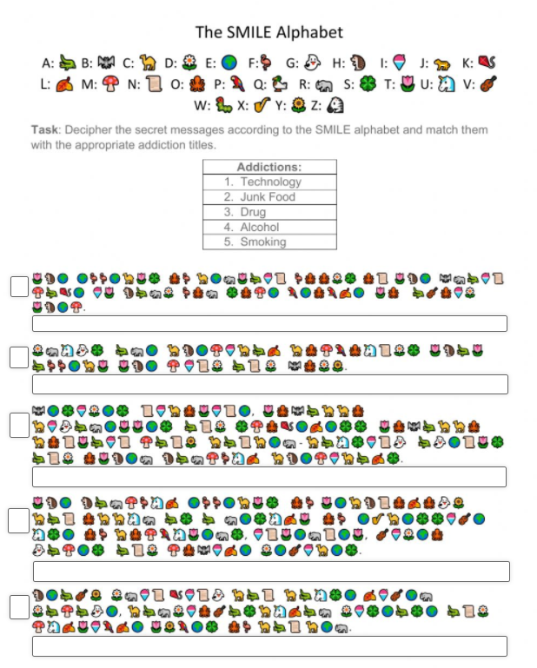
Task 2:
Decode the messages in this worksheet to find out about the zombies (addictions) harmful effects on people.
https://www.liveworksheets.com/2-gb121839ju
(P.S. Task 2 and 3 are correlated with “Dada Class’ Noitcidda Zombies”. )

Slide 6
Task 3:
To get detailed information about different types of addictions and their harmful effects, read the articles on the page about these topics:
Technology / Alcohol / Smoking / Drug / Junk Food
After getting knowledge about these addictions, choose one of them and Code a message of your own that would encourage people not to fall under the zombie’s influence. Use The Smile Alphabet to code your message.
(This collaboration work was achieved by using Google Slides.)

Slide 7
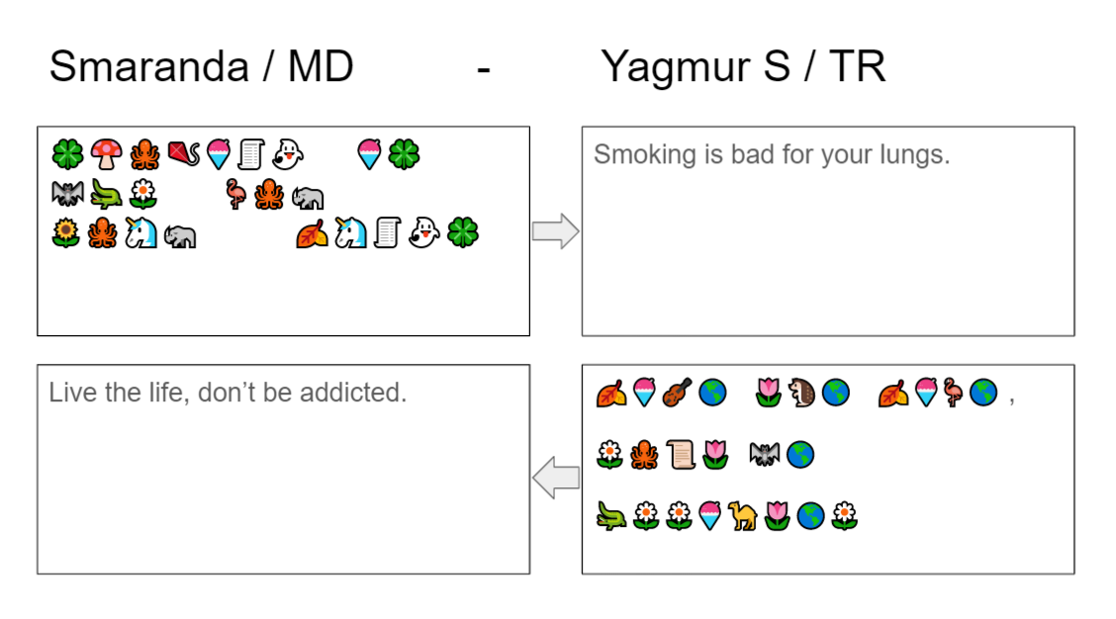
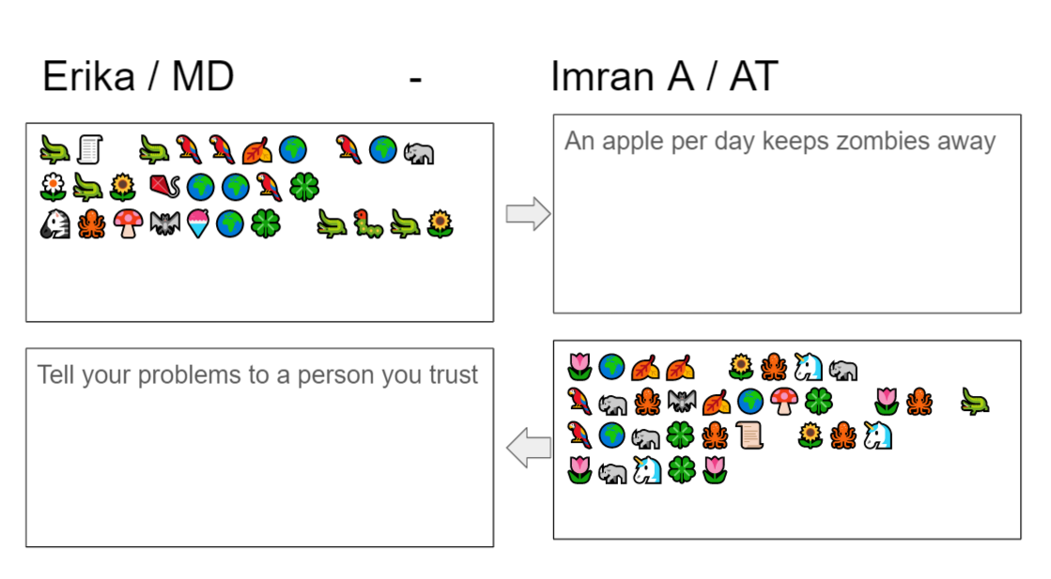
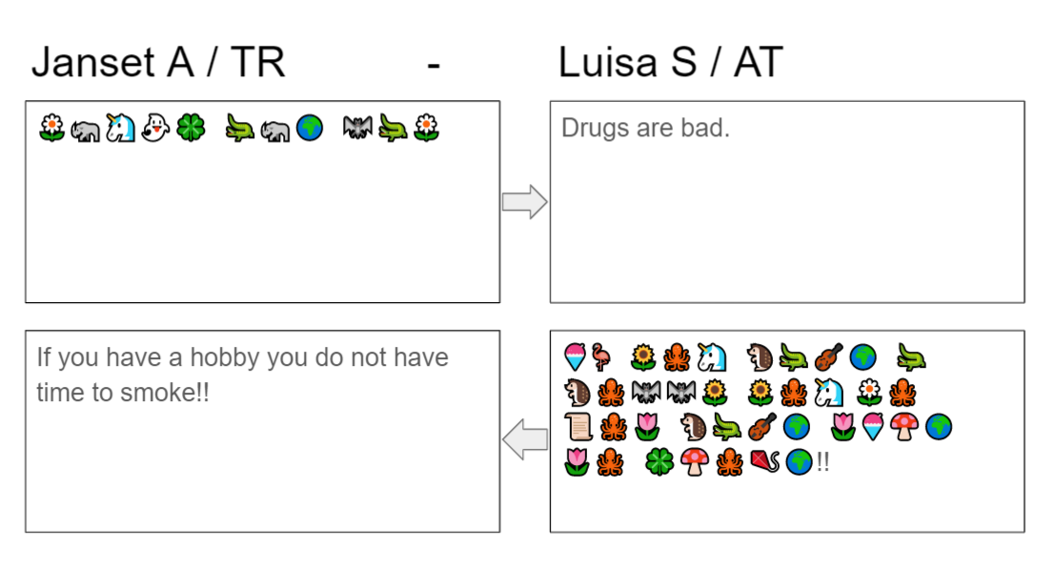
Some samples from the pages

