Slide 1
SMILE Housewarming Party
November 14, 2020

Slide 2
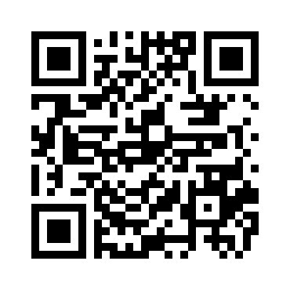

Slide 3
Make a silly face - all at once. Are you ready? Set? Go! Take a screenshot of it.

Slide 4
What street did Harry Potter live on? A) 14 Privet Drive B) 4 Privet Street C) 4 Privet Drive

Slide 5
Who wrote the Harry Potter series? A) J.R.R. Tolkien B) J.K. Rowling C) Mark Twain

Slide 6
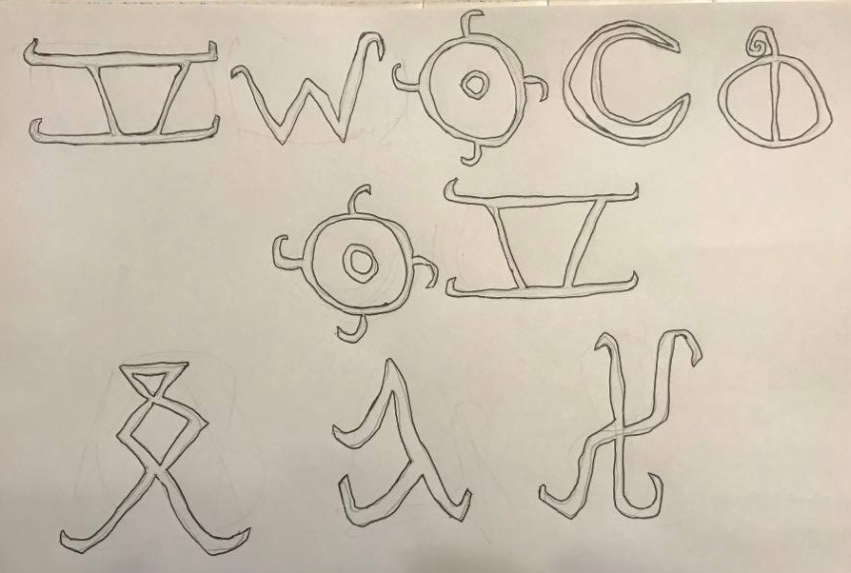
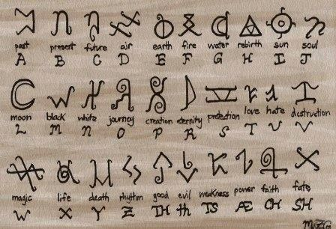
Decode the message
https://www.pinterest.com/pin/548524429590049717/

Slide 7
Who says this? Write the answer in.

Slide 8
What does it do? A) Puts spells on you B) Predicts the future C) Sorts the new students into houses

