Slide 1
Gdansk Tour
By Erika Lozovan

Slide 2
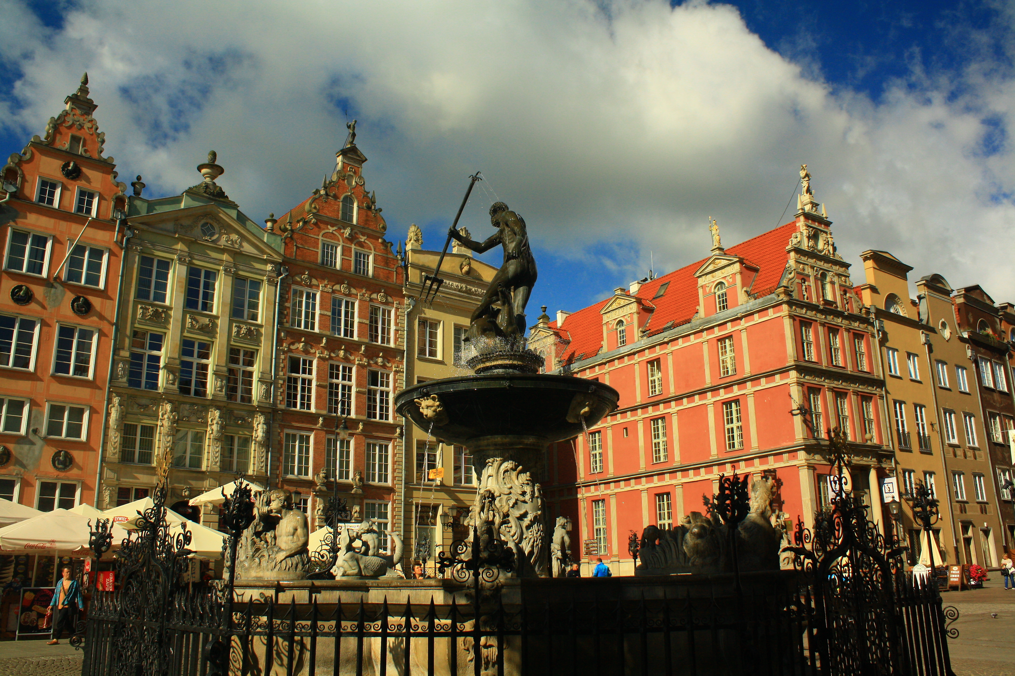
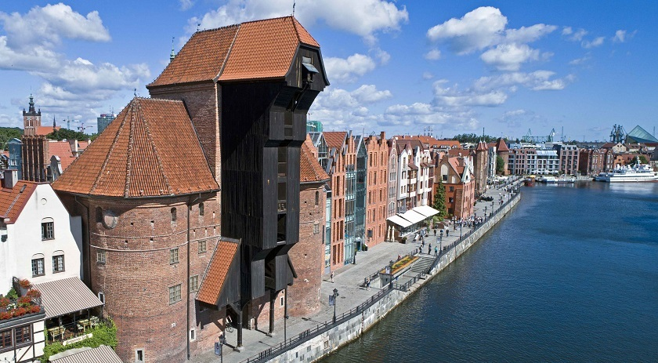
The Main Town

Slide 3
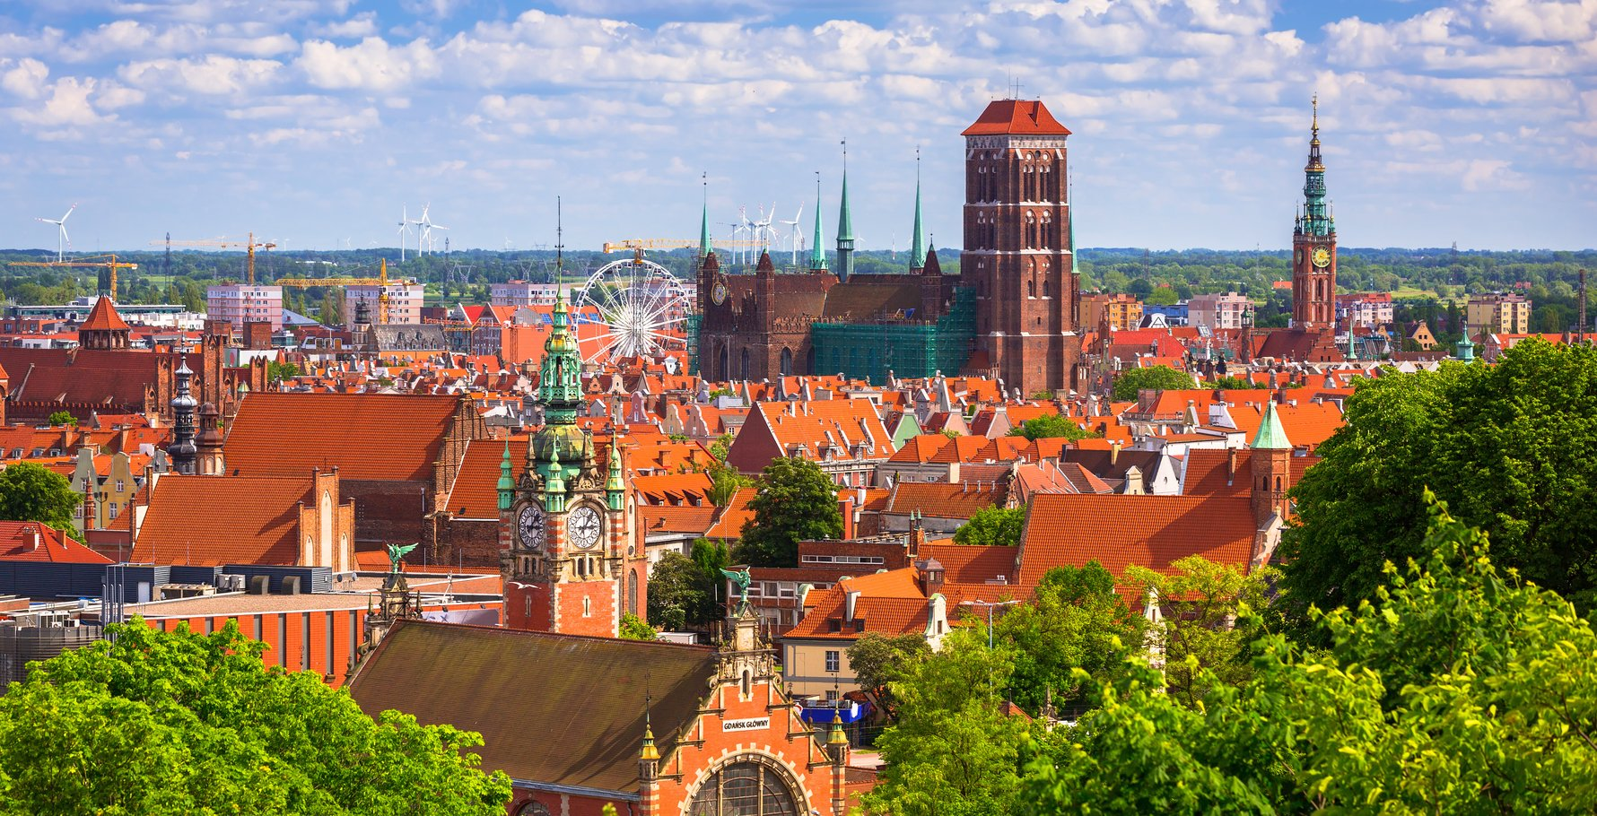
The Old Town

Slide 4
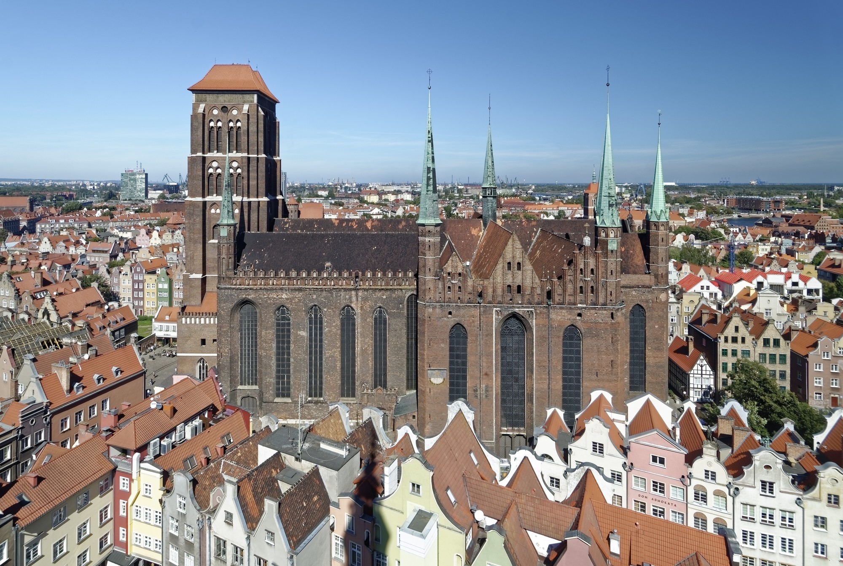
The St. Marys Basilica

Slide 5
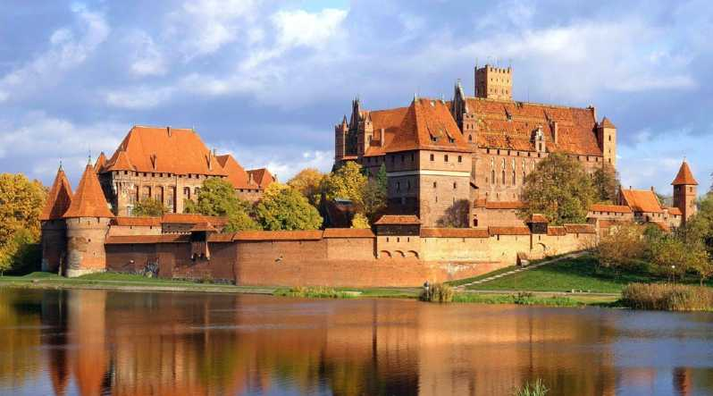
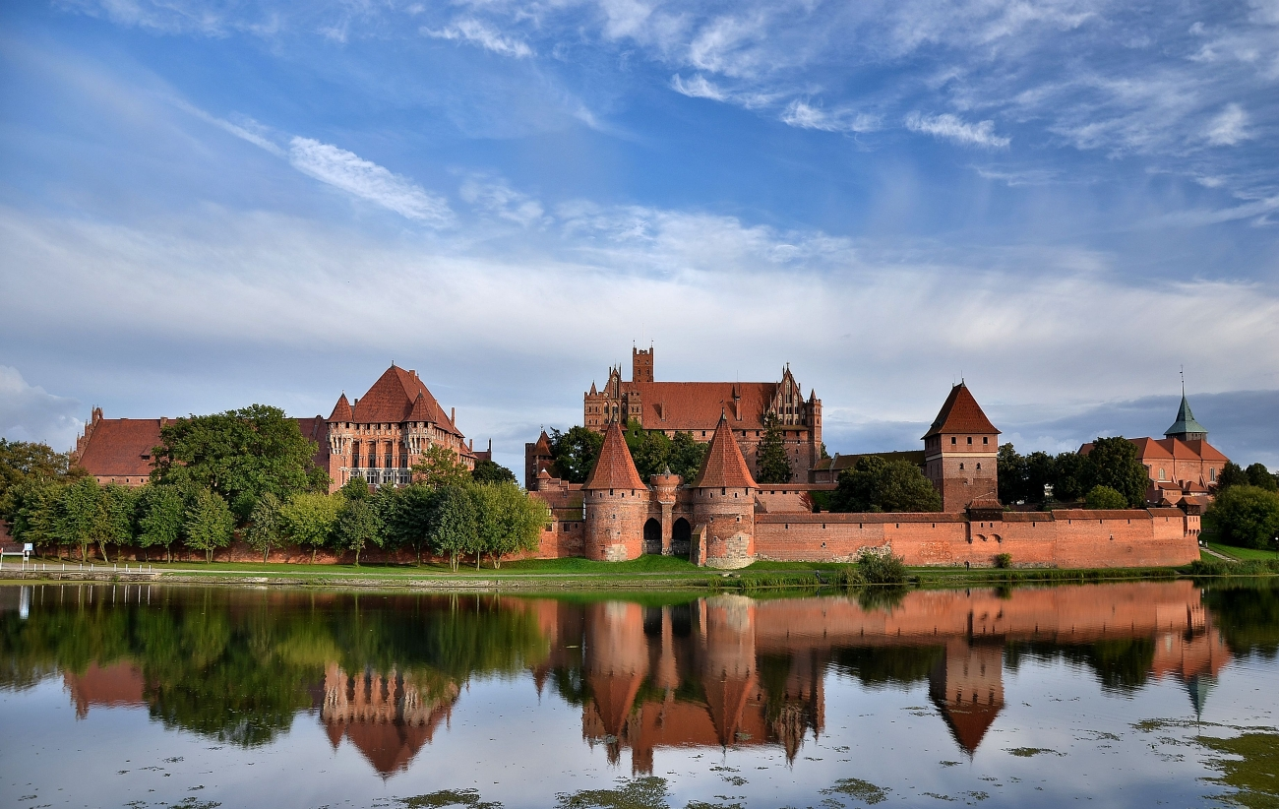
The Malbork Castle

Slide 6
Thank you for listening!

