Slide 1
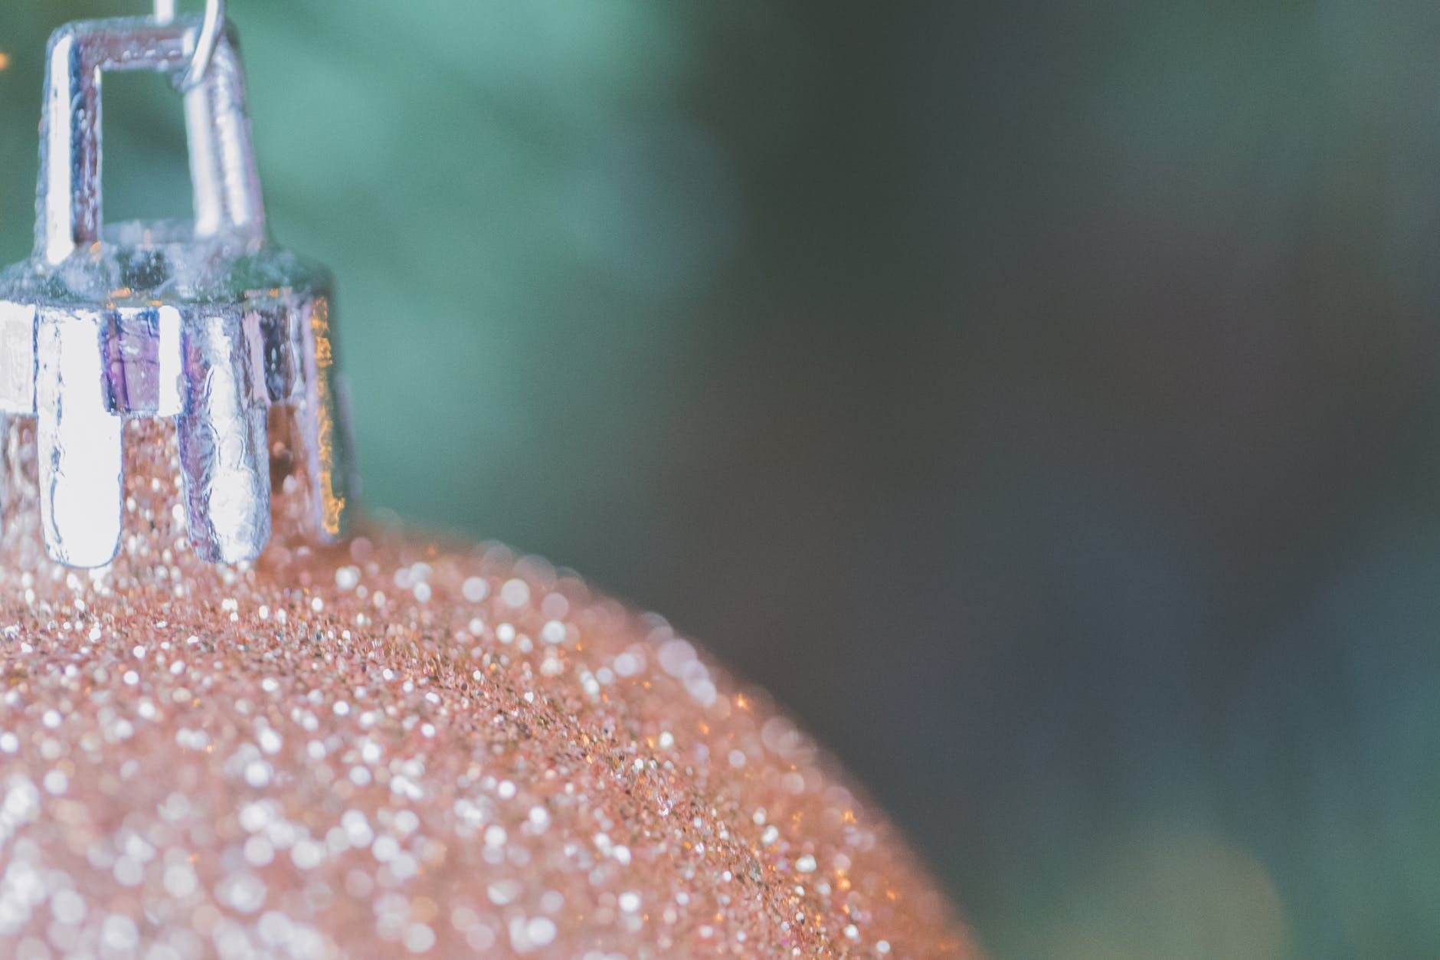
“Pil Pil“
PRAWNS
INGREDIENTS
1kg prawns
10 garlic Parsley
Hot paprika
2 chains
1/2 lemon Olive oil
Salt

Slide 2
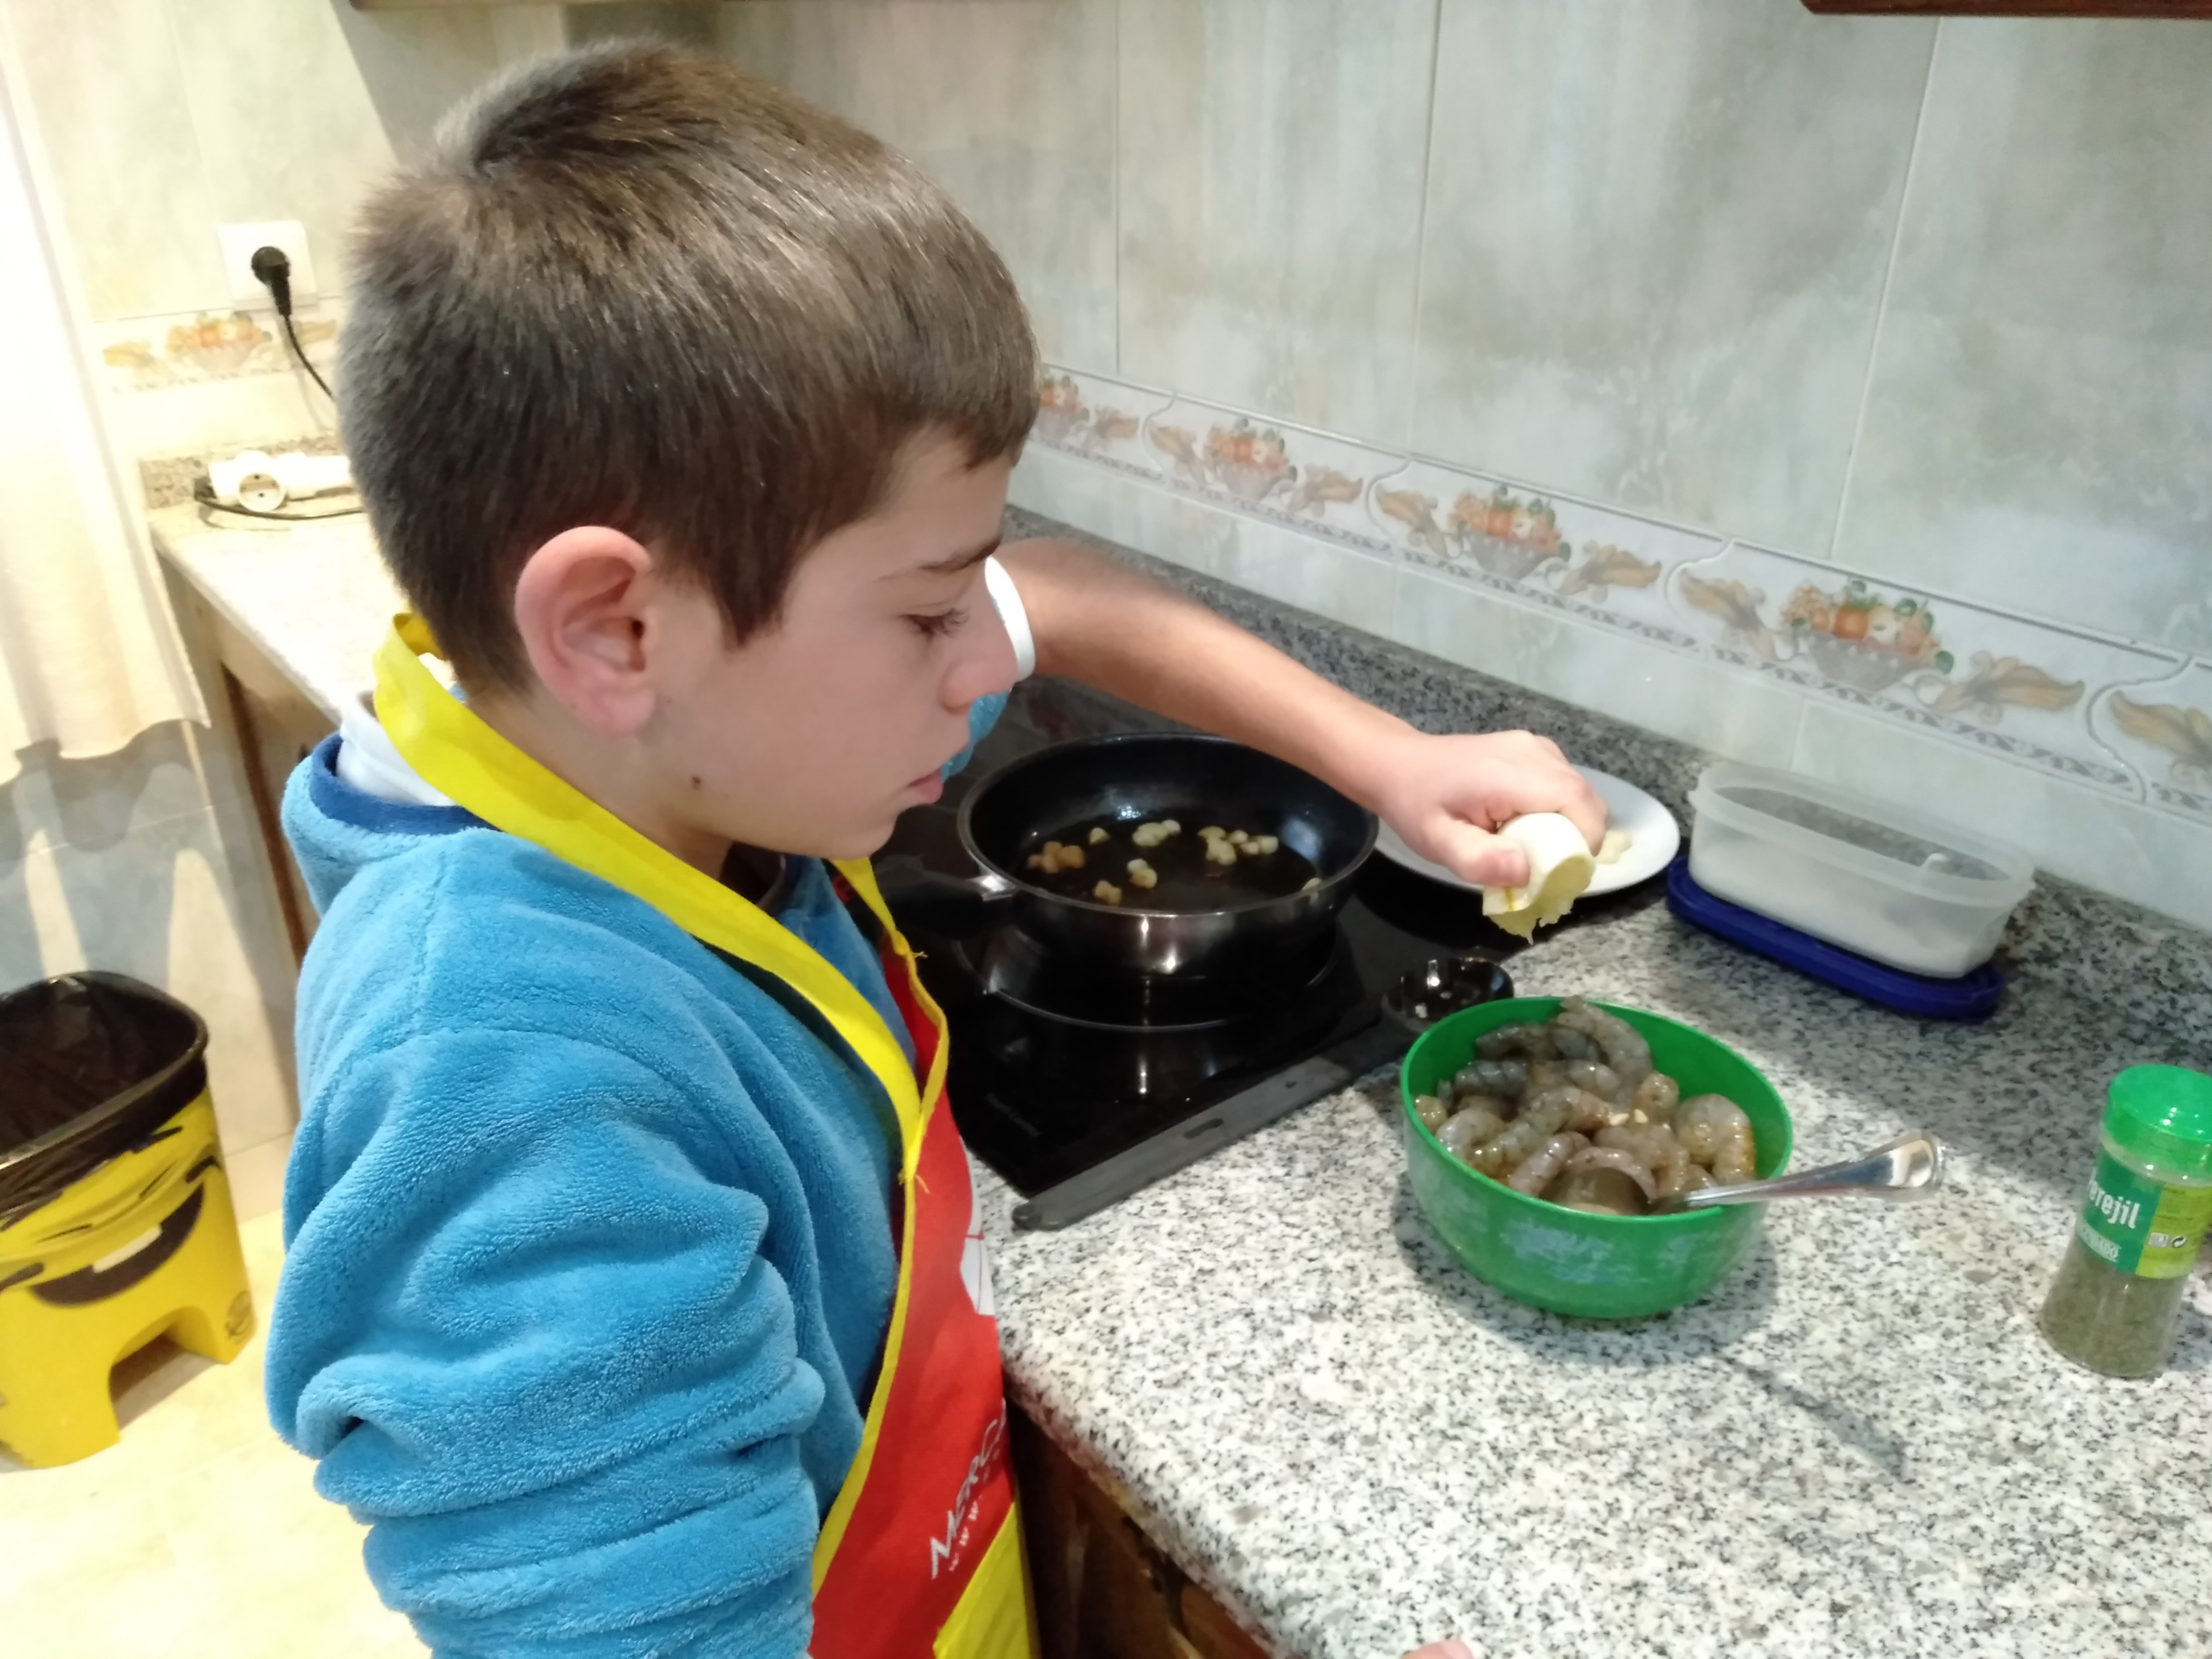
STEP BY STEP
1.- Peel the prawns.
2.- Season with salt,
paprika, pilgrim and
lemon.

Slide 3
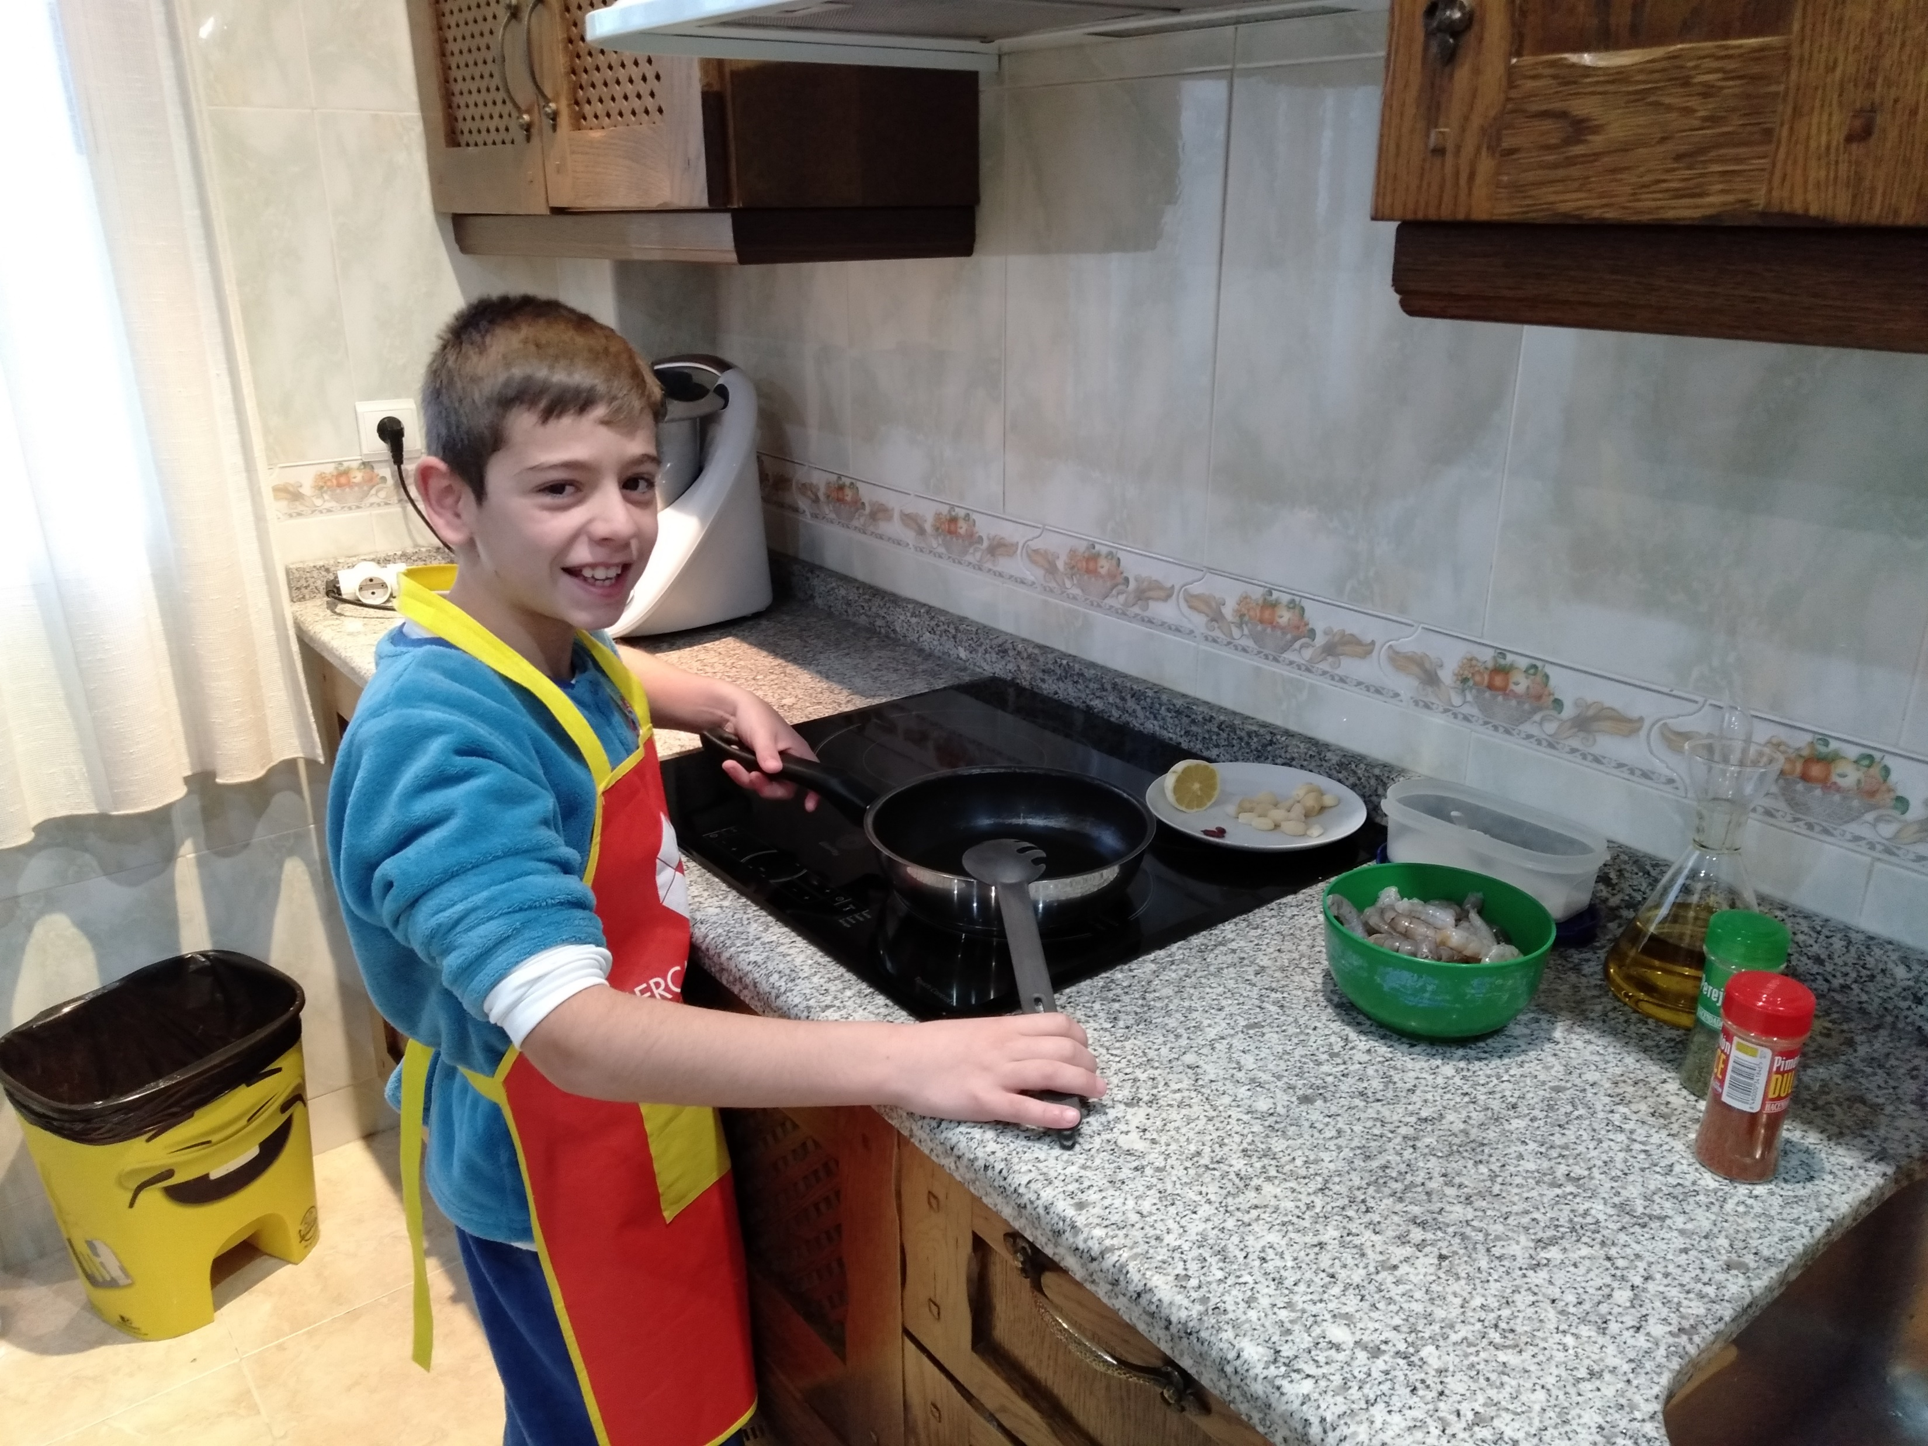
3.- Chop the garlic.
4.- We put oil in the pan, add the garlic and the chain.

Slide 4
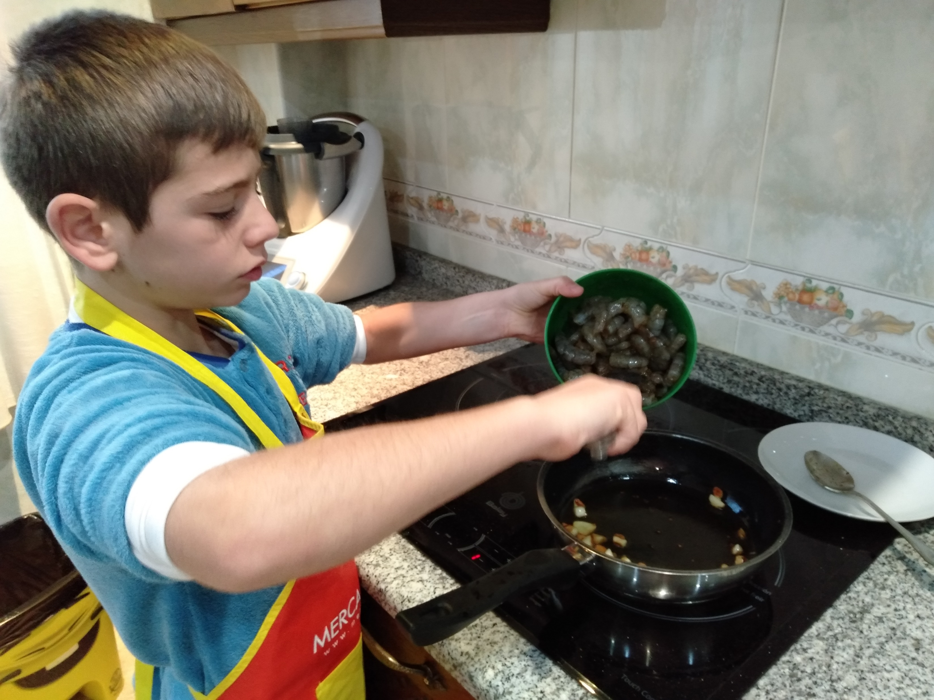
5.- Stir fry and add the prawns until they are fried.

Slide 5
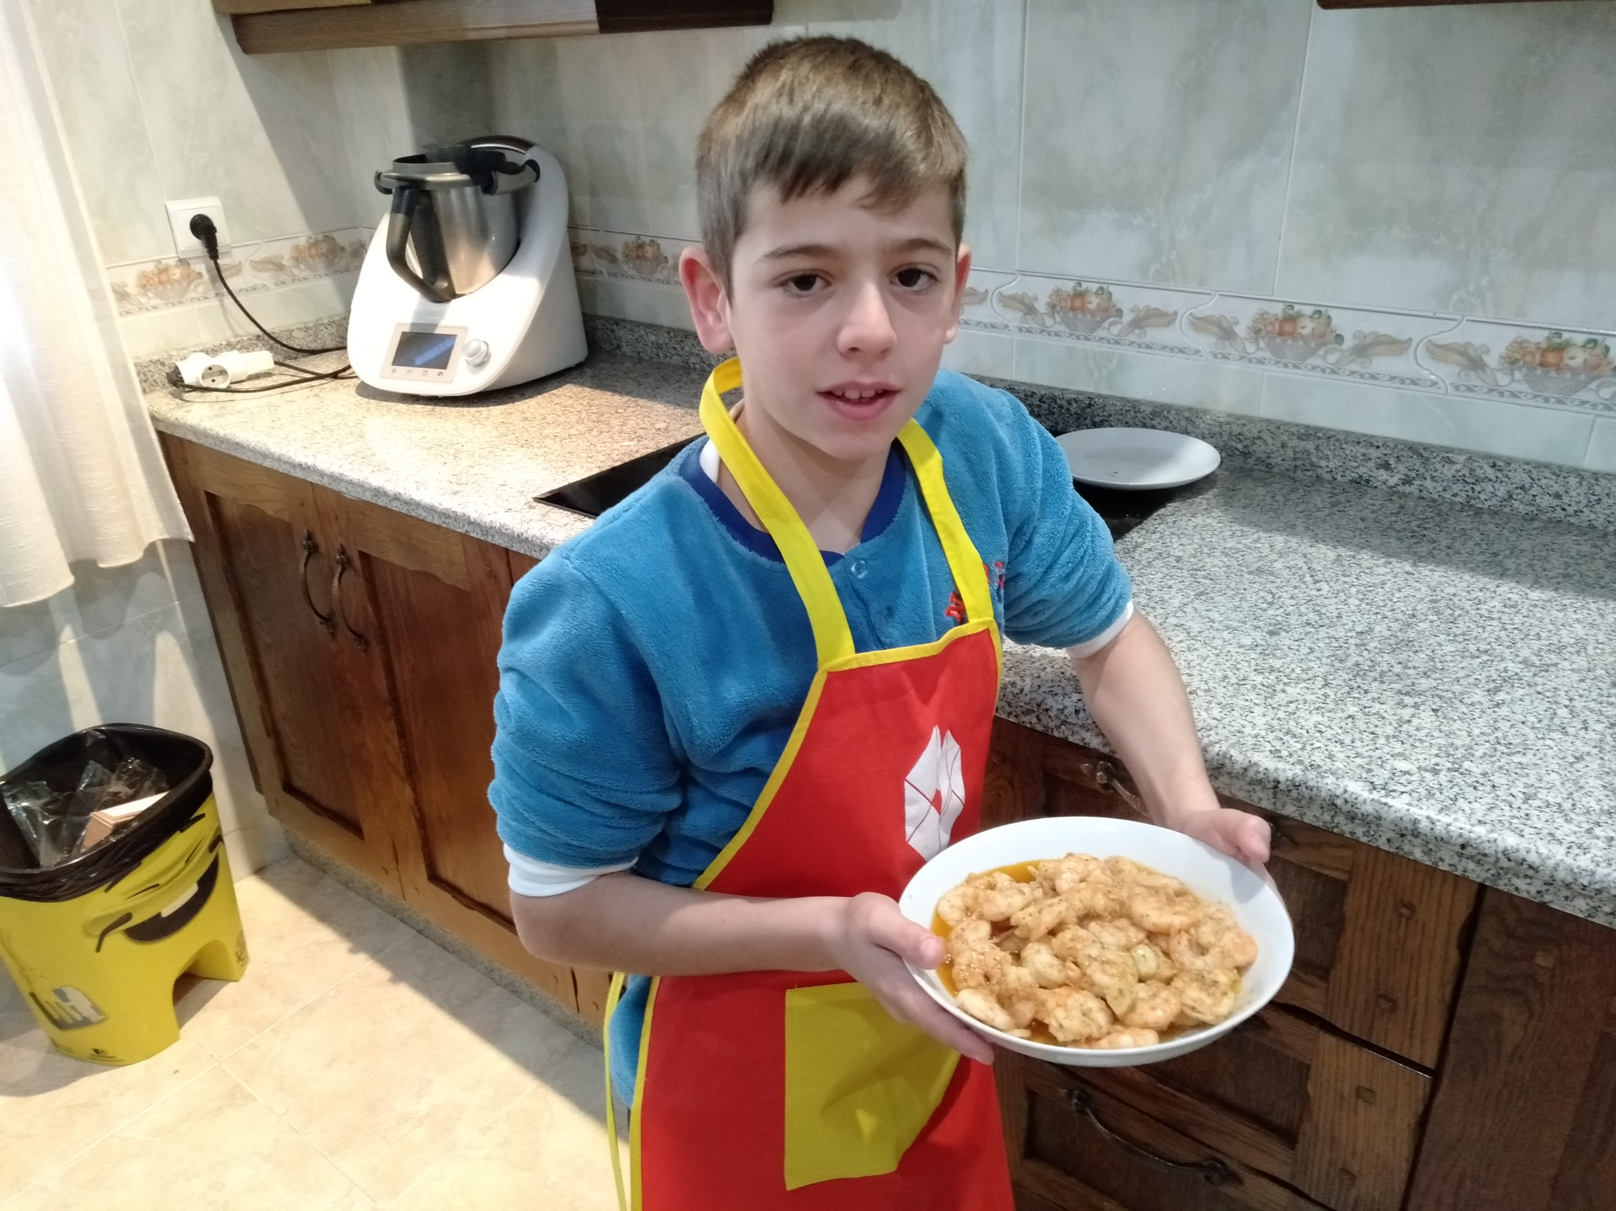
6.- And you just need to eat them.

