Slide 1
MY COOKIE RECIPE

Slide 2
Ingredients

Slide 3
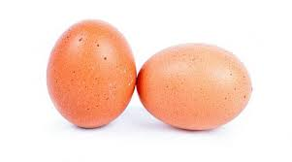
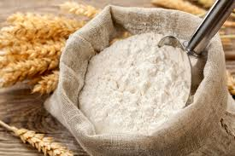
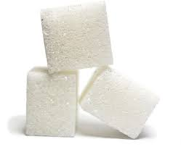
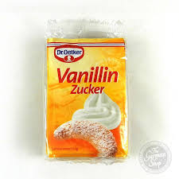
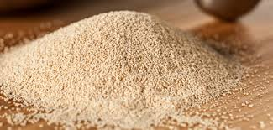
ingredients
250gr SUGAR
250gr BUTTER
500gr FLOUR
2 EGGS
1 PACKET OF VANILLA SUGAR
1 PACKET OF CHENICAL YEAST
2 PUDDING PACKAGES

Slide 4
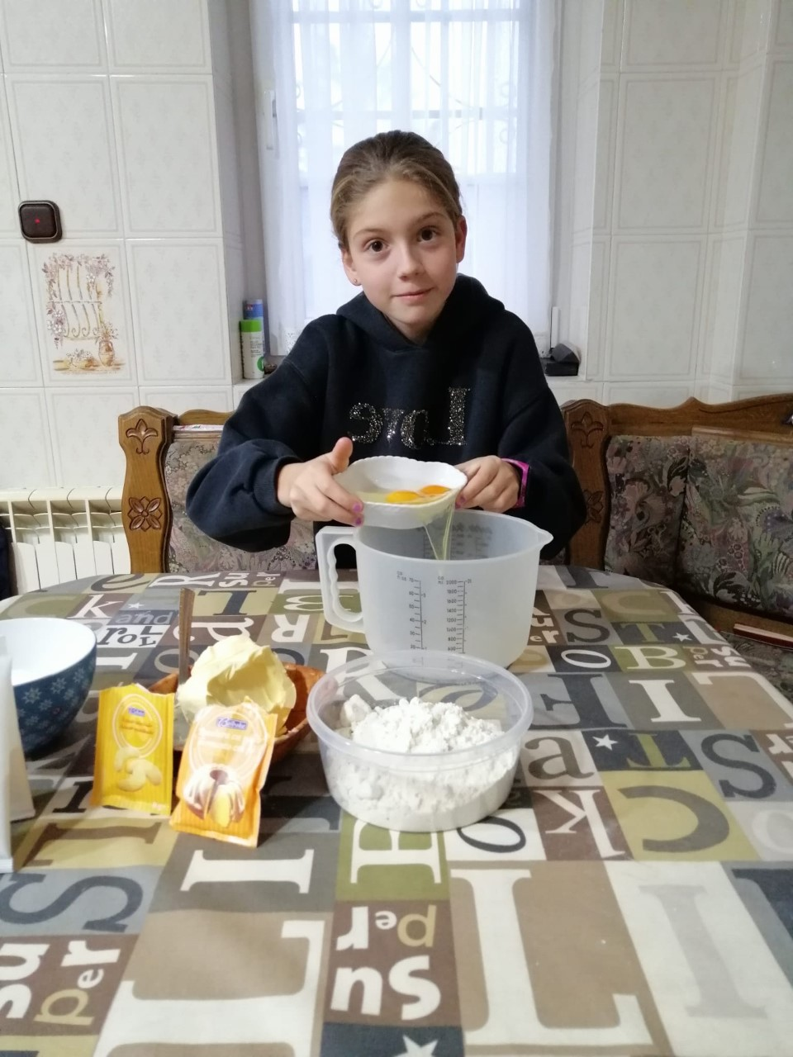
STEP AND STEP
IN A BOWL WE ADD:
2 EGGS

Slide 5
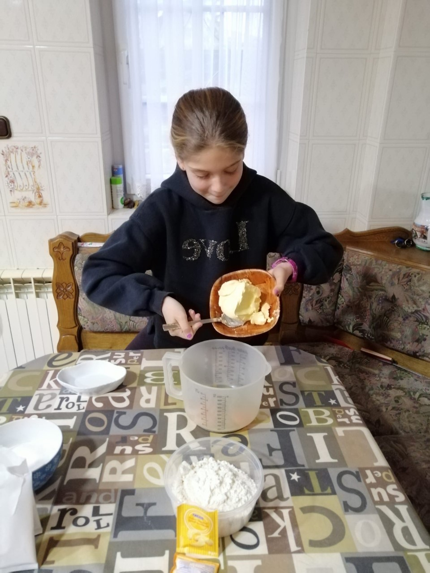
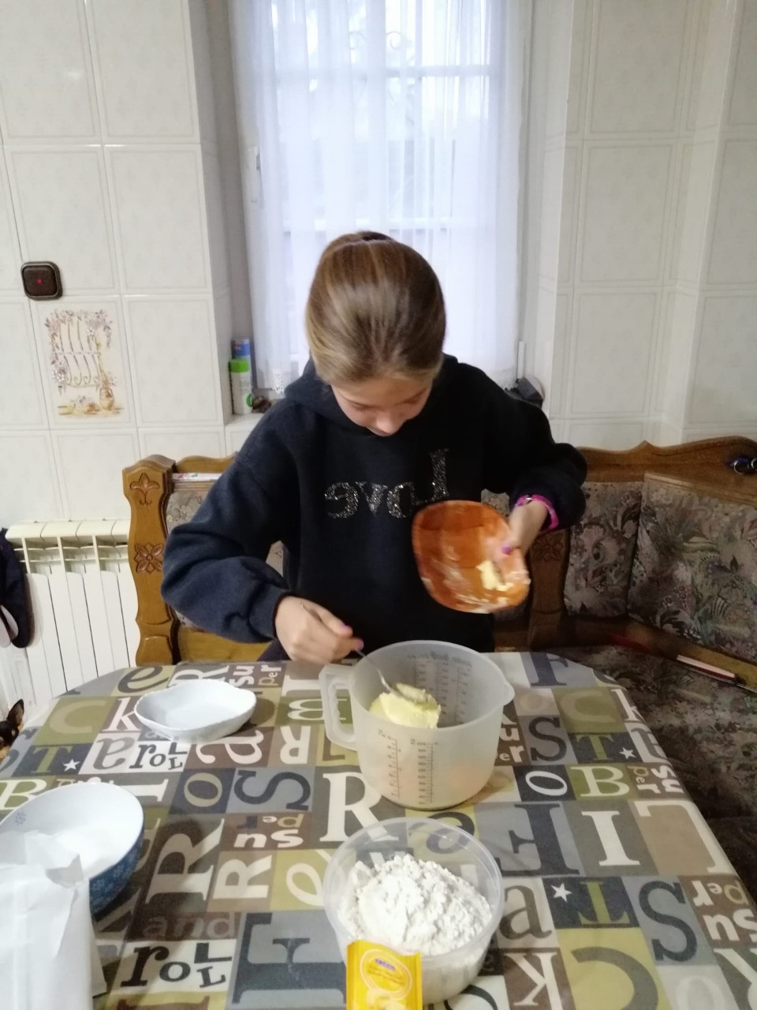
STEP AND STEP
BUTTER

Slide 6
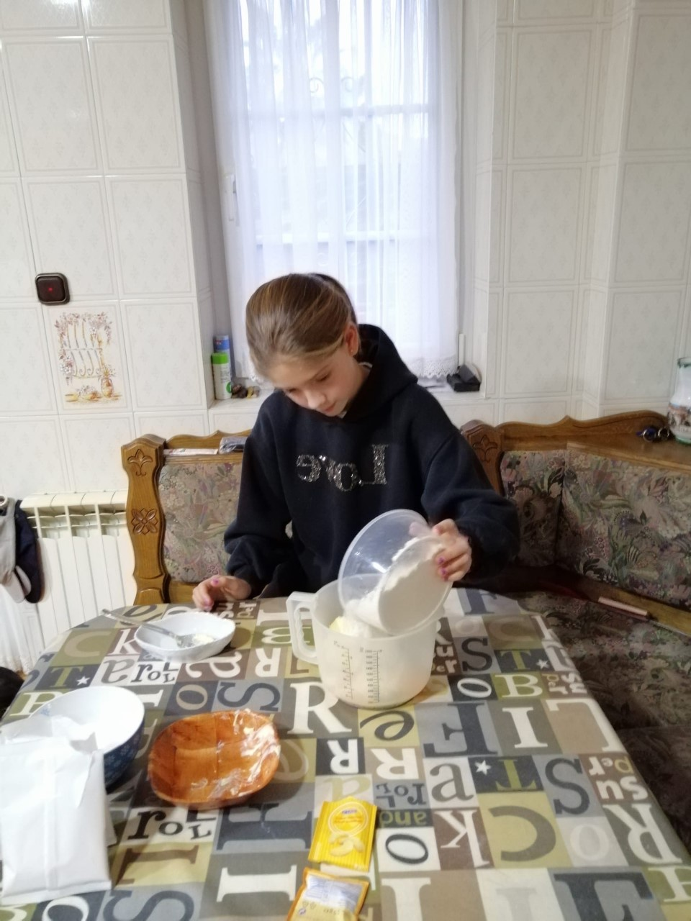
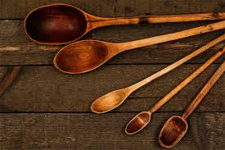
STEP AND STEP
FLOUR

Slide 7
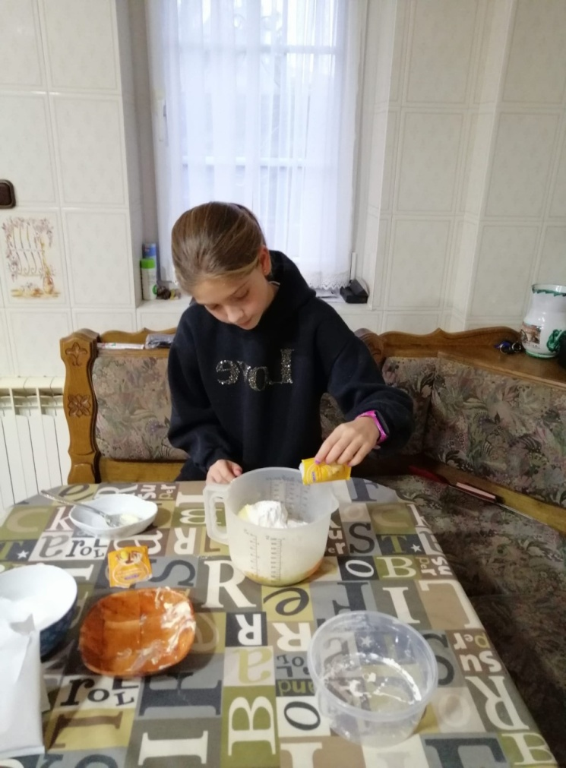
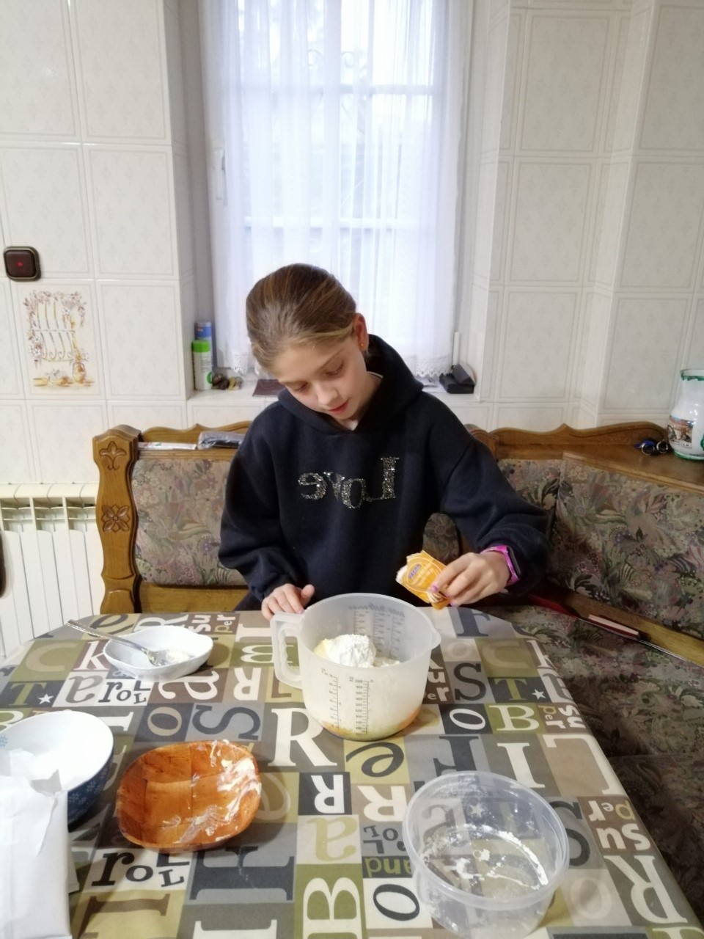
STEP AND STEP
VANILLA SUGAR AND CHENICAL YEAST

Slide 8
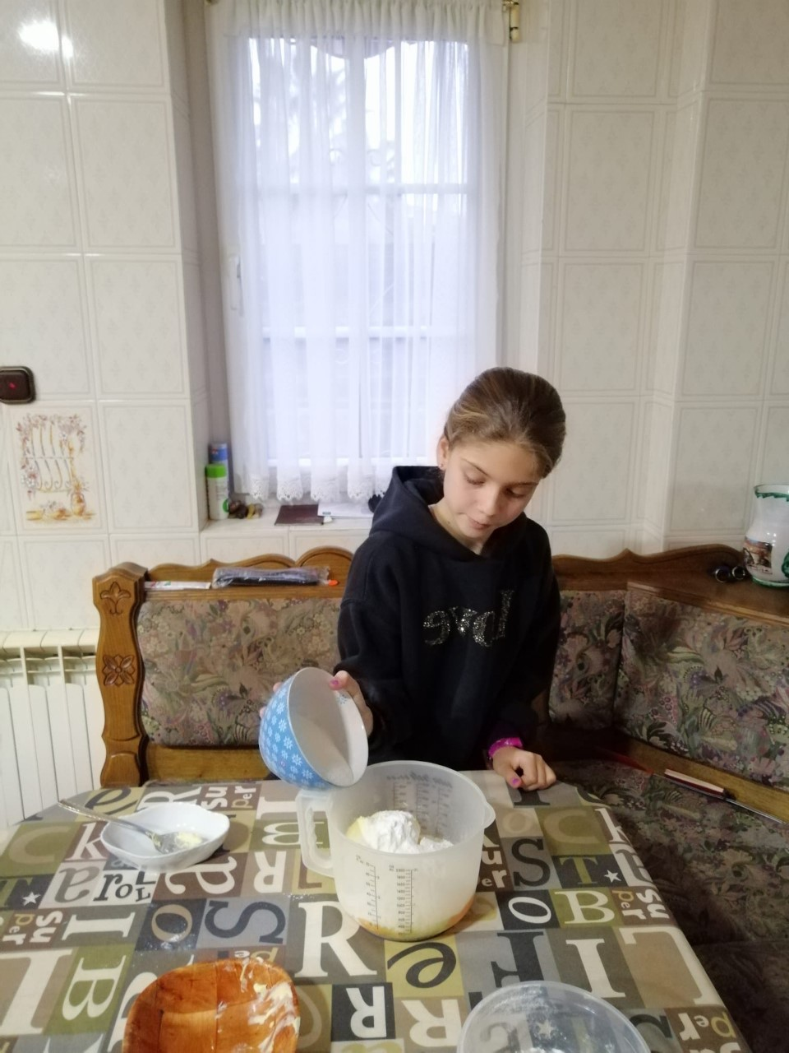
STEP AND STEP
SUGAR

Slide 9
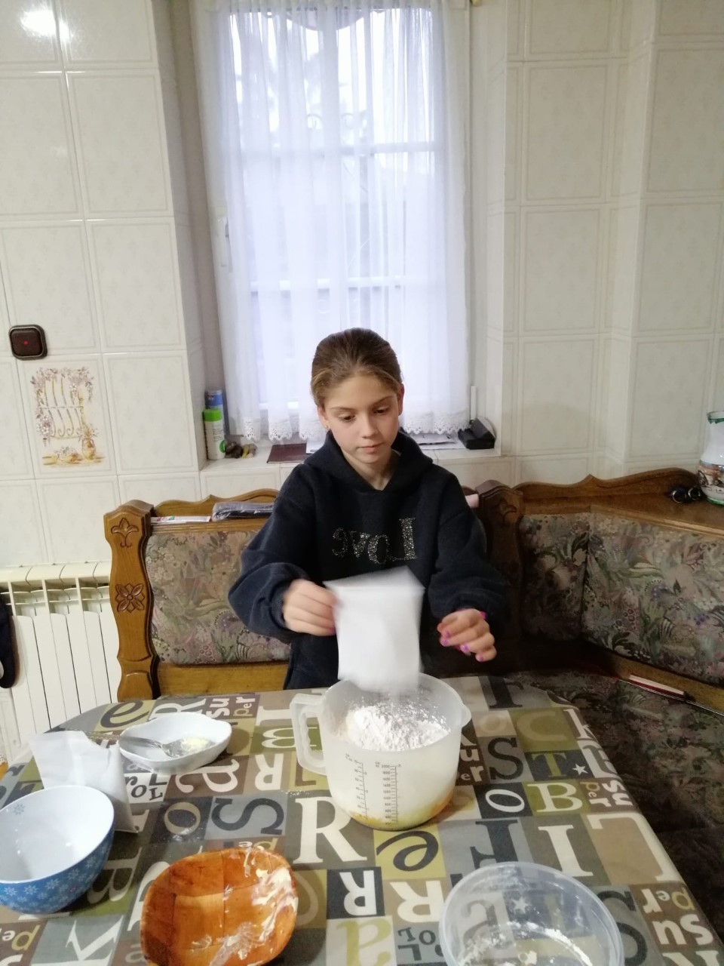
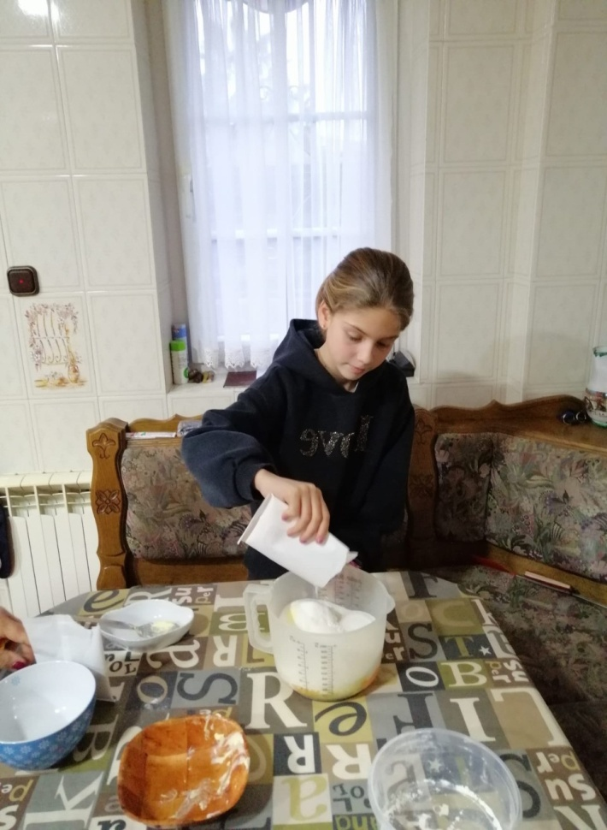
STEP AND STEP
PUDDING

Slide 10
ALL INGREDIENTS ARE BEATEN WITH A BLENDER…

Slide 11
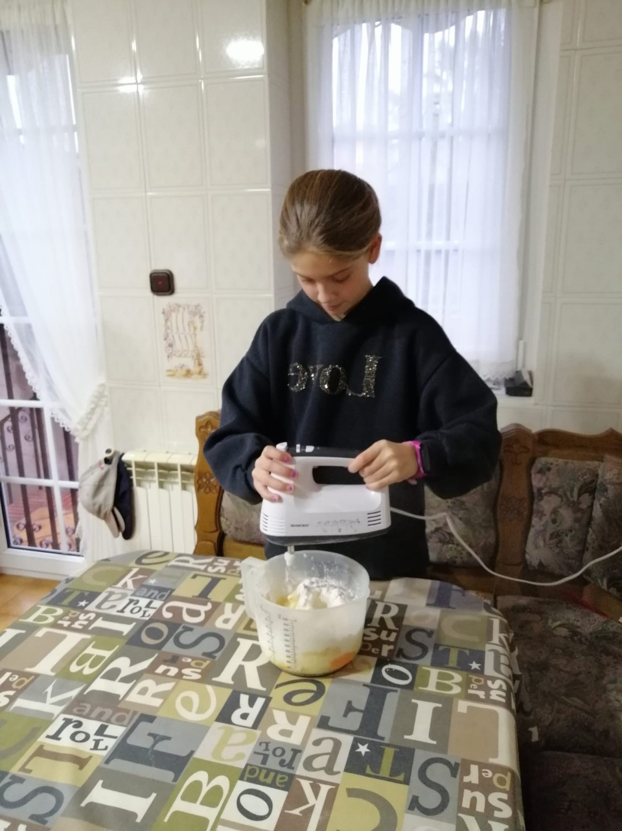
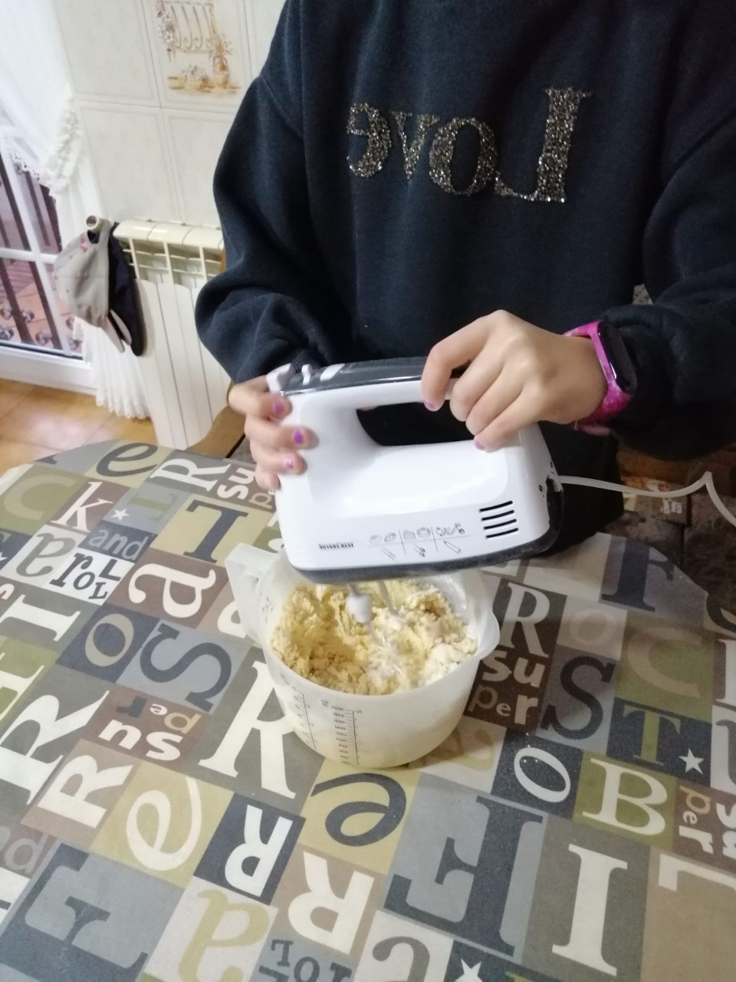

Slide 12
WHEN THE DOUGH IS WELL WIYED, A PASTRY BAG IS INTRODUCED AND COOKIE FORMS ARE MAD

Slide 13
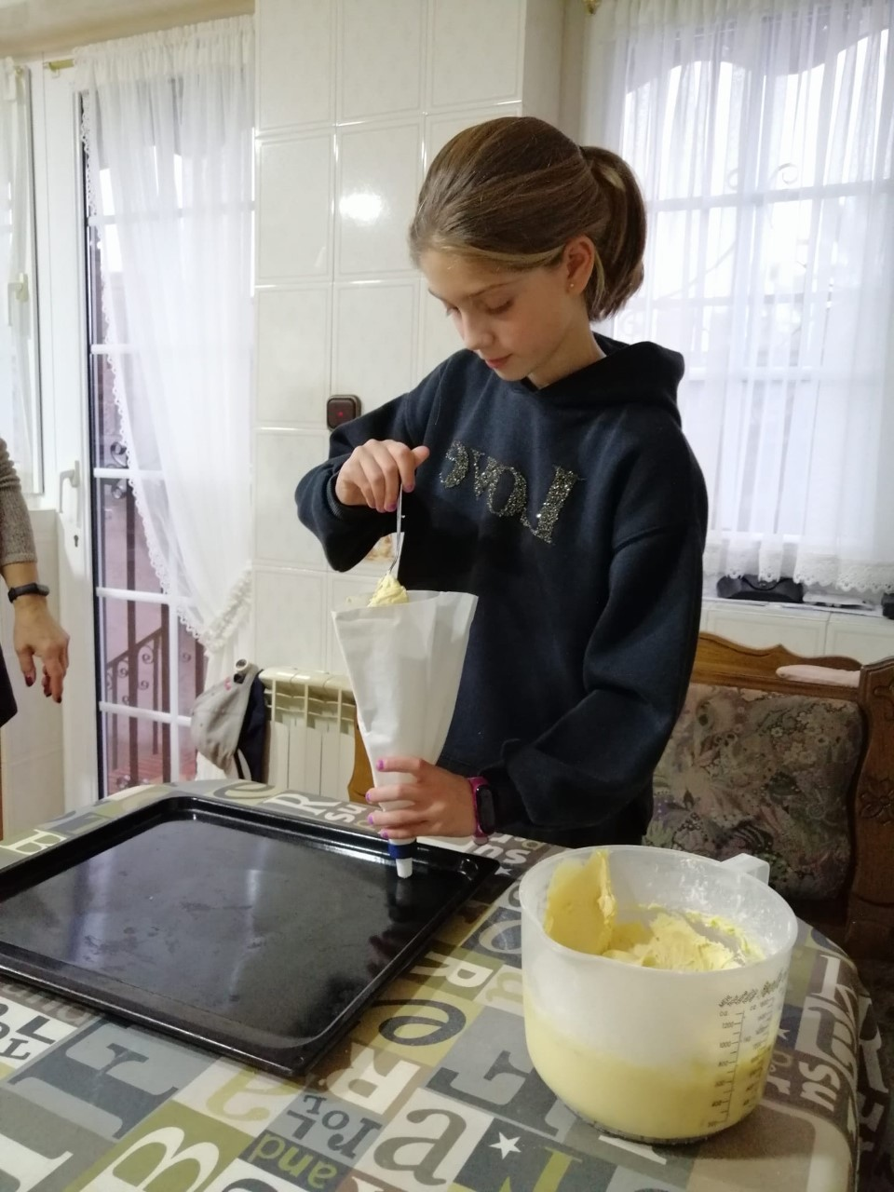
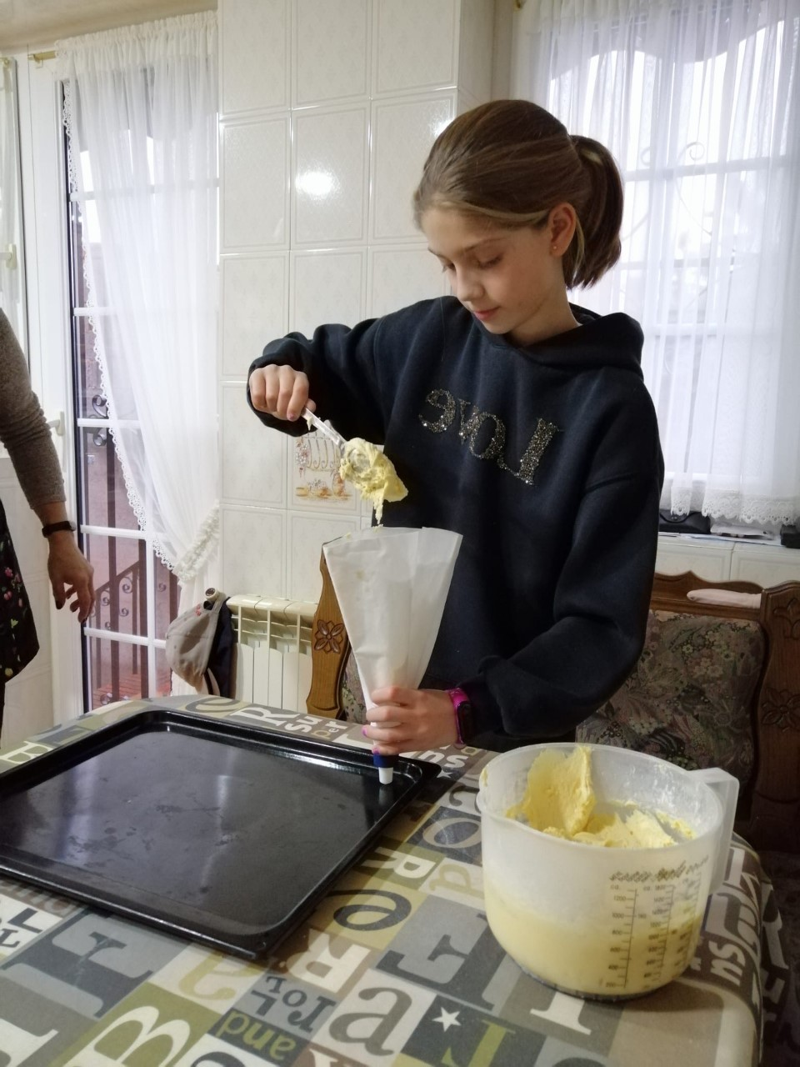

Slide 14
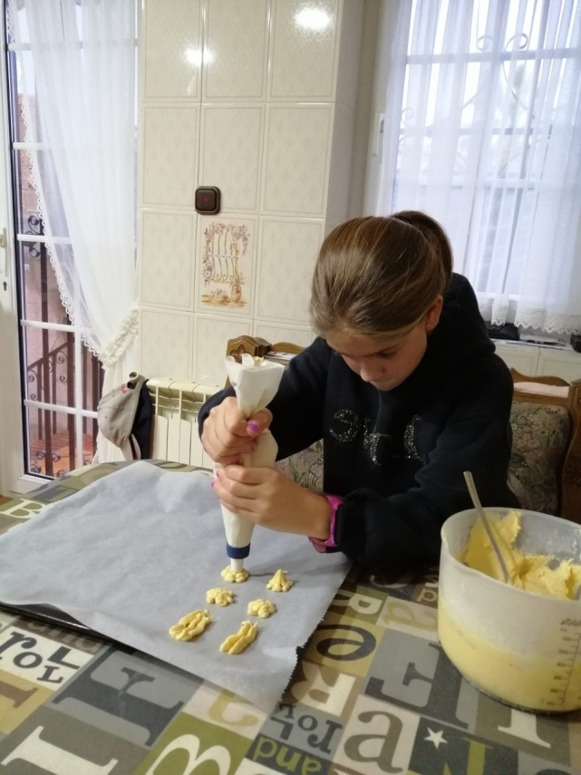
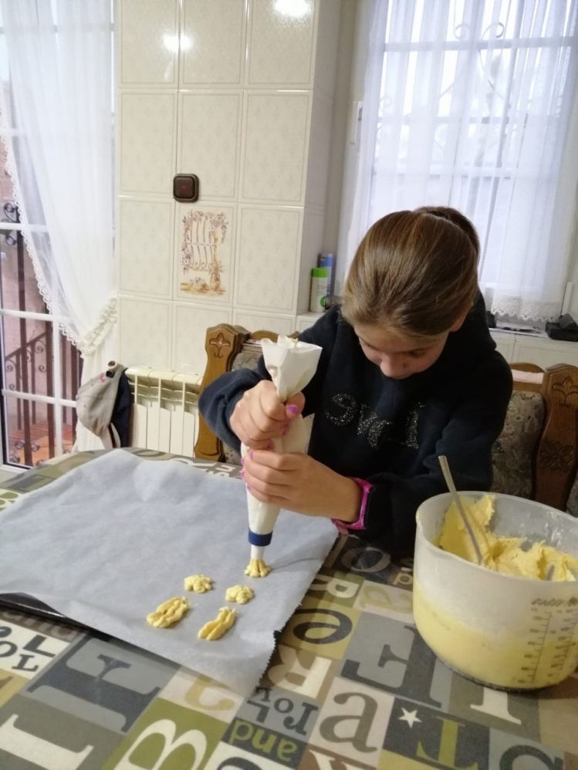
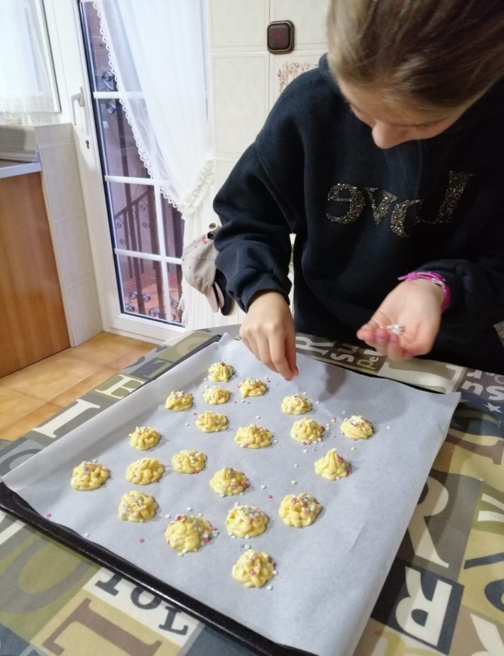

Slide 15
THE COOKIE TRAY IS INTRODUCED IN THE OVEN THAT IS ALREADY PREHEATED TO 220 DEGRESS ABOUT TEN MINUTES OR FIFTEEN MINUTES. THEN STOP COOLING AND READY TO EAT

Slide 16
