Slide 1
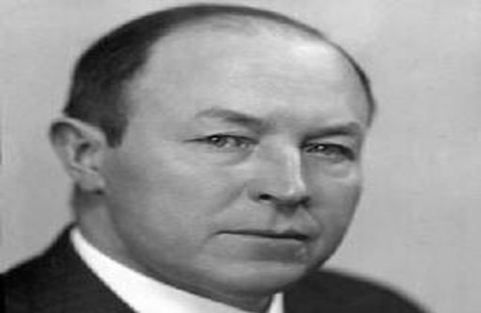
MARTIN BENKA Slovak painter

Slide 4
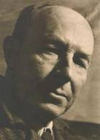
Painter, graphic artist, illustrator, art teacher, national artist

Slide 5
BIOGRAPHY
Martin Benka was born on the 21st September 1888 in Kripnica, todays Kostolište near Malacky.
Martin Benka was the youngest of five siblings.
In the years 1903-1906 he was a painting student in Hodonín. He started to care more and more about real art musical and painting too.
He spent two years at a private school of a Czech painter E. Neumann where a Czech journalist and writer Ján J. Langer noticed his talent and secured him a professional painting course with a significant Czech painter-landscaper Aloise Kalvoda.

Slide 6
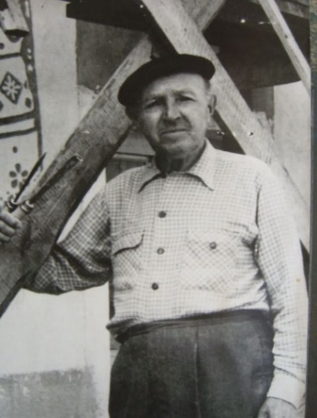
In the 1910 he and theacher J. Štembera displayed their own studies for the first time.
In the 1915 with good references from the press he organized his first own display.
In the 1948 honorary title State Prize Laureate was awarded to him, however he had been awarded several times before. At the occasion of his 65th birthday he became the first Slovak painter awarded by the National artist title and 10 years later in the 1963 he was awarded by the Council of the Republic
for lifelong work.
He died in 1971 at the age of 83.

Slide 7
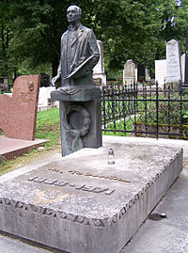
His monument
in the national
Martin Cemetery

Slide 8
CREATION
Benka was the founder moredn Slovak communication in painting and drawing.
He devoted himself to tapestry, scenic art, music and violin making.
He himself created 13 violins they are stored in Martin-Museum of Martin Benka.
Benka created in his studio. Even though he painted nature he couldn´t be disturbet while he was creating. He preferred working alone.
His paintings were based on his studies and drawings from the places he was painting.
He used to say: ,, Nature is my well, book, from which I draw lessons and studio is my shrine.´´
He painted almost 1100 paintings and approx 150 large format oil canvas.
Benka´s artistic activity was very diverse. In his creations he used for example drawing, graphics, sculpture.

Slide 9
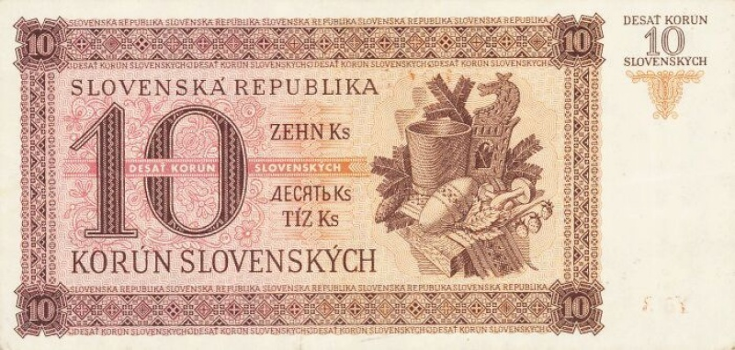
Interest
In 1939, his artworks were used on a 5-crown banknote and on a 10-crown banknote.

Slide 10
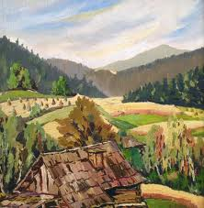
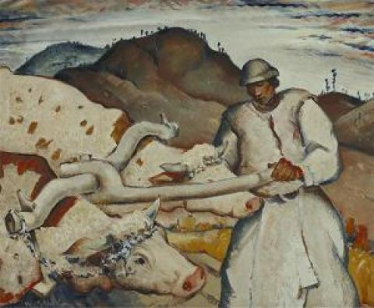
Artworks

Slide 11
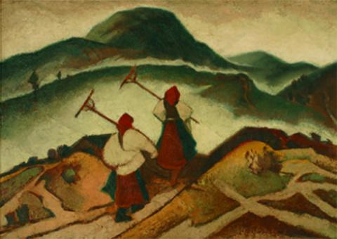
Two women

Slide 12
From harvest

Slide 13
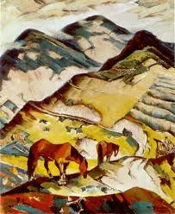
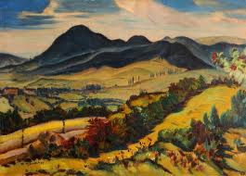
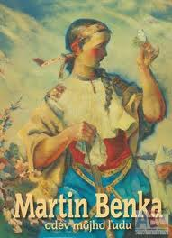
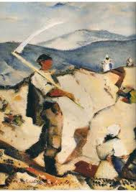
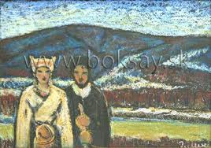

Slide 14
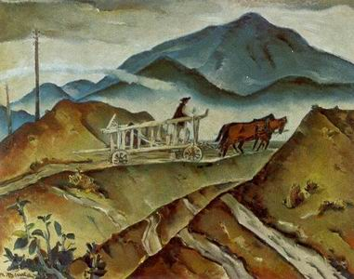
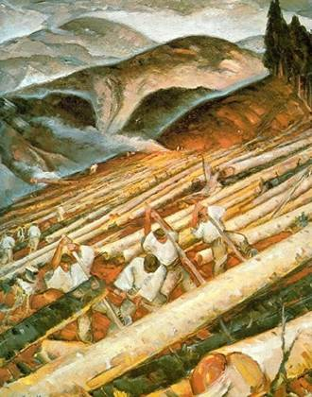

Slide 15
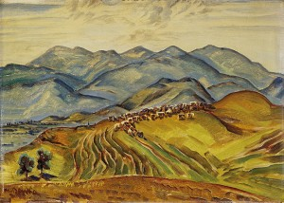
Roháče

Slide 16
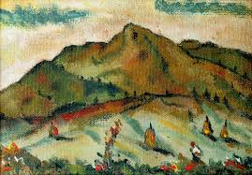
From Liptov

Slide 17
After storm

Slide 18
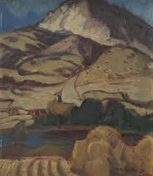
Country

Slide 19
Vineyard

Slide 20
Mikuláš

Slide 21
On the bank of river Revúca

Slide 22
Štrba

Slide 23
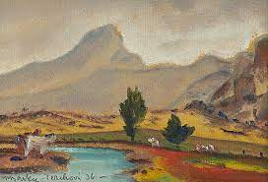
Terchová

Slide 24
In the village

Slide 25
Thank you for interest

