Slide 2
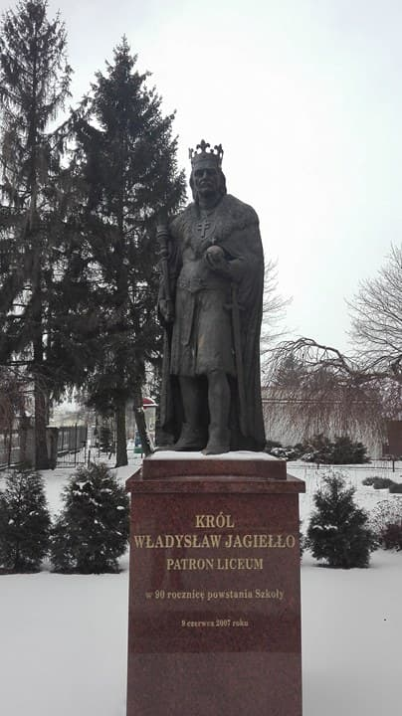
OUR PATRON
1st High School is one of the oldest schools in our town Krasnystaw. Our patron is the king of The Republic of Poland Władysław Jagiełło – ruling the country in the years 1399 – 1434. He’s commemorated by a monument in front of our school.

Slide 3
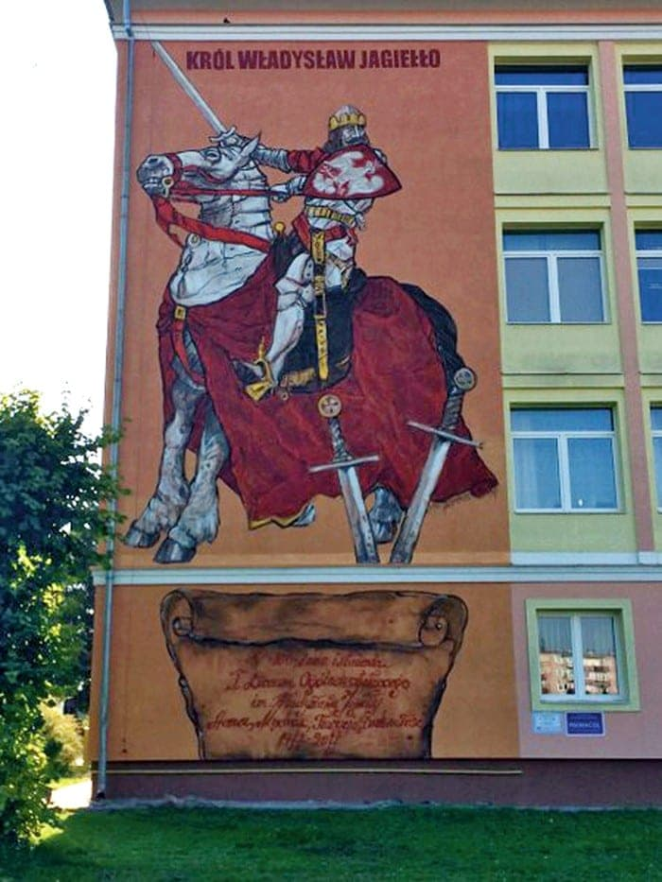
The high school survived times of the wars and communism and it works until now. In 2017, on the occasion of the 100th anniversary of the school’s opening, a mural was made to commemorate The King Władysław Jagiełło, which decorates not only the school, but also the entire town.

Slide 4
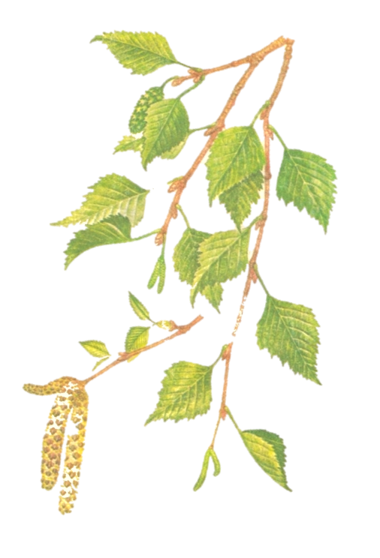
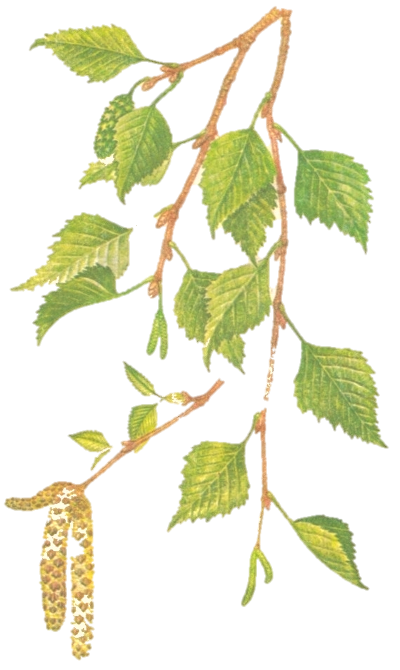
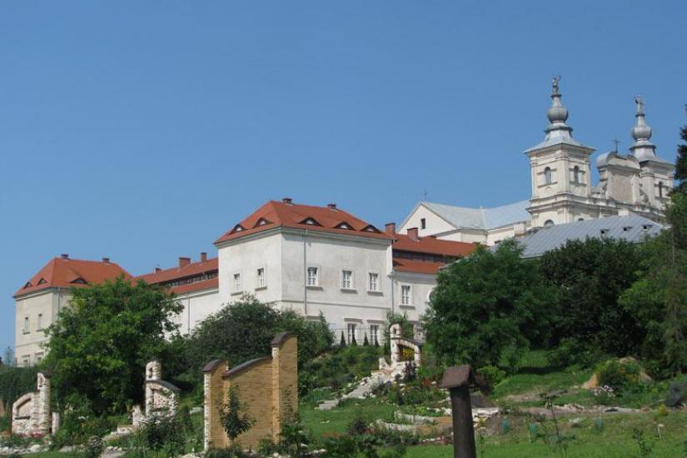
LOCATION
1st high school is located at 50 Poniatowskiego Street, 22-300 Krasnystaw.

Slide 5
Students can choose from several class profiles, for example: humane, mathematical-IT and scientific.

Slide 6
LANGUAGES
Students can choose one additional language that they will learn in the lessons:
German
Spanish
French

Slide 7
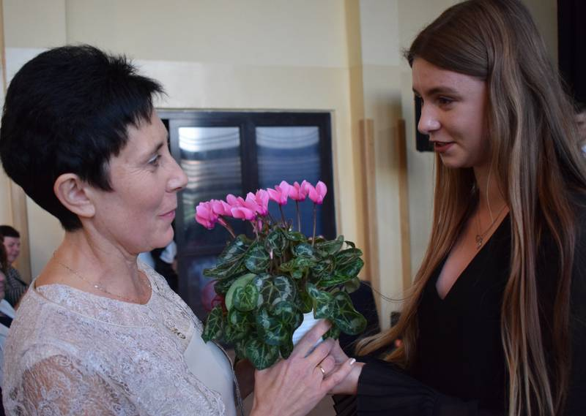
TEACHING STAFF
Our teaching staff consists of 34 teachers headed by Director Anna Patejuk.

Slide 8
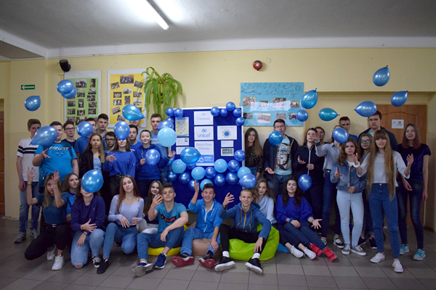
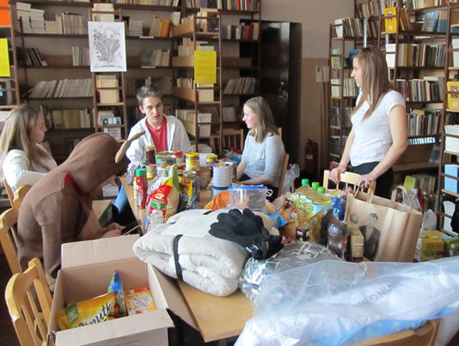
STUDENTS’ GROUP
Student Council is organising many different event and also volunteering, which aims to help those in need. Students readily join in various international projects and engage in activities for the benefit of the school.

Slide 9
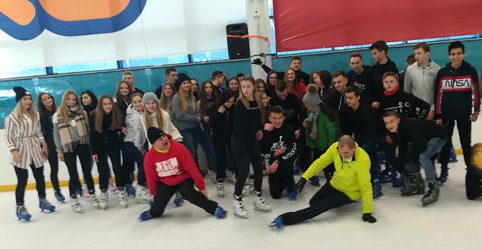
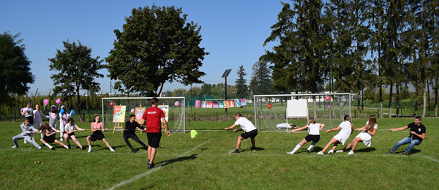
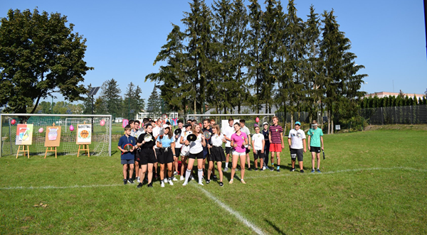
TRADITIONS
Every year in our high school unitiation ceremony is organized to symbolically admit first-graders to the group of students. Also an annual tradition is going to canoe and ice skates to integrate the class.

Slide 10
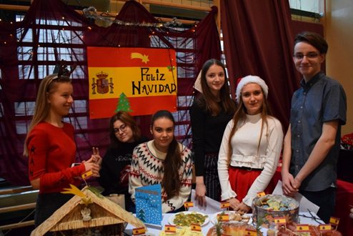
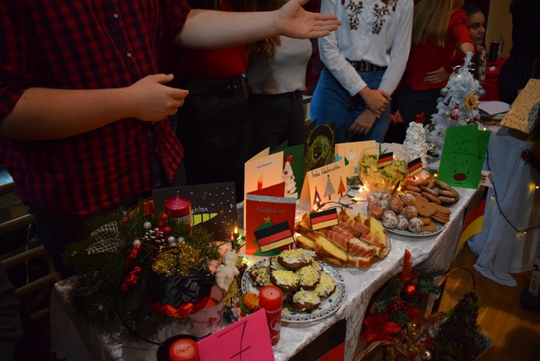
CHRISTMAS MARKET
Christmas market, where students of different classes prepare dishes, costumes, Christmas decorations and carols from the countries selected by them from the list, take place in our school. These countries are Germany, France and Spain.

Slide 11
FUTURE OF JAGIEŁŁO’S STUDENTS
1st high school cooperates in many universities such as: Warsaw School of Economics, Lublin University of Technology, Maria Skłodowska - Curie University, Medical University of Lublin, Catholic University of Lublin named after John Paul II, Higher School of Entrepreneurship and Administration, Higher School of Economics and Innovation in Lublin. This cooperation allows students of our school to go on research, workshops and lectures in these institutions. Every year, trips to universities are organized, enabling students to broaden their knowledge in the field of physics, mathematics, computer science, medicine or the humanities.

Slide 12
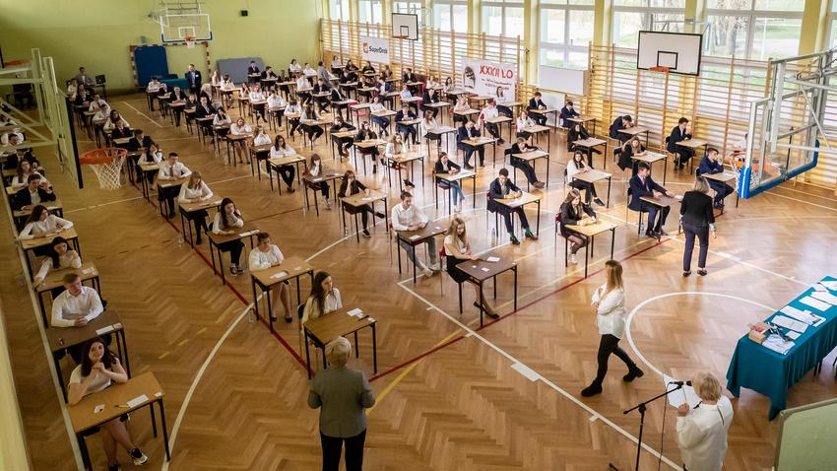
FINAL EXAMS
The Matura exam is test our knowledge from several years of education. Our school has been achieving excellent results for a long time, thus beating the schools in the area. The subjects we have to take are English mathematics and Polish, in addition, we can choose, for example, Biology, chemistry, geography, history or computer science. What university we get depends on the results of the Matura exam.

Slide 13
STUDNIÓWKA
„Studniówka” is an annual tradition in every high school in Poland. We can compare it to Prom. It’s organised between January and February to symbolically celebrate 100 days until Matura exam. Students of the last grade are gathering for example in a venue or in school building. Their outfits are gracious - everyone usually wears fancy dresses or suits. At the beginning, everyone is supposed to dance traditional elegant dance - „polonez”, in pairs. Then, the party starts. Students eat, dance to cheerful hits and just spend time together laughing and talking. „Studniówka” is an event which almost every student of high school waits for.

Slide 14
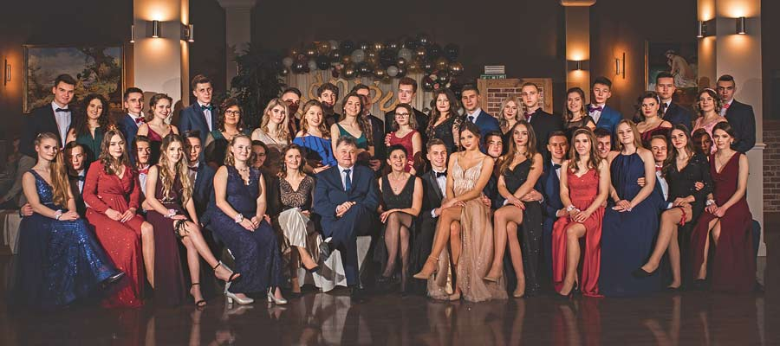

Slide 15
EXCELLENT STUDENTS
Our school boast its numerous group of students, which are laureates of competitions and scientific olympics. Varied events and competitions organised here, make studying more attractive and create imaginative atmosphere. According to rankings, 1st High School is one of the best in our region, or even in whole Poland.

Slide 16
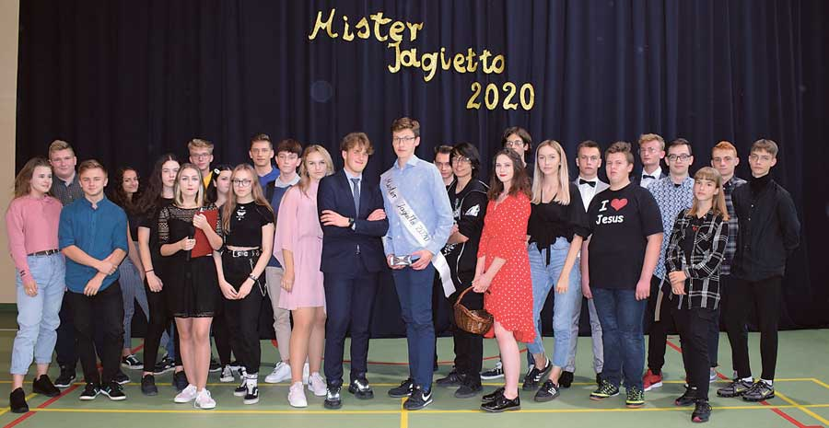
We are very proud that we can study in 1st High School in Krasnystaw and we hope you can visit us some day.

Slide 17
FIND US!!!
Website: 1lokrasnystaw.pl
Facebook’s group: I LO im. Władysława Jagiełły w Krasnymstawie
Instagram profile: jagiellokrasnystaw

