Slide 1
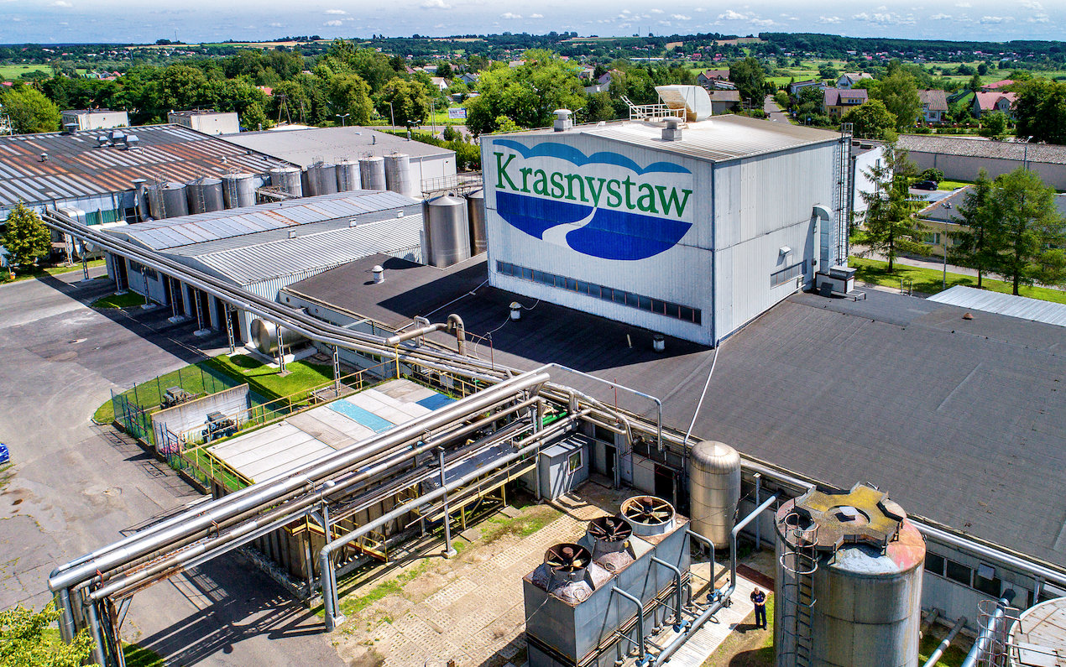
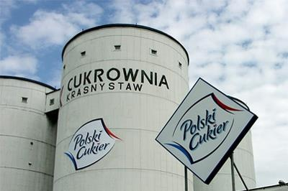
industry

Slide 2
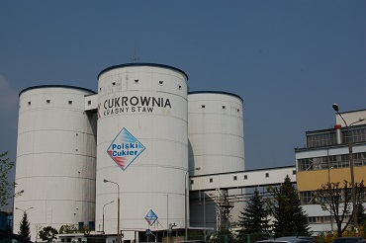
Sugar mill „Krasnystaw”
Sugar mill in Krasnystaw was built in 70s ages. It's the biggest sugar factory in the area.

Slide 3
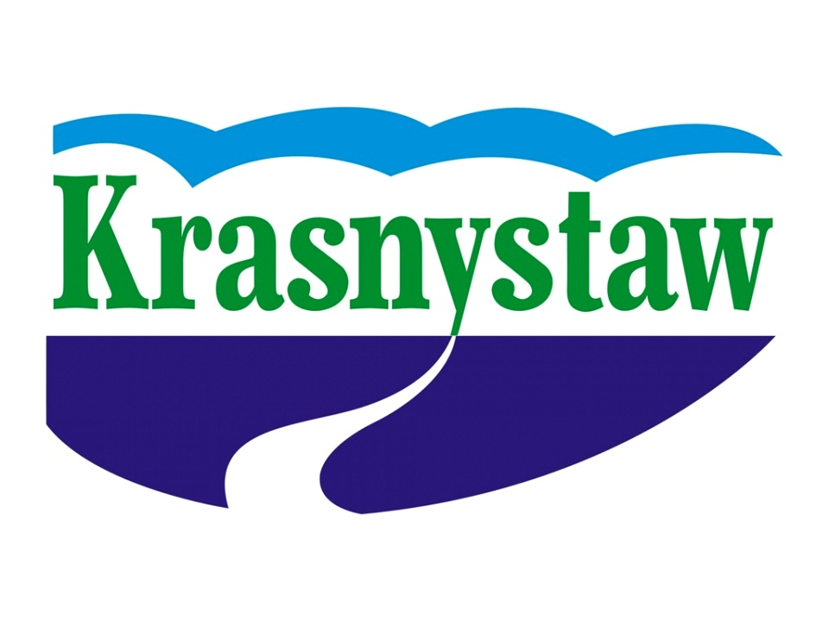
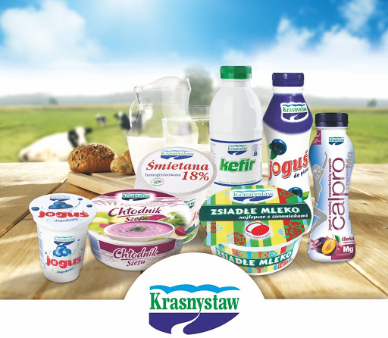
Dairy in Krasnystaw
Dairy in Krasnystaw was built in 1913. During the First World War, Krasnystaw was the place of military operations, so dairy and tools were
destroyed, and cattle were stolen. After the war, dairy was closed to 1924. But in the next ages, dairy began to function and work to this day. Milk delivers 2000 suppliers from Lublin voivodeship and is employed, 600 people. Annually dairy in Krasnystaw produces 160 million liters of milk.

Slide 4
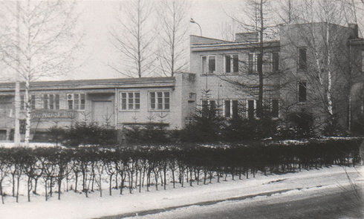
tobacco fermentation plant
The company started its activity in 1951 it operated until 2018 but was closed. It operated for 70 years and employed many employees.

Slide 5
Cerasanit
The company producing sanitary ceramics like bathroom equipment has been operating since 1992. About 1,000 people work there.

