Slide 1
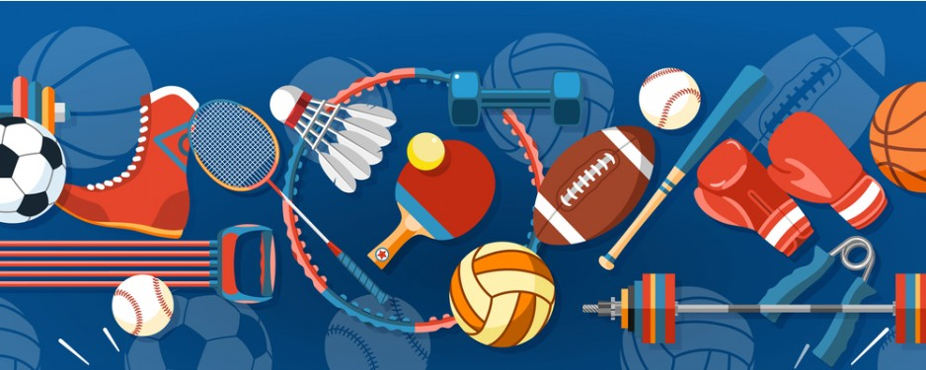
Sporty Krasnystaw
Igor bukowski

Slide 2
Sports obcject
Sports clubs
Sports, wich we can play.

Slide 3
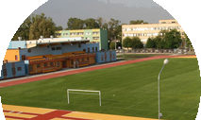
Sports infrastructure :
9 Sports hall
13 football pitch
7 basketball court
Bike trails Green velo
Xtreme fitness gym
swimming pool
5 outdoor gym
Ławczeki bike park
Forest bike trails
Stadium Start Krasnystaw 1944
Tenis court
The most important sports object in our city:
MOSIR Krasnystaw
Green velo
Swimming pool

Slide 4
Sports club:
Uks jedynka Krasnystaw- Football club
Start 1944 Krasnystaw – Football club
Uks rocky Krasnystaw – Boxing club
Wodnik Krasnystaw – Swiminng club
Kps Krasnystaw – Volleyball club
Lmks krasnysatw – Wrestling club
Gladio Krasnystaw – MMA club
Kinga Krasnystaw – female football club
K1 kickboxing Krasnystaw – kickboxing club

Slide 5
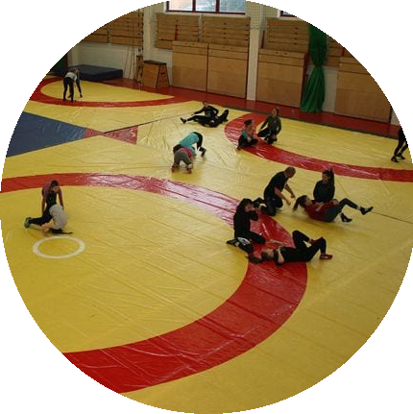
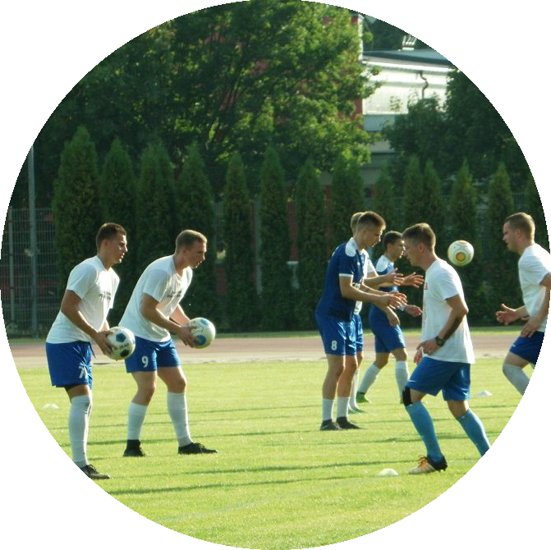
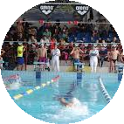
Sports, wich we can play in our city:
Footbal
Volleyball
Basketball
Handball
Swimming
Ride a bike
Wrestling
MMA
Kickboxing
Boxing
Running
Calisthenics

Slide 6
Sports successes of our residents
In wrestling, representants of our city,got a europe champions, and a lot of Polish champions.
Club from our city(UKS Jedynka Krasnystaw) played in all-poland tournament”Tymbark- z podwórka na stadion” and they got 2nd place.
In swimming, representants of our city stayed on the podium many times in the Polish championship

