Slide 1
II Liceum Ogólnokształcące im. C. K. Norwida w Krasnymstawie kk

Slide 2
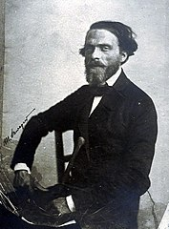
The patron of our school is an outstanding Polish poet Cyprian Kamil Norwid

Slide 3
This is what our school looks like

Slide 4
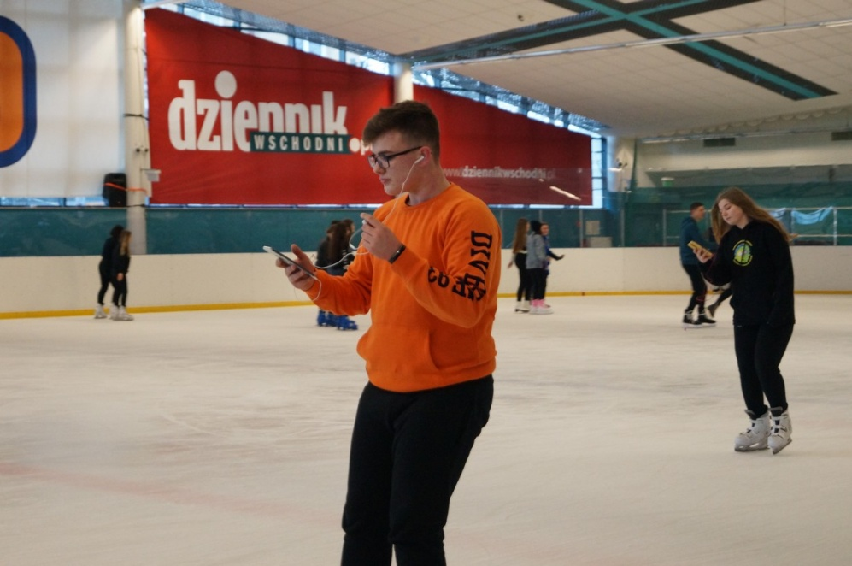
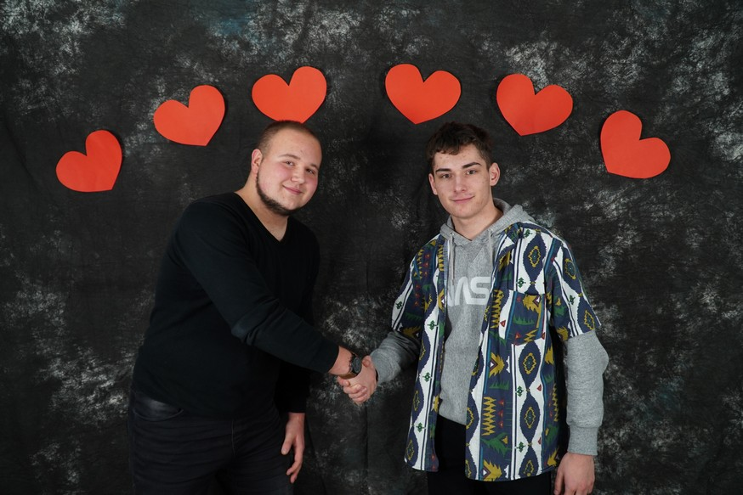
Our school currently teaches ten classes in which there are wonderful and energetic people themselves

Slide 5
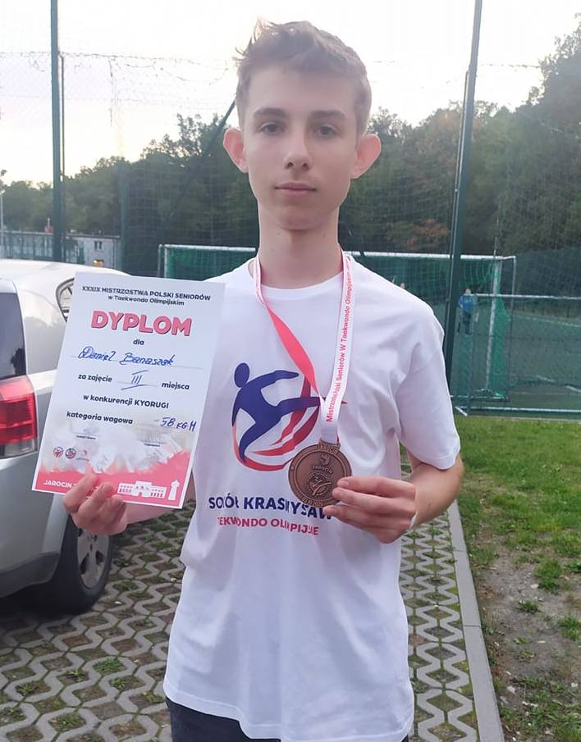
There is a sports club in our school supervised by our PE teachers

Slide 6
We learn four languages in our school
Those are :
Spanish
French
English
German

Slide 7
Our school has a student council chaired by Mikołaj Raczkowski

Slide 8
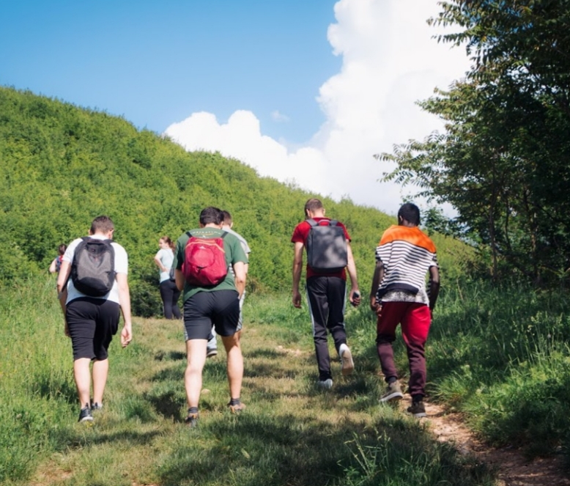
Our school takes part in many projects, for example Erasmus+

Slide 9
There is a voluntary service at our school

Slide 10
In our school we also have a Youth Film Discussion Club - MDKF "ILUZJON"

Slide 11
Thank you for your attention and see you soon ☺
Mikołaj Raczkowski

