Slide 1
CZECH CHRISTMAS
MERRY CHRISTMAS

Slide 2
When do we celebrate?
We celebrate Christmas in the Czech Republic on 24 December. We have dinner around five o´clock in the afternoon and we eat Christmas dinner. Somebody goes to Mass at Christmas. We open presents after the dinner and we are very happy.

Slide 3
What do we eat?
We sit together at the table and some families eat their soup from one plate. Noone can leave the table except the host. For dinner we have a pea soup and fried carp with potato salad.

Slide 4
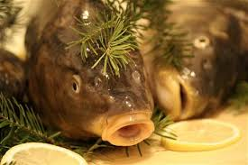
Christmas tradition
Before people eat the carp they usually put their carp into a tub. Some people put them back in the river. Carp as a Christmas dinner can be problem when eating is because a bone can get stuck in the throat.

Slide 5
Christmas tree
The tradition comes from Germany. Lights on the tree symbolize stars and star on the top symbolizes that of Bethlem. Before people decorate Christmas tree with fruit that the next year´s harvest wished. Ornaments on the tree also marked the biggest wishes of the people which had hoped to meet.

Slide 6
When setting the table
We put the coins or fish scales under the plate of Christmas Eve dinner. We put the things there because we wish our family good luck and a lot of money to the next year.

Slide 7
Christmas dinner
If it is an odd number of people at Christmas table, we arrange one place more to have an even number of places.
One empty seat is for a possible guest.

Slide 8
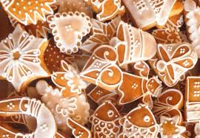
Christmas sweets
Making Christmas sweets is one of the many traditions of Christmas.
We make Christmas sweets with our family each year.
We usually make several types.
There are a lot of great Czech Christmas sweets.

Slide 9
Who brings presents?
A baby Jesus brings presents here.
He is a son of the God.
He was born 24thDecember in the Bethlem of the virgin Mary and Joseph.

Slide 10
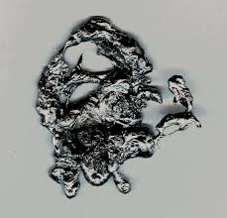
Old traditions – pouring hot lead
At Christams we pour hot lead into the cold water. Lead creates a shape or a symbol of which we can predict what will happen in our future.

Slide 11
Kissing under the mistletoe
Kising under mistletoe is typical Czech tradition. People hang mistletoe on doorframe. Pairs that love each other kiss under the mistletoe. They will love each other the next year too.

Slide 12
Cutting apples
At Christmas people usually slice an apple to see their future. When there is a star, it means that we' will be lucky, but if there is a cross, it means a disaster for us.

Slide 13
Throwing a shoe
This tradition was to reveal a young unmarried girls if she gets married next year. The girl who wants to check it on Chrismas Eve, she must stand with her back to the door, she thows her shoe over her shoulder. If the toe shoes points out to the door, it means that the girl (in question) would marry within a year. If not, next year will remain single.

Slide 14
Floating nutshells
You make little boats of nutshells with burning candles. You put it in the bowl of water. Tradition says that if the boat floats, you will leave your home, if it stops, you will stay at home. When the two nutshells meet, you will fall in love with somebody.
Let´s try it, you will have fun.

Slide 15
New Year Eve
On New Year Eve people usually get together, have a fun, watch TV, sip drinks and watch fireworks after midnight.

Slide 16
New Year´s lunch
On New Year we must not eat anything with feathers - poultry. Our luck could disappear.
There must be lentils or peas on your table, because they bring wealth.

Slide 17
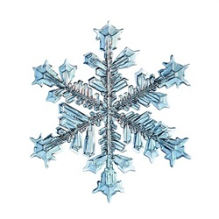
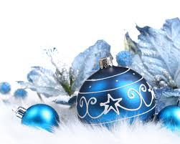
Czech eTwinning masters wish you MERRY CHRISTMAS and HAPPY NEW YEAR 2017!

