Slide 1
Croatian students present Turkey
PROJECT LIVE, LEARN AND WORK IN A DIGITAL SOCIETY

Slide 2
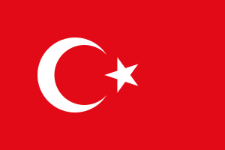
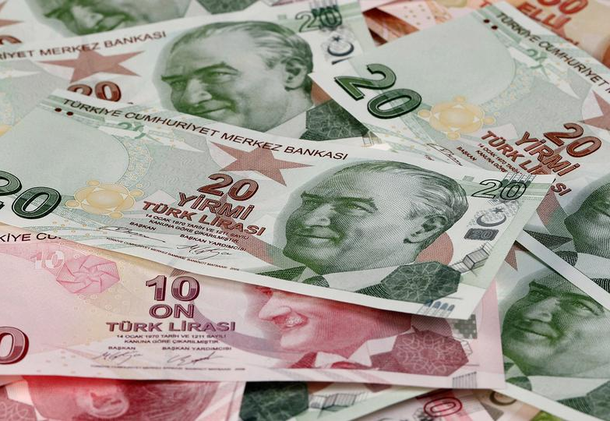
Basic facts about Turkey
OFFICIAL NAME: Republic of Turkey
FORM OF GOVERNMENT: Parliamentary democracy
CAPITAL: Ankara
AREA: 783,562 square kilometers
POPULATION: 84.34 million
OFFICIAL LANGUAGE: Turkish
Flag
Many: Turkish lira

Slide 3
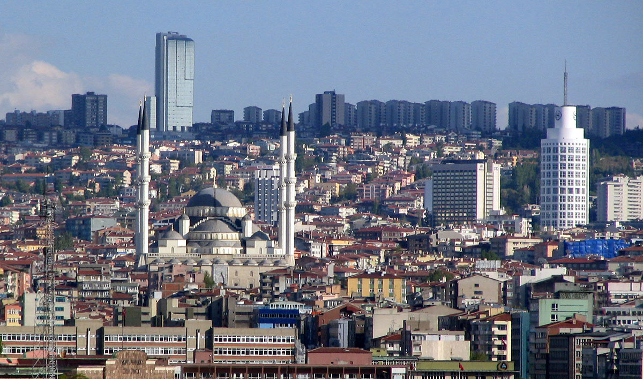
Capital city
The capital of Turkey is Ankara.
It lies about 200 km south of the Black Sea.
It became capital in 1923.

Slide 4
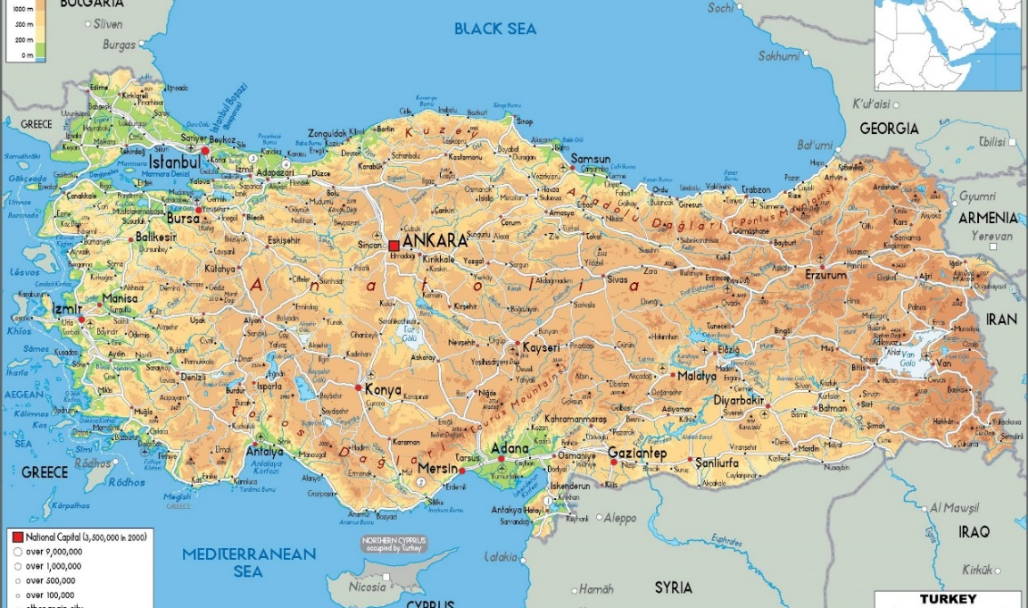
Geographic position
Turkey occupies a unique geographic position, lying partly in Asia and partly in Europe.
Turkey is a large peninsula surrounded on three sides by the Black Sea, the Mediterranean Sea, and the Aegean Sea
It borders with Greece and Bulgaria to the northwest; the Black Sea to the north; Georgia to the northeast; Armenia, Azerbaijan, and Iran to the east; Iraq to the southeast; Syria and the Mediterranean Sea to the south; and the Aegean Sea to the west.

Slide 5
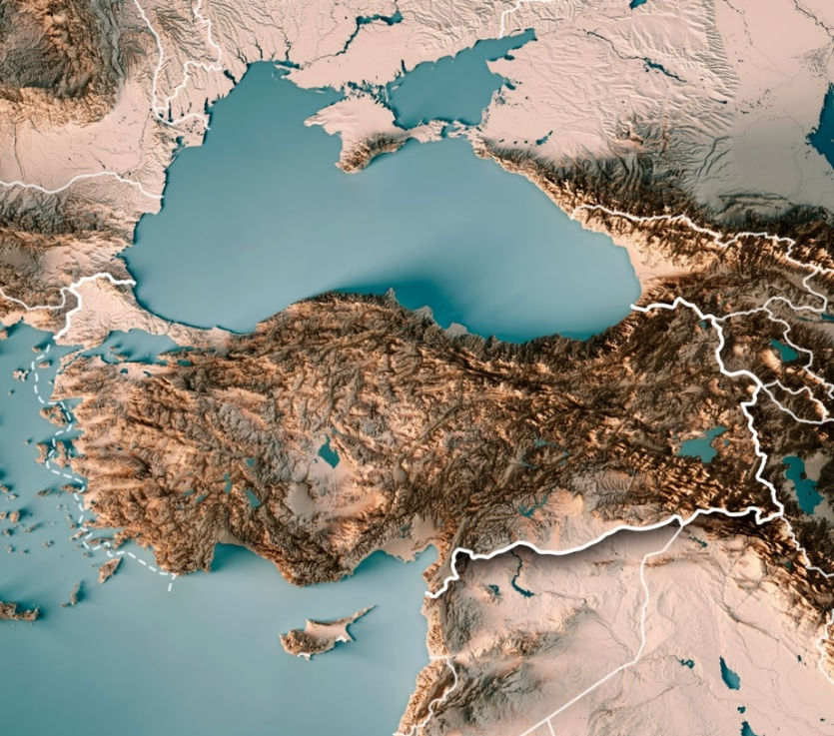
Geology
Turkey is predominantly mountain country.
Ararat is the highest mountain in Turkey, a 5165 meters high. It has two peaks. In the Bible, this mountain is mentioned as the place where Noah's ark was stranded.

Slide 6
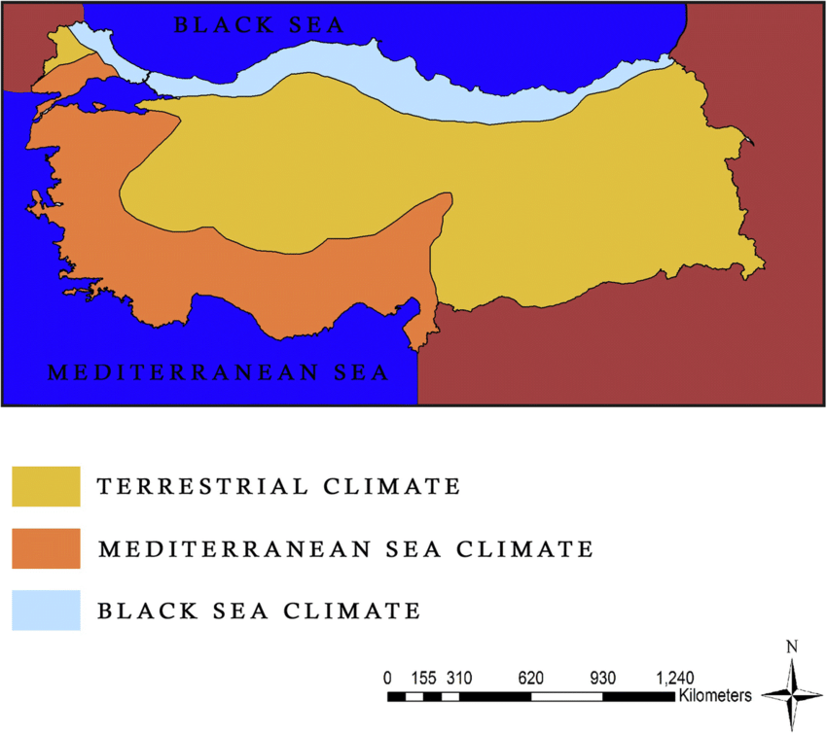
Climate
Mediterranean climate has hot, dry summers and mild to cool, wet winters.
Black Sea climate has warm and wet summers and cool to cold, wet winters.
Terrestrial climate has hot and dry summers, cold and harsh winters.

Slide 7
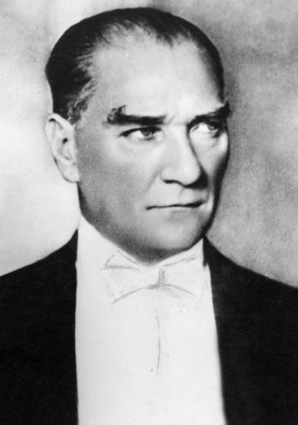
History
Turkey has a rich history.
The Asia Minor Peninsula, which makes up most of Turkey's territory, is one of the world's oldest permanently inhabited areas.
Turkey has a lot of archeological sites.
The most famous historical figure is Mustafa Kemal Atatürk - the founder of the modern Turkish state
Mustafa Kemal Atatürk

Slide 8
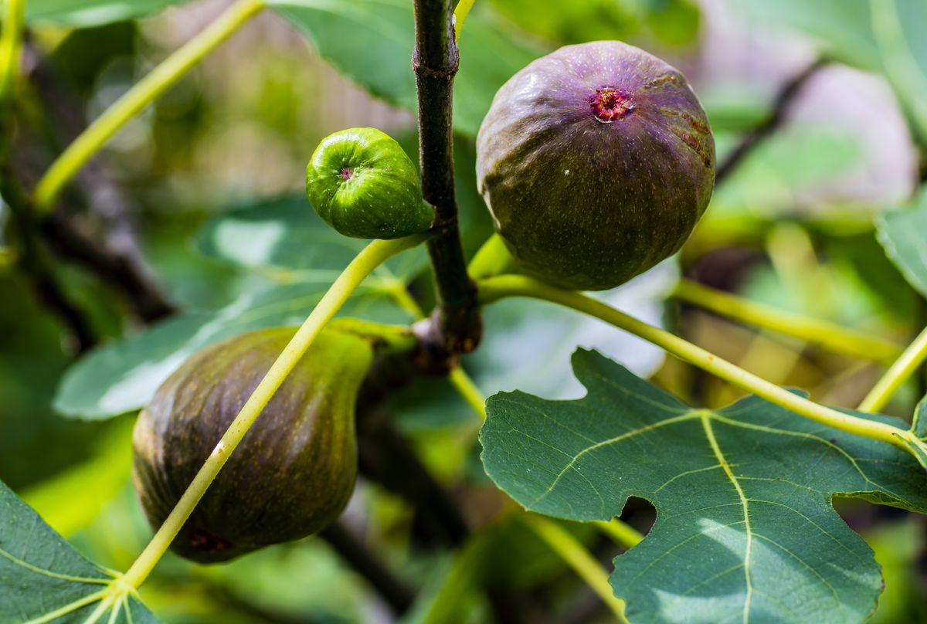
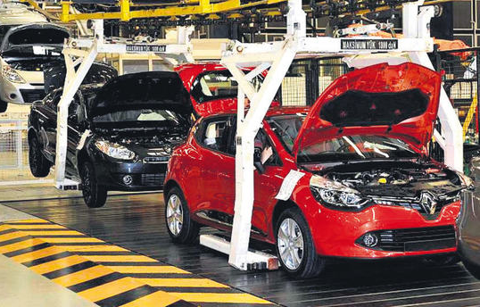
Agriculture and economy
Turkey is the fastest growing economy in Europe.
Turkey is the world's 7th largest agricultural producer, and a top producer and exporter of crops ranging from hazelnuts and chestnuts to apricots, cherries, figs, olives, tobacco and tea.
The top exports include cars, vehicle parts, raw iron bars, delivery trucks, jewelry, apparel and textiles.
One of the most important and developing economic branches is tourism.

Slide 9
Turkey has a lot of interesting places especially many natural beauties and historical monuments.

Slide 10
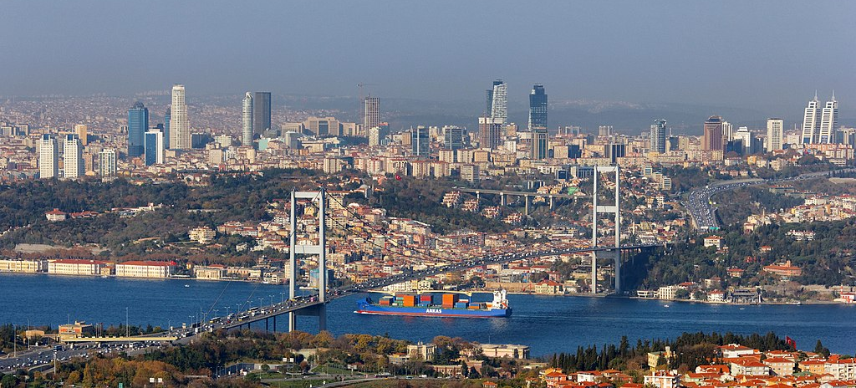
Istanbul
The largest and the most famous city in Turkey.
It is partly in Europe and partly in Asia.
It is built on land in the Bosporus seaway.
It has a population of 15.46 million.
It is the former capital of three great empires - Roman, Byzantine and Ottoman Empire.

Slide 11
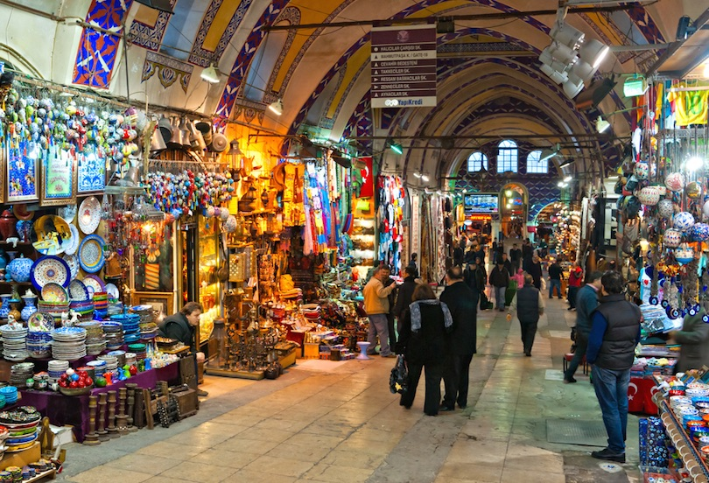
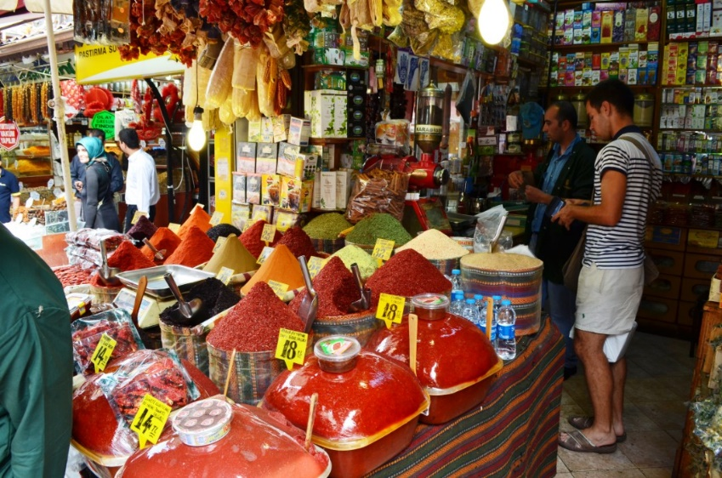
Sights of Istanbul
Hagia Sophia
Blue Mosque
Grand Bazaar
Space Bazaar

Slide 12
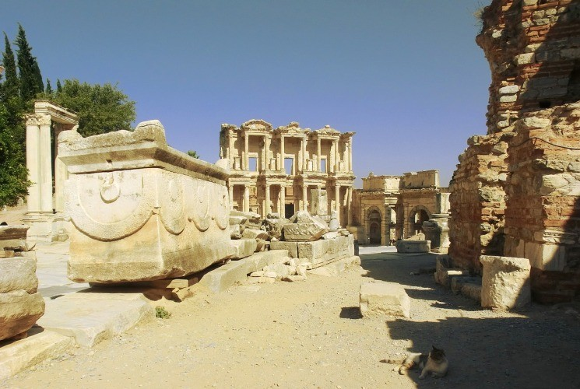
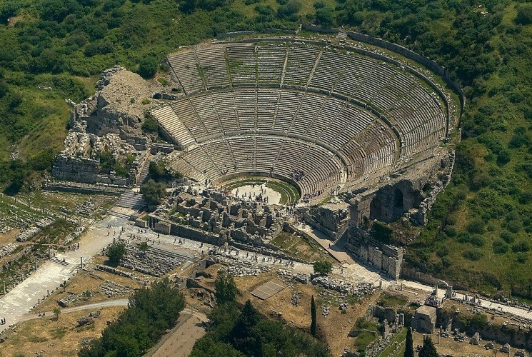
Efes
The ancient city of Ephesus is the most important archeological site in Turkey, and one of the most famous ancient cities in the whole world.
At its peak, Ephesus was the capital of the Roman province of Asia Minor and one of the largest commercial ports in the ancient world.

Slide 13
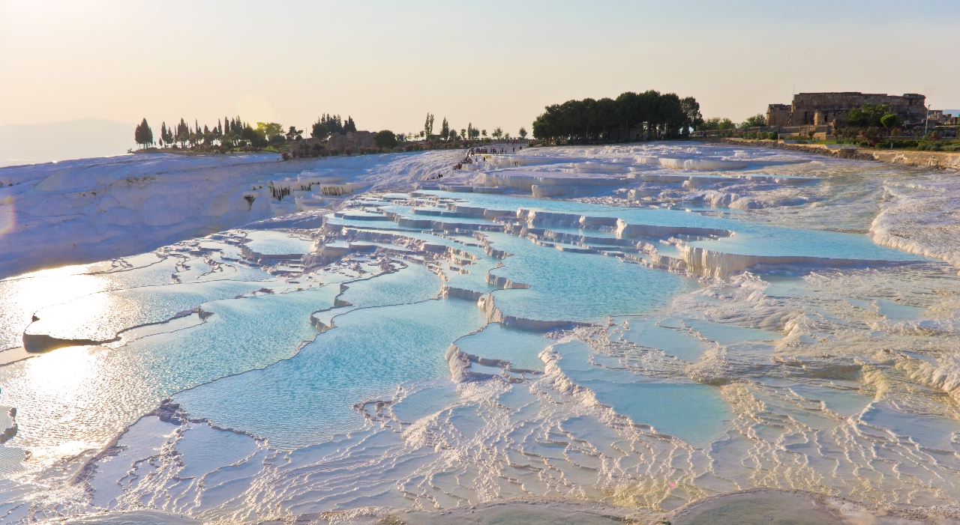
Pammukkale
The white cliffs in Pamukkale in western Turkey are made of a calcium-rich mineral called travertine.
Pamukkale is called the ‘cotton castle’ by literal translation.
There are 17 hot water springs.
The water that appears from the hot springs is at a temperature that ranges from 35°C to 100°C

Slide 14
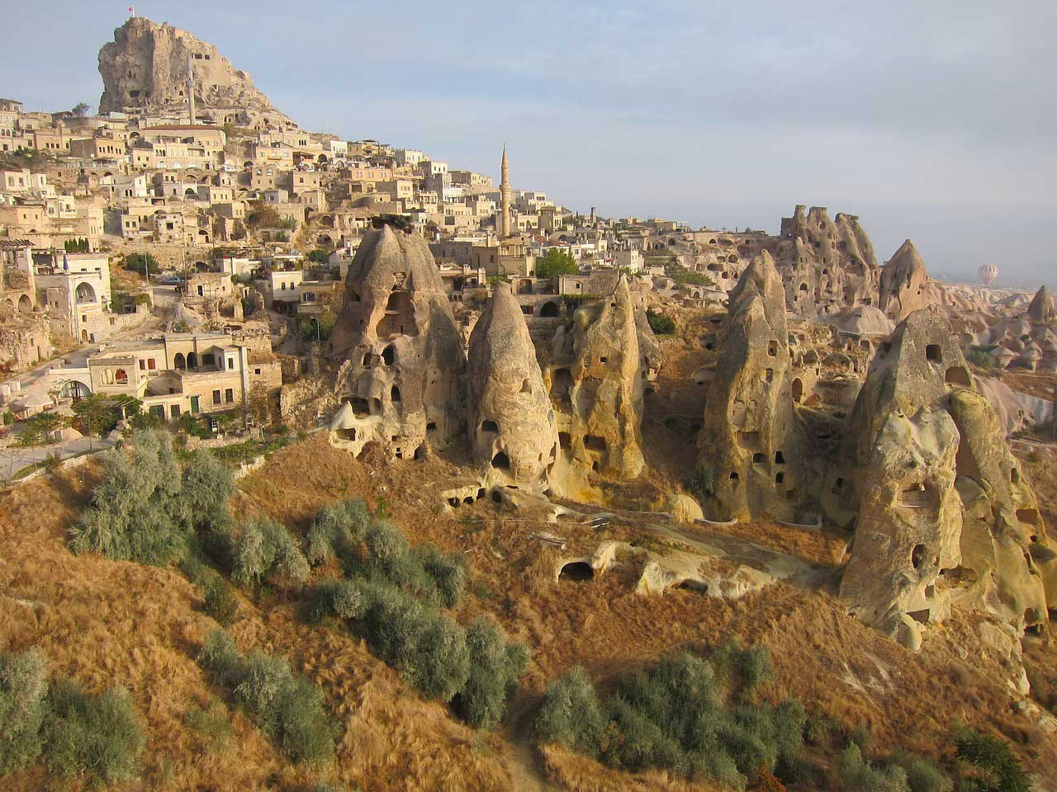
Cappadocia
Cappadocia is a Turkish region, a place full of breathtaking beauty and unique stone formations.
Those unusual rocks were formed by the action of volcanoes and winds.
Ancient people built their homes and shrines in these unique rocks.

Slide 15
Turkey - a resting location for birds
Turkey is a resting location for birds on their migratory journey between their summer and winter homes.
The wetlands in the eastern Mediterranean region of the country are places where the flocks of birds rest and regain their strength for long flights.
Turkey is home to more than 400 migratory bird species making it a unique place for bird-watching enthusiasts.

Slide 16
Relations between Turkey and Croatia
Common words
Some dishes
Popular tv series

Slide 17
Many Croatian words originate from Turkish
CROATIAN | TURKISH | ENGLISH
džezva | džezva | coffee pot
jastuk | yastık | pillow
jogurt | yoğurt | yogurt
pamuk | pamuk | cotton
majmun | maymun | monkey
tamburica | tamburitza | traditional instrument

Slide 18
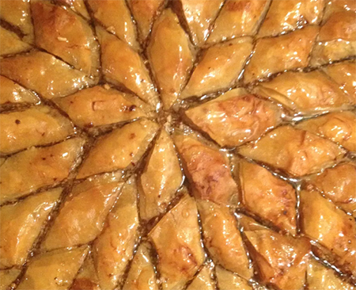
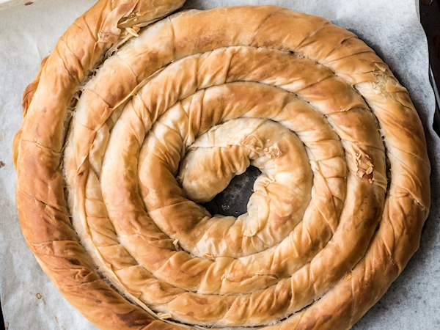
In Croatia we have favorite dishes that originate from Turkey
Baklava
Burek

Slide 19
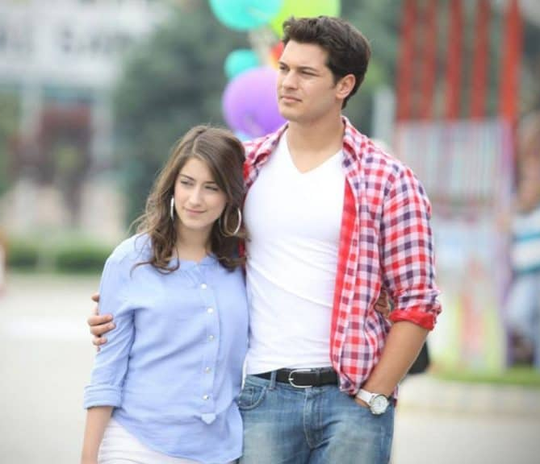
Turkish TV series
About ten years ago, Turkish TV series appeared in Croatia and became very popular.
Almost half a million Croats watch Turkish series every day.
A girl named Feriha
When the leaves fall

Slide 20
Used sorces:
https://maps-turkey.com/maps-turkey-geography/physical-map-of-turkey
https://www.enciklopedija.hr/
https://kids.nationalgeographic.com/geography/countries/article/turkey
https://www.riopricesaputovanja.com/v1/sta-vidjeti-u-istanbulu/
https://en.wikipedia.org/wiki/Istanbul
https://www.britannica.com/place/Turkey
https://www.touropia.com/tourist-attractions-in-istanbul/
https://www.dailysabah.com/turkey/turkeys-wetlands-favorite-hub-of-migratory-birds/news

