Slide 1
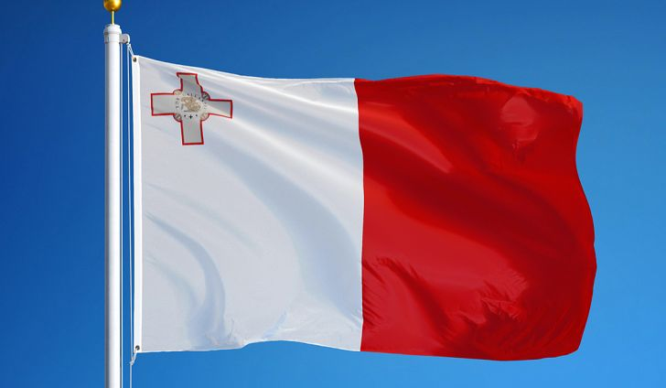
Maltese Traditions
National Sport School Malta

Slide 2
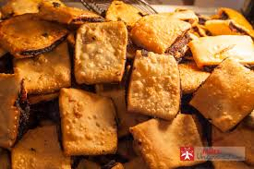
Traditional maltese food
No.1 Imqared

Slide 3
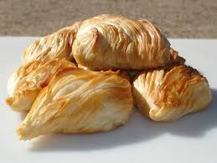
No.2 Pastizzi

Slide 4
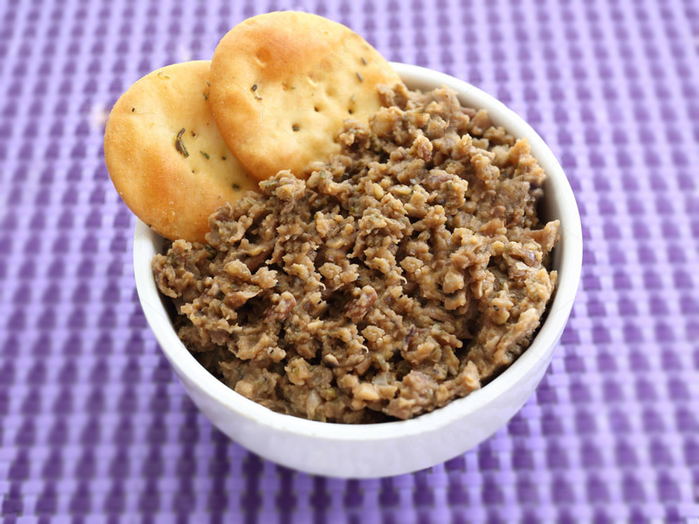
No.3 Bigilla

Slide 5
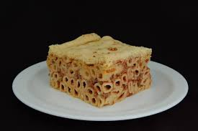
No.4 Imqarrun

Slide 6
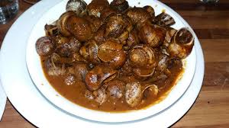
No.5 Bebbux

Slide 7
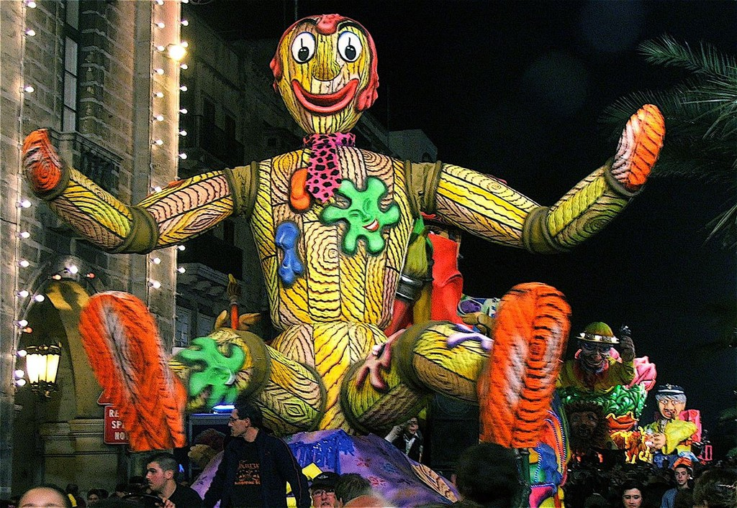
Maltese carnival
Although carnivals take place in several villages, the best are found in Valletta, with other villages not far behind. Dating back to the rule of the Knights of the Order of St John, these carnivals are among the oldest celebrations on the island. The streets come alive with brightly coloured processions of floats, costumes, dancing and music, and the celebrations last for four days and have no theme other than the brighter the better.

Slide 8
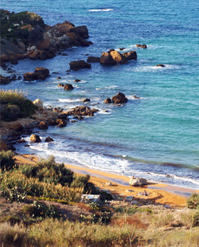
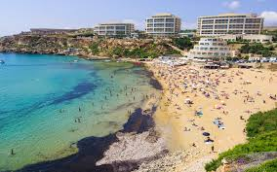
Beaches in Malta
Malta's beaches are not just a location – they are way of life. Here the term “beaching” refers to a tranquil, slower pace at which communities come together to enjoy the sun and the essence of communal spirit. There is something magical about the deep shimmering blue Mediterranean Sea that has enchanted many travellers over several millennia. Spending a holiday in Malta or Gozo necessitates a trip to the beach and the indulgence in its many pleasures. Malta's beaches are among some of the cleanest and most scenic beaches in Europe. Due to its Mediterranean demeanour Malta sports more rocky beaches than sandy ones, yet both are very easily accessible by public transport and within minutes from most hotels.
Beach life is a 24-hour activity in Malta with camping, snorkeling, fishing and out-door grilling being just a few of the many options available.

Slide 9
The end !

