Slide 1
My school My town My country

Slide 2
Public Primary School in Kierlikówka
Public Primary School in Kierlikówka provides education for students aged 8-14. The school includes: kindergarten (children aged 5-6) and basic education which is divided into stages : first (1-3 grades) second (4-8 grades). At the end of 8th grade students take a school leaving exam which is very important for their future education. The patron of our school is Edward Dembowski. The school is located in a small village, Kierlikówka, in the south of Poland. Currently, there are 16 teachers and 106 students at school.
Notes:
2

Slide 3
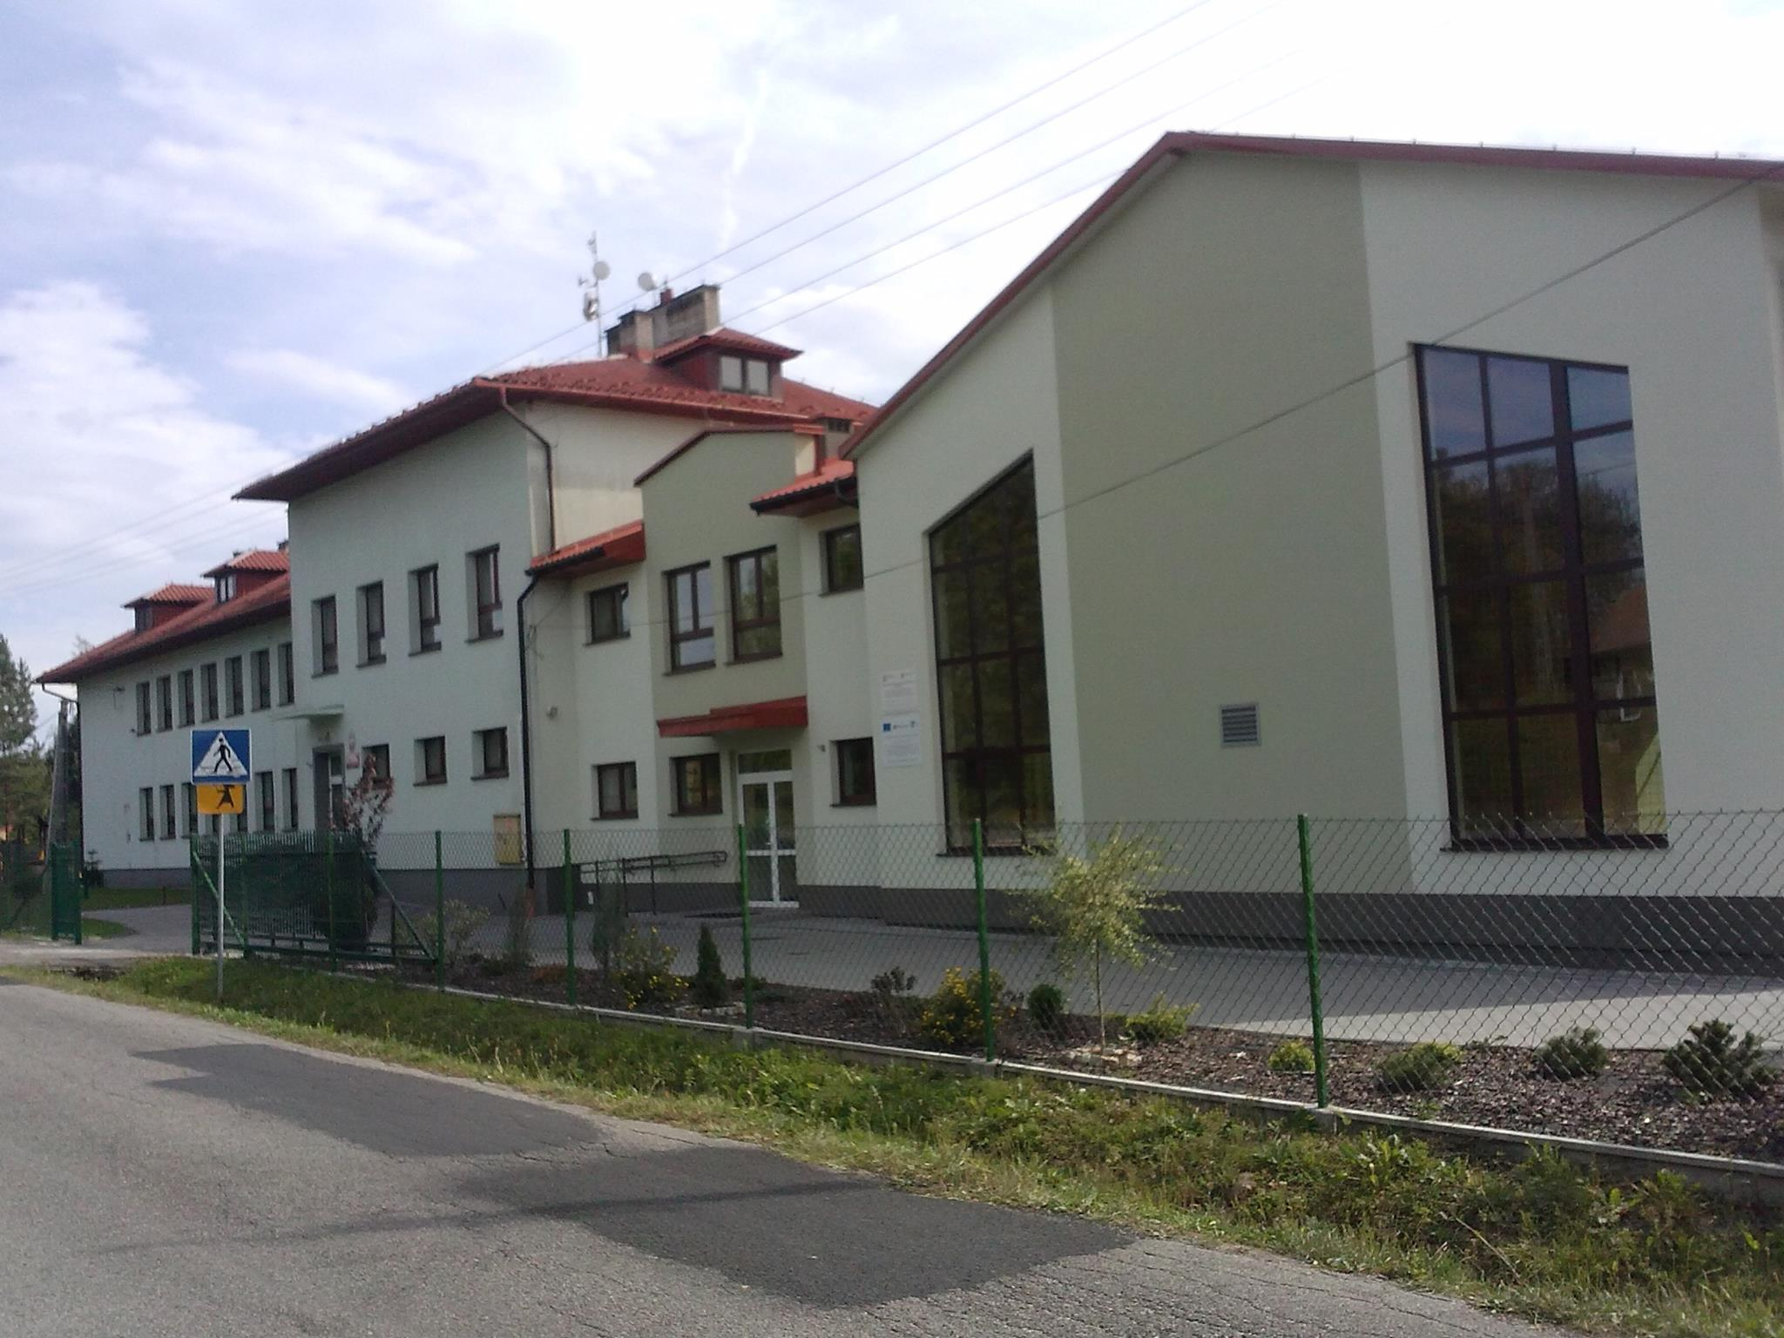
Public Primary School in Kierlikówka

Slide 4
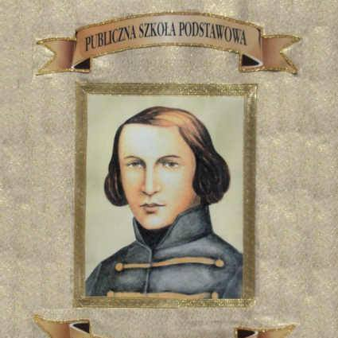
Our School Patron Edward Dembowski

Slide 5
Education is divided into stages:
O stage: Kindergarten (children aged 5-6)
I stage : Grades 1-3
II stage: Grades 4-8
The number and type of subjects depend on the stage.
In the final year students take a leaving school exam in 3 subjects: Polish, maths, foreign language. From year 2021 the exam will consist of four subjects: English, maths, foreign language and the fourth subject chosen by a student.

Slide 6
Students
There are 106 students at our school.
Grade 0 – 25 students
Grade 1 – 19 students
Grade 2 – 15 students
Grade 3 – 10 students
Grade 4 – 9 students
Grade 5 – 9 students
Grade 6 – 14 students
Grade 7 – 13 students
Grade 8 – 7 students

Slide 7
Teaching staff
Headmaster, Biology Teacher – Mrs Beata Stochel
Maths Teacher, Secretary – Miss Paulina Więcław
Maths and Physics Teacher – Mrs Agata Statek
English and Citizenship Education Teacher – Miss Klaudia Matras
Geography Teacher – Mrs Alicja Mucha
Chemistry Teacher – Mrs Paulina Krawczyk
Polish Teacher – Mrs Izabela Sroka
PE and Science Teacher – Mrs Dorota Grabowska
RE teacher – Mr Ks. Zbigniew Wachowicz
History, Polish, Career Counselling Teacher – Mrs Bożena Grabowska

Slide 8
Teaching staff
Elementary Education Teacher- Mrs Joanna Kukla
Elementary Education Teacher- Mrs Małgorzata Dudziak
Elementary Education, Art, Music Teacher- Miss Kinga Górka
Kindergarten Teacher- Mrs Małgorzata Łukasik
Security Education- Mr Bogdan Grabowski
German Teacher- Mrs Barbara Burkowicz

Slide 9
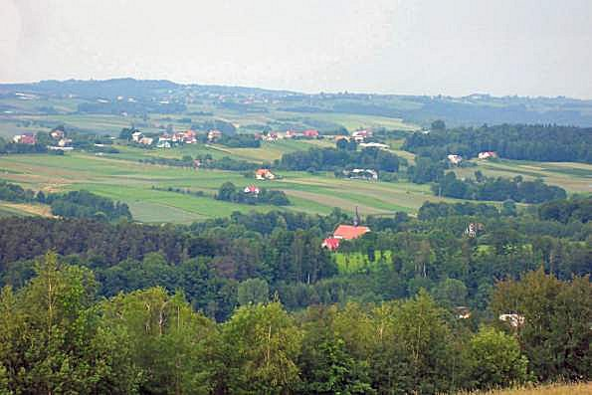
My town
Our school is situated in a small village of Kierlikówka. The village is about fifty kilometers away from one of the most recognisable Polish cities in the world- Cracow. Kierlikówka is one of the seven villages in Trzciana Borough. It is situated in Bochnia County in southern Lesser Poland.

Slide 10
Poland
Poland is situated in central Europe with a coastline on the Baltic Sea in north. Poland is bordered by Germany in west, the Czech Republic in south west, Slovakia in south, Ukraine in south east, Belarus in east and Lithuania and Russia in north east.
The country shares maritime borders with Denmark and Sweden.

Slide 11
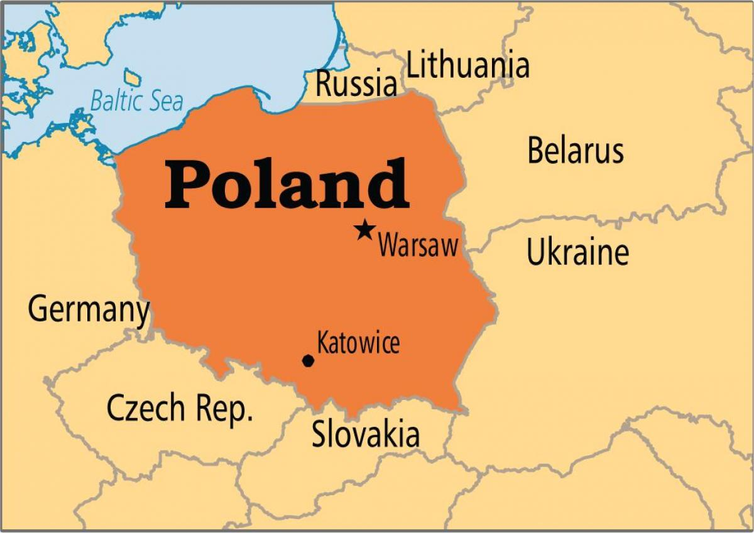

Slide 12
Population: 38 413 000
Area: 312 696 km²
Capital City: Warsaw
Flag:

Slide 13
Emblem:
Anthem: „Mazurek Dąbrowskiego”
President: Mr Andrzej Duda
Prime Minister: Mr Mateusz Morawiecki
Currency: PLN
Official language: Polish

Slide 14
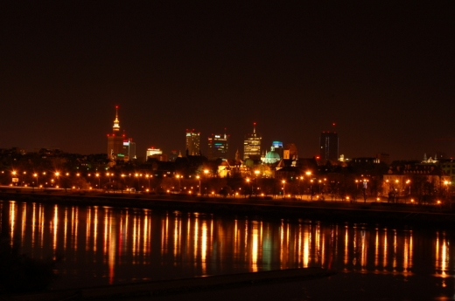
Warsaw- The Capital City
Warsaw is the capital city of Poland. Warsaw is located in the east-central part of the country, Masovian Voivodeship. The President of Poland lives in the Presidential Palace at Krakowskie Przedmieście.

Slide 15
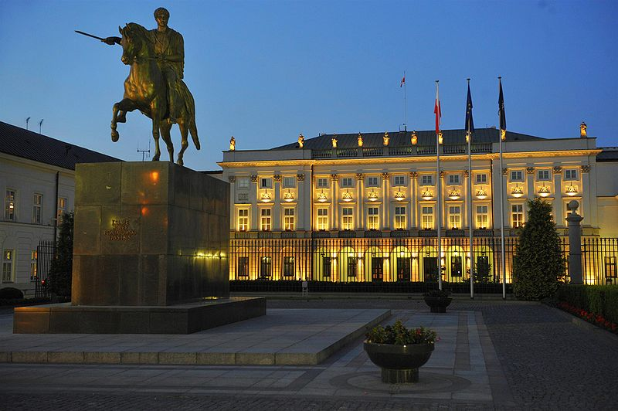
Presidential Palace in Warsaw

Slide 16
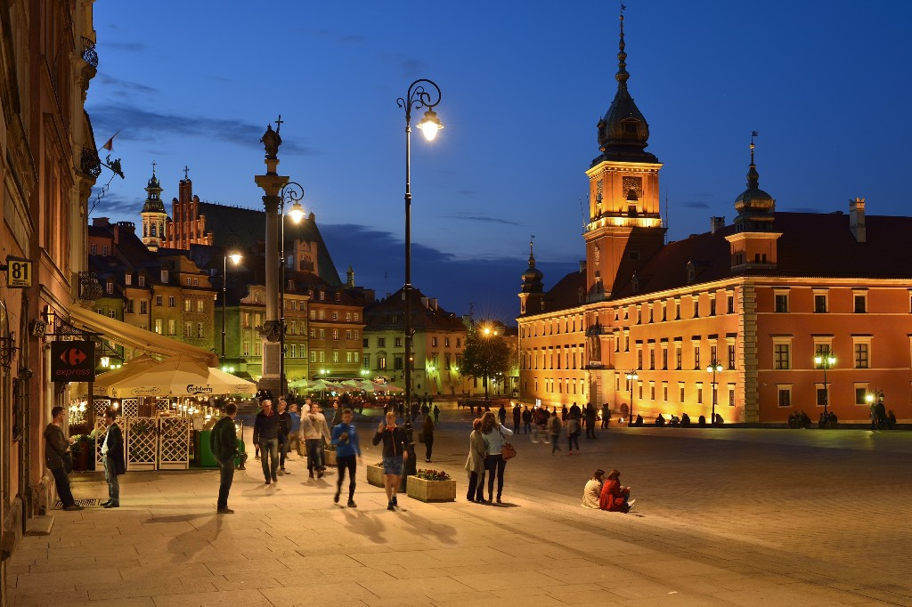
Old Town in Warsaw

Slide 17
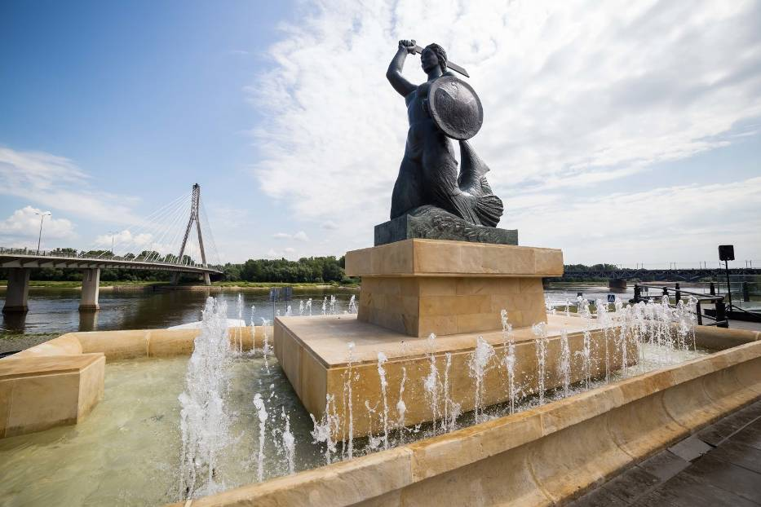
The Warsaw Mermaid

Slide 18
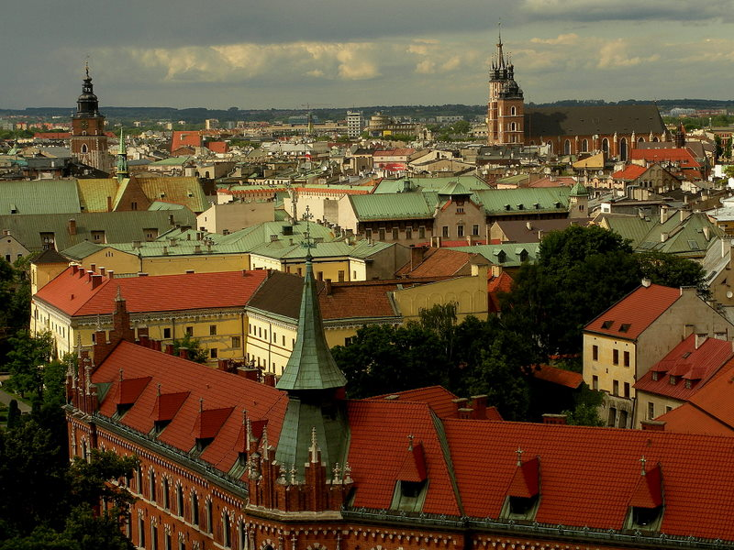
Cracow

Slide 19
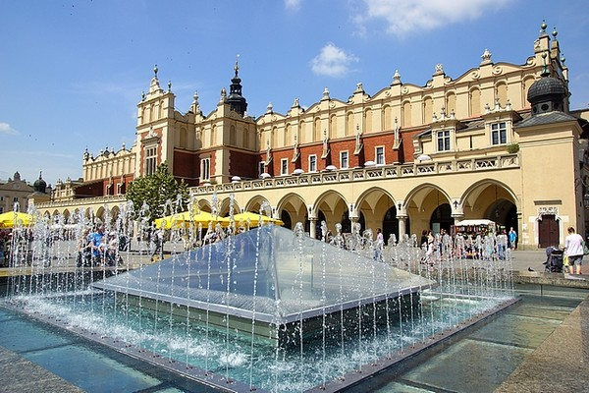
The Main Market Square in Cracow

Slide 20
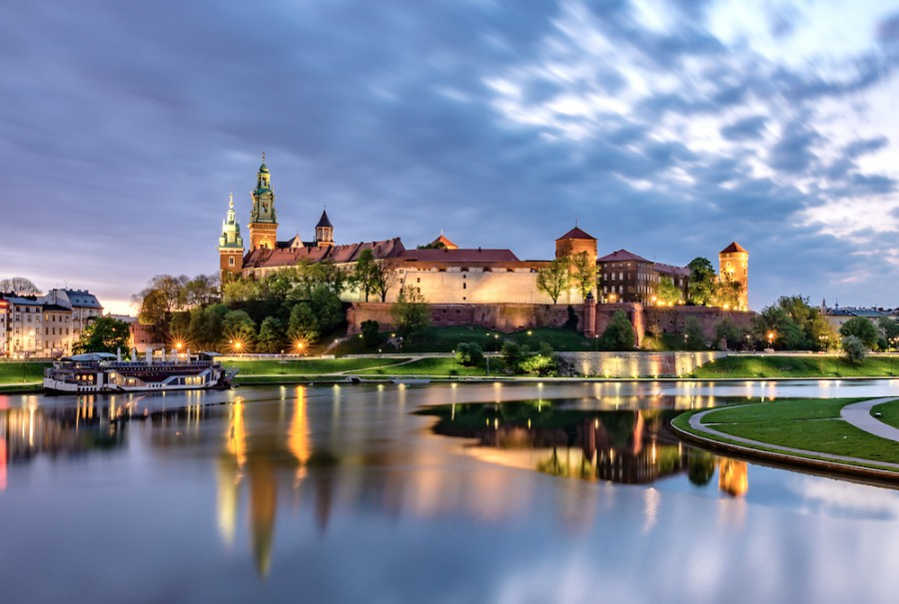
The Wawel Castle in Cracow

Slide 21
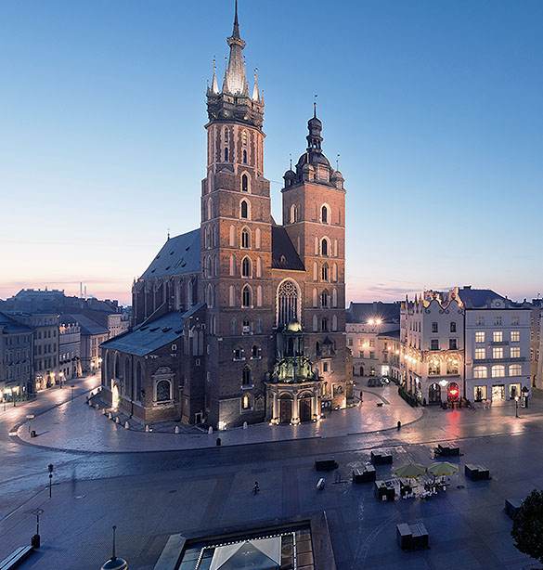
St. Mary’s Basilica in Cracow

Slide 22
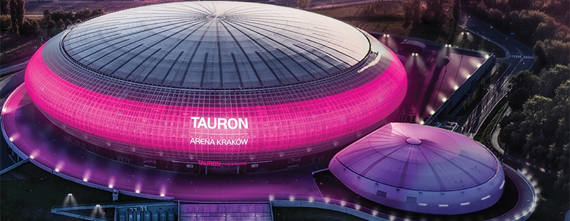
Tauron Arena Kraków

Slide 23
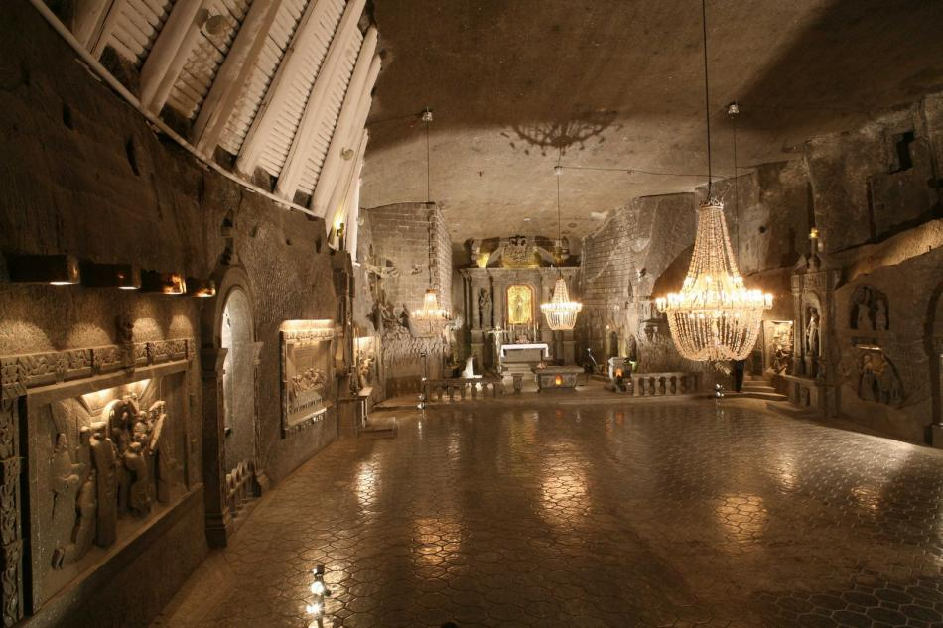
Wieliczka Salt Mine

Slide 24
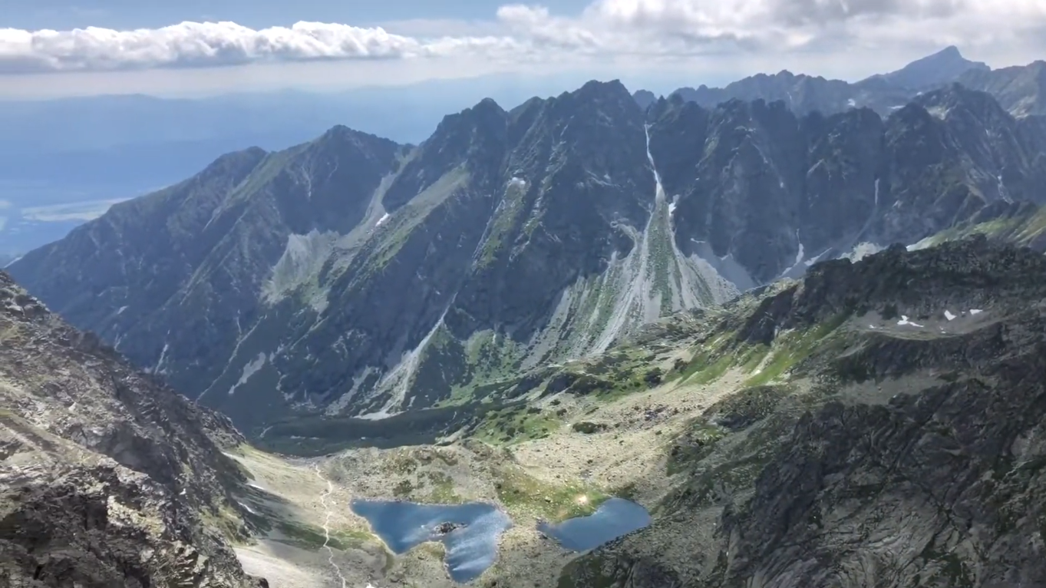
The Tatra Mountains

Slide 25
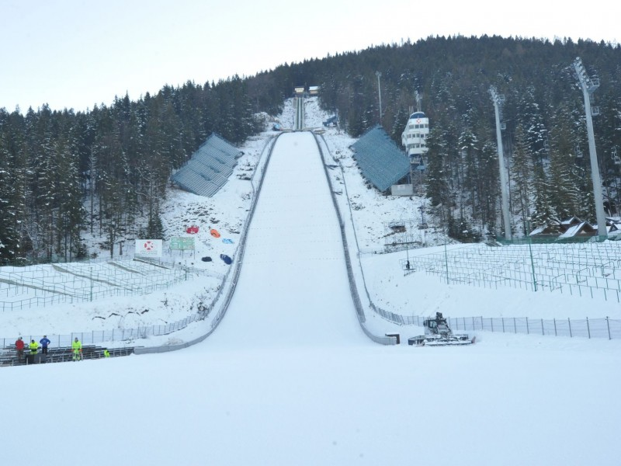
Ski Jumping Hill in Zakopane

Slide 26
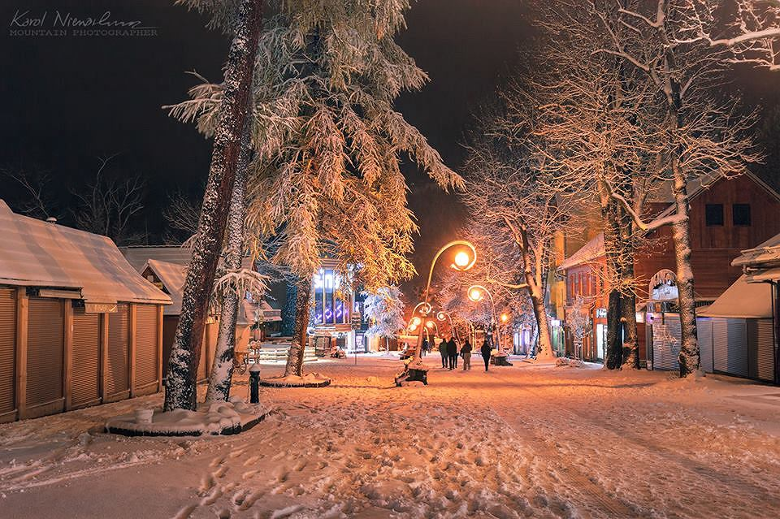
The Krupówki Promenade in Zakopane

Slide 27
WE ARE WAITING FOR YOU
IN POLAND !

