Slide 1
Erasmus - dissemination
Working on collocations

Slide 2
Vous allez découvrir des illustrations représentant des actions quotidiennes.
Pouvez-vous les retrouver en anglais?
Chaque expression comporte un verbe différent.

Slide 3
READY?

Slide 4
What’s the English for…?

Slide 5
have a shower

Slide 6
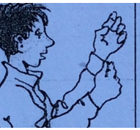
What’s the English for…?

Slide 7
get dressed

Slide 8
What’s the English for…?

Slide 9
make the bed

Slide 10
What’s the English for…?

Slide 11
eat breakfast

Slide 12
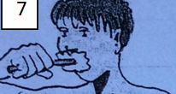
What’s the Englsih for…?

Slide 13
brush one’s teeth

Slide 14
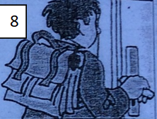
What’s the English for…?

Slide 15
go to school

Slide 16
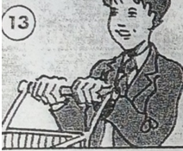
What’s the English for…?

Slide 17
do the shopping

Slide 18
What’s the English for…?

Slide 19
watch TV

Slide 20
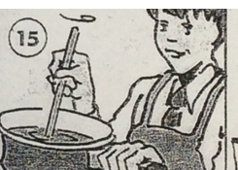
What’s the English for…?

Slide 21
prepare the meal

Slide 22
What’s the English for… ?

Slide 23
read a book

Slide 24
What’s the English for…?

Slide 25
listen to music

Slide 26
Well done!
Now let’s move on to part 2… with a memory game!

