Slide 1
Environmental words IES CERRO DEL VIENTO "Natural Spaces in Andalucía"

Slide 2
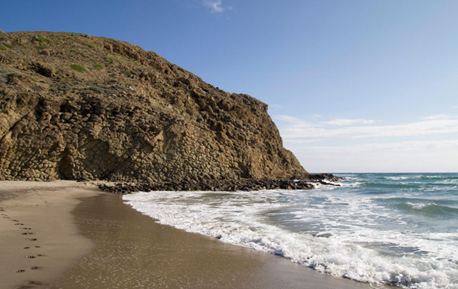
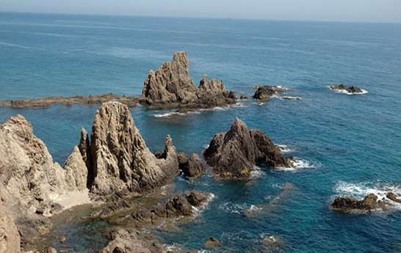
Reef A reef is a bar of rock, sand, coral or similar material just above or below the surface of the sea. The best known reef of Cabo de Gata is the siren reef, which is a famous viewpoint where you can see part of Cabo de Gata beaches
Tide
A tide is known as the rising and falling of the sea, usually twice in each lunar day at a particular place, due to the attraction of the moon and sun. In Mediterranean beaches tides are very limited and their amplitude is very low, with only a few centimeters.

Slide 3
CREDITS
https://www.cabogataalmeria.com/Cabo-Gata/Pueblos-Lugares/Visita-Turistica/Arrecife-Sirenas-Cabo-Gata.html
http://www.fondear.org/infonautic/Mar/El_Mar/Mareas/Mareas.htm
Erik Jiménez
Gastón Moreno
Lucia Márquez
Paula Guerra

