Slide 1
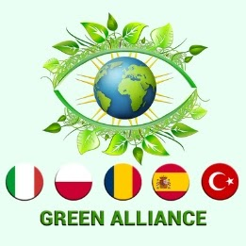
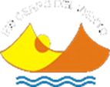
Environmental words IES CERRO DEL VIENTO, SPAIN “Natural Spaces in Andalucía”

Slide 2
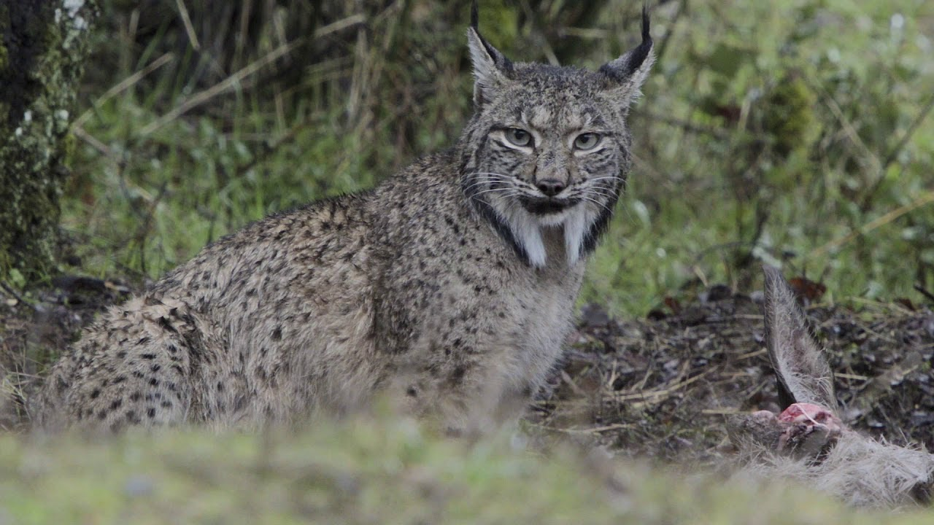
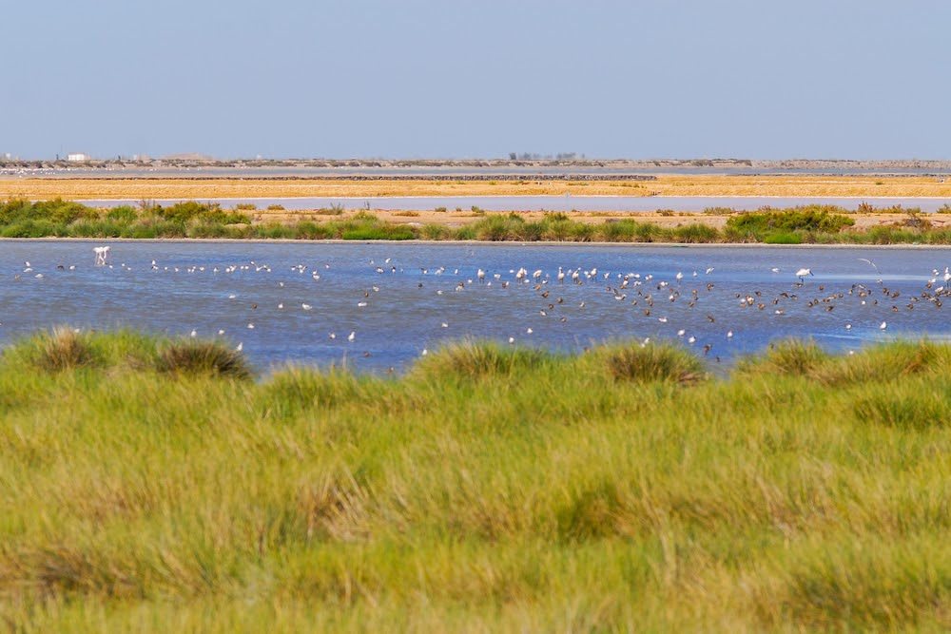
IBERIAN LYNX
The Iberian lynx is an endemic species n from the Iberian Peninsula. It has beautiful light brown fur with black specks. Adult males weigh about 13kg and female 9-10kg. Their diet is based on rabbits. This incredible animal is the most endangered feline in Europe and the second feline in the world.
MARSHLANDS
Marshlands are areas of land covered by water for long periods. They do not usually have trees but grass and other herbaceous plants which grow in the waterlogged rich soil deposited by rivers. There are 3 types of marshlands: tidal salt, tidal freshwater and inland freshwater. The tidal marshlands are shelter for migratory water birds, ducks, cormorants, insects, crustaceous, blackbirds, herrings and frogs.

Slide 3
CREDITS
www.iberian-lynx.com/facts/
https://www.nationalgeographic.org/encyclopedia/marsh/
GROUP MEMBERS: Adriana Cabello, Naila Gálvez, Pablo Lara y Carhen Luzardo

