Slide 1
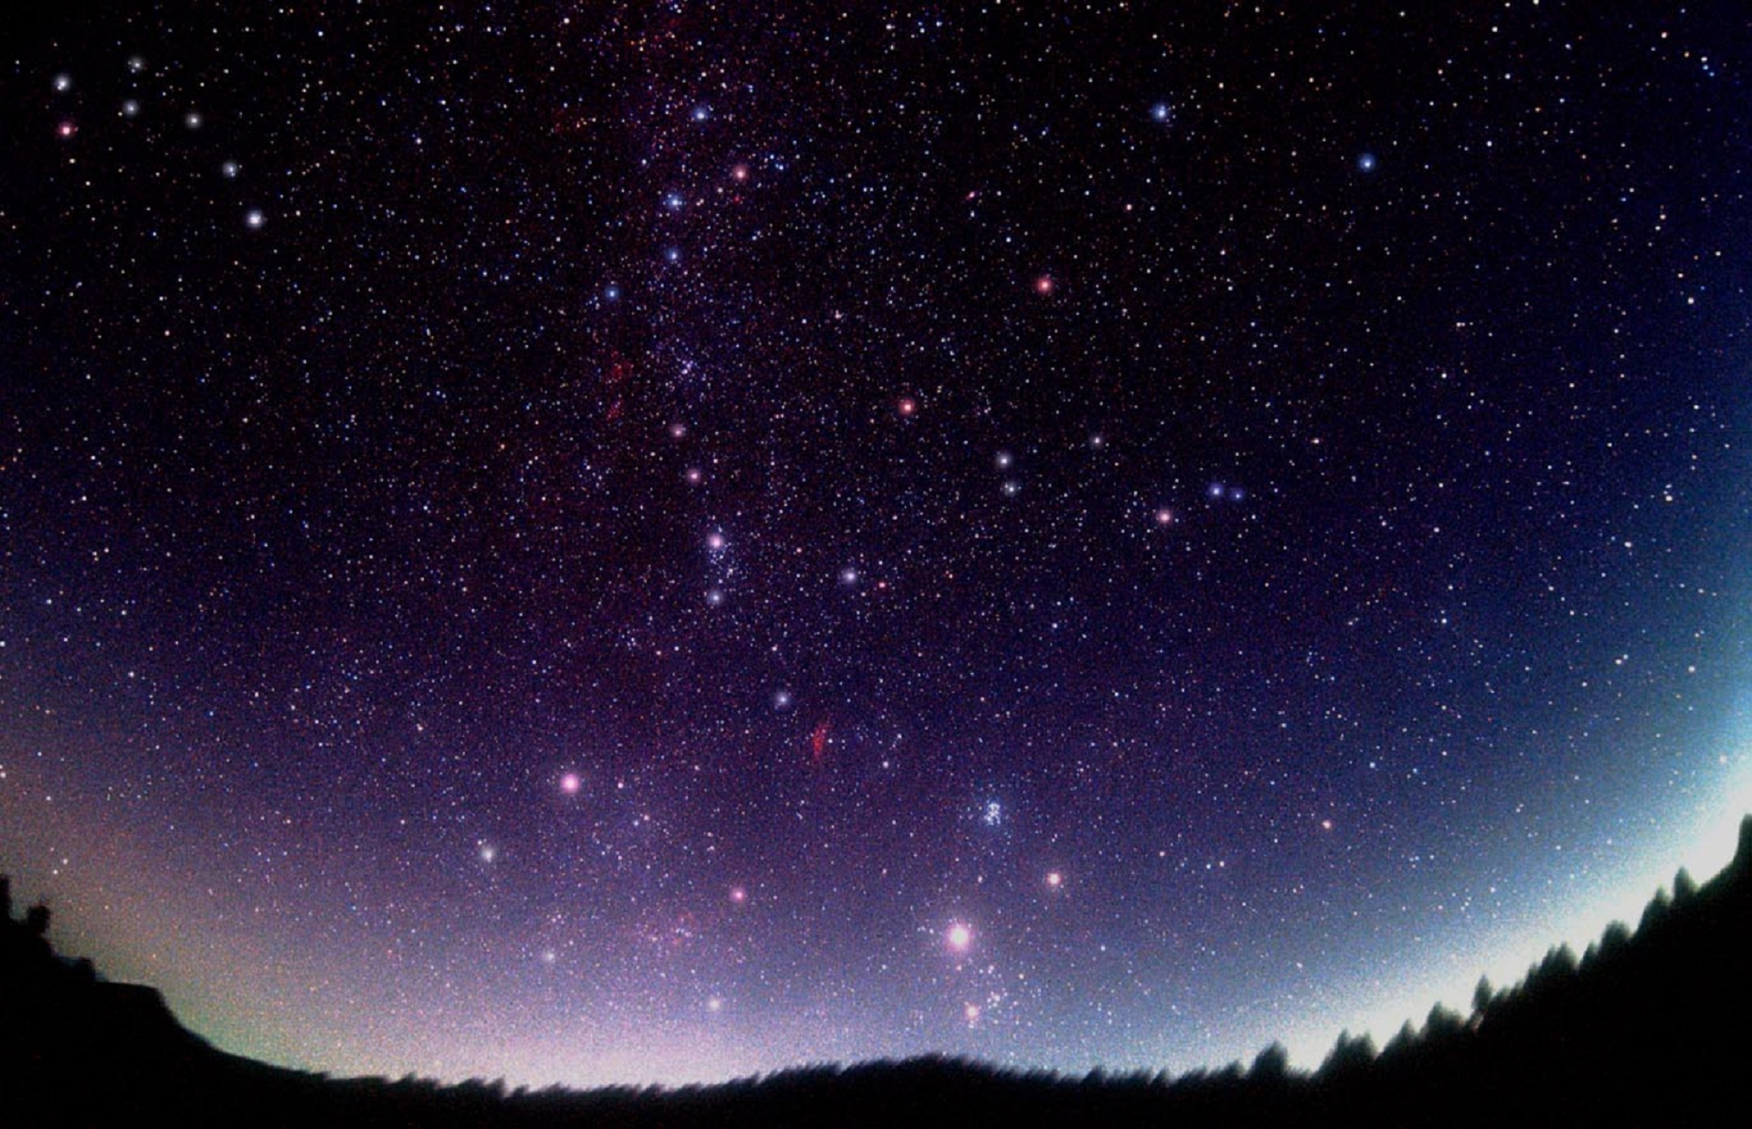
Erasmus KA2-Green Alliance
IIS Della Corte-Vanvitelli,Cava De’Tirreni,Italy
Presents
Enviromental
Words

Slide 2
Ozone
The ozone layer is a fundamental screen for the interception of lethal radiation for life on Earth, and its formation occurs mainly in the stratosphere at the most irradiated tropical latitudes, while global circulation then tends to accumulate it more at high latitudes and at the poles
(ˈəʊ.zəʊn)
Ultraviolet Rays
The radiation coming from the Sun consists on one side of a flow of highly energetic particles consisting mainly of protons, electrons and helium nuclei (the so-called "cosmic radiation" or "solar wind") and on the other side of electromagnetic waves.
(ˌʌl.trəˈvaɪə.lət reɪs)

Slide 3
Surface water acidification
(sɜːfɪsˈwɔː.tərəsɪd.ɪ.fɪˈkeɪ.ʃən)
The acidification of the oceans is the name given to the decrease in the oceanic pH value, caused by the intake of anthropogenic carbon dioxide from the atmosphere. About a quarter of the CO2 present in the atmosphere ends up in the oceans where it turns into carbonic acid (H2CO3).
Biogas
Biogas are a mixture of various types of gas, mainly composed of methane, produced by bacterial fermentation in anaerobiosis of organic residues from vegetable or animal residues. The whole process sees the decomposition of the organic material by some types of bacteria, producing carbon dioxide, hydrogen and methane.
(ˈbaɪ.əʊˌɡæs)

Slide 4
Radon
(reɪ.dɒn)
Radon or sparse (previously called niton or nite) is the chemical element that is represented the periodic table by the symbol Rn and atomic number 86. Radon is a very heavy gas, dangerous for human health if inhaled in significant quantities.
Smog
Dense and dark fog, which forms on urban and industrial areas in the presence of high humidity and strong concentrations of polluting particles, released into the atmosphere by heating systems, vehicular traffic, industrial activities.
(smɒɡ)

Slide 5
Asbetos
Arsenic
Poisonous chemical element (symbol As), silvery, fragile, toxic metal. Naturally present in combination with other metals and in the form of sulphide it is used as hardener in copper alloys and in the manufacture of special mirrors
(ɑː.sən.ɪk)
(æsˈbes.tɒs)
The variety of fiber silicate, the use of which as an isulator is now prohibited due to its carcinogenic properties

Slide 6
Anthropization
The set of transformation and alteration interventions that man makes in tthe area in order to adapt it to his own interests and and needs
(æn.θrə.paɪzeɪ.ʃən)
Benzene
Aromatic hydrocarbon, colorless, volatile,flammable liquid, with a pleasant, toxic and carcinogenic odor, obtained from the cracking and reforming processes of oil and is widely used as a solvent, in fuel mixtures, in many chemical syntheses and in the preparation of dyes and materials plastics.
(ˈben.ziːn)

Slide 7
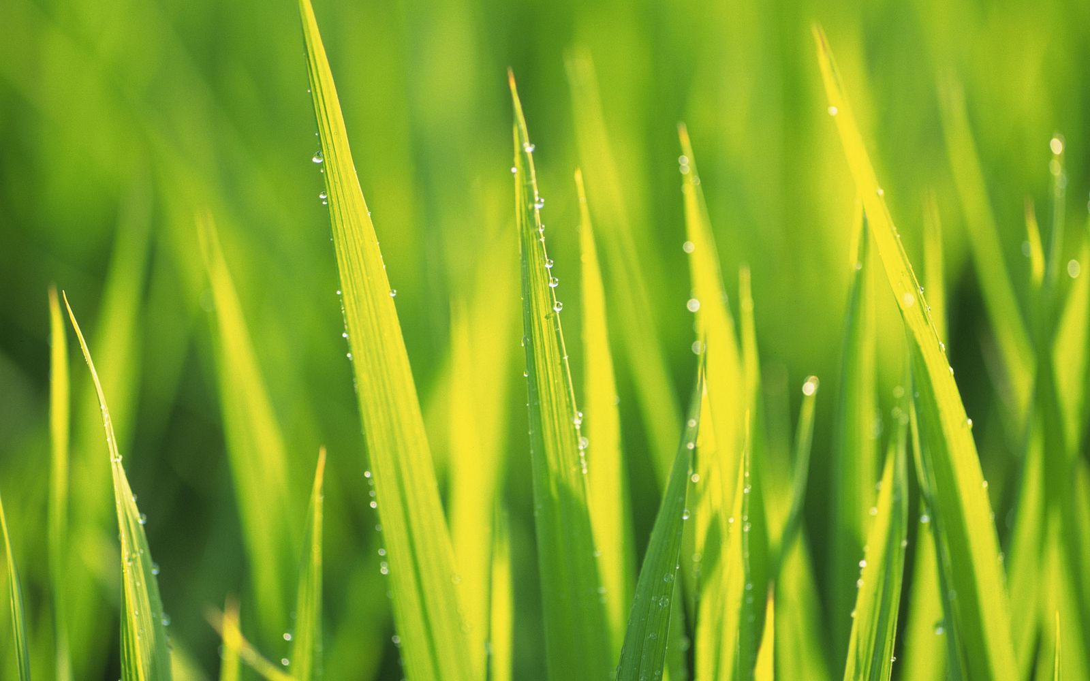
Thank you!
Di Lauro Gennaro
Ferrigno Sabrina
Gemmabella Gabriele
Siani Giuseppe
Ventre Riccardo
Credits:
www.alambicco.unito.it
www.chimica-online.it
www.arpae.it/cms3
Wikipedia
Ebook.scuola.zanichelli.it

