Slide 1
ENVIRONMENTAL
DICTIONARY

Slide 2
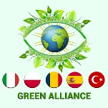
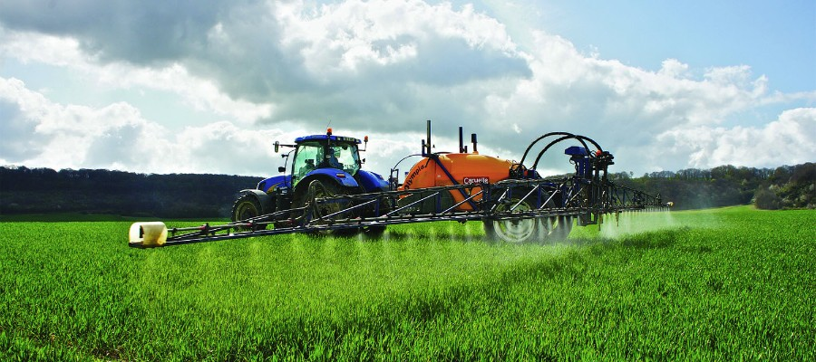
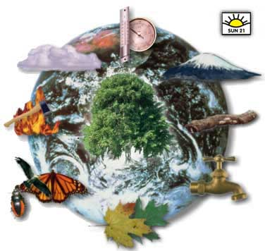
Agricultural Pollution (ˌagriˈkəlCHərəl pəˈlo͞oSHən)
Farming wastes, including runoff and leaching of pesticides and fertilizers; erosion and dust from plowing; improper disposal of animal and carcasses; crop residues and debris.
Therefore, prices of ecological products are expensive in Turkey.
Ecological Balance (ˌiː.kəˈlɒdʒ.ɪ.kəl ˈbæl.əns) Ecological balance is a term used to describe the equilibrium between living organisms such as human being, plants, and animals as well as their environment. World Wide Fund for Nature (WWF) is 'critical' to ensure a sustainable ecological footprint in Turkey.

Slide 3
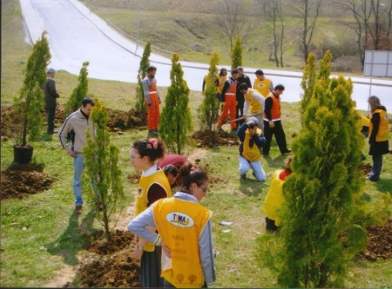
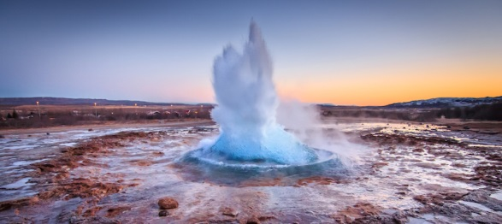
Enviromental Association (ɪnˌvaɪ.rənˈmen.təl əˌsəʊ.siˈeɪ.ʃən) An offical group of people who have joined together for the purpose of protecting the environment. IAERE, Italian Association of Enviromental and Resources Economists Friends of the Earth Poland / Polski Klub Ekologiczny REC Networks: REC Romania – Regional Enviromental Center Greenpeace Espana TEMA: The Turkish foundation for combating erosion reforestation and the protection of natural habitats
Geothermal Energy (dʒiː.əʊˈθɜː.məl ˈenədʒi) Thermal energy is another form in which internal energy is manifested in a system in a state of thermodynamic equilibrium by virtue of its temperature. The geothermal capacity of our country is very high. Despite its good, it has harmful effects on agriculture.

Slide 4
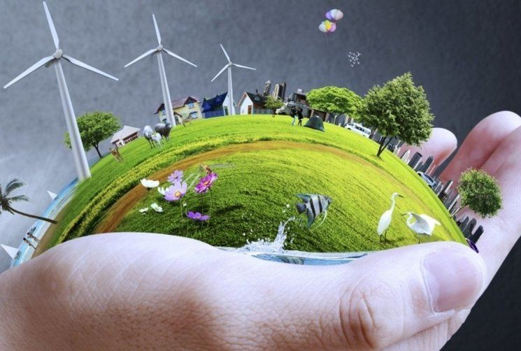
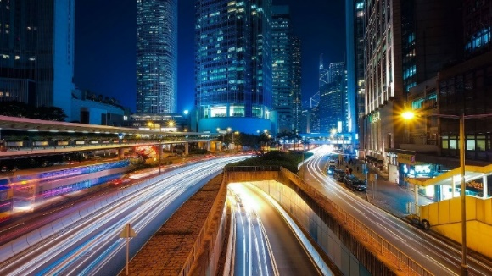
Green Business (ɡriːnˈbɪznɪs) A business functioning in a capacity where no negative impact is made on the local or global environment, the community, or the economy. There are several green business companies in Turkey
Light and Noise Pollution (Līt and noiz pəˈlo͞oSHən) *Light and noise pollution could be classified as excessive and harmful use of said energy sources. *They generally distrupt ecosystems and raise the nearby inhabitants’ stress levels and sometimes can even cause death. * In Turkey, mainly big cities have been suffering from these kinds of pollutions.

Slide 5
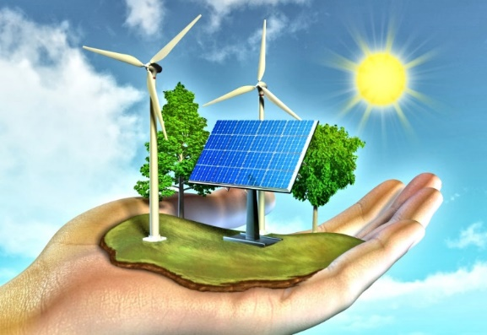
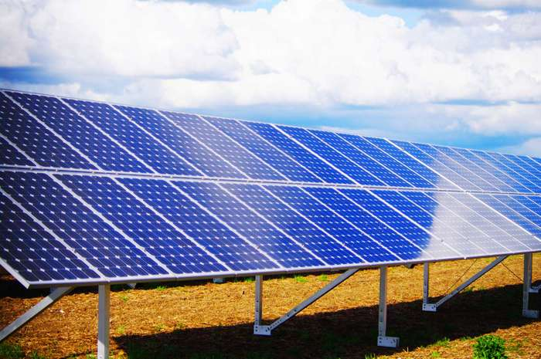
Renewable Resources (rɪˈnjuːəbl rɪˈsɔːsɪz) A renewable resource is one that can be used repeatedly and does not run out because it is naturally replaced. Turkey has a great variety of renewable energies, such as wind, solar, geothermal, biomass, hydraulic.
Solar Energy (səʊ.lər ˈen.ə.dʒi) Solar energy is created by nuclear fusion that takes place in the sun. It is necessary for life on Earth, and can be harvested for human uses such as electricity. There are1644 solar energy centrals in Turkey. Those centrals are producing 1.020.000.000 kWh electrical energy.

Slide 6
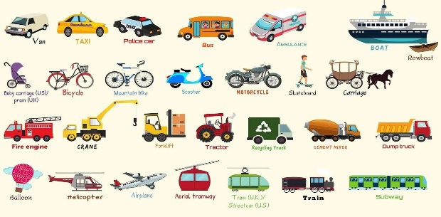
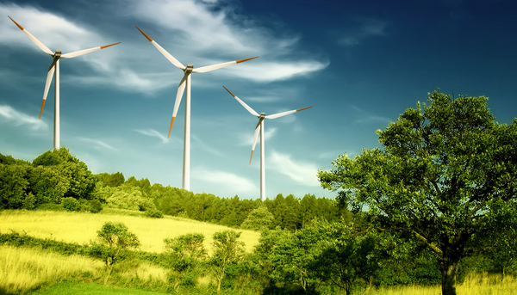
Transportation (transpərˈtāSHən) The environmental impact of transport is significant because transport is a major user of energy, and burns most of the world's petroleum. This creates air pollution, including nitrous oxides and particulates, and is a significant contributor to global warming through emission of carbon dioxide. In Turkey, transportation releases so much CO2 to the air and causes global warming..
Wind Turbine (wɪnd ˌtɜː.baɪn) A large tall structure with blades that are blown round by the wind and produce power to make electricity. Today, there are 171 wind turbines in Turkey. Wind turbines usually take place in the Aegean region. We have still been installing in the other regions of Turkey.

Slide 7
