Slide 1
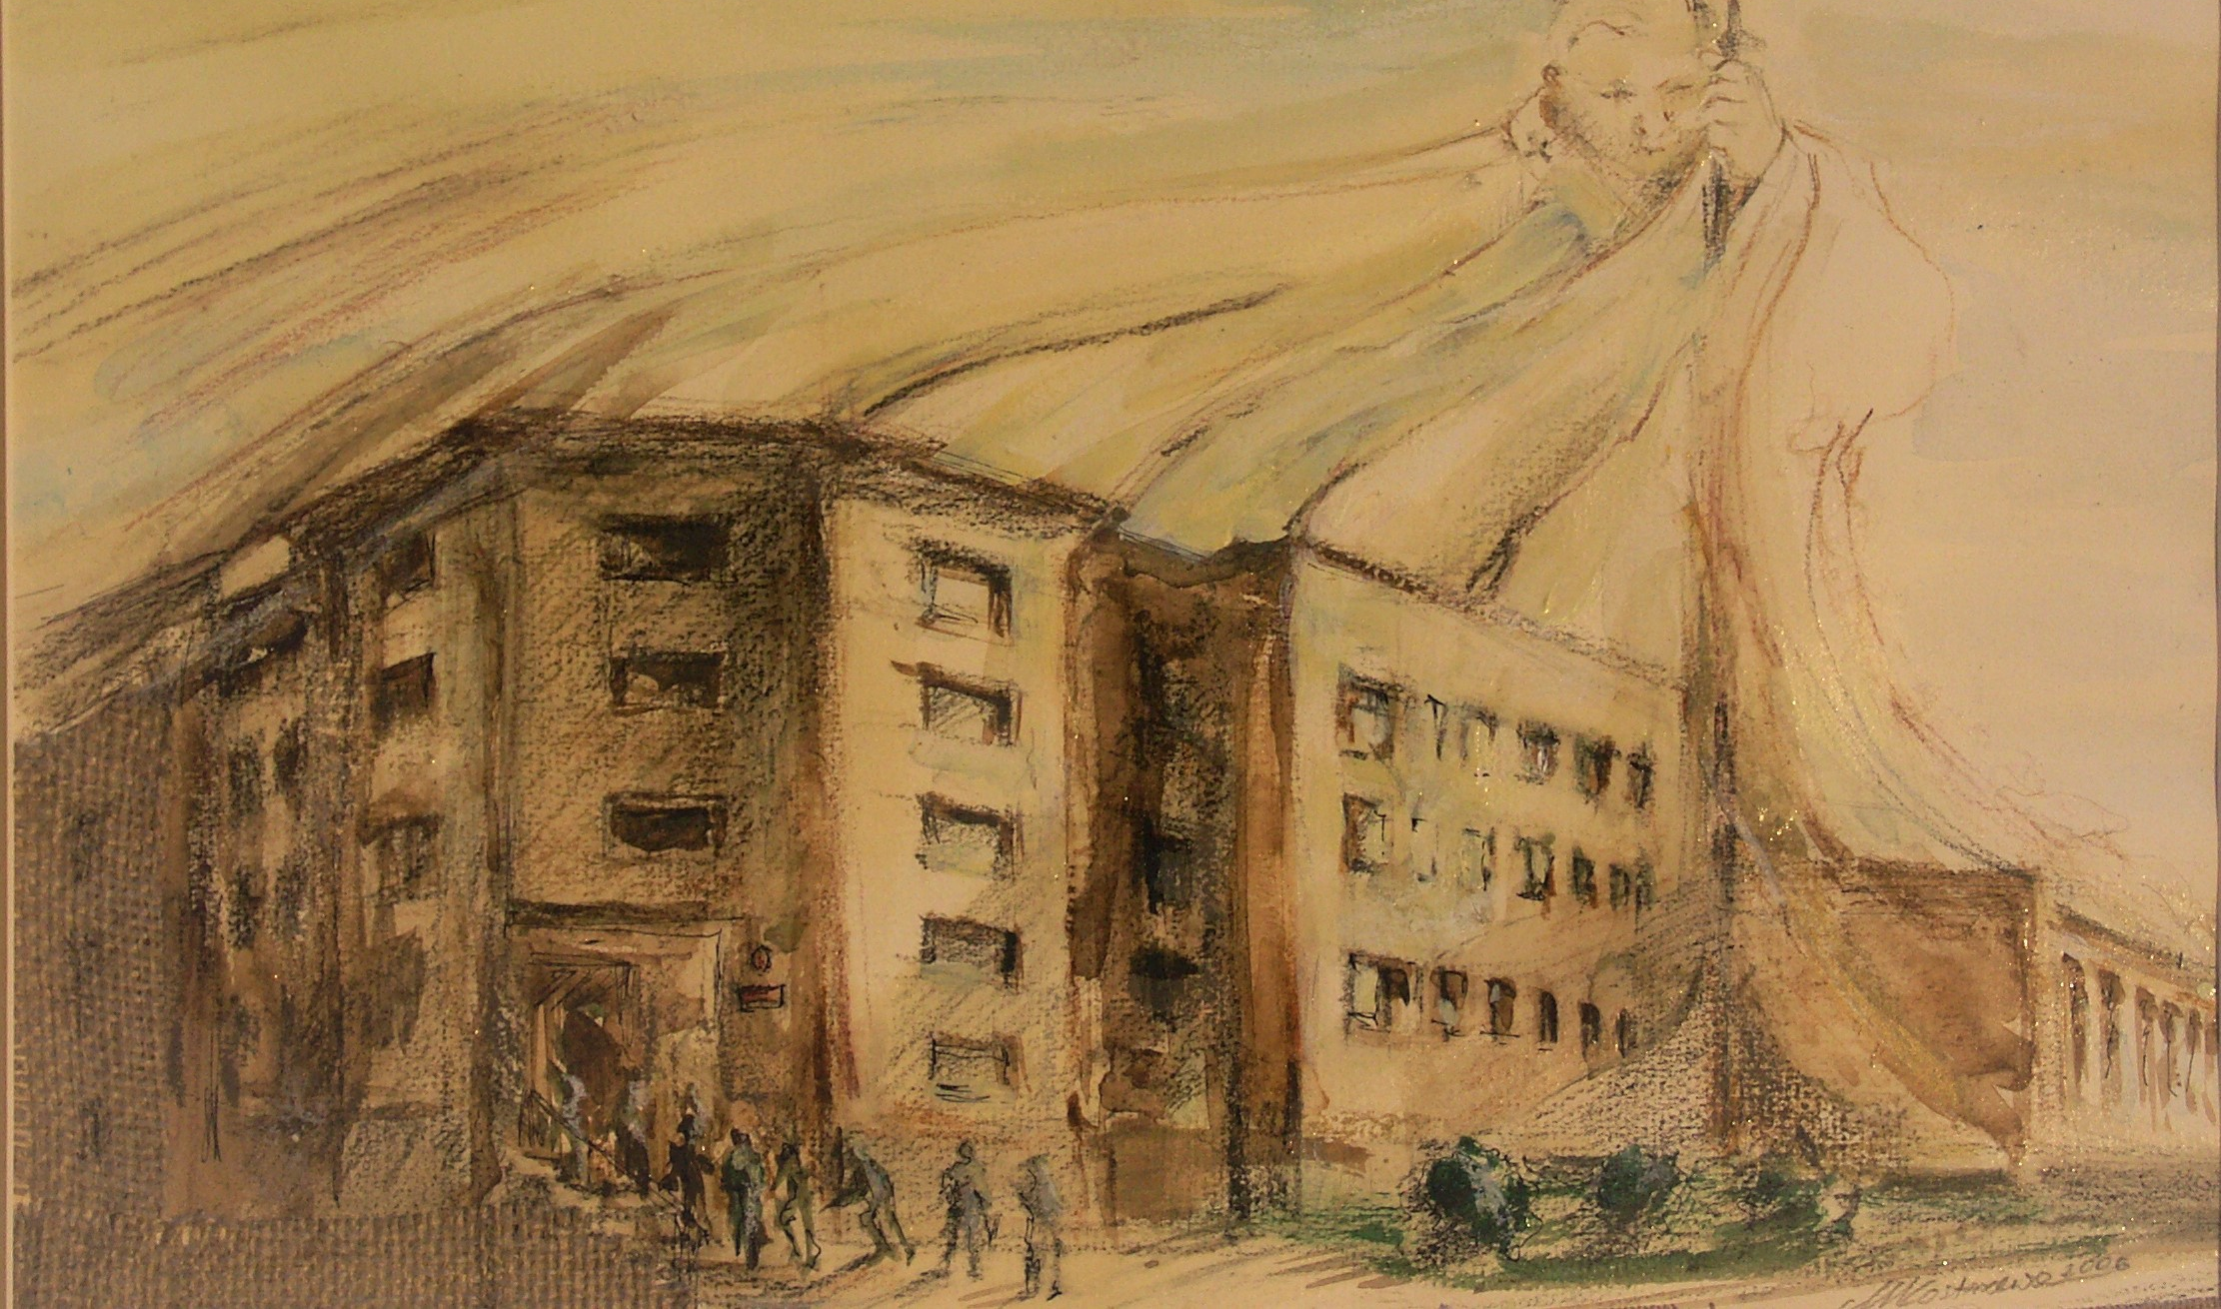
ENVIRONMENTAL
DICTIONARY

Slide 2
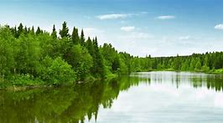
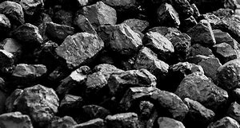
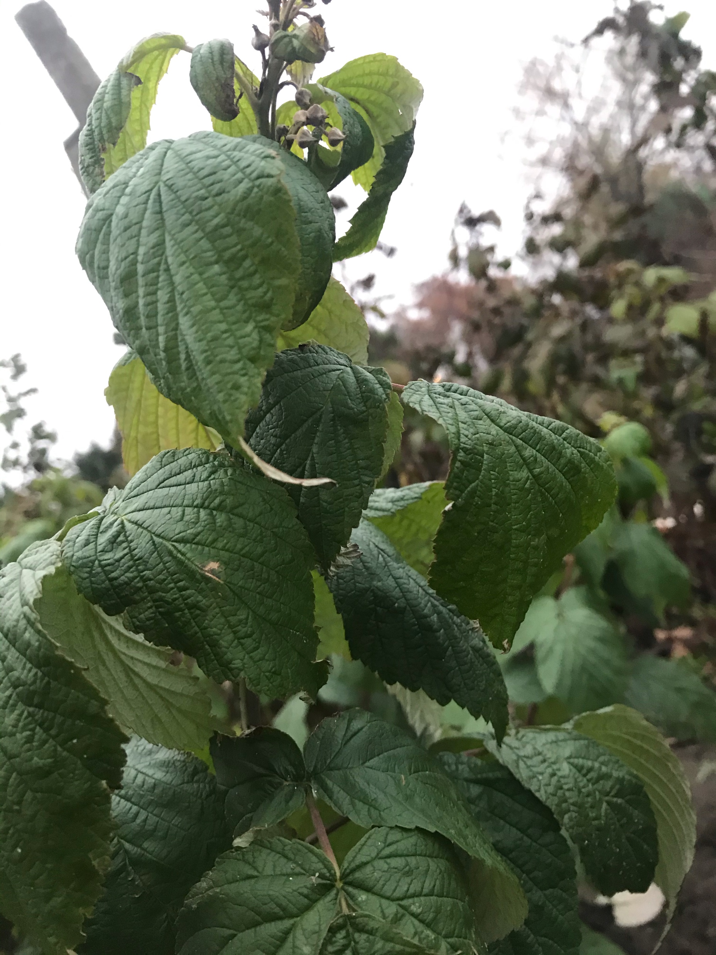
NAURAL RESOURCES
Zespół Szkolno-Przedszkolny
w Dębem, POLAND
ENVIRONMENT
The complex of physical, chemical, and biotic factors (such as climate, soil, and living things) that act upon an organism
or an ecological community and ultimately determine its form and survival.
natural resources plural : industrial materials and capacities (such as mineral deposits and waterpower) supplied by nature

Slide 3
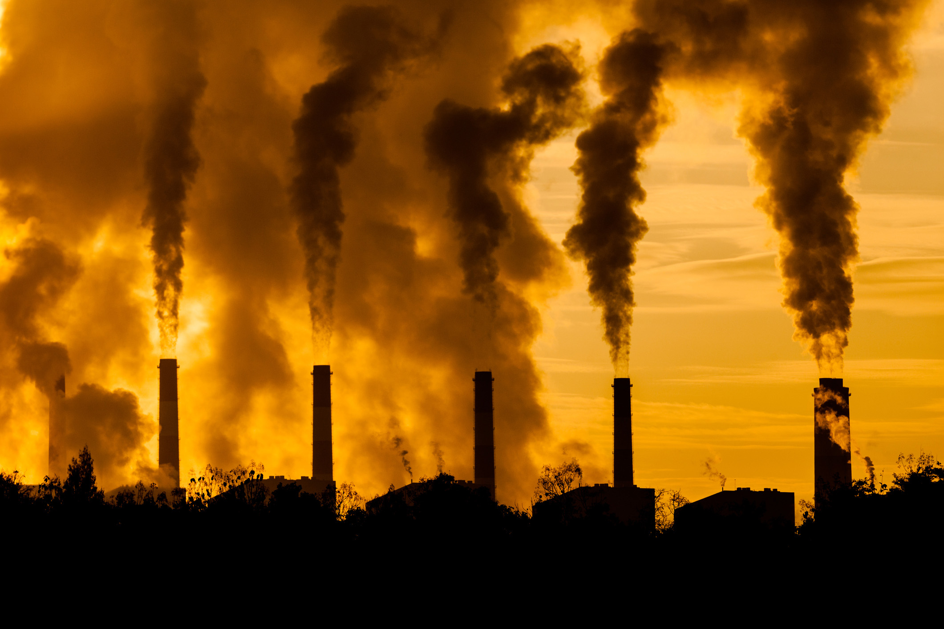
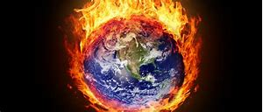
POLLUTION
Zespół Szkolno-Przedszkolny
w Dębem, POLAND
The action of polluting especially by environmental contamination with man-made waste
GLOBAL WARMING
An increase in the earth's atmospheric and oceanic temperatures widely predicted to occur due to an increase in the greenhouse effect resulting especially from pollution

Slide 4
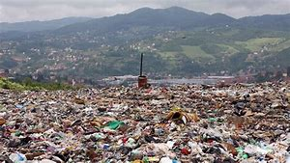
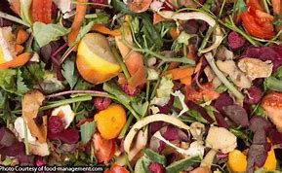
Zespół Szkolno-Przedszkolny
w Dębem, POLAND
WASTE​
Unwanted matter or material of any type, which is often left after useful substances or parts have been removed.
BIODEGRADABLE
Able to decay naturally and harmlessly.​ Biodegradable packaging helps to limit the amount of harmful chemicals released into the atmosphere.

Slide 5
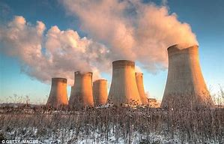
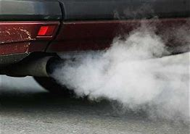
Zespół Szkolno-Przedszkolny
w Dębem, POLAND
CARBON MONOXIDE
This odorless, colorless, and poisonous gas is formed by the combustion of fossil fuels such as gasoline and is emitted primarily from cars and trucks.
FUMES
The unpleasant and often unhealthy smoke and gases that are produced by fires or by things such as chemicals, fuel, or cooking.

Slide 6
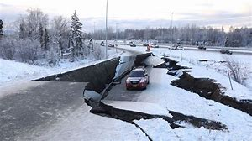
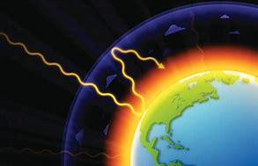
Zespół Szkolno-Przedszkolny
w Dębem, POLAND
EARTHQUAKE​
An earthquake is a shaking of the ground caused by movement of the Earth's crust.
GREENHOUSE
EFFECT
Problem caused by increased quantities of gases such as carbon dioxide in the air. These gases trap the heat from the sun,
and cause a gradual rise in the temperature of the Earth's atmosphere.

Slide 7
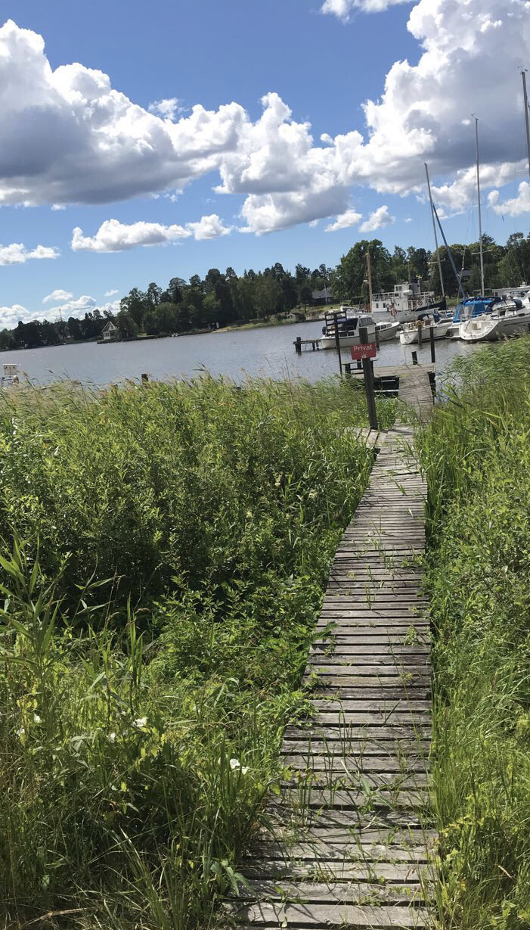
Bibliography
Authors
Zespół Szkolno-Przedszkolny
w Dębem, POLAND
Wiktoria Florczak
with coopertion with:
Natalia Chojnacka
Maria Goral
Gabriela Lazarek
Tomasz Marcinkowski
https://www.merriam-webster.com/dictionary/environment
https://www.myenglishpages.com/site_php_files/vocabulary-lesson-environment.php
https://www.academia.edu/17284705/A_list_of_vocabulary_items_related_to_the_environment
https://www.ucsusa.org/resources/cars-trucks-buses-and-air-pollution
https://www.collinsdictionary.com/dictionary/english/fume

