Slide 1
Environmental words Colegiul Agricol și de Industrie Alimenatră „Vasile Adamachi”, Iași, Romania
Bazon Lavinia Panțiru Florin Rădeanu Teodora Ilinca Tătaru Sabina Vizitiu Andrei

Slide 2
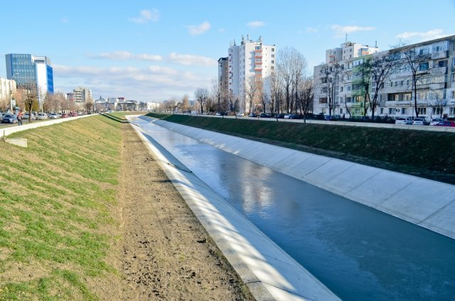
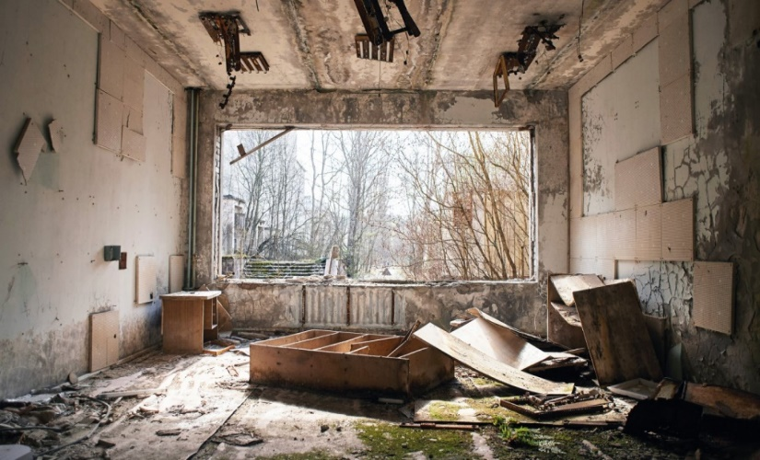
River drying
rɪvə ˈdraɪɪŋ
Radioactive contamination
reɪdɪəʊˈæktɪv kənˌtæmɪˈneɪʃən
Source:Google Images
Source: Google Images
River drying is determined by the substantial decrease in the level of groundwater (groundwater reservoir) and the level of the flowing and standing water.
The Chernobyl disaster is considered the worst nuclear power plant accident in history.
Romania was heavily contaminated by radioactive material from Chernobyl. We were soon dubbed “the Chernobyl children”, the communist authorities kept Romanians in the dark about the magnitude and implications of the explosion.
Notes:
River Dying: The pollution comes from the engines of the Institution. The way that the company tried to diminute the pollution was by placing some absorbant materials for oil and hydrocarbs, but still, some of the pollutants got away as iridescent substances. The Water Basin Administrants Prut-Barlad installed seven absorband barrages on Nicolina and Bahlui rivers, also, absorbant material was spread on the water surface, for collecting the iridescent pollutants. The Authorities installed another flowing absorbant barrage on the river Jijia. Because of the danger of the pollution, the Ministry of Water and Forests got in touch with Republic Moldova Authorities, and they started cooperating for the utilisation and protection of Prut and Dunarea.
Chernobyl: Romania increased the intensity their chemical training for soldiers and officers and were given courses on how to better understand and prepare for biochemical attacks. We were soon told to avoid lying in the sun, or risk burning the skin. Only later did we realise that radioactive fallout was the real concern.
Dorina-decompressing my memories and digging up those of my family back in Romania – there’s still a heaviness in my chest. There’s an understandable desire among people in eastern Europe to distance ourselves from our difficult – even traumatic – past, but Chernobyl’s heritage, like most communist heritage, is as much about the past as it is about the future.

Slide 3
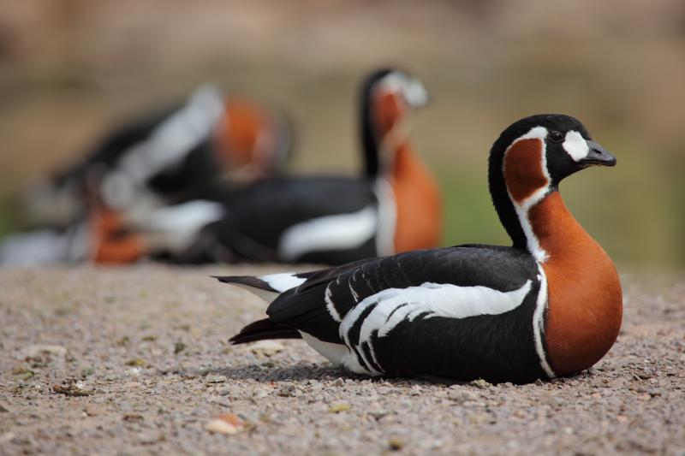
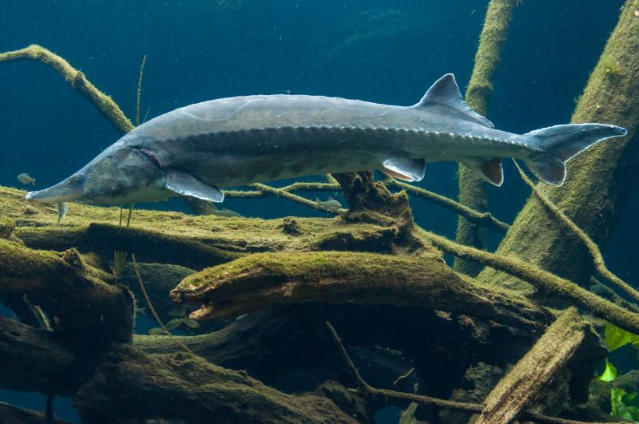
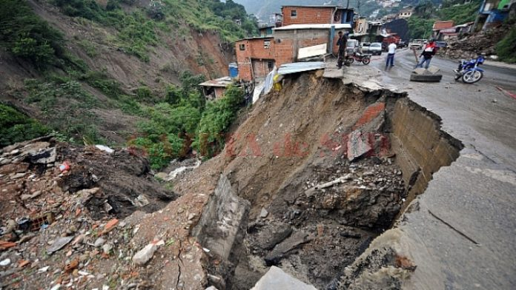
Extintion of animal species
Extintion ʌv ˈænəməl ˈspiʃiz
Landslides
Lændˌslaɪdz
Threatened species are any species of animals, plants, fungi, which are in danger of disappearing from the earth.
Romania is the ideal habitat for many species of animals due to the diversity of ecosystems and extensive forests, but illegal hunting and deforestation continue to cause havoc among wild animals. Examples: red breasted goose, beluga
The landslides represent displacements of the rocks that form the slopes of mountains, hills, hydro-amelioration works or other man-made ramps. Rock movements can occur along the slope or laterally, as a result of natural phenomena or even as a result of human activities.

Slide 4
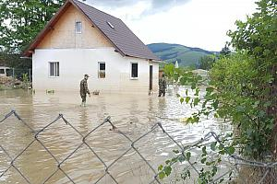
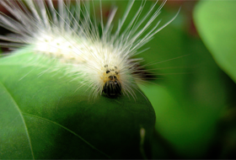
Floods
Flʌdz
Hairy caterpillar invasion
Hɛri ˈkætəˌpɪlər ɪnˈveɪʒən
Source: www.romania-insider.com
Source: www.romania-insider.com
Flooding is a natural hazard which means temporary water cover of land that is not normally covered with water. The cause of the floods is the overflow of rivers or lakes. Flooding can occur during floods, due to torrential rains, sudden melting of snow, etc. Sometimes, the floods occur at the mouth of the plain rivers, following the action of the winds that blow from the sea, the earthquakes underwater, etc.
Hairy caterpillar is a common pest present in Romania since 1949 when it was reported in Bihor county, although its presence in Europe has been reported since 1940.
Hairy caterpillar feeds a large number of plant leaves, attacking mulberry fruit trees, vines and lately sunflower and maize attack.

Slide 5
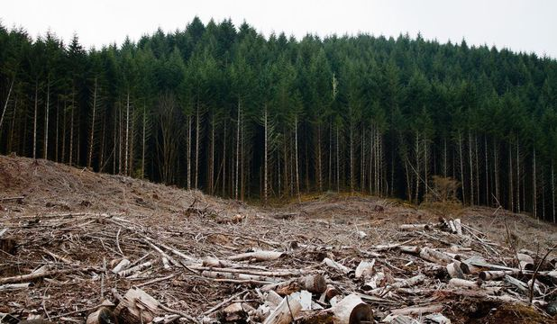
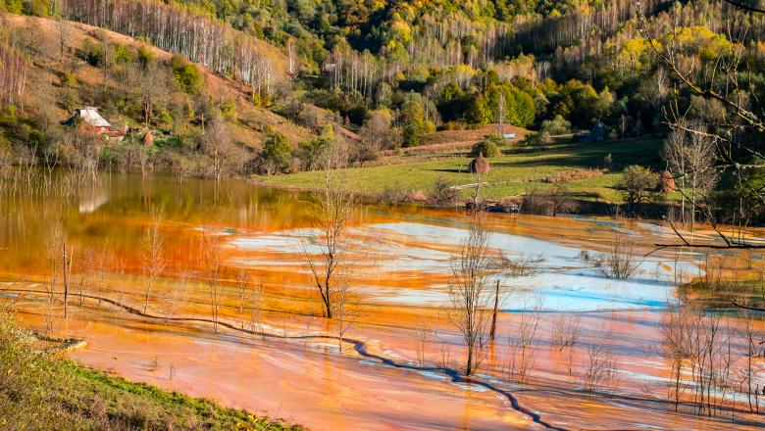
Deforestation
dɪˌfɔrɪˈsteɪʃən
Uncontrolled exploitation of land resources
ʌnkənˈtroʊld ˌɛkˌsplɔɪˈteɪʃən ʌv lænd ˈrisɔrsɪz
Source: www.ziare.com
Source: www.google.com
Deforestation consists in the total removal of the woody vegetation from a certain area, without being followed by its regeneration, including the removal of roots and shrubs, with the change of use and destination of the land.
Natural resources represent the totality of mineral deposits, arable land, forests and water available to a particular country.
Excessive extraction of underground resources, excessive consumption and pollution have led to degradation and depletion of natural substrate.

Slide 6
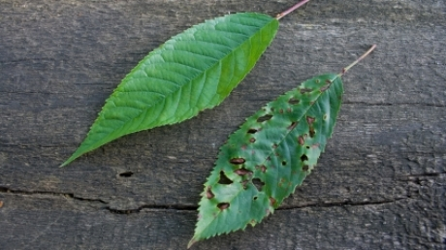
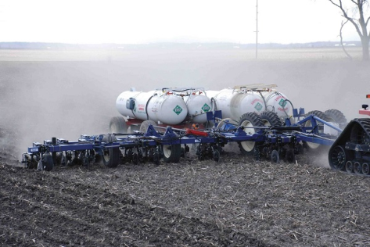
Acid Rain
æsəd reɪn
Excessive use of fertilizers
ɪkˈsɛsɪv juz ʌv ˈfɜrtəˌlaɪzərz
Acid rains are precipitations that have a pH lower than 5.6, and therefore have a pronounced acid character.
Acid precipitation usually occurs when large quantities of sulfur dioxide (SO2) or nitrogen monoxide (NO) are released into the atmosphere.
In Romania, intensive agriculture has the effect of water and soil pollution but the main cause is the excessive use of fertilizers, pesticides or irrigation water.
Excessive nitrogen accumulation in the environment can cause a number of problems, such as dead areas in water, acid rain, smog, climate change or depletion of the ozone layer.

Slide 7
Credits
Https://www.Dw.Com/ro/azotul-un-pericol-din-ce-%c3%aen-ce-mai-mare-pentru-mediu/a-6101396
Https://www.Descopera.Ro/stiinta/9352608-ploile-acide-moartea-care-vine-din-cer
Https://adevarul.Ro/news/societate/goana-resurse-1_50ad48e87c42d5a663923ffd/index.Html
Https://ro.Wikipedia.Org/wiki/resurse_naturale
Https://www.Rosiamontana.Org/
Https://ro.Wikipedia.Org/wiki/defri%c8%99are
Https://cjsutm.Ro/alunecari-de-teren/
Https://ro.Wikipedia.Org/wiki/specii_amenin%c8%9bate
Bazon Lavinia Panțiru Florin Rădeanu Teodora Ilinca Tătaru Sabina Vizitiu Andrei

