Slide 1
Environmental words IES CERRO DEL VIENTO, SPAIN “Natural Spaces in Andalucía”

Slide 2
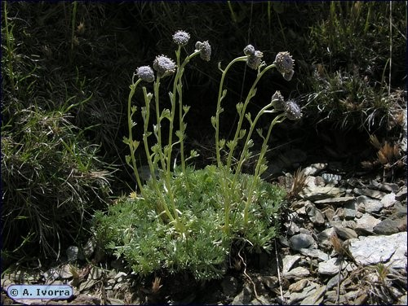
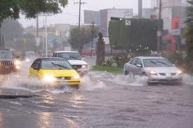
Artemisia granatensis
Torrential rain
Artemisia granatensis Boiss. is a paradigmatic species for plant conservation in Spain and Europe. It is a critically endangered (CR) endemic species growing above 2500 m in the Sierra Nevada (southern Spain). Natural populations have been considerably devastated in the past due to intensive human exploitation for folk medicine.
We use this word to describe the weather when rain falls copiously (22km/h to 30km/h). “Heavy rain” falling at a rate of greater than or equal to 7.6 mm of water per hour is considered to be torrential rain in Mediterranean areas. Torrencial rains are increasing due to global warming. If the town doesn´t have enough drains or trees to absorb water, there will be a flood. It usually causes damage to parks, shops and houses (specially basements.)

Slide 3
CREDITS
https://waste.ideal.es/snvertebrados.htm
http://rjb.revistas.csic.es/index.php/rjb/article/view/359
https://skydayproject.com/torrential-rain
Rocío Gaspar, Amelia Altozano, Margarita Barbadilla, Salvador Aguilar.

