Slide 1
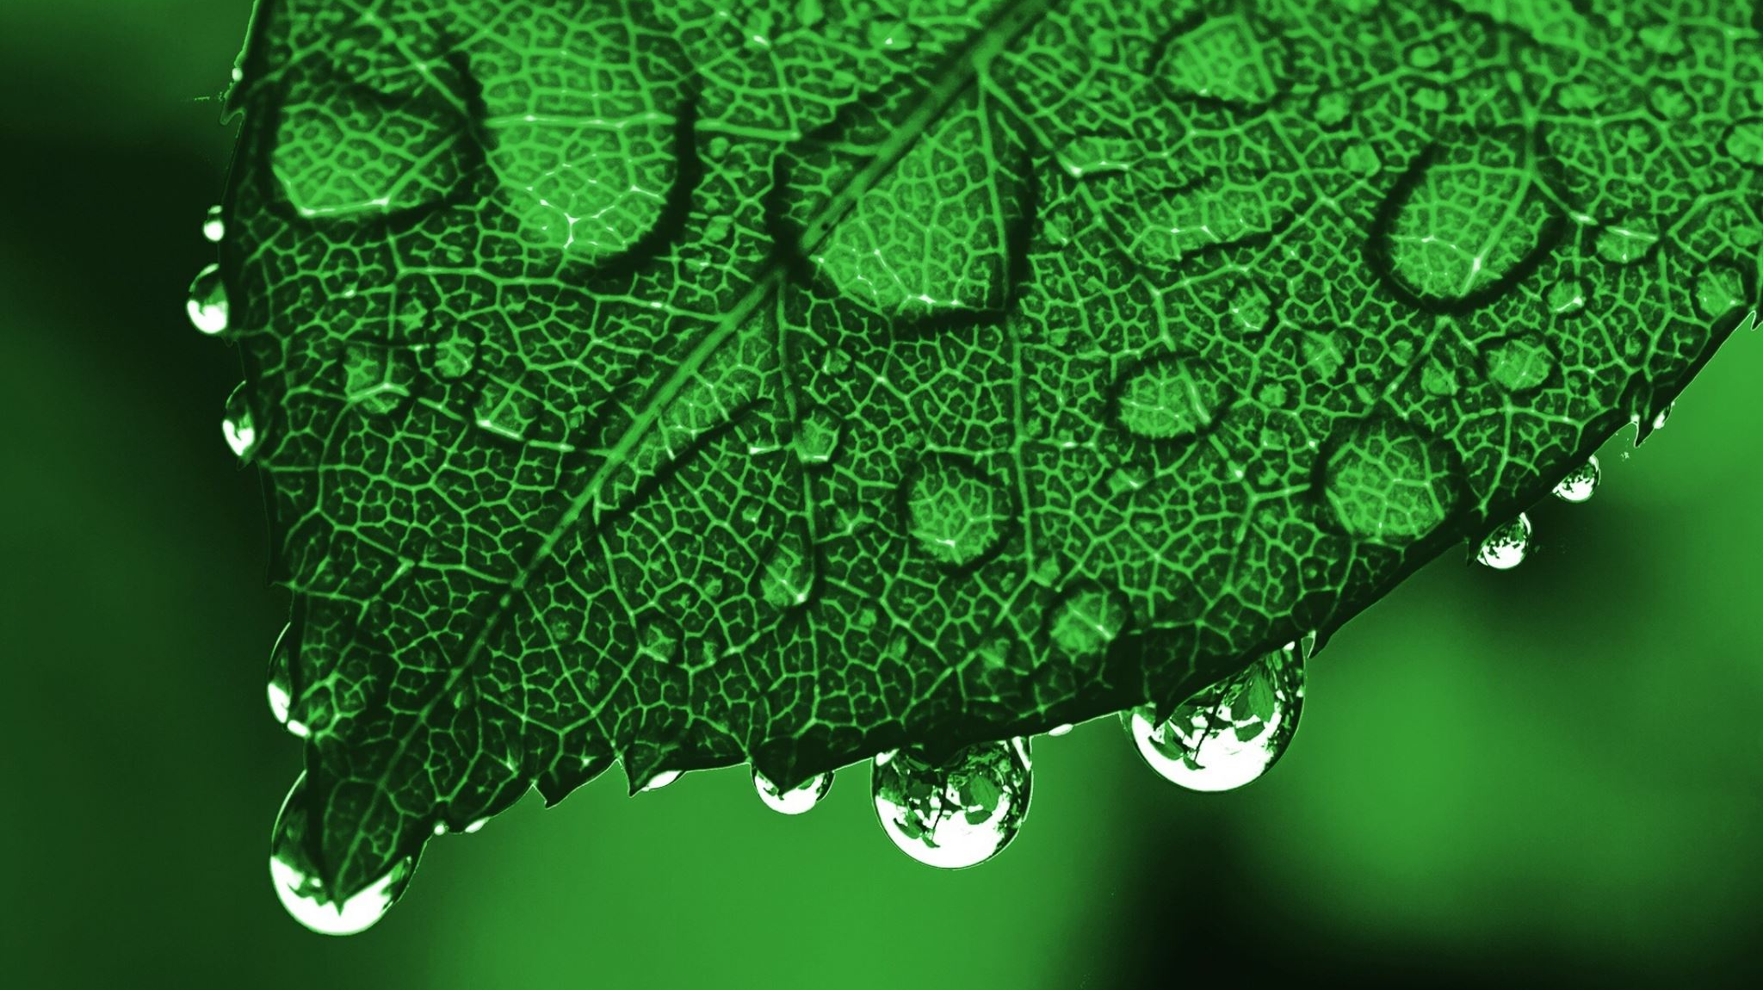
Andalucia
Cazorla

Slide 2
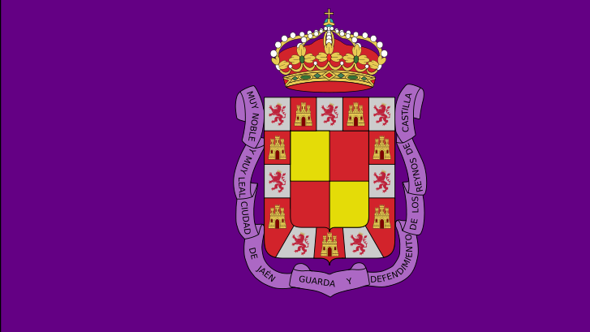
Cazorla:
Description:
Cazorla lies at an elevation of 836 metres on the western slope of the Sierra de Cazorla. It is the entry point and base for visits to the Natural Park of Sierras de Cazorla, Segura y Las Villas Natural Park, a vast protected area of magnificent river gorges and forests. Spain's second longest river, the Guadalquivir, has its source in the mountains to the south of the settlement.
Distances to nearby cities are: Jaén, 121 km.; Granada, 205 km.; and Linares, 71 km.

Slide 3
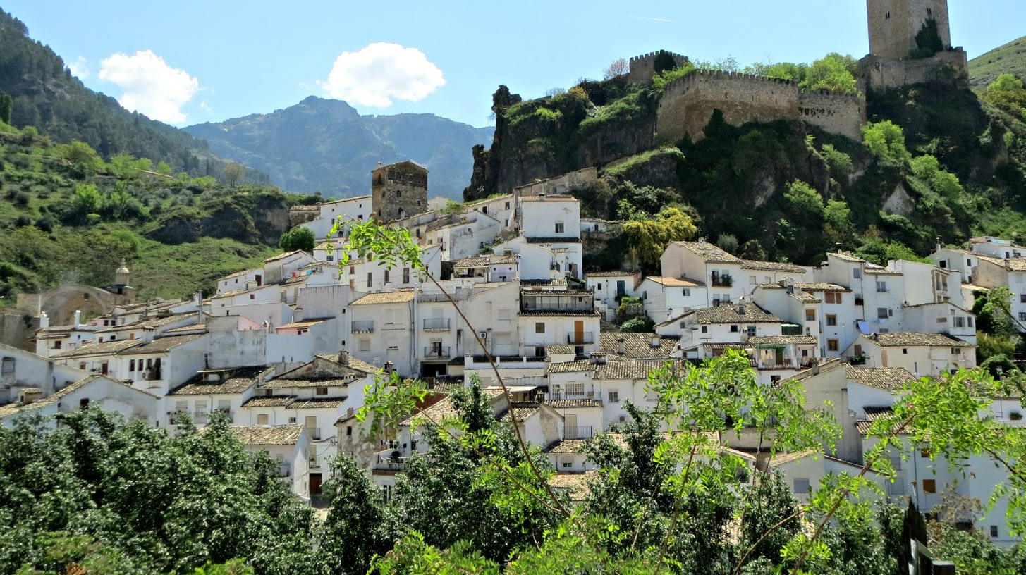
History of Cazorla:
The history of Cazorla goes back more than two thousand years. Under the Romans the town had the name of Carcacena. Not only were there significant Iberian and Roman settlements here, but this was also the see of one of the first bishoprics of early Christian Spain. Under the Moors it was a strategic stronghold and one of dozens of fortresses and watchtowers guarding the mountains. Taken after a bitter struggle in 1235, during the Reconquista, the town then acted as an outpost for Christian troops.

Slide 4
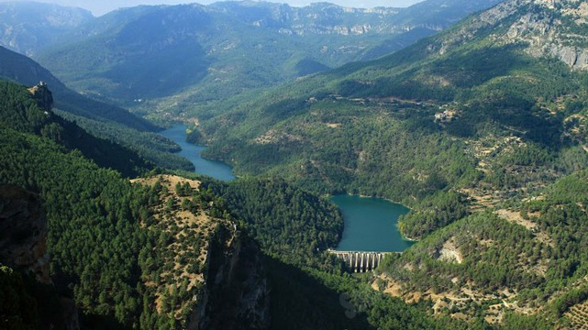
Natural park:
Sierras de Cazorla, Segura y Las Villas Natural Park is a natural park in the eastern and northeastern part of the province of Jaén, Spain, established in 1986. With an area of 2,099.2 square kilometers (810.5 sq mi), it is the largest protected area in Spain and the second largest in Europe. It was declared a biosphere reserve by UNESCO in 1983 and also a Special Protection Area for migratory birds in 1988.

Slide 5
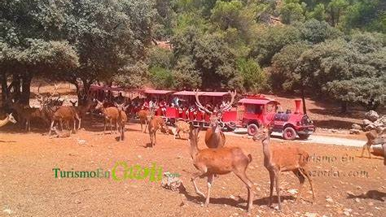
Collado del Almendral Cinematotic Park:
The Collado del Almendral Cinegetic Park is visited by guided tour by tourist train on a 5km tour (about 45 minutes by train), where visitors can see animals in semi-freedom within a natural setting of 100 hectares. They will observe among others; deer, deer, mouflons, goat... We also have a 1.5 km walking route. (optional, upon payment of visit) which includes the stop at two viewpoints overlooking the Tranco swamp, where the exhibition and bird watching facilities are located. The center has a gift shop and a café.

Slide 6
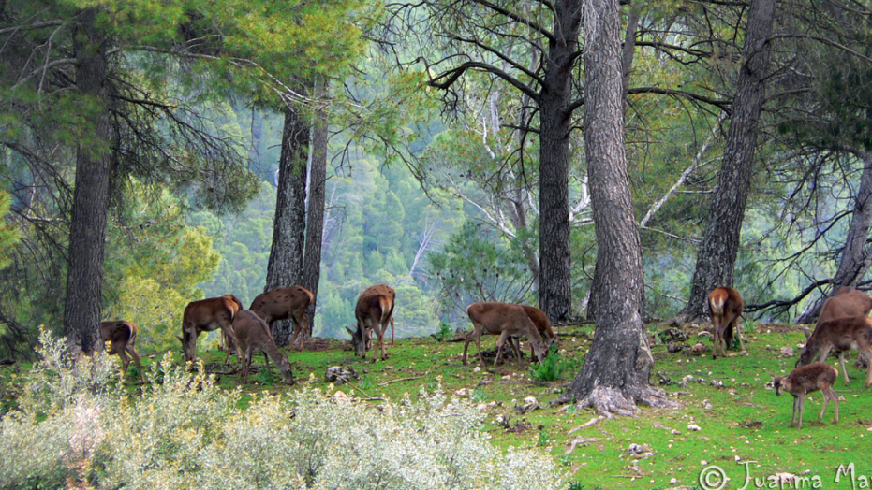
Animals:
The garduña (Mars foina), the fox (Vulpes vulpes), field mouse (Apodemus sylvticus), otter (Lutra lutra), the wild cat (Felis sylvestris) the badger (Meles meles), the deer (Cervus elphus), the gamo (Dama), the goat montés (Capra pyrena hispanicicaa), wild boar (His scrofa).

Slide 7
By: Jorge Moriel David Toledo Mario Erkelens Emilio Sánchez

