Slide 1
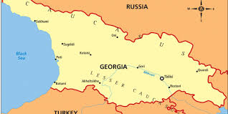
Georgia

Slide 2
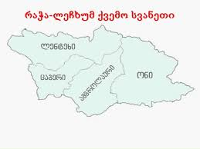
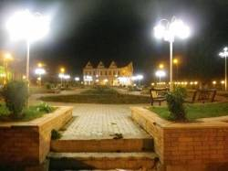
Region Racha, Lechkhumi, lower Svaneti
Racha, Lechkhumi, lower Svaneti
Lentekhi
Ambrolauri
Oni
Tsageri
Oni municipality

Slide 3
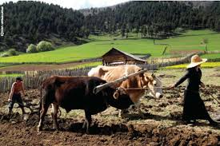
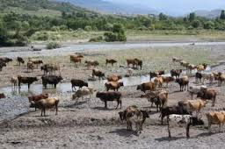
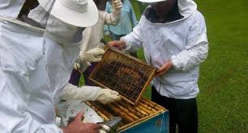
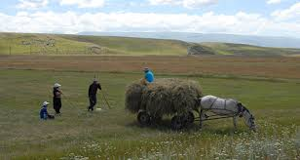
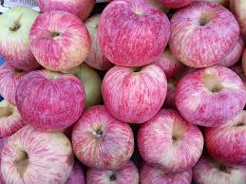
The Inhabitants of the Oni municipality are engaged in agriculture.

Slide 4
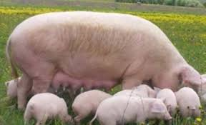
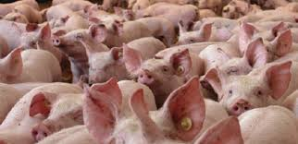
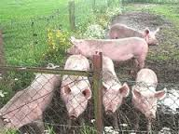
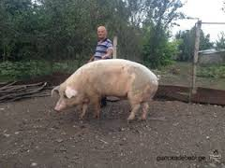
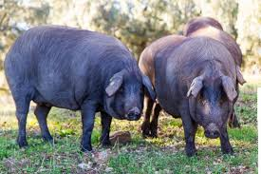
Pig breeding is a priority for the Oni region.

Slide 5
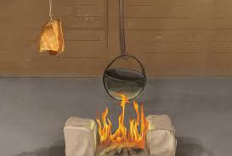
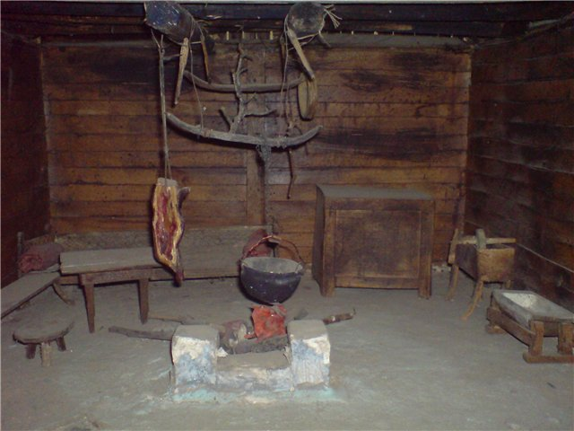
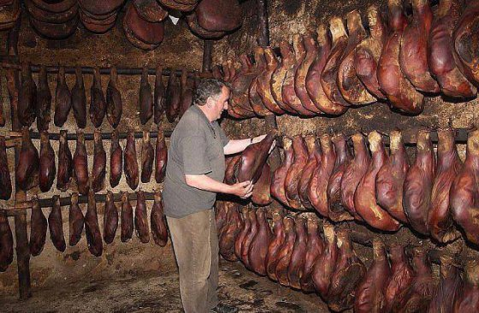
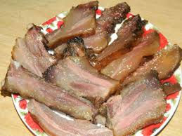
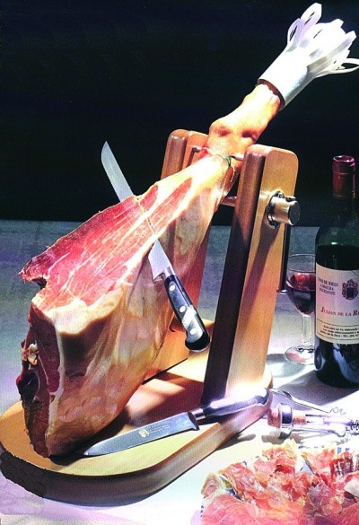
Rachvelien ham is unique…
The ham from Racha is a Smoked ham…
The ham from Racha.

Slide 6
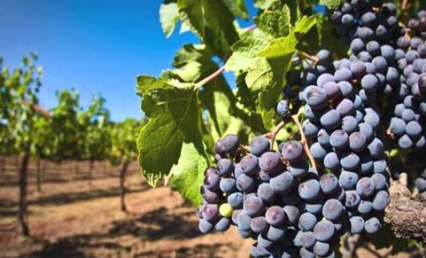
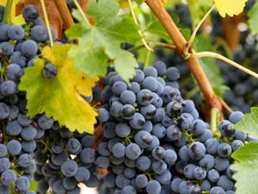
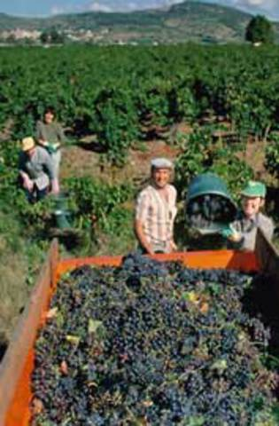
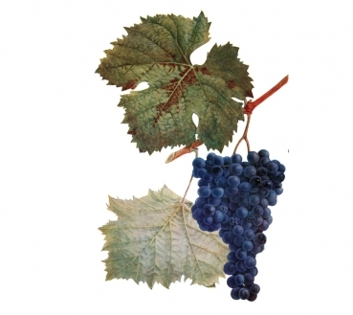
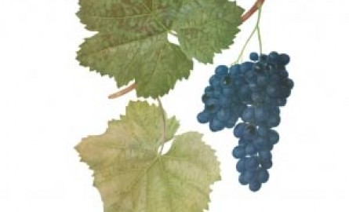
Special attention is paid to viticulture.
Notable endemic species of grapes inchude
“Aleqsandreuli “and “Mujuretuli”.

Slide 7
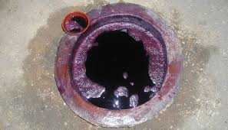
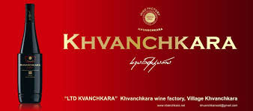
The world famous, and unique, wine ‘Khvanchkara” is made in Racha. “Khvanchkara” wine is said to have medicinal properties.
A special underground vessel for wine “Churi”

Slide 8
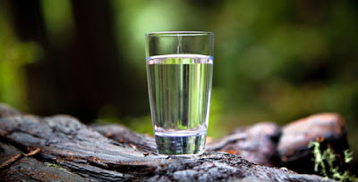
Racha is rich in natural resources, such as the mineral waters found in Shovi, Utsera (Gverita), Oni (Sortuani), Ghebi and many ather places .

Slide 9
Shovi – Rest house ,, Racha ''
The Family Rest House in Shovi is in the heart of the georgian Caucus Mountains.

Slide 10
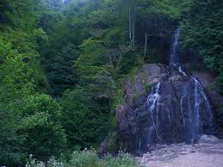
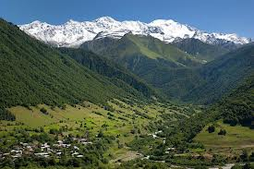
Racha is tich with a wide spatial forest where meny unique species grow, such as the chesnut, beech, maple, fire-tree, pine-tree, elm and many o ther trees.

Slide 11
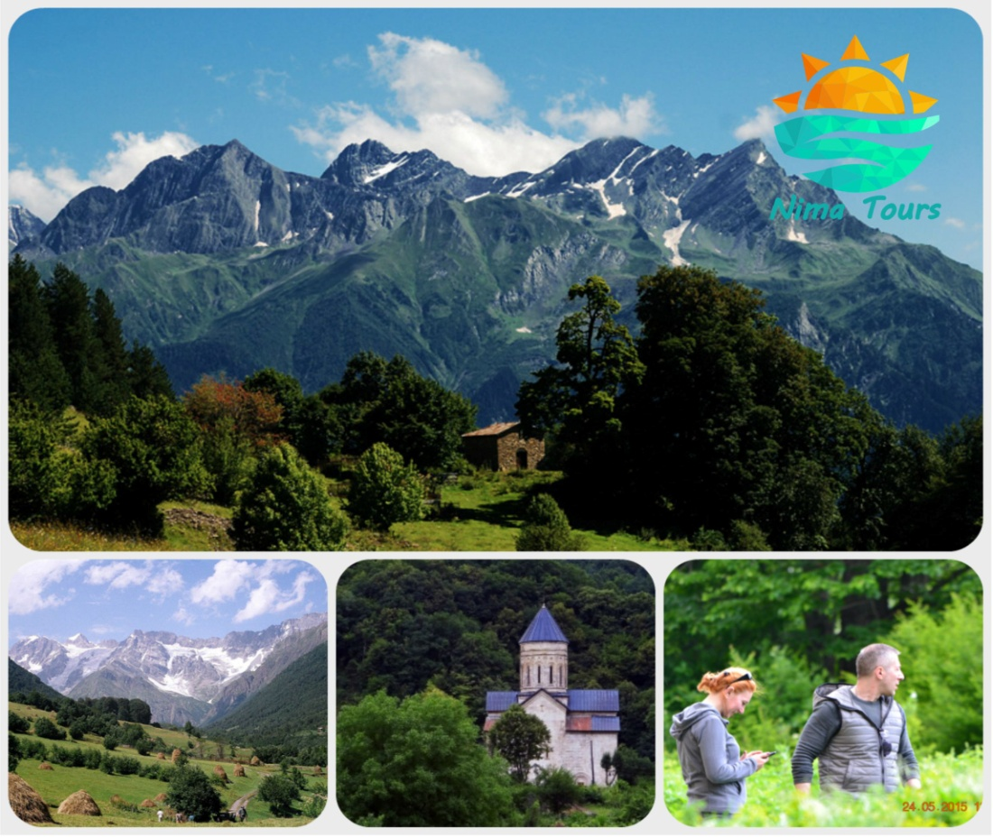
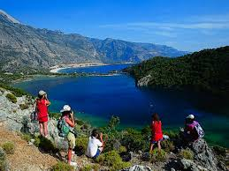
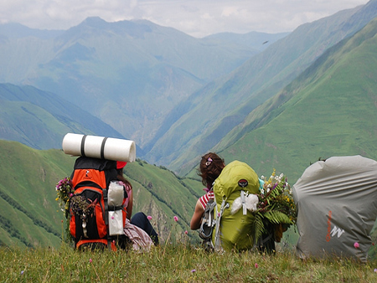
Tourists are attracted to the Oni region for its unique natural beauty.

Slide 12
Racha is a beautiful and interesting region…
Visit us in Oni and experience the regions uniqueness!!!

Slide 13
Thanks for attention!!!

