Slide 1
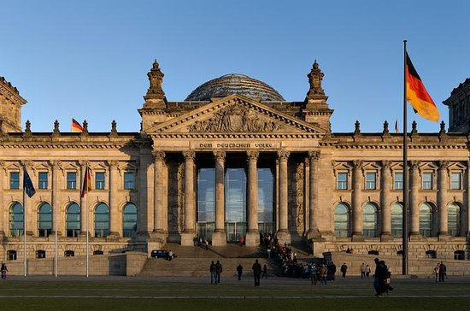
Federal Republic of Germany
by Julia Laux

Slide 2
structure
General information
History of the Federal Republic of Germany
state organization
sights
sources

Slide 3
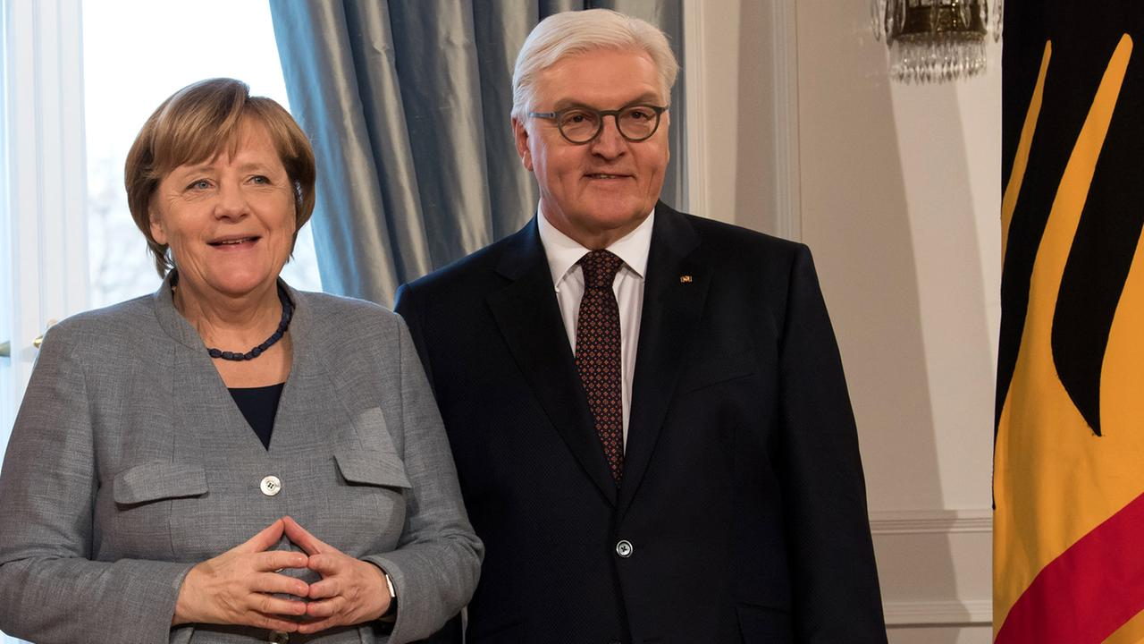
General information
Official language: German
Capital: Berlin
Form of government: parliamentary democracy
Head of state: Federal President Frank-Walter Steinmeier
Head of government: Federal Chancellor Angela Merkel
Population: approx. 82.521.000
Area: approx. 357.385 km²
Currency: Euro

Slide 4
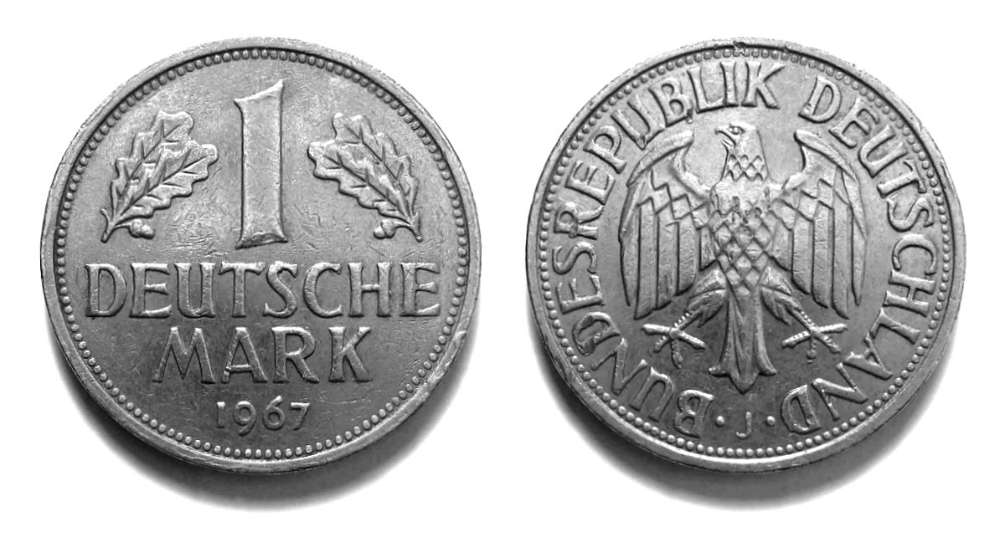
History of the Federal Republic of Germany
1945 - Division by victorious powers
1948 - Advent of the D-Mark
May 1949 - Signature of the Basic Law
August 1949 - First federal election
1954 - Germany became world champion -> created cohesion
1959 -Fall of the Berlin Wall

Slide 5
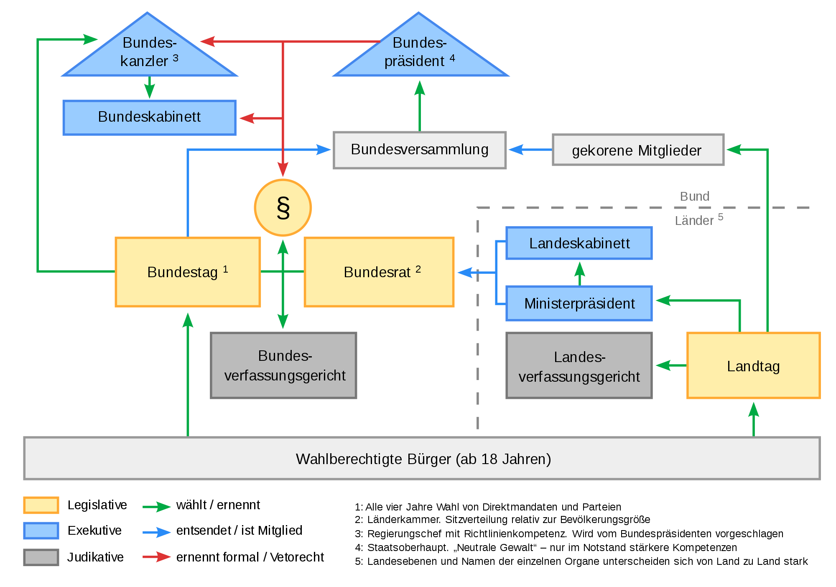
state organization

Slide 6
sights
Neuschwanstein Castle
Brandenburg Gate
Reichstag building
Berlin Wall
Cologne Cathedral

Slide 7
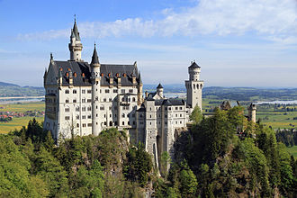
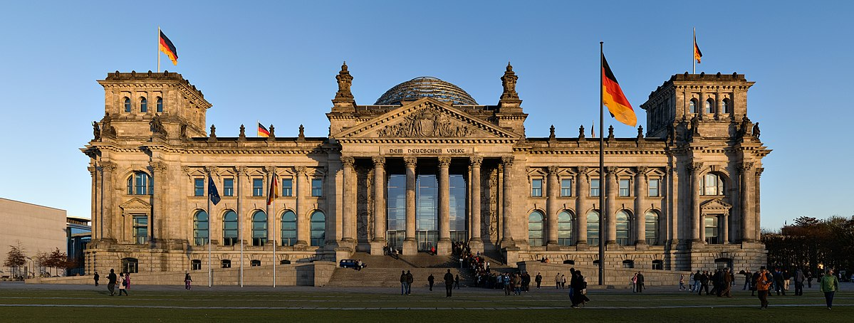
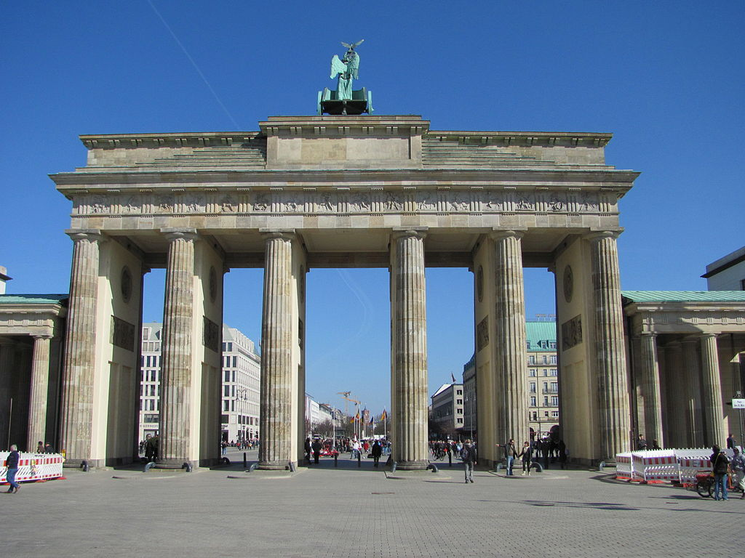
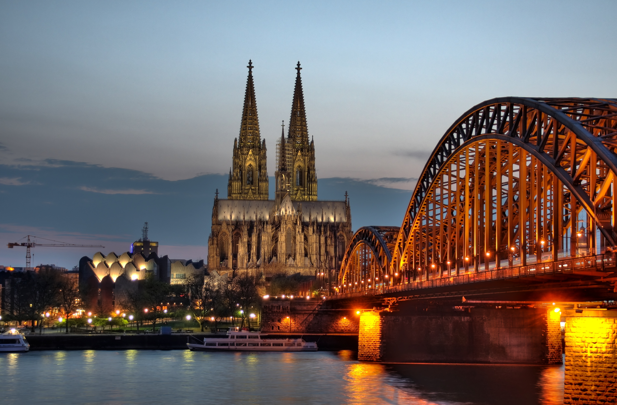
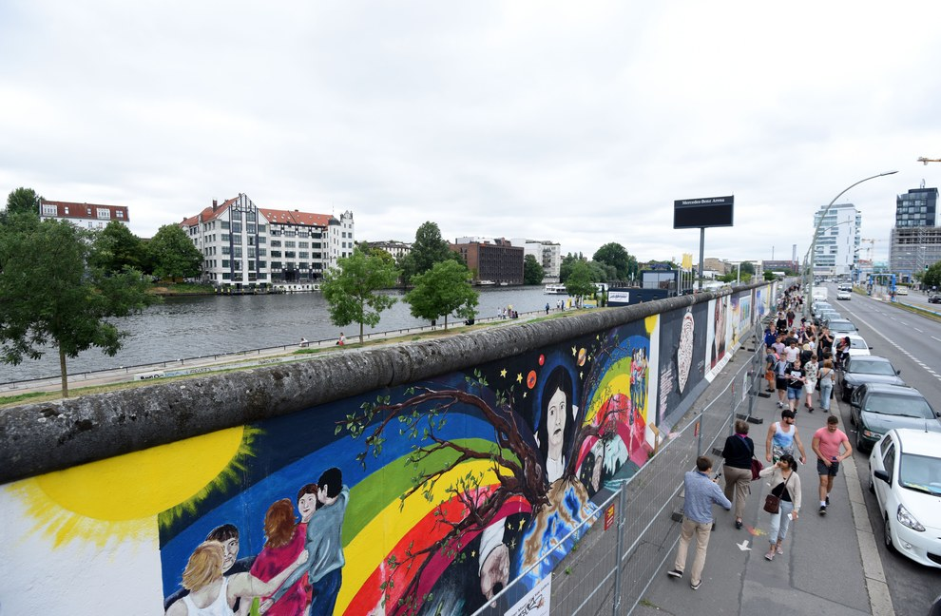
sights
Schloss Neuschwanstein
Reichstagsgebäude
Kölner Dom
Brandenburger Tor
Berliner Mauer

Slide 8
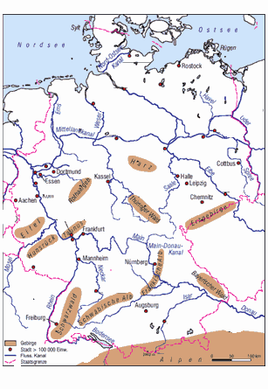
Mountains and Rivers

Slide 9
German food
Schwarzwälder Kirschtorte
Thüringer Klöße
Grüne Soße
Kartoffelpuffer
Schlachtplatte
Milchreis

Slide 10
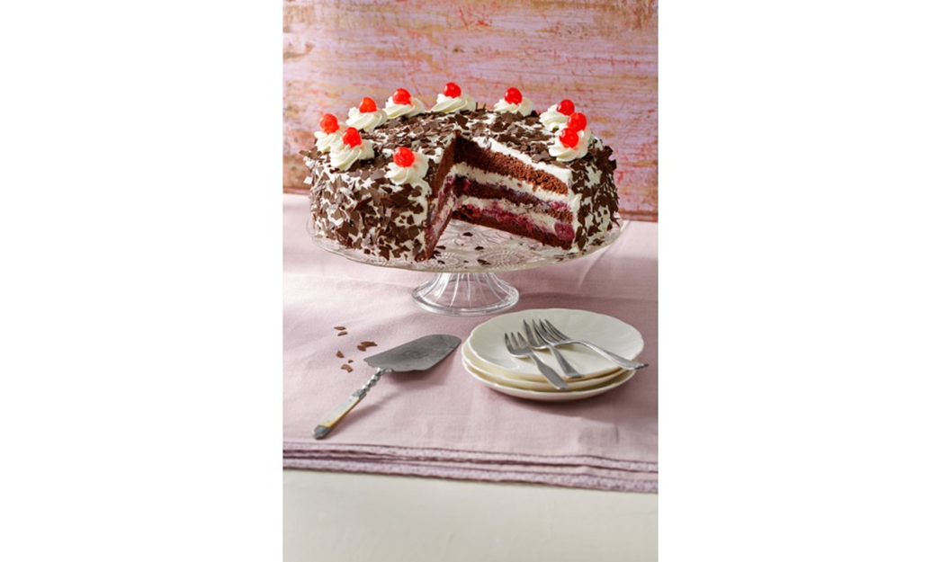
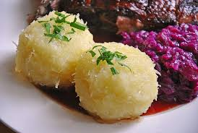
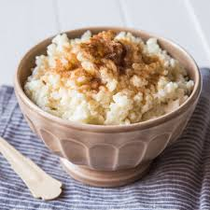
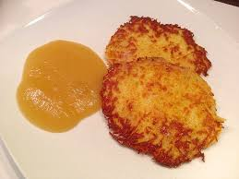
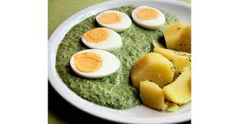
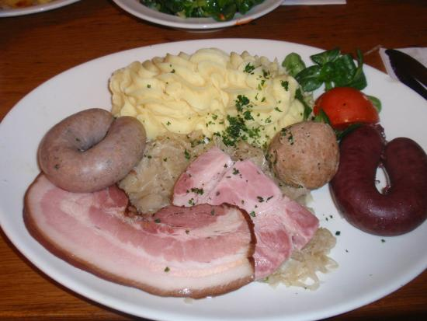

Slide 11
sources
https://www.google.com/url?sa=i&rct=j&q=&esrc=s&source=images&cd=&cad=rja&uact=8&ved=2ahUKEwigzpeO9MPaAhUNyKQKHWFxALAQjRx6BAgAEAU&url=https%3A%2F%2Fwww.tripadvisor.de%2FAttractions-g187323-Activities-Berlin.html&psig=AOvVaw0c6RfGVb2wp_wBknNfLF9A&ust=1524143751149858
https://www.google.com/url?sa=i&rct=j&q=&esrc=s&source=images&cd=&cad=rja&uact=8&ved=2ahUKEwjc6Zny_MPaAhUFzKQKHSdlBJ0QjRx6BAgAEAU&url=https%3A%2F%2Fwww.zdf.de%2Fnachrichten%2Fheute%2Fsteinmeier-will-merkel-als-kanzlerin-vorschlagen-100.html&psig=AOvVaw1jl6UmYr98z0geXU0IIZLS&ust=1524146073560971
https://www.google.com/imgres?imgurl=https%3A%2F%2Fupload.wikimedia.org%2Fwikipedia%2Fcommons%2Fthumb%2Fb%2Fb8%2F1_mark_brd_1967_retouched.jpg%2F1200px-1_mark_brd_1967_retouched.jpg&imgrefurl=https%3A%2F%2Fde.wikipedia.org%2Fwiki%2FDeutsche_Mark&docid=wIAD1R2QUhyN2M&tbnid=TV2LJi3ZXvC0UM%3A&vet=10ahUKEwi30NyczcnaAhWJCCwKHeL5CDUQMwg0KAAwAA..i&w=1200&h=642&safe=active&client=safari&bih=839&biw=1440&q=d-mark&ved=0ahUKEwi30NyczcnaAhWJCCwKHeL5CDUQMwg0KAAwAA&iact=mrc&uact=8
https://www.google.com/url?sa=i&rct=j&q=&esrc=s&source=images&cd=&cad=rja&uact=8&ved=2ahUKEwj5kb_wzcnaAhUNbVAKHXT4C7AQjRx6BAgAEAU&url=https%3A%2F%2Fde.wikipedia.org%2Fwiki%2FPolitisches_System_der_Bundesrepublik_Deutschland&psig=AOvVaw2RXQcHi06f3Jty2CHtAqj5&ust=1524339410673339
https://www.google.com/url?sa=i&rct=j&q=&esrc=s&source=images&cd=&cad=rja&uact=8&ved=2ahUKEwjB6qfk_8vaAhXIAewKHR0vCtoQjRx6BAgAEAU&url=https%3A%2F%2Fde.wikipedia.org%2Fwiki%2FSchloss_Neuschwanstein&psig=AOvVaw2HIk-N5ii-Ca0qK4FoCY7R&ust=1524421771966334
https://www.google.com/url?sa=i&rct=j&q=&esrc=s&source=images&cd=&cad=rja&uact=8&ved=2ahUKEwiOrOaigMzaAhXPCOwKHTQGDFUQjRx6BAgAEAU&url=https%3A%2F%2Fwww.hurraki.de%2Fwiki%2FBrandenburger_Tor&psig=AOvVaw22Dvj3lcDEr6o6R25eEvHF&ust=1524421886200943
https://www.google.com/url?sa=i&rct=j&q=&esrc=s&source=images&cd=&cad=rja&uact=8&ved=2ahUKEwi4gpeSgczaAhUC3aQKHeroBXwQjRx6BAgAEAU&url=https%3A%2F%2Fde.wikipedia.org%2Fwiki%2FReichstagsgeb%25C3%25A4ude&psig=AOvVaw1C2b5-D0wUs08KLYHLG8Dm&ust=1524422135459635
https://www.google.com/url?sa=i&rct=j&q=&esrc=s&source=images&cd=&cad=rja&uact=8&ved=2ahUKEwjzhpfugczaAhUJzKQKHSN3DTcQjRx6BAgAEAU&url=https%3A%2F%2Fwww.onetz.de%2Fweiden-in-der-oberpfalz%2Fvermischtes%2Fwinfried-prem-erinnert-sich-an-abriss-der-grenze-zwischen-ost-und-westdeutschland-einen-kilometer-berliner-mauer-pro-tag-d1815388.html&psig=AOvVaw27DcoxPSp5AsOzwTPt9CRq&ust=1524422306992613
https://www.google.com/url?sa=i&rct=j&q=&esrc=s&source=images&cd=&cad=rja&uact=8&ved=2ahUKEwiv7YrCgszaAhWNyKQKHZk4ClQQjRx6BAgAEAU&url=https%3A%2F%2Fde.wikipedia.org%2Fwiki%2FK%25C3%25B6lner_Dom&psig=AOvVaw2QQKrrsYOU2xS276XzBUEs&ust=1524422411009720

