Slide 1
Medicinal- and Thermal springs
from lina & Jessy

Slide 2
structure
Medicinal- and Thermal springs
Effects
Locations Thermal springs
Locations Medicinal springs
Sources

Slide 3
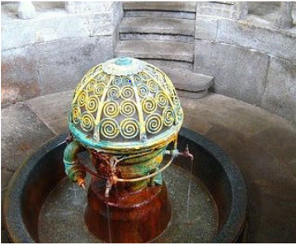
Medicinal- and Thermal springs
Medicinal springs
Thermal springs
Healing, natural groundwater
Oldest natural remedy
Temperature over 20 degrees
Species-poor
Bacteria colonized
Few solute oxygen
Discoloration of the water

Slide 4
effects
Medicinal springs
Thermal springs
Effect on Organs like Stomach, intestine, heart circulation and kidneys
stimulate metabolism
Used as a drink
Used for therapeutic purposes
Positive influence
Power sources
Improvement of vein function, activation of the metabolism and the kidney
Muscle relaxation, joint relief, suppression of stress hormones and circulation increase

Slide 5
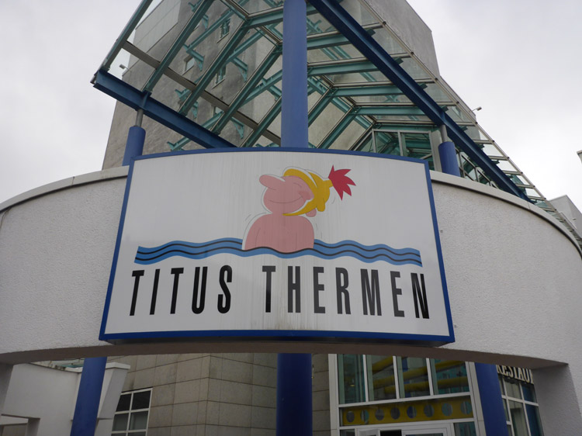
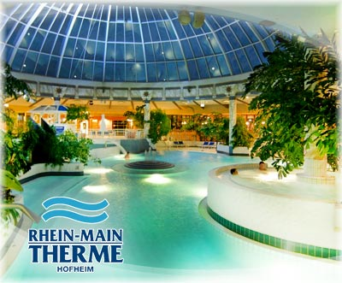
Locations Thermal springs
In areas with increased volcanic activity and close to deep-going current systems
Thermal baths Aukammtal – Wiesbaden
Titus Thermen – Frankfurt
Rhein-Main-Therme - Hofheim am Taunus

Slide 6
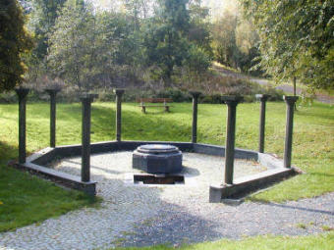
Locations medicinal springs
 | Augusta Viktoria source – Löhnberg | Karlsbrunnen – Bad Nauheim | Sauerborn – Probbach
Calcium | 190mg | 680 mg | 274 mg
Magnesium | 70mg | 56,2 mg | 52 mg
Hydrogencarbonate | 1020mg | 1.224 mg | 1213 mg
Potassium | 10mg | 129,0 mg | 1,73 mg
Natrium | 260mg | 3.477 mg | 39,40 mg
Chloride | 340mg | / | 5,07 mg
Sulphate | 30mg | / | 2,80 mg

Slide 7
Effects of the individual Sources
Karlsbrunnen – Bad Nauheim
SaUerborn - Probbach
Moderately effective for constipation¹
Promotes stomach and pancreatic secretion
Can be used At Liver- and biliousness
Healing effect in case of headache, heartbeat, Asthma and cough
Effective At liver and spleen
¹Costipazione, zápcha

Slide 8
sources
https://www.proplanta.de/Ratgeber/Gesundheit/Uebersichtskarte-von-Heilquellen-in-Deutschland_tipps1385305224.html
https://www.everyday-feng-shui.de/heilquellen-extrakt-minerale-aus-heilwasser-extrahieren/
https://de.wikipedia.org/wiki/Heilwasser
https://de.wikipedia.org/wiki/Thermalquelle
http://www.quellenatlas.eu/media/f305b5d530823e65ffff8a55ac14422f.pdf
https://www.mineralienrechner.de/vergleichstabelle-gerolsteiner-mineralienrechner/800.html

