Slide 1
Abdullah: An Unexpected Journey
Made with love

Slide 2
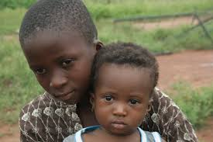
Chapter 1: Abdullah and Fatima
Once upon a time, there were two children who were brother and sister, and were escaping from Cameroon because there was a war there. Their names were Abdullah and Fatima. Their father was killed by the Cameroon’s soldiers.

Slide 3
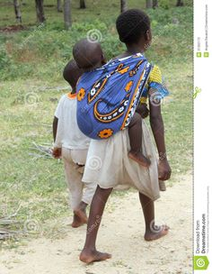
Chapter 2: From Cameroon to Libya
The two children and their mother had to find a way to escape from Cameroon and travel to Libya on foot. Finally they arrived to Zawilah (a Libyan city)after 1 month. They were safe for now, but they wanted to go to a European country and live in peace.

Slide 4
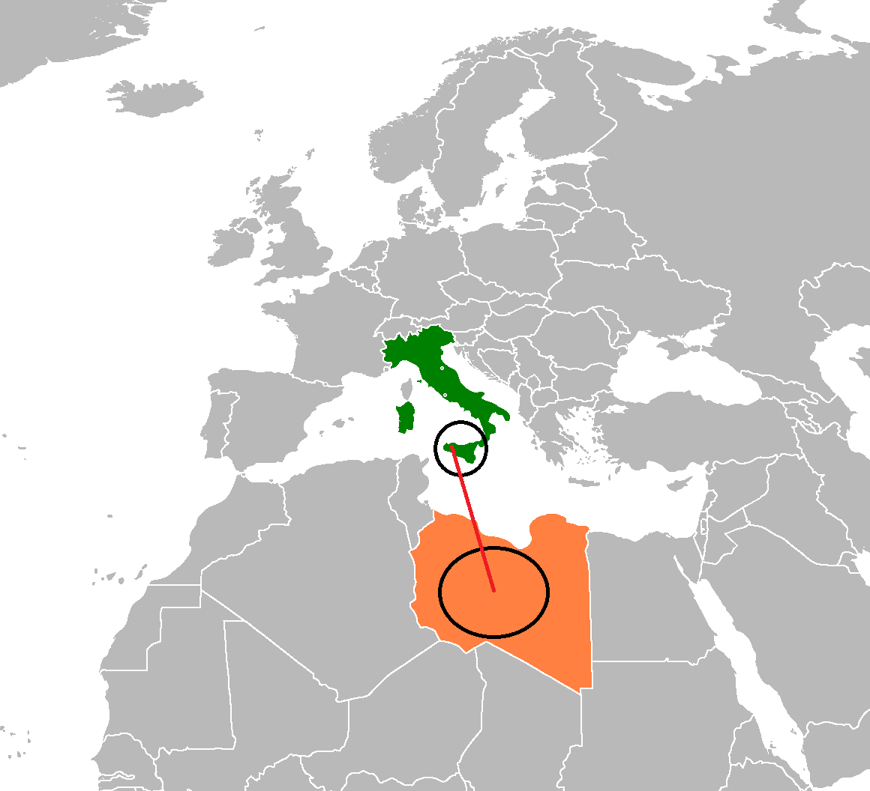
Chapter 3: The journey to freedom.
Abdullah and Fatima’s mother had bought three tickets for her and her children, so they can go to Sicily for a better life and escape from the war. The day they were going to leave the mother had fever. Some hours later she died in the boat. The two children were alone…

Slide 5
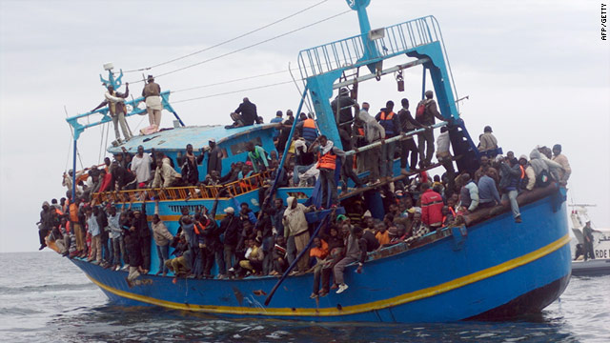
Chapter 4: The only one alive.
Reaching Sicily the boat hit some rocks near the shore and the boat sunk. People from the land saw the boat sinking and tried to save them, but they were too late. Abdullah was lucky and was saved first, but Fatima didn’t have the same luck. She didn’t know how to swim and was drowned. When Abdullah heard about his sister he started to cry, but he had to continue. All alone…

Slide 6
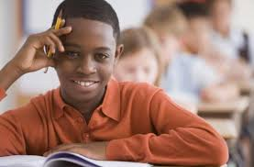
Epilogue: 19/05/2017
Ten years passed and Abdullah was adopted from a family. He was one of the best students in the whole country. He participated to a lot of projects, including ‘Erasmus+’ . He went to the university of Oxford and became a rich man. Today he is a very successful man, but he never forgot his story and his family…….

Slide 7
THE END...MAYBE
Written by:
Yusuf Uyanik
Dimos Georgellis
Vethusan Felix
Amedeo Migliore

