Slide 1
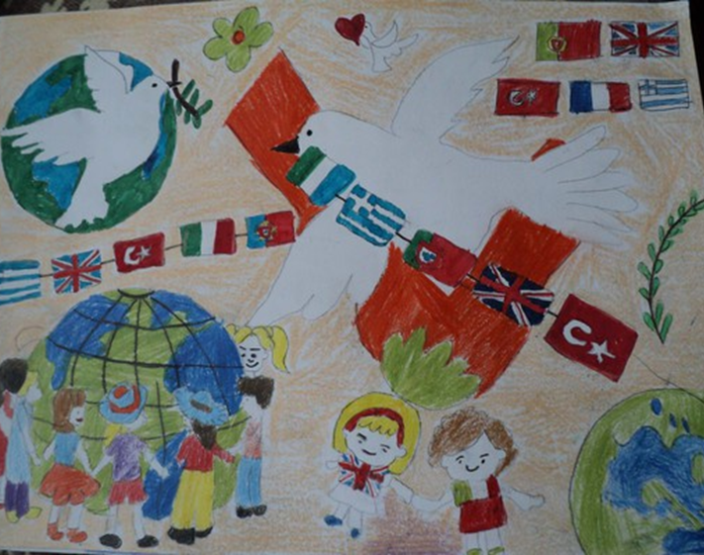
Every Child Matters:
Refugees and Immigrants in Education
3rd Transnational Project Meeting
Tendring Technology College
9th to 13th October 2017

Slide 2
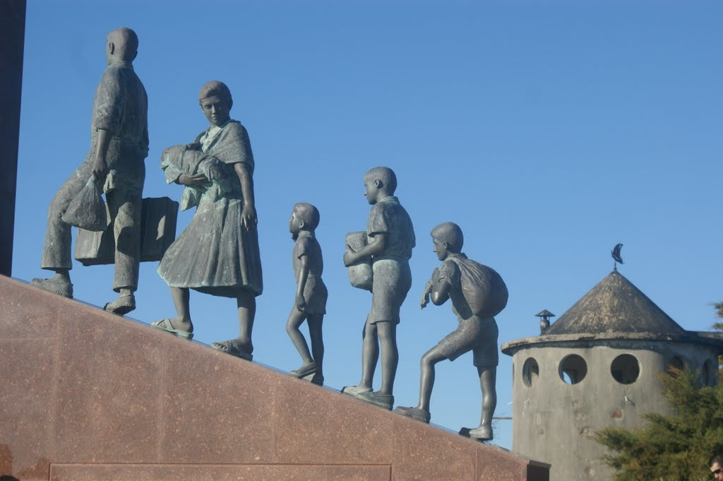
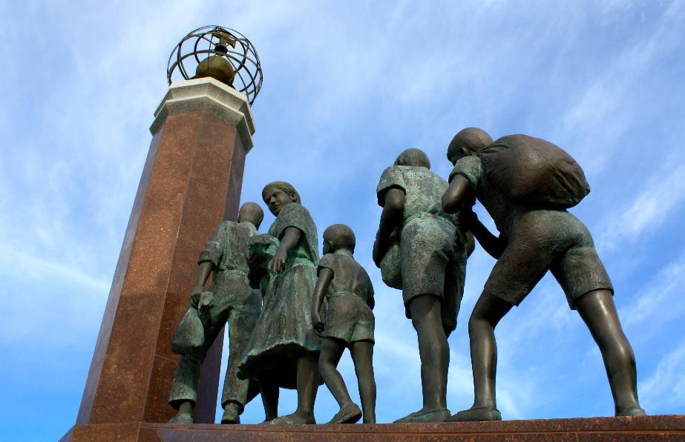
The influence of emigration on art and music in Portugal
“Monumento ao emigrante” (Emigrants Statue) in Laúndos, Póvoa de Varzim

Slide 3
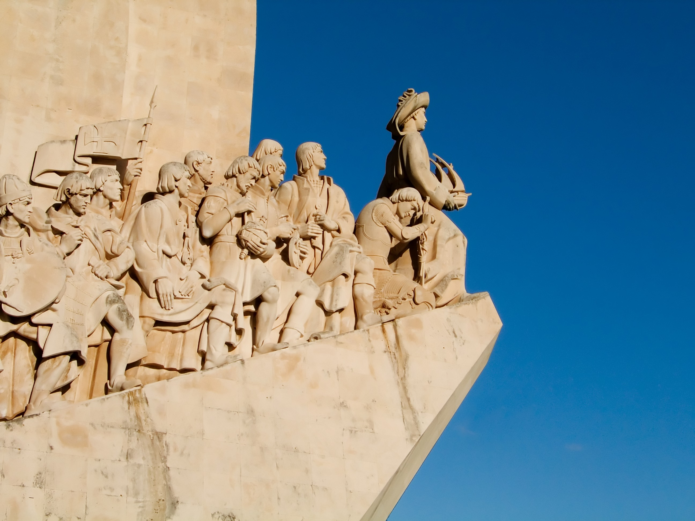
The beginning of emigration from Portugal dates from the 15th century, the start of the Portuguese period of overseas exploration, when many Portuguese settled in Africa, America and Asia.
Today, there are more than two million Portuguese emigrants, meaning that more than 20% of the Portuguese population lives outside our country.

Slide 4
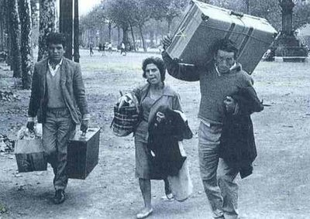
In the late 1950s, Portuguese emigration increased towards destinations in the expanding economies of Northern and Central Europe, particularly France.
In the next 15 years, up until 1974, more than 1.5 million Portuguese emigrated, trying to escape a poor economy and an oppressive dictatorship, to take up jobs in low-wage, low-productivity sectors.
Emigrants carrying a “mala de cartão” (luggage made of cardboard)

Slide 5
In recent years, mainly since 2013, the number of Portuguese leaving Portugal has grown substantially and it is estimated that around 110.000 people, most of them with a college degree, leave our country every year.

Slide 6
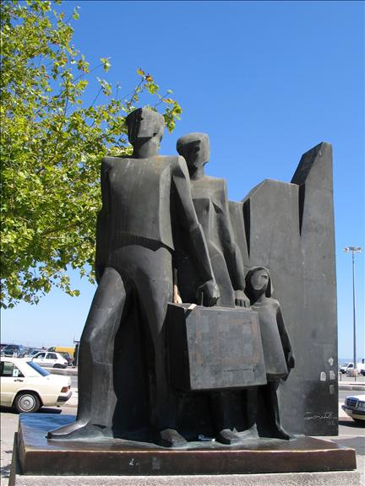
Emigration has important political, financial and social consequences in our society, and has influenced the work of many authors.
Manuel Alegre is one of those authors. He is a poet and a politician, who was forced into exile in 1964 because of his opposition to Salazar's dictatorial government.

Slide 7
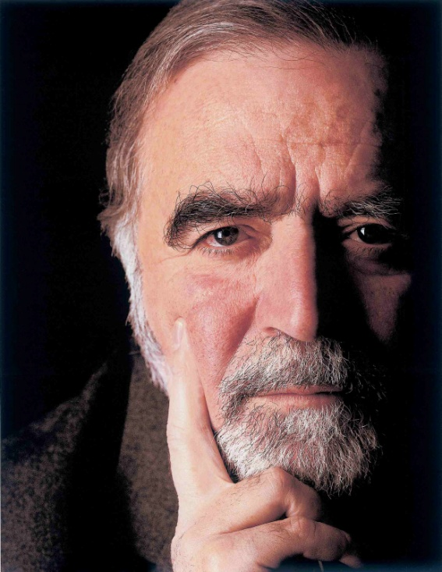
Trova do imigrante
Manuel Alegre

Slide 8
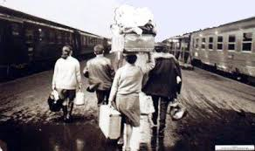
Trova do emigrante
Parte de noite e não olha Os campos que vai deixar Todo por dentro a abanar Como a terra em Agadir Folha a folha se desfolha Seu coração ao partir Não tem sede de aventura Nem quis a terra distante A vida o fez viajante Se busca terras de França É que a sorte lhe foi dura E um homem também se cansa As rugas que o suor cava Não são rugas são enganos São perdas lágrimas e danos De suor por conta alheia Não compensa nunca paga Quanto suor se semeia

Slide 9
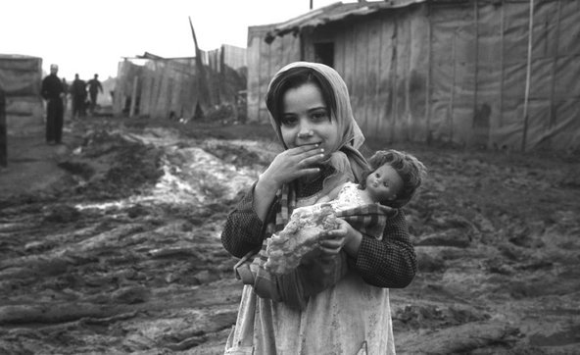
Em vida vive-se a morte Se o trabalho não dá fruto Morre-se em cada minuto Se o fruto nunca se alcança Porque lhe foi dura a sorte Vai para terras de França Não julguem que vai contente Leva nos olhos o verde Dos campos onde se perde Gente que tudo lhe deu Parte mas fica presente Em tudo o que não colheu Verde campo verde e triste Em ti ceifou e hoje foi-se Em ti ceifou mas a foice Ceifava somente esperança Nem sempre um homem resiste Vai para terras de França

Slide 10
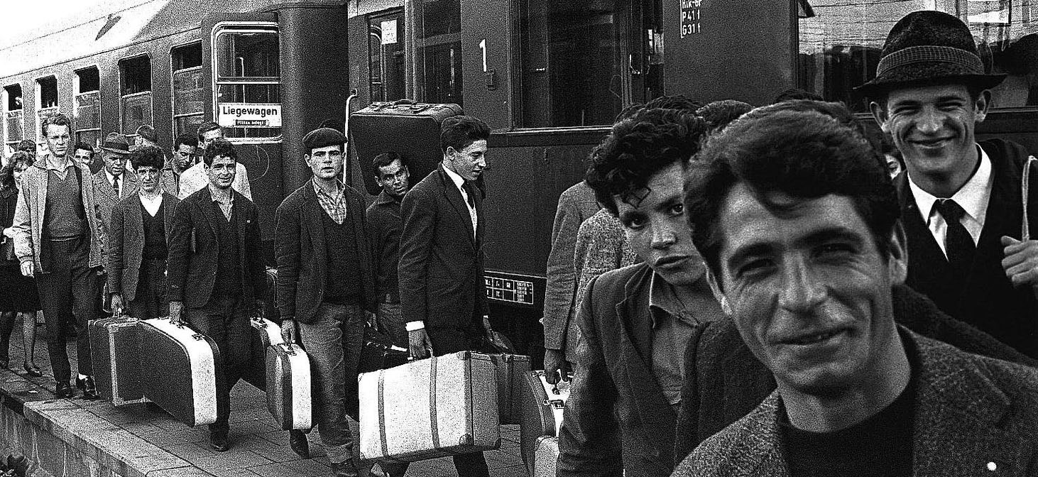
Vai-se um homem vai com ele A marca de uma raiz Vai com ele a cicatriz De um lugar que está vazio Leva gravada na pele Uma aldeia um campo um rio Ficam mulheres a chorar Por aqueles que se foram Ai lágrimas que se choram Não fazem qualquer mudança Já foram donos do mar Vão para terras de França.

Slide 11
This poem talks about the feelings and thoughts of emigrants.
The poet begins by saying that emigrants leave their houses and villages at night, without looking at what they leave behind because it´s to painful for them to do it.
Then, they start their journey to France, but they do it without any desire to discover new lands or start new adventures. They do it because they are forced by the economical crisis and because they want to try their luck.
However, all this journey is made with the memory of their villages and loved ones, who are at home crying.

Slide 12
Other Portuguese authors wrote books on emigration, created art works, produced films, wrote songs…
Rio Grande is a music band that launched, in 1996, a song entitled “Postal dos Correios”. “Postcard”, in English.

Slide 13
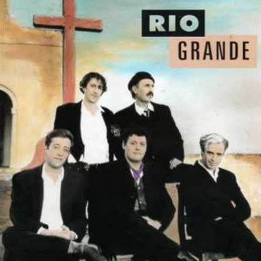
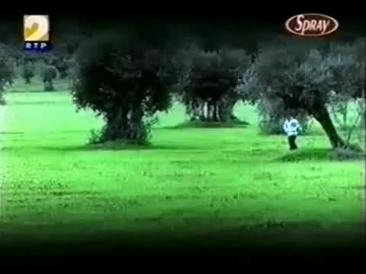
Postal dos correios, Rio Grande
This song talks about a man that is outside his home country and writes back to his parents to tell them a little bit about his life and also asks for his family situation.

Slide 14
Postal dos correios, Rio Grande
Dear mum, dear dad, how is everything? We are finding it the way God wants us to In between good and bad days There is always one that gives us more to do But let’s talk about better things: Laurinda makes custom-made dresses The boy studies IT and computers They say it’s a job with a great future The parcel arrived here safely By the “expresso” that stopped at Piedade Wheat bread and sausage for lunch At least I have a taste of home I hope you don't take long to reply Send me any news by post Does the stream run well or will it dry? How are the olive trees of Candeio? I have nothing more to write Greetings to all the family Sending my love and a big hug I might go there for Christmas.

Slide 15
Thank you for your attention!

